Slide 1
WARM-UP
Look at the picture
Use flashcard: “Healthy or Unhealthy” to answer
2 minutes

Slide 2
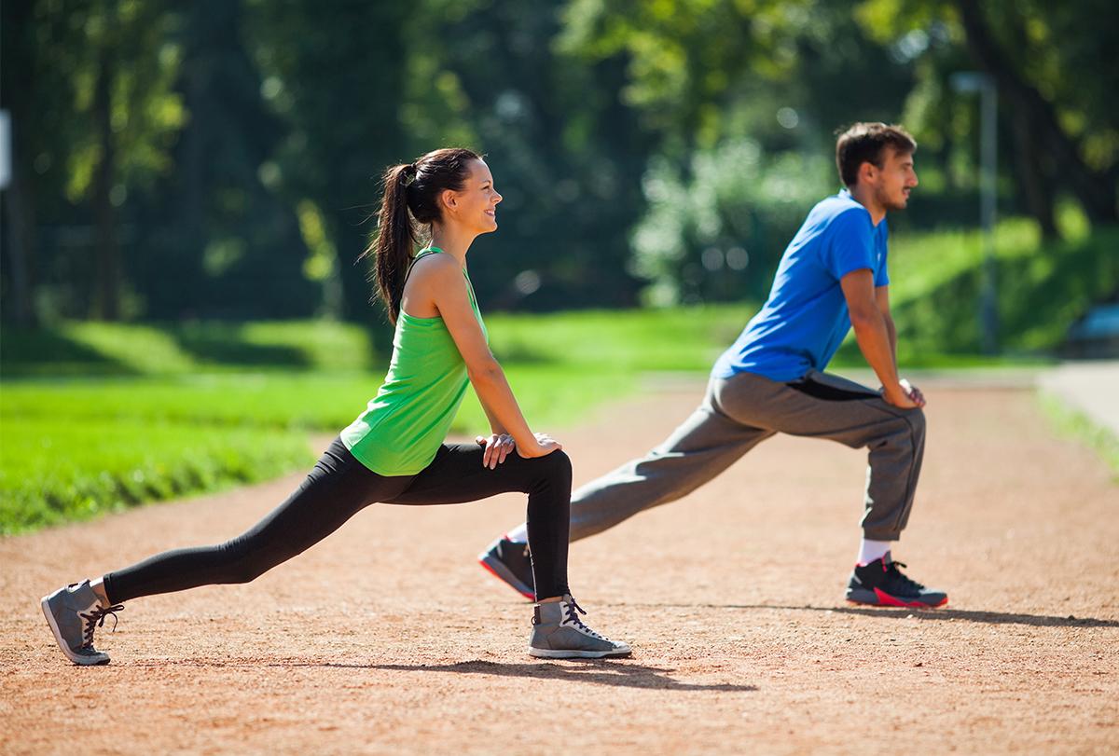
Is it HEALTHY or UNHEALTHY?

Slide 3
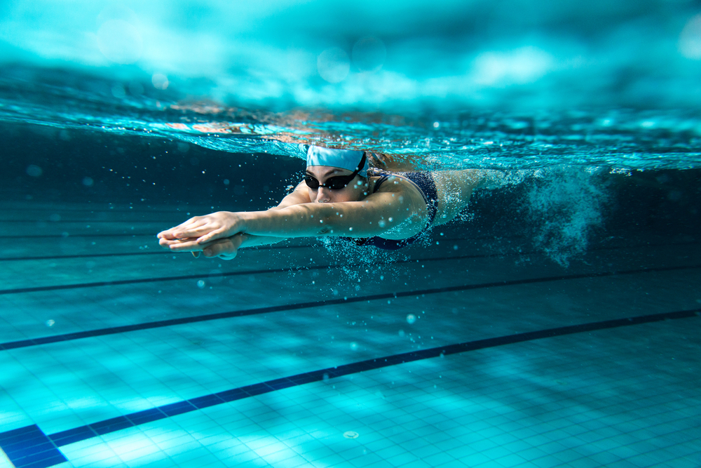
Is it HEALTHY or UNHEALTHY?

Slide 4
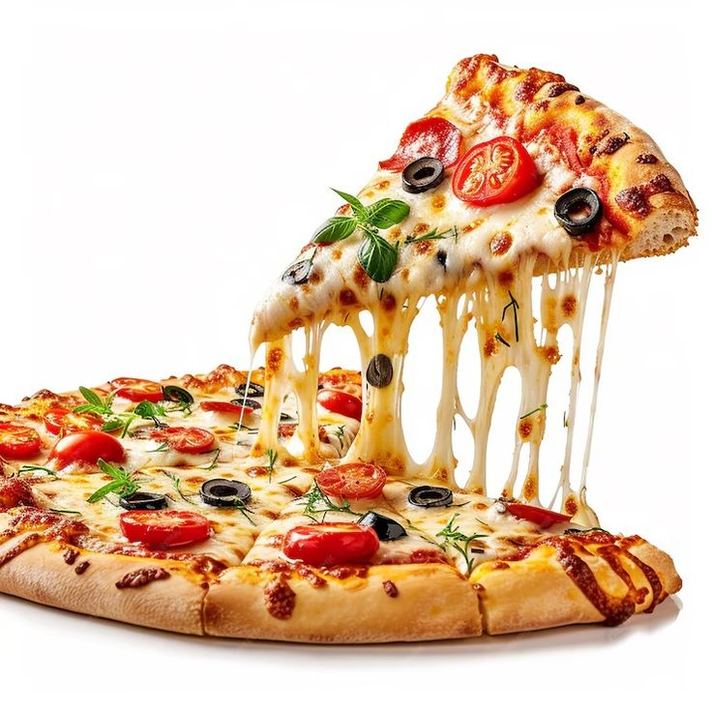
Is it HEALTHY or UNHEALTHY?

Slide 5
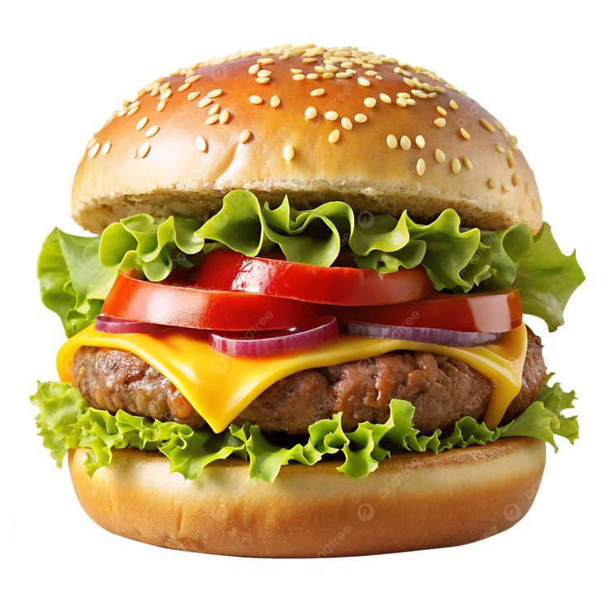
Is it HEALTHY or UNHEALTHY?

Slide 6
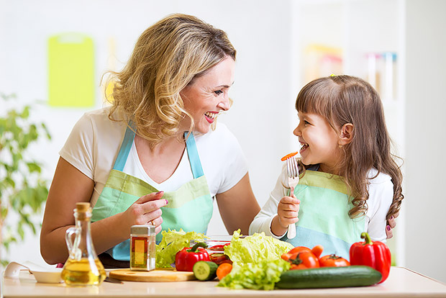
Is it HEALTHY or UNHEALTHY?

Slide 7
What is it?
doing exercise
swimming
pizza
pizza
doing exercise
eating fruits and vegetables
swimming
hamburger
eating fruits and vegetables
hamburger

Slide 8
Can you guess the topic?

Slide 9
Unit 2: Healthy living
Lesson 1: Getting started
Teacher: Tran Thu Ha

Slide 10
OBJECTIVES
Use the lexical items related to the topic Healthy living
Identify and talk about the daily activities and decide if they are good or bad for health

Slide 11
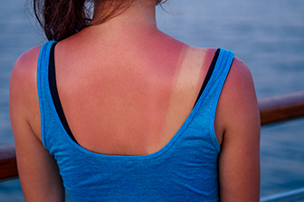

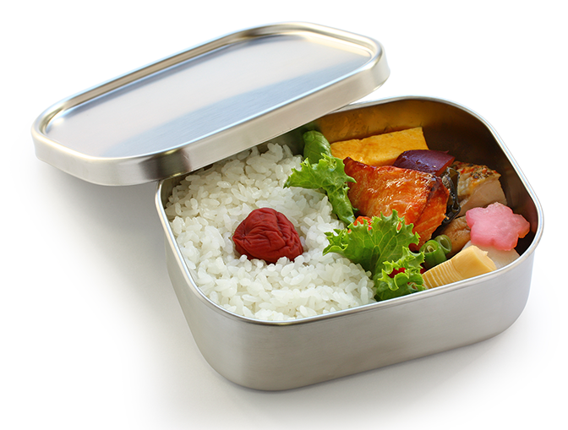
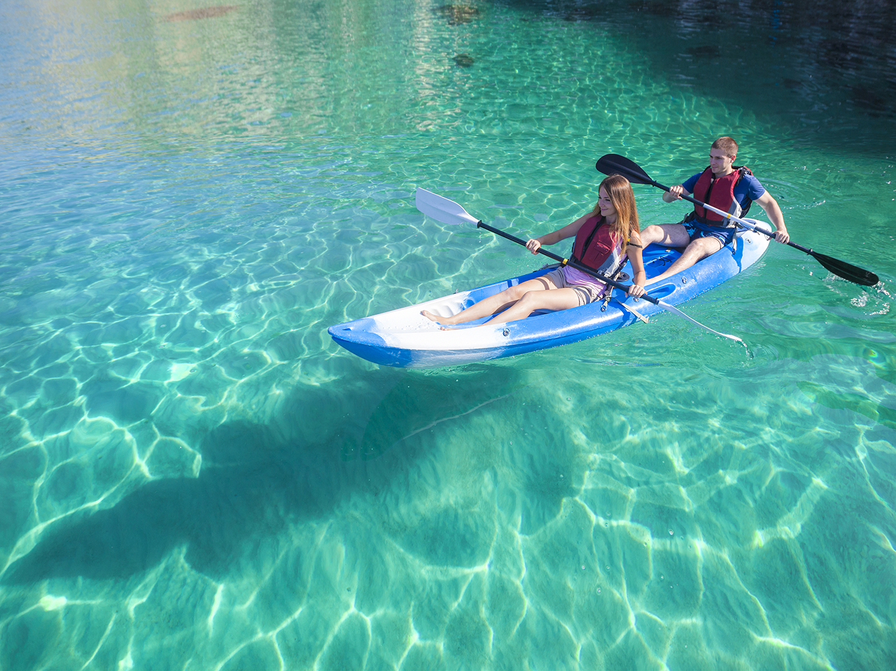
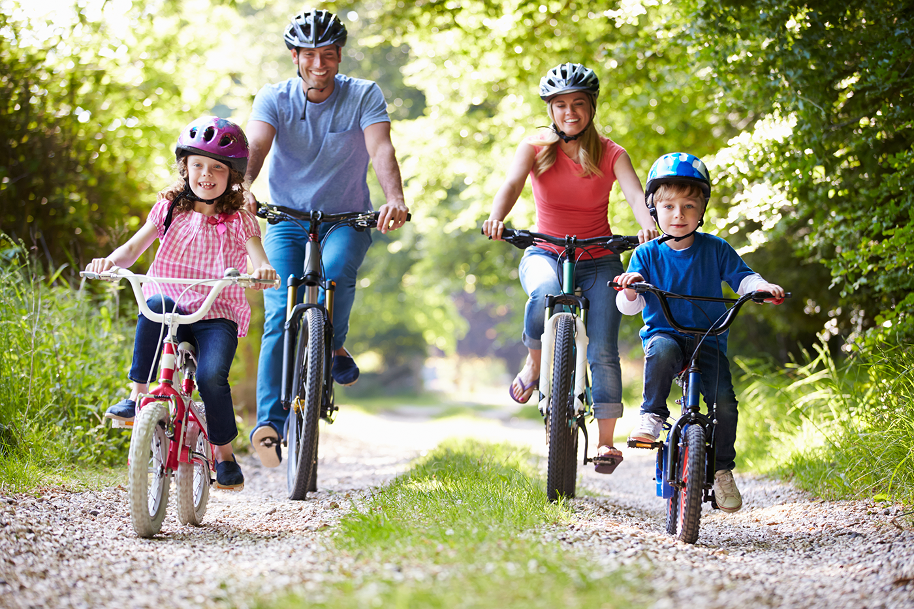
Write a word or phrase from the box under its picture (Ex3 - page 19)
boating
suncream
sunburn
suncream
lunch box
lunch box
sunburn
cycling
boating
cycling

Slide 12
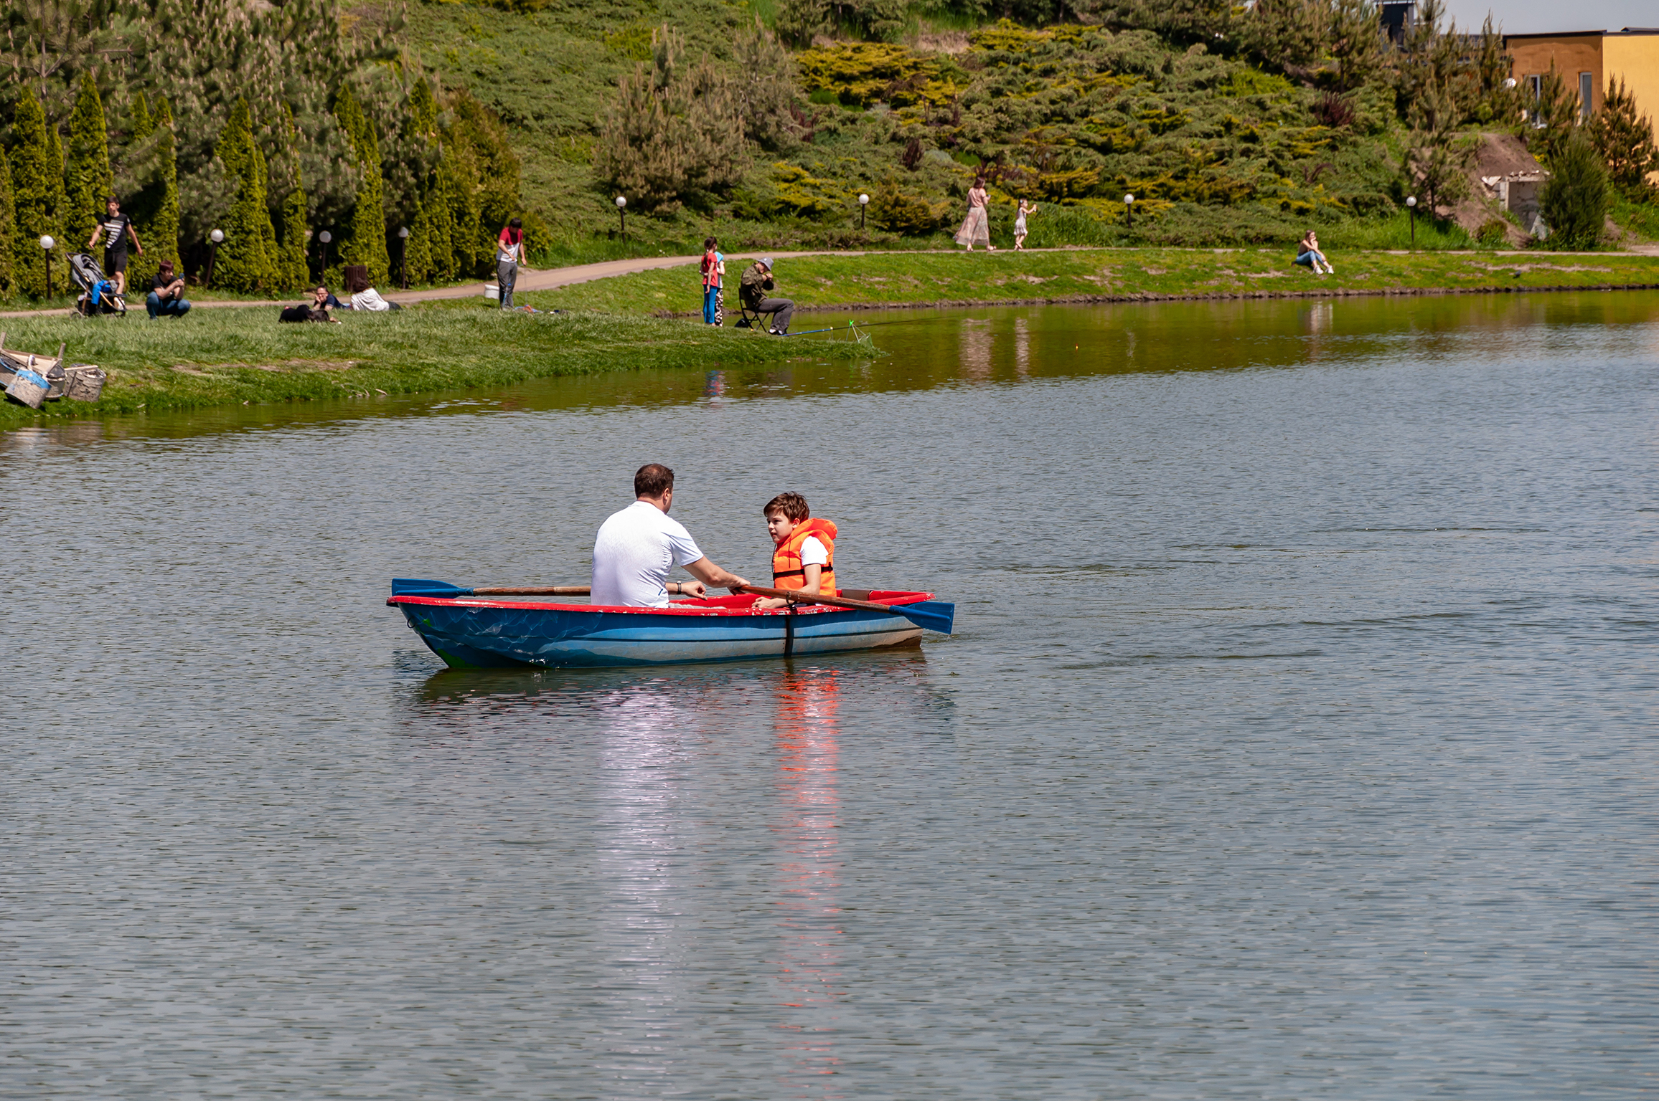
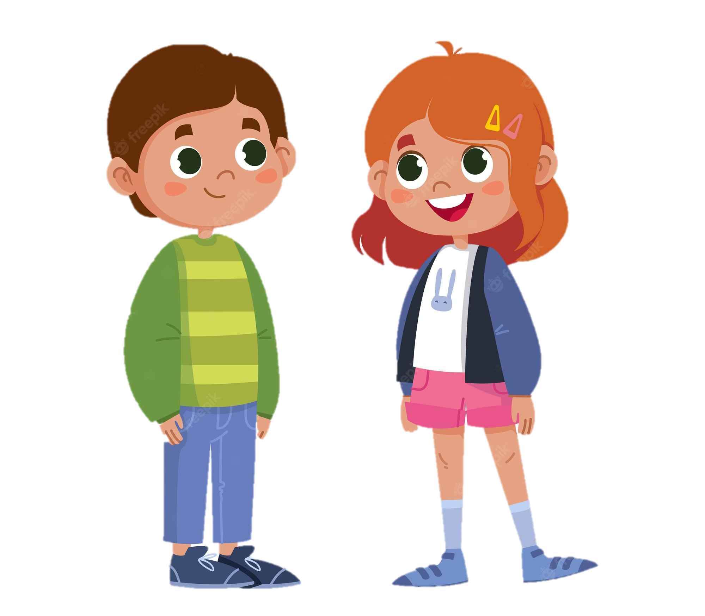
Look and answer.
Let’s guess and answer.
1. Who are talking?
Mark and Mi
2. Who are in the picture ?
Mark and his father
3. What are they doing?
They are boating.
Mi
Mark

Slide 13

Listen and read (Ex1 – page 18)
Mi: This is a nice picture, Mark.
Mark: That’s my dad and I boating at Yen So Park.
Mi: I also see a lot of people exercise there.
Mark: Yes, it’s a popular place for people in my neighbourhood.
Mi: Outdoor activities are good for our health. My family often goes cycling in the countryside. It’s quiet and there’s a lot of fresh air.
Mark: It sounds interesting.
Mi: Yes, it’s lots of fun. We also bring fruit, water, and a lunch box with us.
Mark: I’d love to join you next time.
Mi: Sure. Bring along a hat and suncream.
Mark: Why suncream?
Mi: It’s really hot and sunny at noon so you might get sunburn.
Mark: I see.
Mark
Mi

Slide 14
Read again and answer. (Ex2 - page 19)
Mi: This is a nice picture, Mark.
Mark: That’s my dad and I boating at Yen So Park.
Mi: I also see a lot of people exercise there.
Mark: Yes, it’s a popular place for people in my neighbourhood.
Mi: Outdoor activities are good for our health. My family often goes cycling in the countryside. It’s quiet and there’s a lot of fresh air.
Mark: It sounds interesting.
Mi: Yes, it’s lots of fun. We also bring fruit, water, and a lunch box with us.
Mark: I’d love to join you next time.
Mi: Sure. Bring along a hat and suncream.
Mark: Why suncream?
Mi: It’s really hot and sunny at noon so you might get sunburn.
Mark: I see.
What are Mark and Mi talking about? A. Health problems B. Healthy activities C. Sports and games

Slide 15
Complete each sentence with a word from the conversation. (Ex4 - page 19)
1. In the picture, Mark and his father are __________.
2. The people in Mark’s neighbourhood love to go to the _________ .
3. Mi’s family often goes cycling in the ___________.
4. - I don’t want to get sunburn.
- Wear a hat and use __________.
5. Activities like running and cycling are good for our_________ .

Slide 16
Complete each sentence with a word from the conversation. (Ex4 - page 19)
1. In the picture, Mark and his father are __________.
boating
Mi: This is a nice picture, Mark.
Mark: That’s my dad and I boating at Yen So Park.
2. The people in Mark’s neighbourhood love to go to the _________ .
park
Mark: That’s my dad and I boating at Yen So Park.
Mi: It also see a lot of people exercise there.
Mark: Yes, it’s a popular place for people in my neighbourhood.

Slide 17
Complete each sentence with a word from the conversation. (Ex4 - page 19)
3. Mi’s family often goes cycling in the ____________.
countryside
Mi: Outdoor activities are good for our health. My family often goes cycling in the countryside. It’s quiet and there’s a lot of fresh air.
4. - I don’t want to get sunburn.
- Wear a hat and use __________.
suncream
Mi: Sure. Bring along a hat and suncream.
Mark: Why suncream?
Mi: It’s really hot and sunny at noon so you might get sunburn.

Slide 18
Complete each sentence with a word from the conversation. (Ex4 - page 19)
5. Activities like running and cycling are good for our ________.
health
Mi: Outdoor activities are good for our health. My family often goes cycling in the countryside. It’s quiet and there’s a lot of fresh air.
Mark: It sounds interesting.
Mi: Yes, it’s lots of fun. We also bring fruit, water, and a lunch box with us.

Slide 19
Complete each sentence with a word from the conversation.
Mi: This is a nice picture, Mark.
Mark: That’s my dad and I boating at Yen So Park.
Mi: I also see a lot of people exercising there.
Mark: Yes, it’s a popular place for people in my
neighbourhood.
Mi: Outdoor activities are good for our health.
My family often goes cycling in the countryside. It’s quiet and there’s a lot of fresh air.
Mark: It sounds interesting.
Mi: Yes, it’s lots of fun. We also bring fruit, water, and a lunch box with us.
Mark: I’d love to join you next time.
Mi: Sure. Bring along a hat and suncream.
Mark: Why suncream?
Mi: It’s really hot and sunny at noon so you might get sunburn.
Mark: I see.
1
2
1. In the picture, Mark and his father are _________ .
boating
2
2. The people in Mark’s neighbourhood love to go to the _______ .
5
park
3
3. Mi’s family often goes cycling in the ____________
countryside
4. - I don’t want to get sunburn.
- Wear a hat and use __________.
4
suncream
5. Activities like running and cycling are good for our ______.
health

Slide 20
Good / bad for health

Slide 21
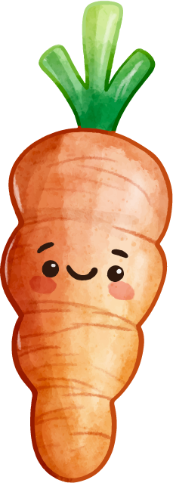
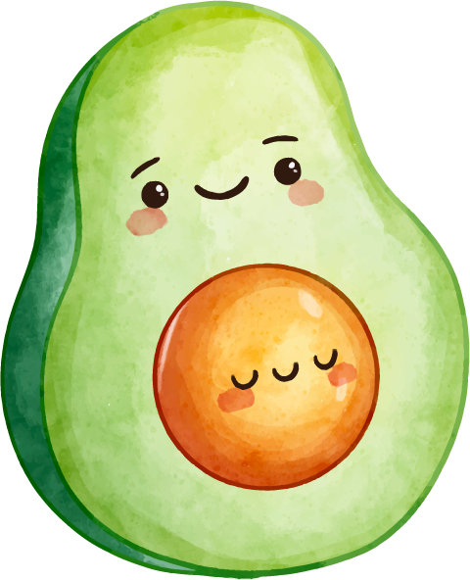
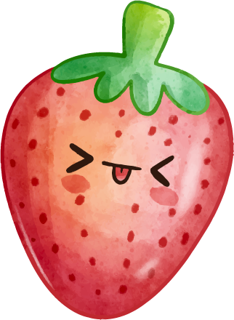
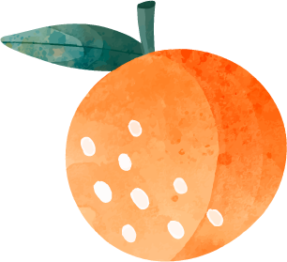

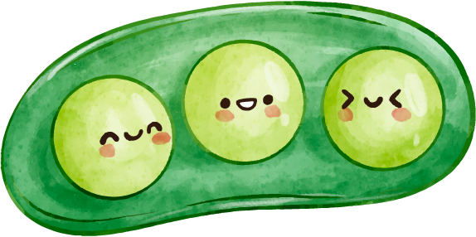
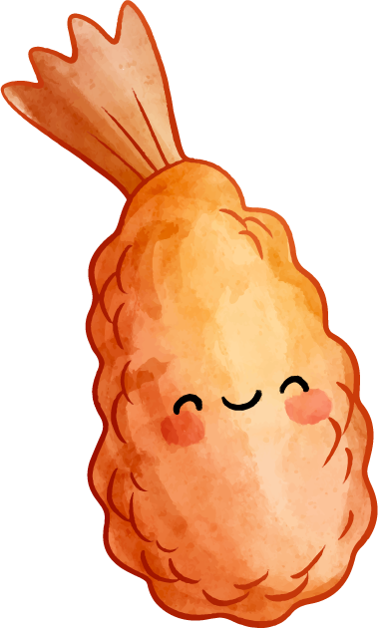


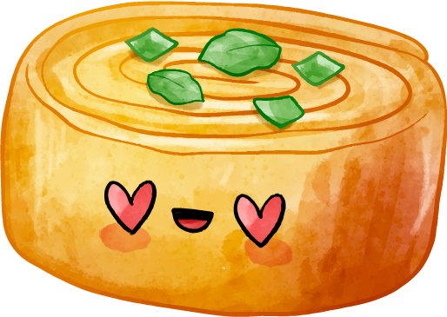
Good / bad for health
(Ex5 - page 19)
Work in groups of 2.
Make a presentation/ video/ poster/ mind map.
Answer what daily activities/ food you think are good/ bad and reason why.
Present in front of the class.

Slide 22
Let’s present!

Slide 23
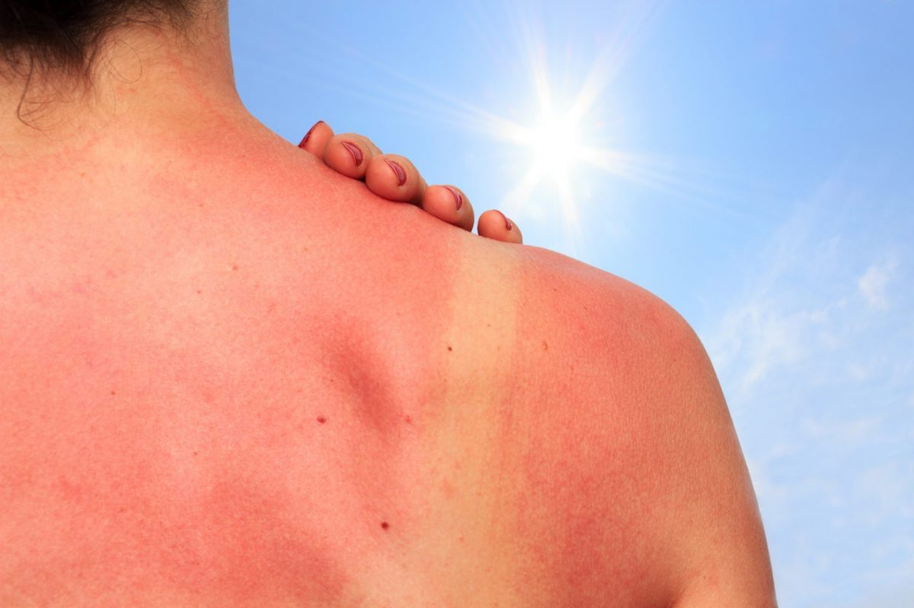
RECAP
1
What activities are good for your health?
A. cycling
B. boating
C. rarely eating breakfast
2
What health problem is it?
A. sunny
B. sunburn
C. suncream

Slide 24
Thanks
Do you have any questions?
Please keep this slide for attribution

