Slide 1

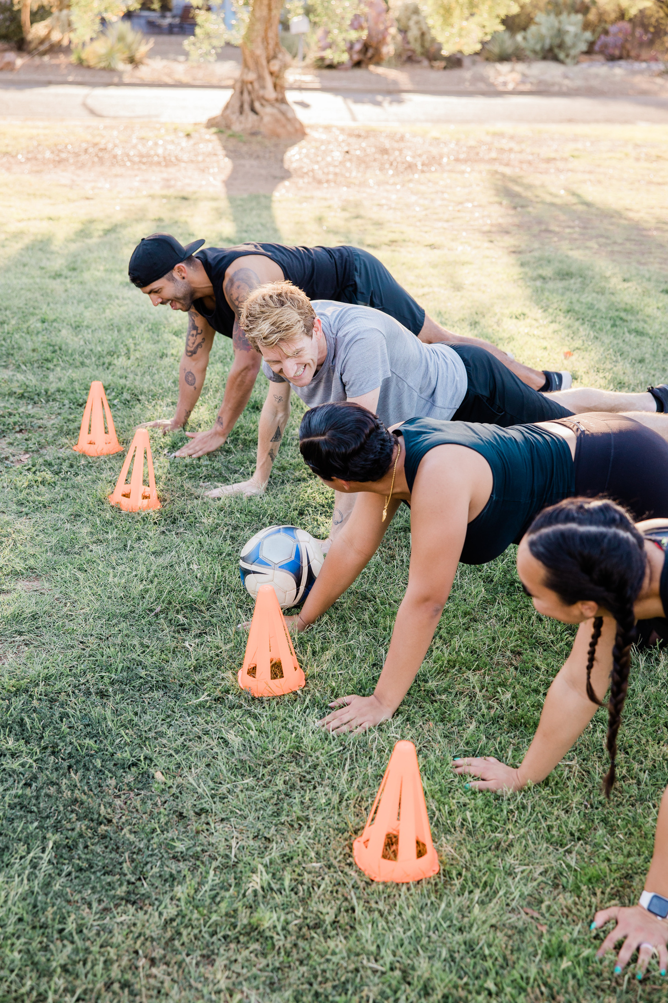

Unit 8
Sports and games
Lesson 6: Skills 2

Slide 2


BRAINSTORMING
Groups of 6
Write as many sports as you can.
3 minutes

Slide 3
listen for general and specific information about sport(s) / game(s);
Lesson objectives
01
By the end of this lesson, students will be able to:
write a paragraph about a sport / game.
02

Slide 4



Ex 1 (p.23) Listen to the passages. Who are they about?
?
?
Alice
Hai

Slide 5
Ex 2 (p.23) Listen to the passages again. Then tick (✓)T (True) or F (False) for each sentence.
 | True | False
1. The passages are about two sportsmen.
2. Hai goes cycling at the weekend.
3. Hai's favourite sport is karate.
4. Alice doesn't like doing sport very much.
5. Alice plays computer games every day.

Slide 6
Ex 2 (p.23) Listen to the passages again. Then tick (✓)T (True) or F (False) for each sentence.
 | True | False
1. The passages are about two sportsmen.
2. Hai goes cycling at the weekend.
3. Hai's favourite sport is karate.
4. Alice doesn't like doing sport very much.
5. Alice plays computer games every day.
students.
✓
✓
✓
✓
sometimes
✓

Slide 7
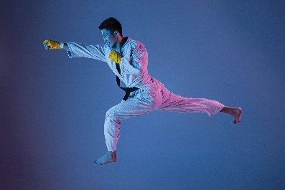

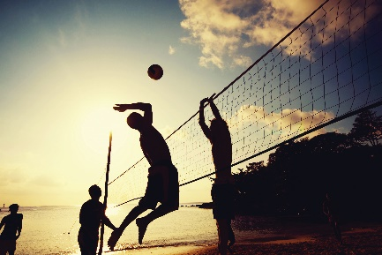
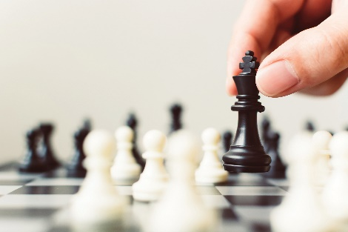
Ex 3 (p.23) Listen again and fill each blank with a word to complete each sentence.
1. Hai plays __________ at school.
2. Hai practises karate at the club __________ times a week.
3. __________ likes watching sport on TV.
4. Alice plays __________ every Saturday.
a sport/ game
number
person
a sport/ game

Slide 8
Ex 3 (p.23) Listen again and fill each blank with a word to complete each sentence.
1. Hai plays __________ at school.
2. Hai practises karate at the club __________ times a week.
3. __________ likes watching sport on TV.
4. Alice plays __________ every Saturday.
volleyball
a sport/ game
three
number
Alice
person
chess
a sport/ game

Slide 9
listen for general and specific information about sport(s) / game(s);
✓
Lesson objectives
01
By the end of this lesson, students will be able to:
write a paragraph about a sport / game.
02
Notes:
Hai and Alice have talked about their favorite sports? What’s about you?

Slide 10
Ex 4 (p.23) In pairs. Ask and answer about the sport / game you like in FULL sentence.
1. What is the name of the sport / game?
2. How many players are there?
3. How often do you play it?
4. What equipment does it need?
5. Why do you like it?
My favourite sport is …
There are … players in a team.
I play it twice a week.
It need sports shoes, rackets, ball
I like/ love it because ….
Notes:
Remind them about the brainstorming. Pick a sport they like best and answer the question in FULL SENTENCE.
Với lớp giỏi, GV có thể ko cần đưa gợi ý và gọi 1 bạn lên làm mẫu luôn
Phần gợi ý dành cho đối tượng HS yếu kém hơn.

Slide 11
Ex 5 (p.23) Write a paragraph of 40-50 words about the sport / game you talked about.
1. What is the name of the sport / game?
2. How many players are there?
3. How often do you play it?
4. What equipment does it need?
5. Why do you like it?
My favorite sport is …
There are … players.
There are … players.
I sometimes/ usually/ always/ often ….
I …. once/ twice/ three times a week/ everyday.
I like/ love it because ….
Notes:
Write and then swap check.

Slide 12
Peer check
Criteria | Yes | No
1. Are the verbs in the correct form?
2. Are the nouns in the correct form?
3. Is the spelling correct?
4. Has the paragraph answered all questions?

Slide 13
listen for general and specific information about sport(s) / game(s);
✓
Lesson objectives
01
By the end of this lesson, students have been able to:
write a paragraph about a sport / game.
✓
02

Slide 14
Thank you
for your attention!

