Slide 1


Slide 2

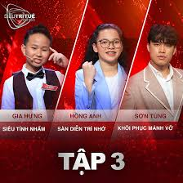
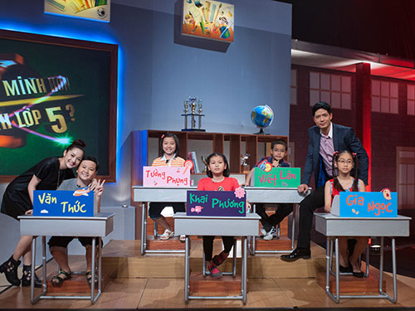
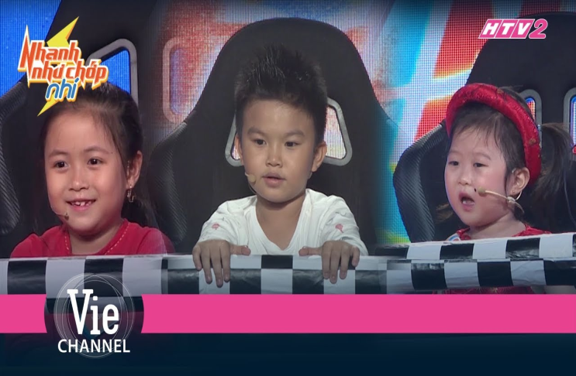
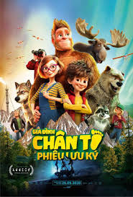
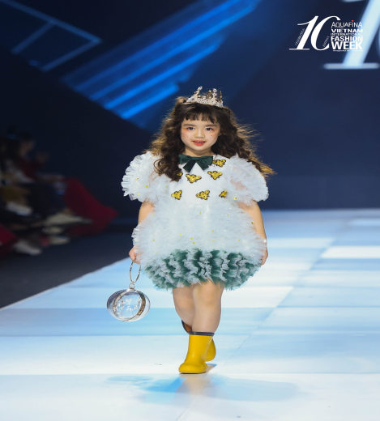
* GAME:
+ Match the names of TV programmes with suitable pictures.
lightning fast kids
Model Kid Vietnam
SuperBrain Vietnam
Animated films
The Voice Kids
Who's smarter than 5th graders?

Slide 3



e
TELEVISION
Unit 7:
LESSON 2

Slide 4

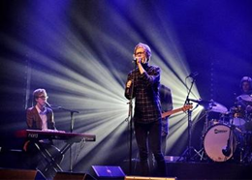
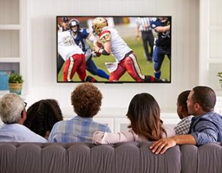
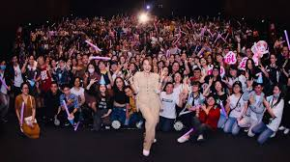
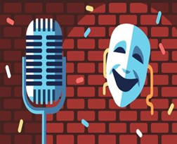
* Vocabulary
- comedy (n):
Hài kịch
- viewer (n):
Người xem
- performer (n):
Người biểu diễn
- live (adj) :
Trực tiếp
- popular (adj):
Phổ biến
- boring (adj) :
nhàm chán
>< interesting

Slide 5
* Checking vocab:
Rub out and remember
- comedy (n):
hài kịch
- viewer (n):
người xem
- performer (n):
người biểu diễn
- live (adj) :
trực tiếp
- popular (adj):
phổ biến
- boring (adj) :
nhàm chán

Slide 6

Write the words / phrases in the box next to the definition.
talent show
comedy
educational programme
viewer
character
1.
an animal or person in a film
character
2.
a programme which teaches maths, English, etc.
educational programme
3.
a film / show which makes people laugh
comedy
4.
a competition to choose the best performer
talent show
5.
a person who watches TV
viewer

Slide 7

Complete the sentences with the words / phrases in the box.
character
viewers
game show
animated films
comedies
channel
Do you watch Bibi, the popular for children?
1.
channel
2.
Which do you prefer: Jerry the mouse or Tom the cat?
character
I love
animated films like Happy Feet and Coco.
3.
like Happy Feet and Coco.
I love Children are Always Right, a
game show for kids.
4.
for kids.
5.
My father often watches
comedies. They’re so funny.
. They’re so funny.
6.
A popular programme has a lot of .
viewers

Slide 8

Complete the sentences with the adjectives in the box.
popular
educational
cute
boring
live
funny
popular
1.
The most channel for children is the Cartoon Network.
2.
. I don’t want to watch it.
This film is very
boring. I don’t want to watch it.
Cat Kitty is a very
cute character. Children love her.
3.
character. Children love her.
4.
You can watch this programme at the same time it happens. It’s
live.
.
5.
Comedies are
funny. People laugh a lot when they watch them.
. People laugh a lot when they watch them.
6.
We learn a lot from Discovery Channel. This channel is
educational.
.

Slide 9
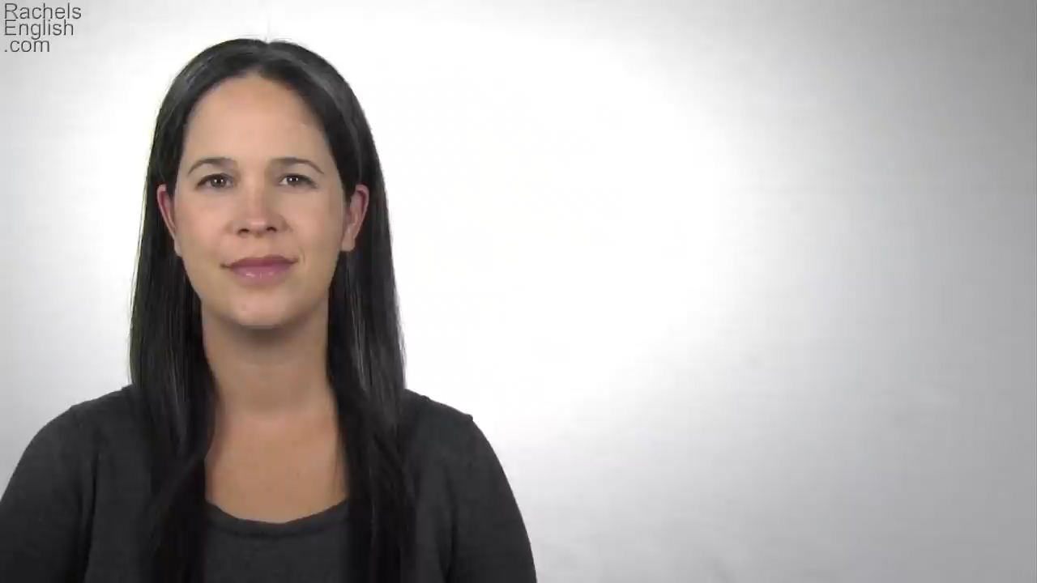
* Pronunciation
/θ/and /ð/
/θ/: think,
/ð/: this,
thank, throw, theatre, third.
that, these, those, there, father.

Slide 10


* Pronunciation
/θ/and /ð/
Listen and repeat the words.
/θ/ | /ð/
theatre earth anything both through | there them neither weather than

Slide 11


* Game: Tongue Twister Race.
Tongue Twister sentences
Take turns to read the sentences quickly and correctly.
1.
They are thinking about the weather there.
2.
The new theatre opens on Thursday the third.
3. The first thing that they think of is this.
4. . These things finish sooner than you think

Slide 12
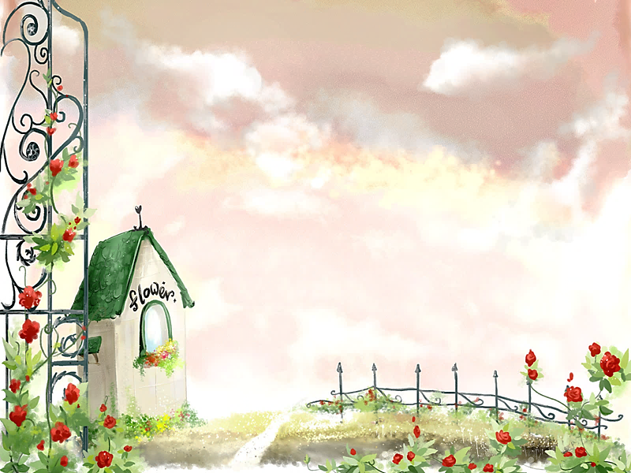
Homework
Learn by heart the new words
Do exercise in workbook
Prepare for the next lesson – A closer look 2

Slide 13

Thank you!
Have a nice day!

