Slide 1


Slide 2









Warm up:
Game: Pelmanism
1
2
3
4
GO
BE
DO
PLAY
Grammar
MEET
6
7
DRINK
WENT
WAS/
WERE
5
8
The past simple
Imperatives
Choose the correct answer A, B, or C.
Look at each picture and choose the correct answer.
Write the correct form of the verbs to complete the conversation.
PLAYED
MET
DID
DRANK
9
10
11
12
Tell your friends what to do and what not to do at the gym.
Work in groups. Ask and answer questions about your last weekend.

Slide 3

UNIT 8: SPORTS AND GAMES
Grammar
The past simple
Imperatives
Grammar:
The past simple
Choose the correct answer A, B, or C.
Look at each picture and choose the correct answer.
Write the correct form of the verbs to complete the conversation.
Tell your friends what to do and what not to do at the gym.
Work in groups. Ask and answer questions about your last weekend.

Slide 4

* Grammar:
The past simple ( Thì quá khứ đơn)
We use the past simple to talk about something that happened in the past.
Example:
I played badminton with Phong yesterday.

Slide 5
* Grammar 1:
The past simple ( Thì quá khứ đơn)
Form:
 | To verb | To be
Positive | S + Ved + … . | S + was/ were + … .
Negative | S + didn’t + Vo + … . | S + wasn’t/ weren’t + …
Interrogative | Did + S + Vo + … ? | Was/ Were + S + … .
Answer | →Yes, S + did. →No, S + didn’t. | →Yes, S + was/were. →No, S + wasn’t/ weren’t.
W/H questions | W/H + did + S + Vo + … ? | W/H + was/were + S + ...?
* Notes: There are regular and irregular verbs in past simple tense. Ex: go - went ; play - played
Grammar
The past simple
Imperatives
* Adverbs of time are used with the past simple are: yesterday, 2 weeks/ 3 months… ago, last week/ month/ year/
Work in groups. Ask and answer questions about your last weekend.

Slide 6

Choose the correct answer A, B, or C.
1.
There _______ an interesting match on TV last night.
A.
is
B.
were
C.
were
2.
My dad _______ a lot of tennis some years ago.
Grammar
A.
plays
B.
played
C.
is playing
The past simple
Imperatives
3.
I was at the gym last Sunday, but I _______ you there.
A.
B.
don’t see
C.
didn’t see
not saw
Choose the correct answer A, B, or C.
Look at each picture and choose the correct answer.
4.
The teacher _______ us about our homework this morning.
Write the correct form of the verbs to complete the conversation.
A.
B.
not asking
C.
doesn’t ask
didn’t ask
Tell your friends what to do and what not to do at the gym.
5.
_______ sleep well last night?
Work in groups. Ask and answer questions about your last weekend.
A.
B.
Did you
C.
Were you
Do you

Slide 7
Lucky number Game
1
6
2
Team A
Team B
8
2
8
10
4
4
6
2
10
6
5
3
4
TIẾP

Slide 8

Choose the correct answer A, B, or C.
1.
There _______ an interesting match on TV last night.
A.
is
B.
were
C.
were

Slide 9
Choose the correct answer A, B, or C.
2.
My dad _______ a lot of tennis some years ago.
Grammar
A.
plays
B.
played
C.
is playing
The past simple
Imperatives

Slide 10
Choose the correct answer A, B, or C.
The past simple
Imperatives
3.
I was at the gym last Sunday, but I _______ you there.
A.
B.
don’t see
C.
didn’t see
not saw
Choose the correct answer A, B, or C.
Look at each picture and choose the correct answer.

Slide 11
Choose the correct answer A, B, or C.
Choose the correct answer A, B, or C.
Look at each picture and choose the correct answer.
4.
The teacher ______us about our homework this morning.
Write the correct form of the verbs to complete the conversation.
A.
B.
not asking
C.
doesn’t ask
didn’t ask
Tell your friends what to do and what not to do at the gym.

Slide 12
Choose the correct answer A, B, or C.
Tell your friends what to do and what not to do at the gym.
5.
_______ sleep well last night?
Work in groups. Ask and answer questions about your last weekend.
A.
B.
Did you
C.
Were you
Do you

Slide 13

LUCKY NUMBER!
Grammar
The past simple
Imperatives
Choose the correct answer A, B, or C.
Look at each picture and choose the correct answer.
Write the correct form of the verbs to complete the conversation.
Tell your friends what to do and what not to do at the gym.
Work in groups. Ask and answer questions about your last weekend.

Slide 14
Choose the correct answer A, B, or C.
1.
There _______ an interesting match on TV last night.
A.
is
B.
were
C.
were
2.
My dad _______ a lot of tennis some years ago.
Grammar
A.
plays
B.
played
C.
is playing
The past simple
Imperatives
3.
I was at the gym last Sunday, but I _______ you there.
A.
B.
don’t see
C.
didn’t see
not saw
Choose the correct answer A, B, or C.
Look at each picture and choose the correct answer.
4.
The teacher _______ us about our homework this morning.
Write the correct form of the verbs to complete the conversation.
A.
B.
not asking
C.
doesn’t ask
didn’t ask
Tell your friends what to do and what not to do at the gym.
5.
_______ sleep well last night?
Work in groups. Ask and answer questions about your last weekend.
A.
B.
Did you
C.
Were you
Do you

Slide 15

Write the correct form of the verbs to complete the conversation.
Nick: Hi, there.
Sonny: Hello, Nick. Did you have a nice weekend?
Nick: Yeah, it was OK. On Sunday, I (1. go) _______ fishing with my dad. How about you?
Sonny: Oh, I (2. have) _______ a good weekend, too.
Nick: Really? What _______ you (3. do) _______?
Sonny: I (4. visit) _______ the museum with my family, then we (5. eat) _______ at my favourite restaurant.
Nick: Did you watch football last Sunday
Sonny: Oh, yeah! My favourite team (6. score) _______ a fantastic goal!
went
had
did
do
visited
ate
scored

Slide 16

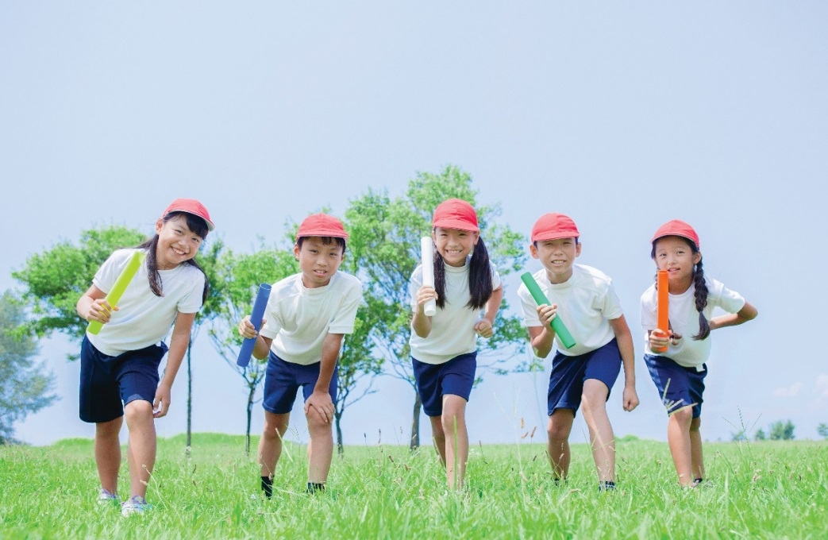
Work in groups. Ask and answer questions about your last weekend.
Example:
A: Did you do any sport last weekend?
B: Oh yes, and I was exhausted.
C: Really? What did you do?
…

Slide 17
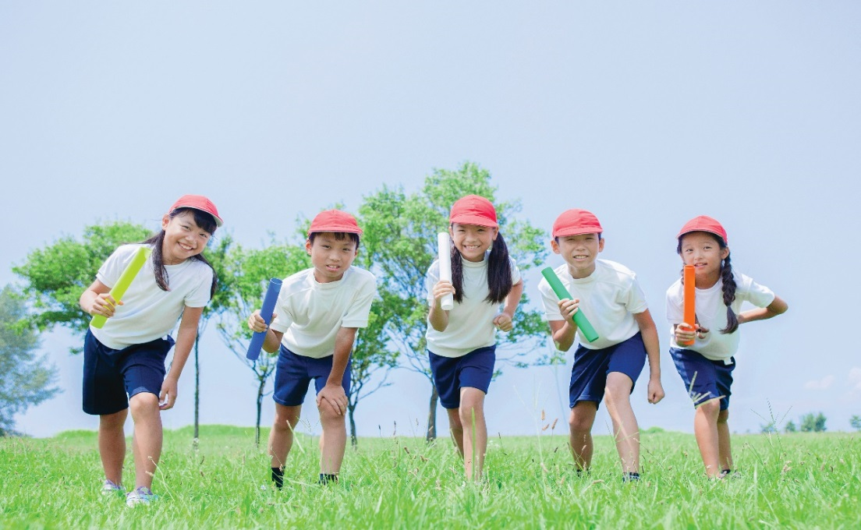
Work in groups. Ask and answer questions about your last weekend.
Example:
A: Did you do any sport last weekend?
B : Yes, I played football with some friends . And you?
C: Oh no, I visited my grandparents.
……

Slide 18

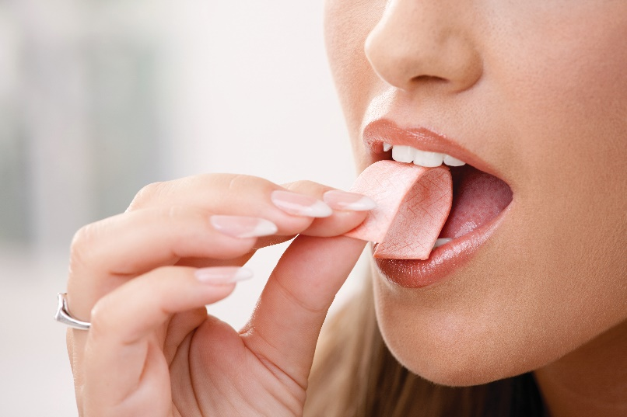
Grammar 2:
Imperatives
We use imperatives to tell someone to do something, or to give a direct order.
It’s a chewing gum.
Chew it.
Don’t swallow it.
Positive: V
Negative: Don’t + V

Slide 19


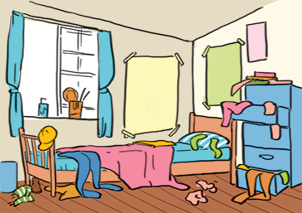


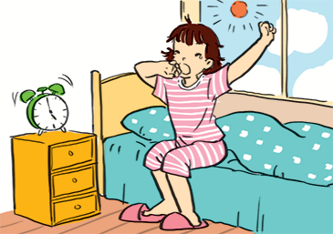
Look at each picture and choose the correct answer.

Slide 20
Look at each picture and choose the correct answer.
1.
(Park / Don’t park) here.

Slide 21
Look at each picture and choose the correct answer.
2.
(Close / Open) the window. It’s windy outside.

Slide 22
Look at each picture and choose the correct answer.
3.
(Tidy up / Don’t tidy up) your room.

Slide 23
Look at each picture and choose the correct answer.
Lift : thang máy
4.
(Use / Don’t use) the lift when there is ﬁre.

Slide 24
Look at each picture and choose the correct answer.
5.
(Try / Don’t try) to get up early to do some exercise.

Slide 25


Tell your friends what to do and what not to do at the gym.
GYM RULES
Example:
Change your clothes.
Don’t speak loudly.
_______
_______
_______
Do as the instruction on equipment.
Don’t litter.
Put on your sports shoes.
Pay your fee first.
Don’t eat or drink at the gym.

Slide 26

Homework:
- Make 3 sentences about yourself, using the past simple.
- Give 3 orders or tell your friends to do an activity / everyday routine.
- Prepare lesson 5- skills 1..

Slide 27

Goodbye!
See you again
Thank you!
Have a nice day!

