Slide 1


Slide 2

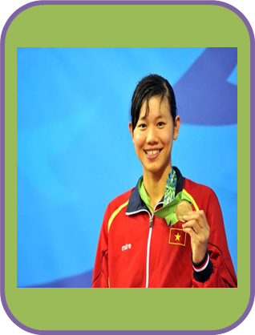
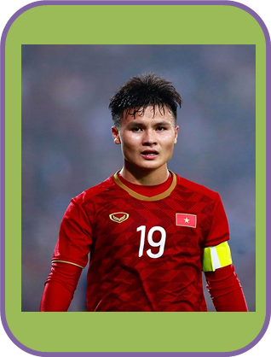
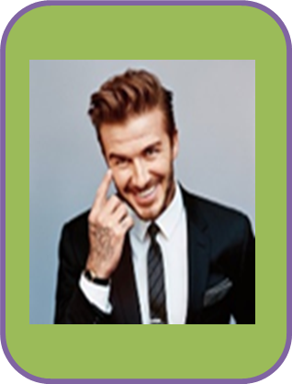
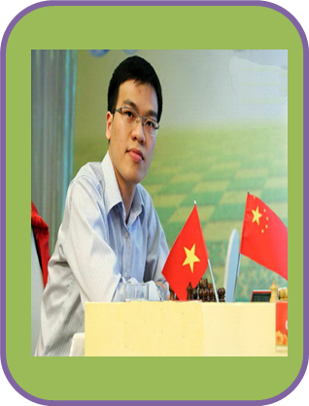
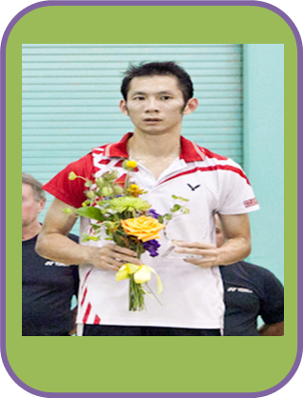
* Warm - up
* Choose a number and answer the questions
Who is she/ he?
What sport does he (she) play?
1
2
3
4
5

Slide 3
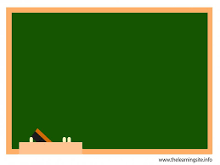



UNIT 8: SPORTS AND GAMES
LESSON 6: SKILLS 2
* Listening
* Writing

Slide 4



I. Listening
Listen to the passages. Who are they about?
The listening passages are about Hai and Alice.

Slide 5

Listen to the passages again. Then tick () T (True) or F (False) for each sentence.
 | T | F
1. The passages are about two sportsmen.
2. Hai goes cycling at the weekend.
3. Hai’s favourite sport is karate.
4. Alice doesn’t like doing sport very much.
5. Alice plays computer games every day.





Audio script

Slide 6

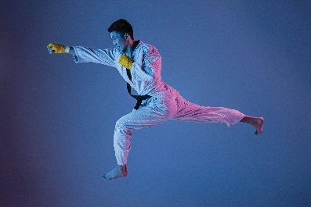
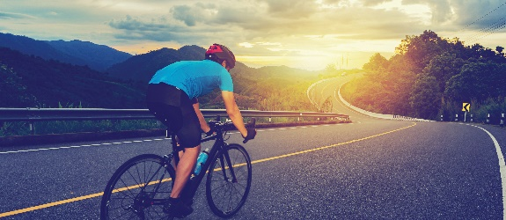
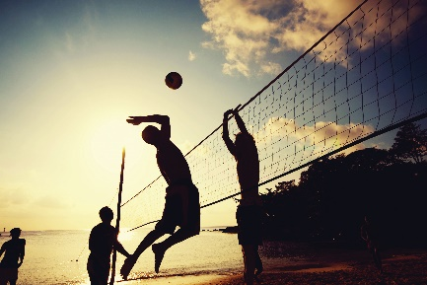
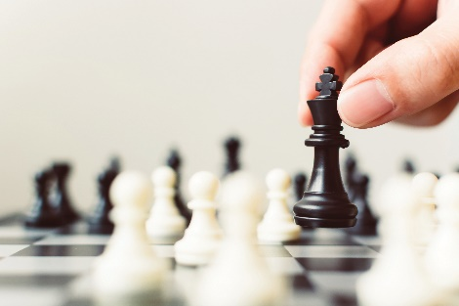
Listen again and fill each blank with a word to complete each sentences.
1. Hai plays ________ at school.
2. Hai practises karate at the club ___ times a week.
3. _________ likes watching sport on TV.
4. Alice plays_________ every Saturday.
Audio script

Slide 7
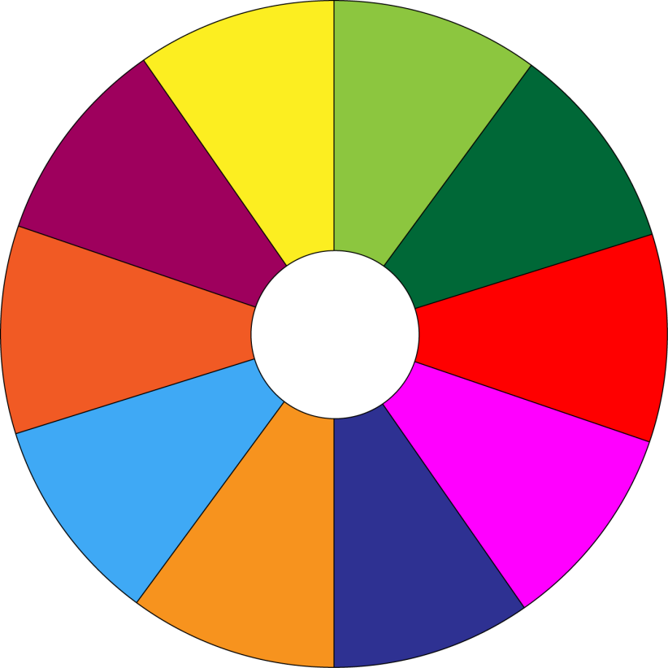
THE BIG WHEEL GAME
QUESTIONS
10
40
1
2
30
50
SPIN
20
10
3
4
-15
-20
05
60

Slide 8
1. Hai plays ________ at school.
volleyball

Slide 9
2. Hai practises karate at the club _____ times a week.
three

Slide 10
3. ______likes watching sport on TV.
Alice

Slide 11
4. Alice plays________every Saturday.
chess

Slide 12
Listen again and fill each blank with a word to complete each sentences.
1. Hai plays ________ at school.
2. Hai practises karate at the club ___ times a week.
3. _______ likes watching sport on TV.
4. Alice plays_________ every Saturday.
volleyball
three
Alice
chess
Audio script

Slide 13
AUDIO SCRIPT
Hello. My name's Hai. I love sport. I play volleyball at school and I often go cycling with my dad at the weekend. But my favourite sport is karate. I practise it three times a week. It makes me strong and confident.
My name's Alice. I'm twelve years old. I don't like doing sport very much, but I like watching sport on TV. My hobby is playing chess. My friend and I play chess every Saturday. I sometimes play computer games, too. I hope to create a new computer game one day.

Slide 14
AUDIO SCRIPT
AUDIO SCRIPT
Hello. My name's Hai. I love sport. I play volleyball at school and I often go cycling with my dad at the weekend. But my favourite sport is karate. I practise it three times a week. It makes me strong and confident.
My name's Alice. I'm twelve years old. I don't like doing sport very much, but I like watching sport on TV. My hobby is playing chess. My friend and I play chess every Saturday. I sometimes play computer games, too. I hope to create a new computer game one day.

Slide 15

II. Writing
Work in pairs. Talk about the sport / game you like. Use the following questions as cues.
What is the name of the sport / game?
How many players are there?
How often do you play it?
What equipment does it need?
Why do you like it?

Slide 16
Work in pairs. Talk about the sport / game you like. Use the following questions as cues.
What is the name of the sport / game?
How many players are there?
How often do you play it?
What equipment does it need?
Why do you like it?
badminton.
2 or 4 player.
Three times a week
racket, shuttlecock, net .
because it’s fun and good for health.

Slide 17


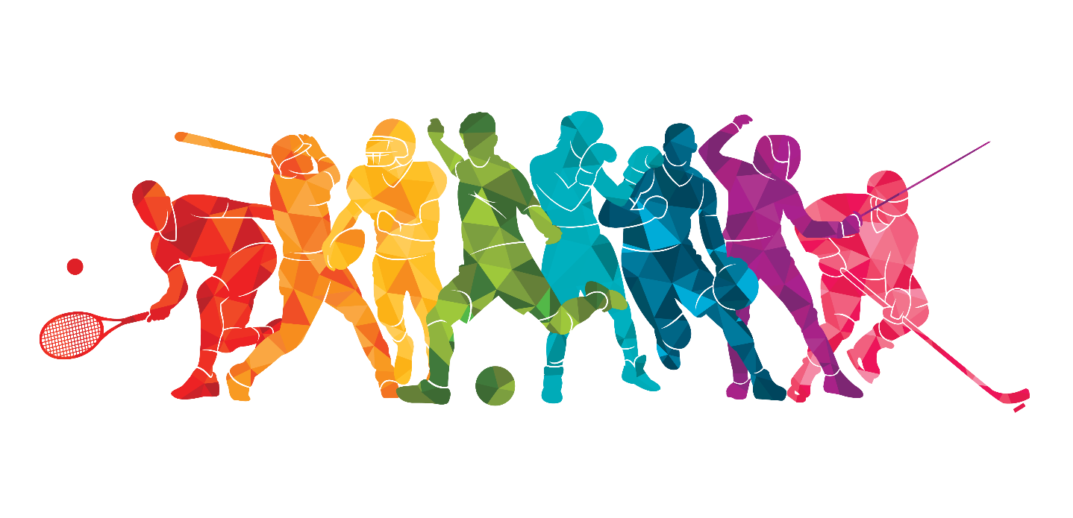
Write a paragraph of 40-50 words about the sport / game you talked about in 4. You can also refer to the listening passages.
I usually play badminton after school with my friend because to play this sport we need two players. I play badminton three times a week. To play badminton, I need two racquets ,one shuttlecock and net. I love badminton very much because it’s fun and good for health.

Slide 18
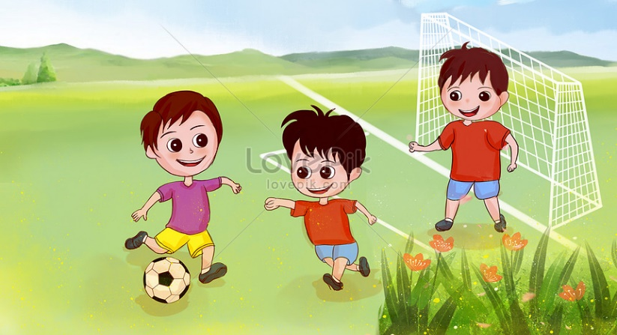
Write a paragraph of 40-50 words about the sport / game you talked about in 4. You can also refer to the listening passages.
My favourite sport is football. It’s a team sport. It usually lasts for 90 minutes for an offcial football match but we play only for 30 minutes. There are 11 player on each team. It’s very easy to play because we need only one ball and sport shoes to play. I usually play football with my friends in the afternoon. I love football very much because it’s fun and good for health.

Slide 19


homework
- Rewrite the passage.
- Prepare “ Looking back and project”

Slide 20


homework
- Rewrite the passage.
- Prepare “ Looking back and project”

Slide 21
My favourite sport is badminton.
It’s an individual sport and a team sport.
It may last about 90 minutes.
There are about 2 or 4 player.
It needs some equipment: racket, shuttlecock, net .
I love badminton very much because it’s fun and good for health.
Liên hệ Côi nguyễn nhé.

