Slide 1


Slide 2
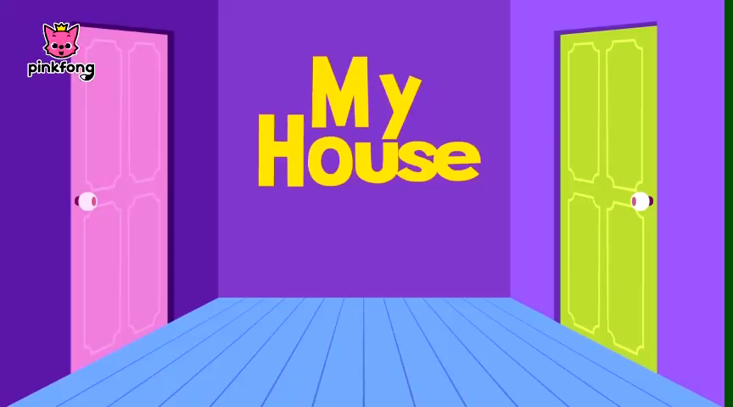
List the rooms in the house

Slide 3
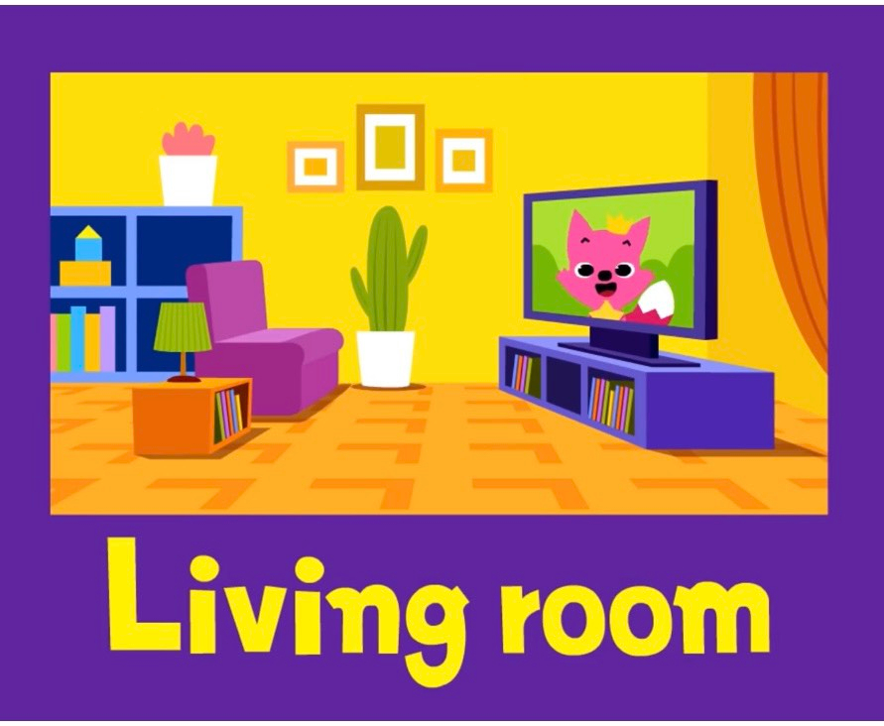
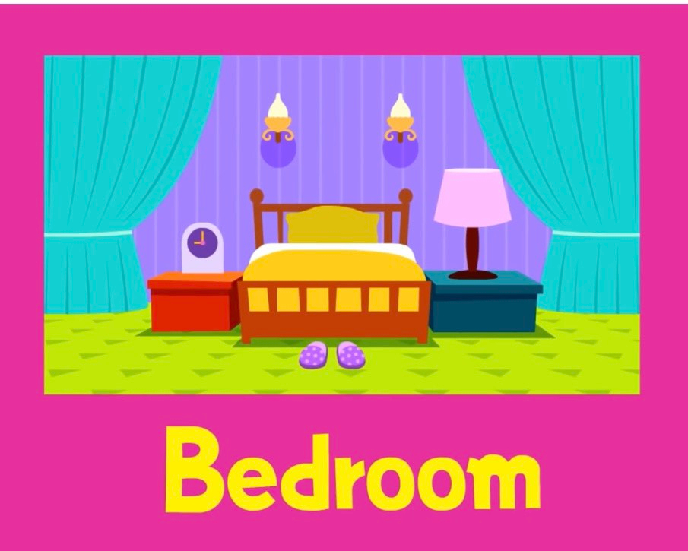
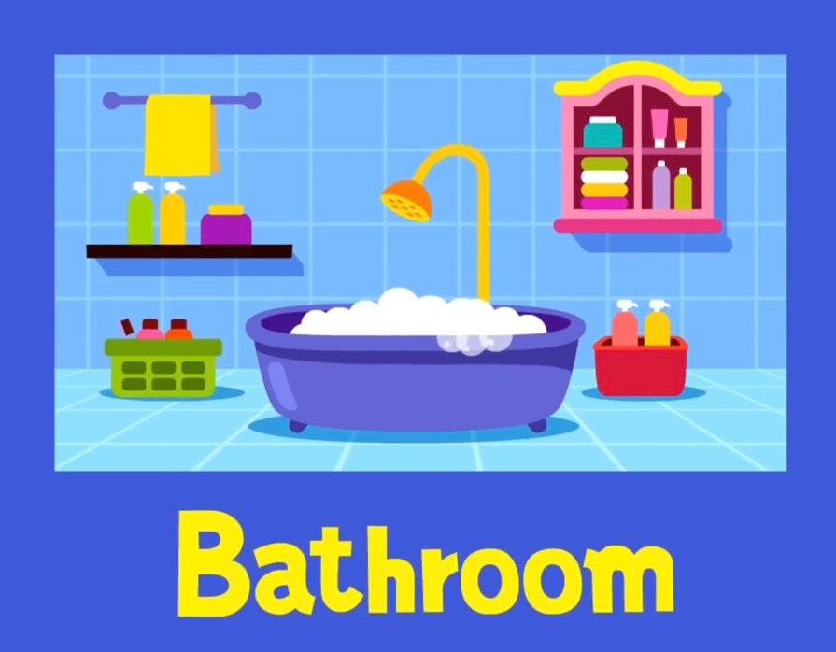


Slide 4

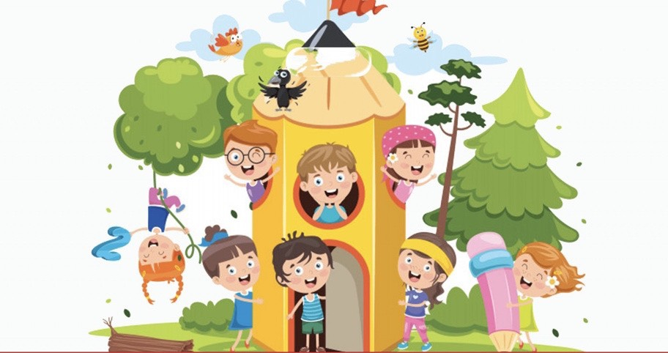
LESSON 2: A CLOSER LOOK 1

Slide 5
I. VOCABULARY

Slide 6


Listen and repeat the words / phrases in the box. Then put them in the appropriate columns. You may use some more than once.
electric cooker
fridge
dishwasher
electric fan
washing machine
computer
wireless TV
smart clock
living room | bedroom | kitchen
wireless TV
wireless TV
electric cooker
electric fan
smart clock
fridge
smart clock
computer
electric fan
dishwasher
computer
electric fan
washing machine
wireless TV

Slide 7

Match the appliances in A with what they can help us to do in B.
A
1. electric cooker
2. dishwasher
3. fridge
4. washing machine
5. computer
B
a. receive and send emails
b. keep food fresh
c. cook rice
d. wash and dry dishes
e. wash and dry clothes

Slide 8
Match the appliances in A with what they can help us to do in B.
A
1. electric cooker
2. dishwasher
3. fridge
4. washing machine
5. computer
B
c. cook rice
d. wash and dry dishes
b. keep food fresh
e. wash and dry clothes
a. receive and send emails
A: What can an electric cooker help us to do?
B: It can help us to cook rice.

Slide 9

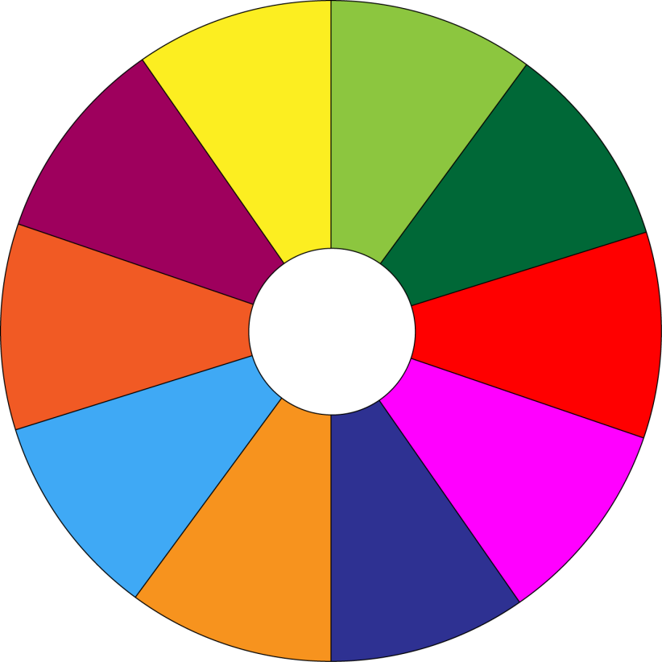
THE BIG WHEEL GAME
QUESTIONS
1
10
40
30
50
2
SPIN
20
10
3
-15
-20
05
60
4

Slide 10

Work in pairs. Ask and answer questions about appliances, using the information in 2.
dishwasher
A: What can a dishwasher help us to do?
B: It can help us to wash and dry dishes.

Slide 11
Work in pairs. Ask and answer questions about appliances, using the information in 2.
fridge
A: What can a fridge help us to do?
B: It can help us to keep food fresh.

Slide 12
Work in pairs. Ask and answer questions about appliances, using the information in 2.
washing machine
A: What can a washing machine help us to do?
B: It can help us to wash and dry clothes

Slide 13
Work in pairs. Ask and answer questions about appliances, using the information in 2.
Computer
A: What can a computer help us to do?
B: It can help us to receive and send emails.
receive and send emails.

Slide 14
STRESS IN TWO-SYLLABLE WORDS
receive emails
2 syllables
2 syllables
a verb
a noun

Slide 15
Quy tắc nhấn trọng âm của từ có 2 âm tiết
1. Đối với hầu hết các danh từ và tính từ có hai âm tiết trong tiếng Anh thì trọng âm rơi vào âm tiết thứ nhất.
- money (n.) /ˈmʌni/
- artist (n.) /ˈɑːtɪst/
- lovely (adj.) /ˈlʌvli/
healthy (adj.) /ˈhelθi/
Pretty (adj): /'priti/
famous (adj):/'feiməs/

Slide 16
Quy tắc nhấn trọng âm của từ có 2 âm tiết
2. Trọng âm rơi vào âm tiết đầu nếu:
+ âm tiết thứ 2 của từ gồm một nguyên âm ngắn
+ và kết thúc với ít hơn hoặc bằng một phụ âm
- answer/ ˈænsər/
- summer/ˈsʌmər/
- question/ˈkwestʃən/
- music/ ˈmjuzɪk/
- practise / ˈpræktɪs/
- visit/ ˈvɪzɪt/
- clever /'klevə[r]/

Slide 17

II. Pronunciation
Stress in two-syllable words
Listen and repeat the words. Then listen and repeat
picture
receive
bedroom
enjoy
village
robot
kitchen

Slide 18

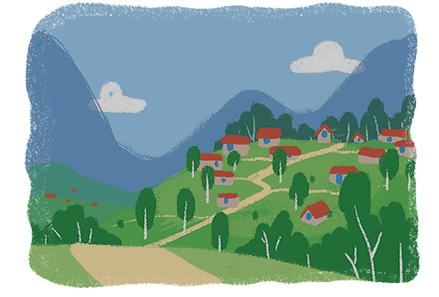
Listen and repeat the sentences. Pay attention to the stress of the underlined words.
1.
The picture is on the wall of the bedroom.
2.
The robot helps me to do the housework.
3.
There’s a very big kitchen in the palace.
4.
Their village is in the mountains.

Slide 19
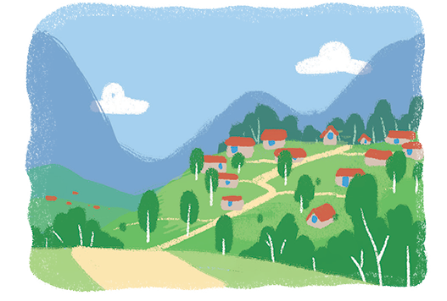
Listen and repeat the sentences. Pay attention to the stress of the underlined words.
1.
The picture is on the wall of the bedroom.
2.
The robot helps me to do the housework.
3.
There’s a very big kitchen in the palace.
4.
Their village is in the mountains.

Slide 20
* Production
Game: “Up and down”
Eg: cushion (stand up)
table ( stand up)
famous (sit down)
modern ( sit down )

Slide 21

* Homework
- Learn by heart all the new words. - Prepare lesson 3 ( A closer look 2).

