Slide 1

Hello every one !!!
ENGLISH 6

Slide 2
* Warm up: Brainstorming
computer
Household appliances
dishwasher, rice cooker, dryer,smart TV, modern fridge , robots ……

Slide 3





LESSON 7

Slide 4

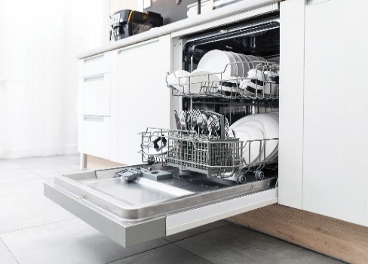
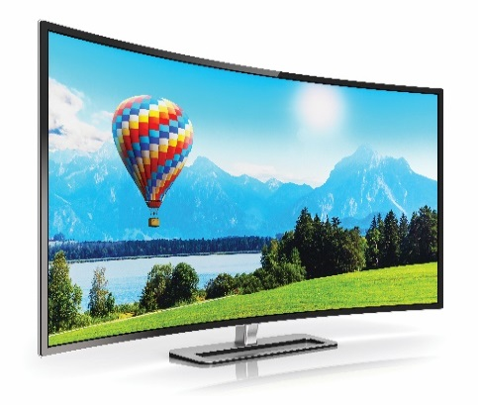

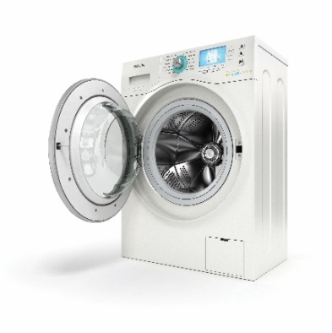
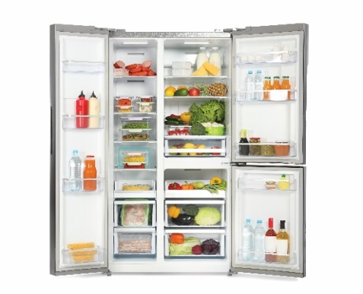
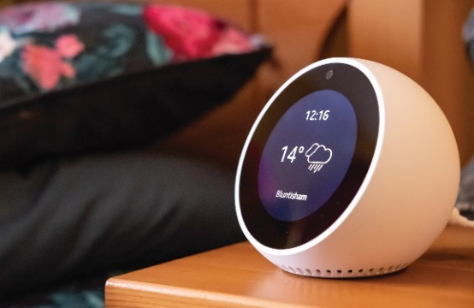
* Vocabulary
Write the words / phrases under the correct pictures.
computer
wireless tv
dishwasher
smart clock
fridge
washing machine
1. computer
2. dishwasher
3. wireless TV
4. washing machine
5. fridge
6. smart clock

Slide 5

Think about what the appliances will do in the future. Fill the table.
1. robots | Look after the house
2. washing machine
3. wireless tvs
4. super cars
5. smart clocks
6. dishwashers
wash clothes
access to internet
can fly
can play online music
wash dishes

Slide 6

* Grammar
Complete the sentences with will ('ll) or won’t.
1.
Tomorrow is Sunday, so I
_______ have to get up early.
won’t have to get up early.
2.
will / ‘ll invite him to our party.
When I see Tom tomorrow, I
_______ invite him to our party.
will / ‘ll like her.
3.
You must meet Anna. I am sure you
_______ like her.
We
won’t start our dinner until Jack arrives.
4.
_______ start our dinner until Jack arrives.
will / ‘ll phone you when I get home from school.
5.
_______ phone you when I get home from school.
I
won’t pass his examination. He hasn’t studied yet.
6.
Tony
_______ pass his examination. He hasn’t studied yet.

Slide 7

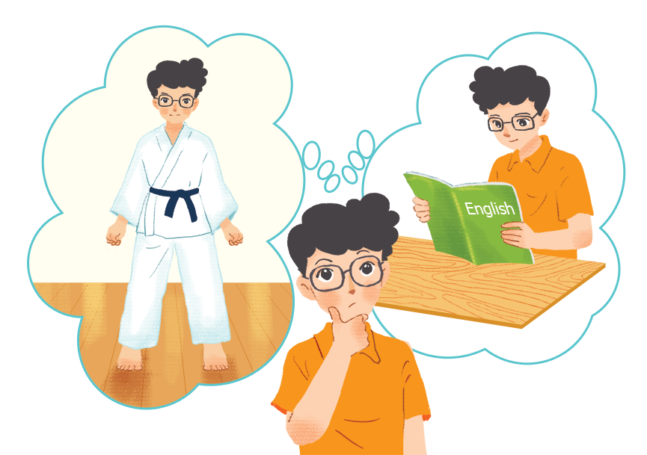
Complete the sentences with might or might not.
1.
I am still not sure where to go for my holiday.
I
_______ go to Da Lat.
might go to Da Lat.
2.
The weather is not very good.
It
_______ rain this afternoon.
might rain this afternoon.
_______ be a meeting on Friday
might not be a meeting on Friday
3.
There
because the teacher is ill.
_______ come to the party tonight
Ann
because she is busy.
4.
might not come to the party tonight
5.
Phong is thinking about what he will do on Sunday. He
at home and study English.
_______ stay
might not stay
_______ go to a judo club, or he _______ stay
might not go to a judo club, or he

Slide 8
* Production:
* Complete the sentences with might or will.
1. They ………..live longer in the future.
2. We ……….. find aliens on Earth one day, but I’m sure they will not speak our language.
3.The weather is not very good. It ……. rain this afternoon.
4. I’m very worried about my examination next week.
- B: Don’t worry. You _______ pass.

Slide 9
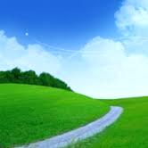



Who’s faster?
3
4
2
5
1
6

Slide 10
* Complete the sentences with might or will .
1. They ………...live longer in the future.
will

Slide 11
* Complete the sentences with might or will .
might
2. We ……….. find aliens on Earth one day, but I’m sure they will not speak our language.

Slide 12
* Complete the sentences with might or will .
3. The weather is not very good. It…….…. rain this afternoon.
might

Slide 13

LUCKY apple!

Slide 14
LUCKY apple!

Slide 15
* Complete the sentences with might or will .
4. I’m very worried about my examination next week.
- B: Don’t worry. You _______ pass.
will

Slide 16





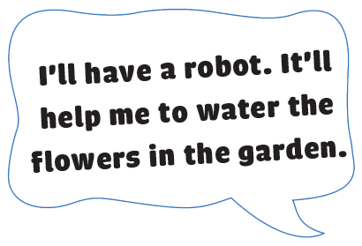


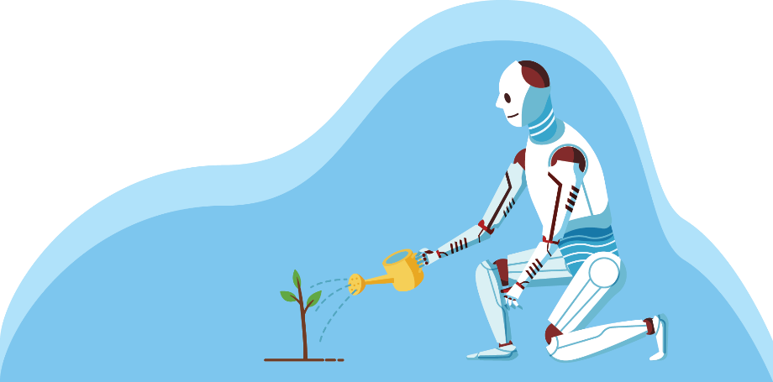
Think about an appliance you would like to have in the future.
Make a poster for your future appliance.
Write details about the appliance on the poster.
Share your poster with your class.

Slide 17

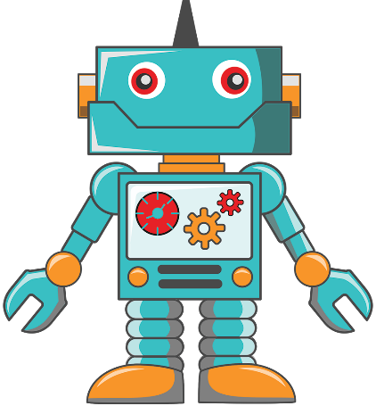
Think about an appliance you would like to have in the future.
Make a poster for your future appliance.
Write details about the appliance on the poster.
Share your poster with your class.

Slide 18
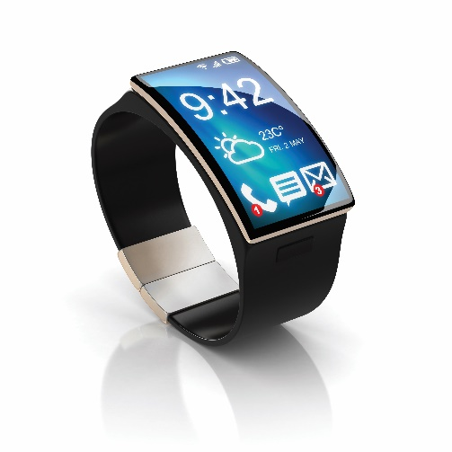
Think about an appliance you would like to have in the future.
Make a poster for your future appliance.
Write details about the appliance on the poster.
Share your poster with your class.

Slide 19

* Homework
Revise vocab and grammar.
Practise the exercises again.
Prepare: Unit 11 – Lesson1.

Slide 20




