Slide 1
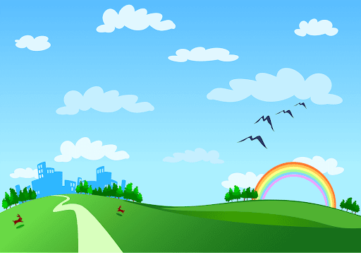
Good morning class!!!

Slide 2


* Warm up:
Chatting:
"Our greener world”
relating to the protection of the environment.
- Green :
- What is this picture about?
Do you like to live in a green world?
Why or why not?
- "Let's go green!” :
to do more to protect nature and the environment.

Slide 3
SOME THINGS YOU DO EVERYDAY WHICH IS
GOOD FOR THE ENVIRONMENT
- Plant trees.
- Go to school / work by bikes or by
- public transport to reduce air pollution.
- Reuse and recycle things
- Don’t liter. - ……….

Slide 4



Slide 5



LESSON 1:
Let’s go green!

Slide 6
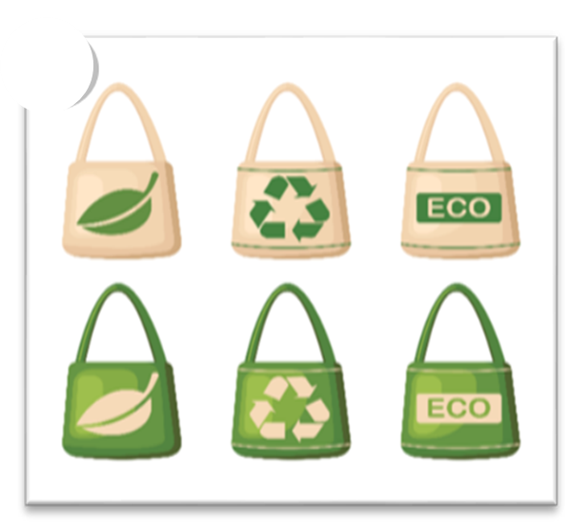
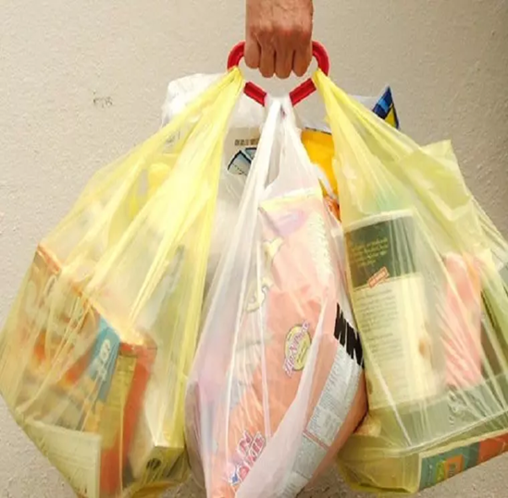
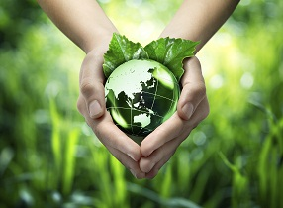
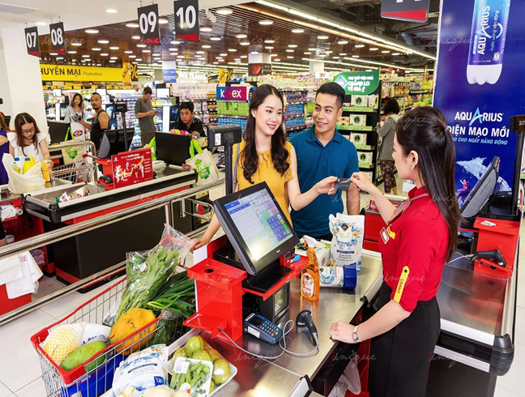
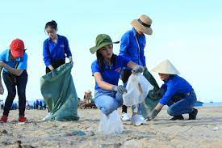
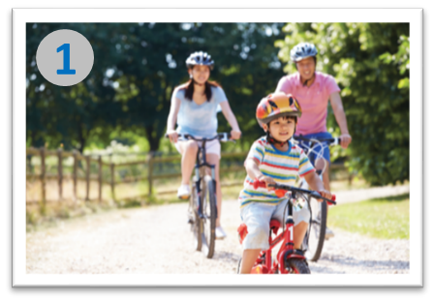
* Vocabulary
reusable [riːˈjuːzəb(ə)l] (a):
có thể tái sử dụng
plastic bag [ˈplastɪk] (n) :
túi ni lông
environment [ɪnˈvaɪ .rən .mənt] (n):
môi trường
check- out (n) :
quày thu ngân
pick up /pɪk ʌp / (v):
nhặt (rác), đón
cycle /ˈsaɪkl/ (v) :
đi xe đạp

Slide 7
* Checking vocab:
reusable [riːˈjuːzəb(ə)l] (a):
có thể tái sử dụng
plastic bag [ˈplastɪk] (n) :
túi ni lông
environment [ɪnˈvaɪ .rən .mənt] (n):
môi trường
check- out (n) :
quày thu ngân
pick up /pɪk ʌp / (v):
nhặt (rác), đón
cycle /ˈsaɪkl/ (v) :
đi xe đạp

Slide 8


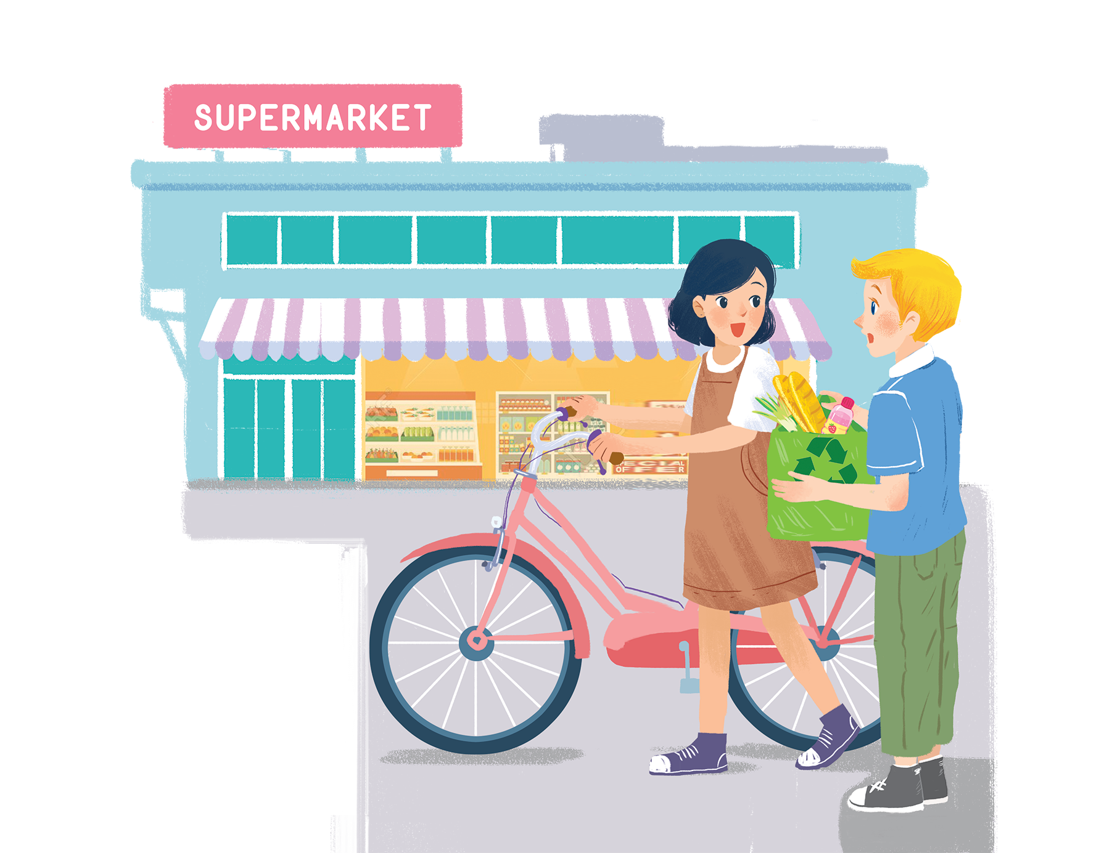
Listen and read.
Let’s go green!
Who are they?
What are they looking at?
What are they talking about?
- They are Nick and Mi.
- They are at the supermarket
- They are talking about ways to go green.
( to protect the environment)
Mi.
Nick

Slide 9
Let’s go green!
Mi: Hi, Nick.
Nick: Hello, Mi.
Mi: You’ve bought a lot of things.
Nick: Yes. We’re going on a picnic tomorrow.What are you doing at the supermarket, Mi?
Mi: I’m buying some eggs. Hey, what’s this?
Nick: It’s a reusable shopping bag.
Mi: Do you always use it?
Nick: Yes. It’s better than a plastic one.If we all use this kind of bag, we will help the environment.
Mi: I see. I’ll buy one for my mum. Where can I buy one?
Nick: At the check-out. By the way, you’re also green. You’re cycling.
Mi: You’re right. If more people cycle, the air will be cleaner. Right?
Nick: Yes. Oh, it’s 5 o’clock already. I have to go now. See you later.
Mi: See you, Nick. Bye.

Slide 10

Read the conversation again. Complete the following sentences. Use no more than three words in each blank.
a picnic tomorrow.
1.
Nick is going on
_______ tomorrow.
2.
_______.
The green shopping bag is better than the
plastic one.
3.
People can buy green bags at
_______.
the check-out.
4.
Mi wants to buy
a reusable bag for her mum.
_______ bag for her mum.
5.
Nick thinks that Mi is green because
she’s cycling.
_______.

Slide 11

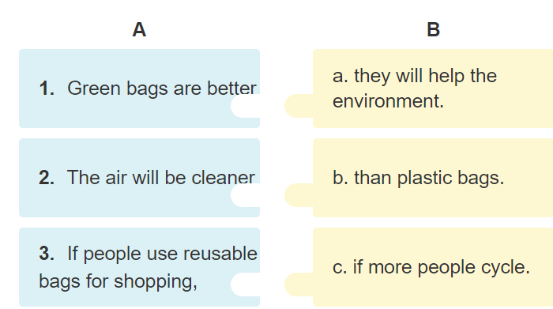
Based on the ideas in the conversation, match the first half of the sentence in column A with its second half in column B.

Slide 12

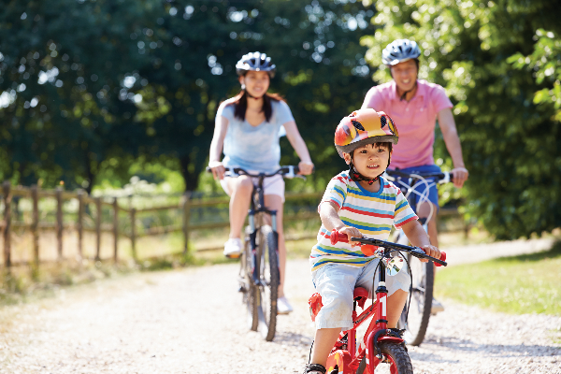
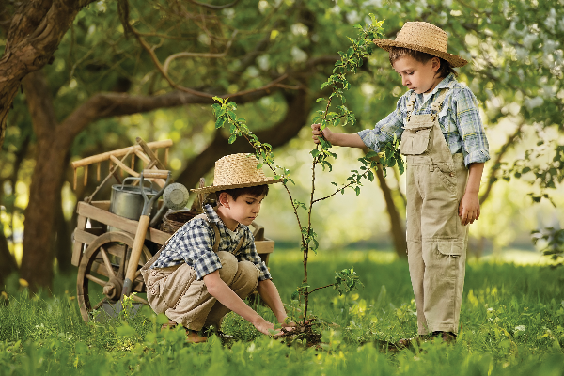
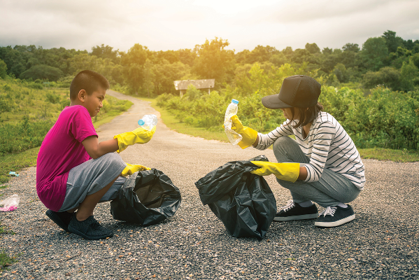
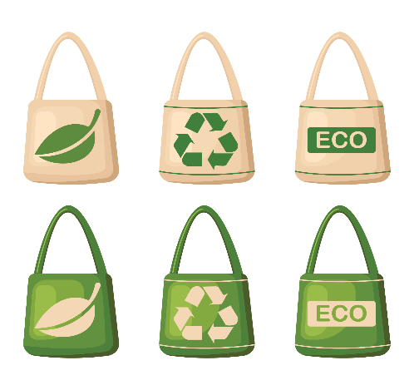
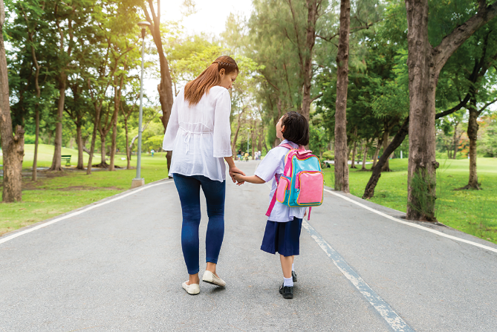
Match the pictures with the ways to help the environment.
1
2
3
planting trees and flower
picking up rubbish
d.
walking to school
a.
b.
e.
using reusable bags when shopping
c.
cycling
4
5

Slide 13


Find someone who ... Work in groups. Ask and answer to find someone who does the things in 4.
-plant trees and flowers -pick up rubbish -cycle -walk to school
-use reusable bags when shopping
A: Do you plant trees?
B: No, I don’t.
A: Do you pick up rubbish?
B: Yes, I do.

Slide 14


homework
- Learn by heart all the new words.
- Read the dialogue again.
- Prepare lesson 2 ( A closer look 1)

Slide 15




