Slide 1
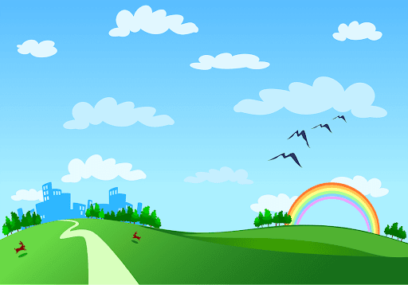
Good morning class!!!

Slide 2

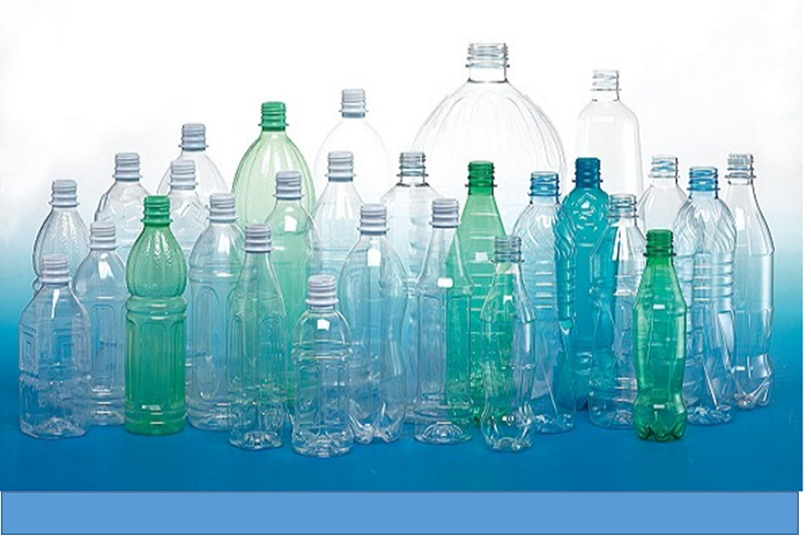
* WARM –UP
* Chatting:
- What should we do with this bottle?
→ We should reuse (recycle, reduce) it
- What advantages does a green world have?
→ Fresh air, healthy food, live longer, and so on

Slide 3




LESSON 2:
Vocabulary
Pronunciation

Slide 4
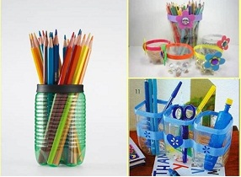
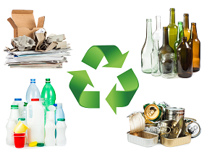

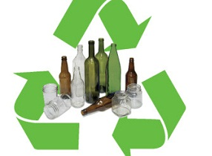
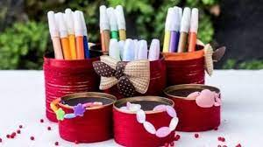
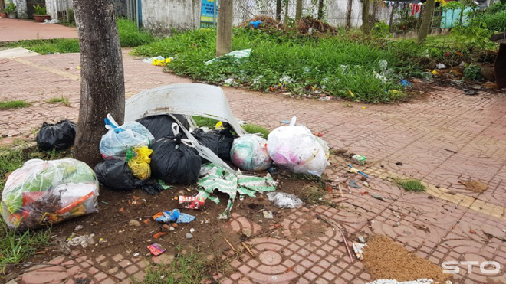
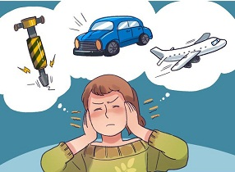
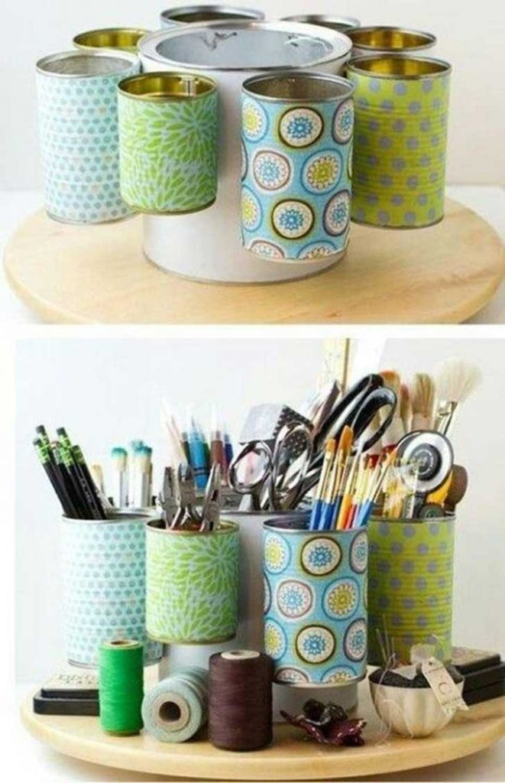
* Vocabulary:
- reuse /ˌriːˈjuːs/ (v) :
Sử dụng lại
- recycle (v) /ˌriːˈsaɪkl/:
tái chế
- reduce /rɪˈdjuːs/ (v):
giảm, dùng ít lại
- glass /ɡlɑːs/ (n):
thủy tinh,
- can /kæn/ (n):
vỏ đồ hộp, lon
- noise: noiz/ (n):
tiếng ồn
- rubbish /ˈrʌbɪʃ/ (n):
rác thải

Slide 5
* Checking vocab:
What and Where
rubbish
can
recycle
reduce
glass
reuse
noise

Slide 6




The three Rs stand for Reduce – Reuse – Recycle. Draw a line from a symbol in column A to its matching word in column B and its meaning in column C.
A | B | C
 | Reduce | using something again
 | Reuse | creating new products from used materials
 | Recycle | using less of something

Slide 7

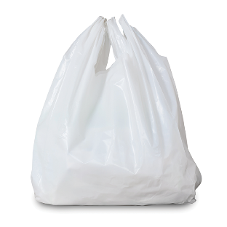
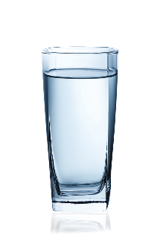
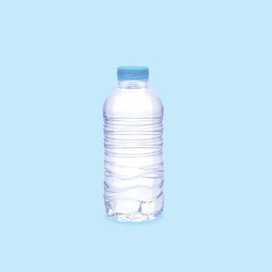
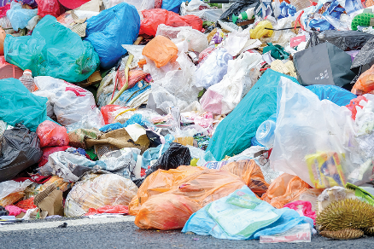

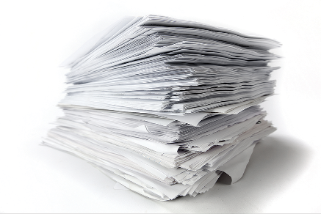

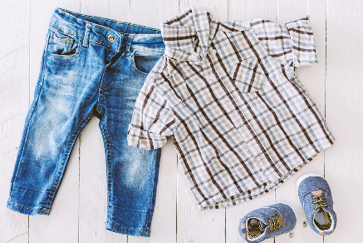
Write a word / phrase in the box under each picture.
rubbish
plastic bottle
glass
noise
plastic bag
paper
water
clothes

Slide 8
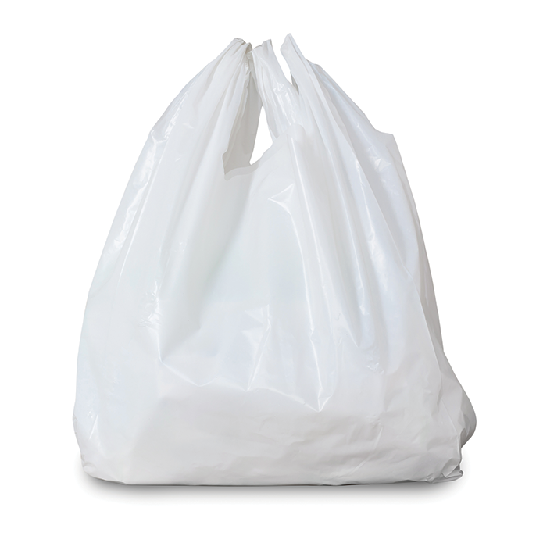

rubbish
plastic bottle
glass
noise
plastic bag
paper
water
clothes
1.
1. rubbish
2.
2. plastic bag

Slide 9
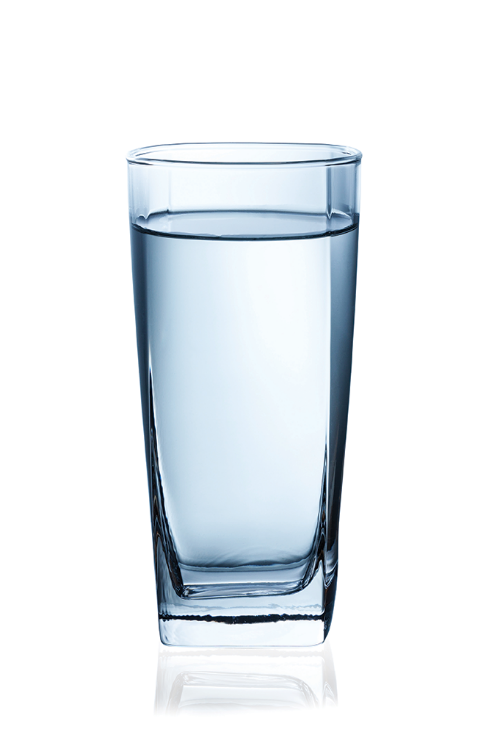
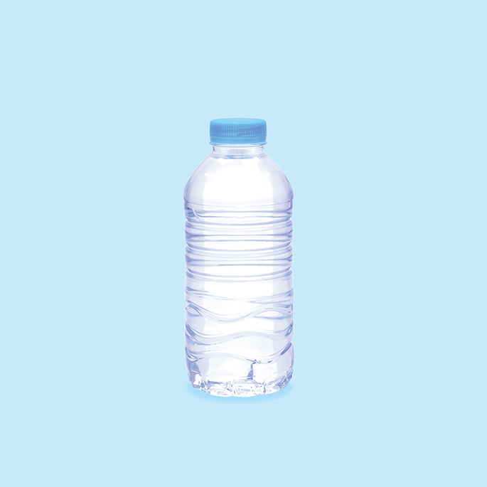
rubbish
plastic bottle
glass
noise
plastic bag
paper
water
clothes
3. glass
4. plastic bottle
3.
4.

Slide 10

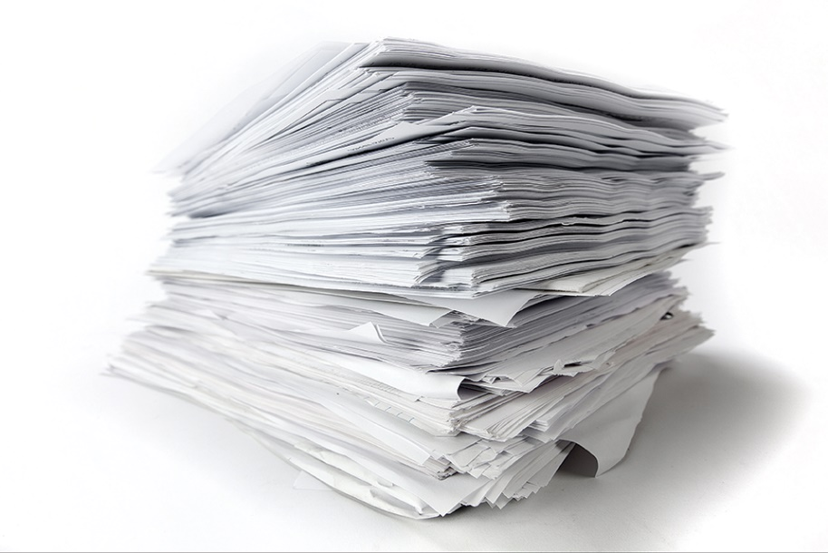
rubbish
plastic bottle
glass
noise
plastic bag
paper
water
clothes
5. noise
6. paper
5.
6.

Slide 11

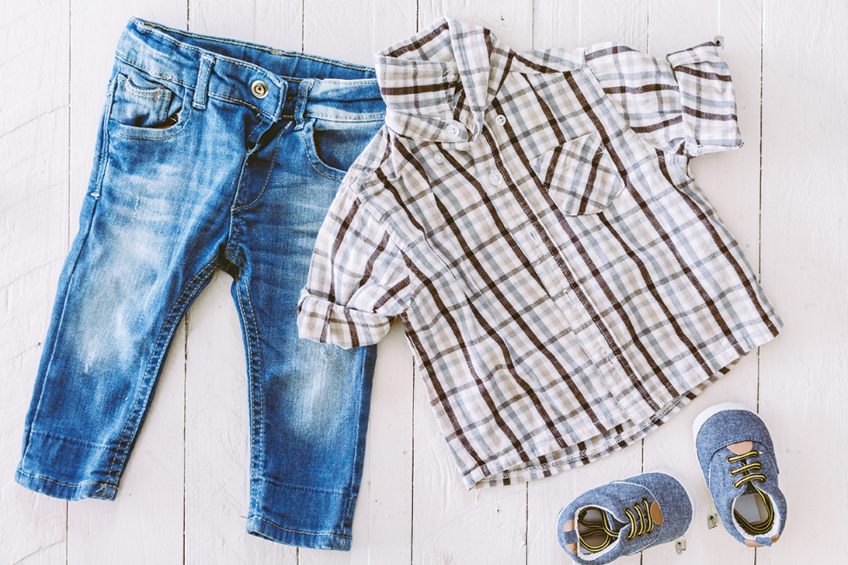
rubbish
plastic bottle
glass
noise
plastic bag
paper
water
clothes
7.
7. water
8.
8. clothes

Slide 12

Work in pairs. Put the words from 2 into groups. Some words can belong to more than one group.
rubbish
plastic bottle
glass
noise
plastic bag
paper
water
clothes
Reduce | Reuse | Recycle

Slide 13
Work in pairs. Put the words from 2 into groups. Some words can belong to more than one group.
Reduce | Reuse | Recycle
rubbish
plastic bag
rubbish
plastic bag
glass
plastic bag
noise
plastic bottle
glass
plastic bottle
paper
plastic bottle
paper
water
paper
water
clothes

Slide 14
Work in pairs. Put the words from 2 into groups. Some words can belong to more than one group.
Reduce | Reuse | Recycle
rubbish
plastic bag
rubbish
plastic bag
glass
plastic bag
noise
plastic bottle
glass
plastic bottle
paper
plastic bottle
paper
water
paper
water
clothes
Can you add more words to each group?
electricity
envelope
newspaper
gas
carton box
textbook
textbook
plastic container

Slide 15
* Pronunciation
Rhythm in sentences
(Nhịp điệu của câu)
In a sentence, the stressed and unstressed syllables combine to make rhythm.
Trong một câu, các âm tiết được nhấn trọng âm và không được nhấn trọng âm kết hợp với nhau để tạo thành nhịp điệu.

Slide 16


Listen to these sentences, then repeat.
Pay attention to the bold syllables.
1.
If you cycle, it’ll help the Earth.
2.
Water is good for your body.
3.
The students are planting trees in the garden.
4.
Is it better to use paper bags?
5.
We are happy to walk to school.

Slide 17

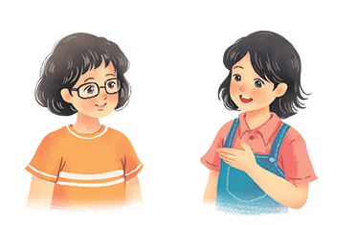
Listen to the conversation. Pay attention to the bold syllables. Then practise the conversation with a classmate.
Vy: What are you doing?
Mi: I’m writing an article about going green.
Vy: Great! I’m writing a poem about the 3Rs.
Mi: Let me read it.
Vy: I’m still writing. Wait for a minute.

Slide 18


Homework:
- Learn by heart all the new words.
- Create a poem and read it with correct rhythm
Prepare lesson 3 ( A closer look 2).

Slide 19

