Slide 1
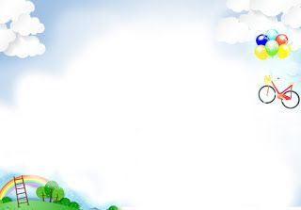

SONG VE SECONDARY SCHOOL
Hello every one !!!
love
NGUYỄN THỊ THU BA

Slide 2
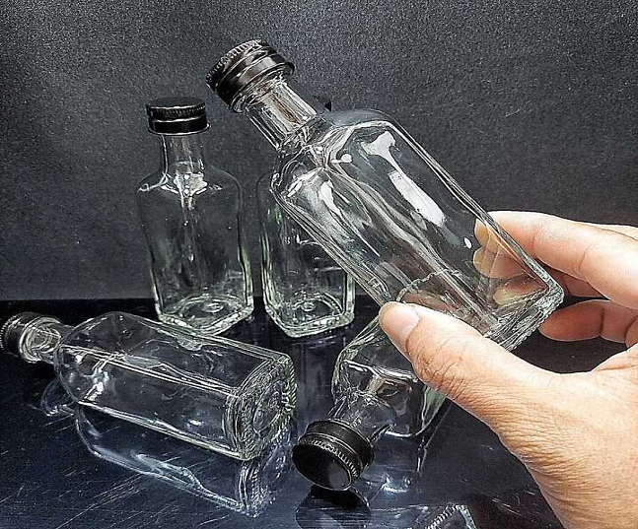
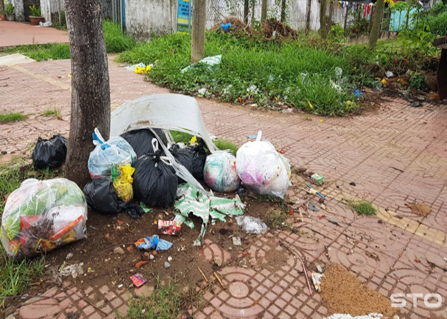
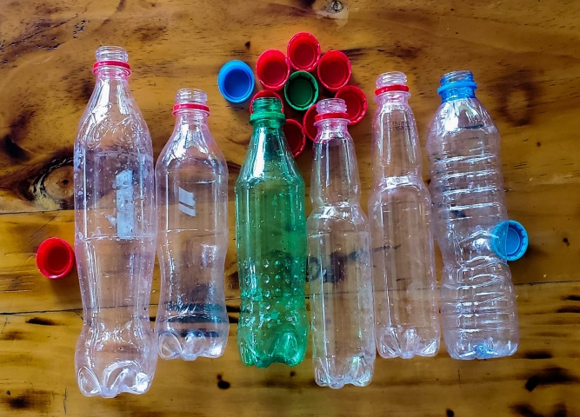

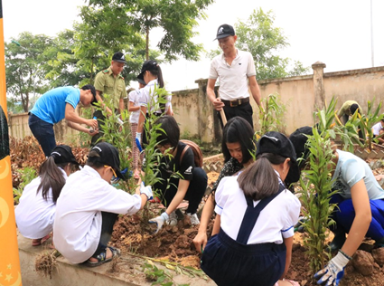
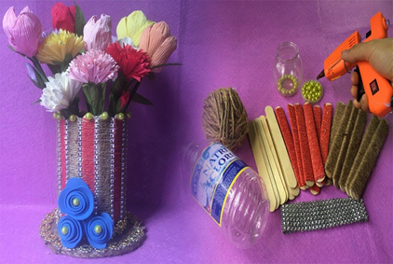
* Warm up:
Crossword puzzle
1
A
R
T
I
C
L
E
S
G | L | A | S | S
2
P | A | P | E | R
3
P | L | A | S | T | I | C
4
R | U | B | B | I | S | H
5
R | E | C | Y | C | L | E
6
W | A | L | K
7
T | R | E | E
8
R | E | U | S | E
K
1. The bottles are made of ………………
2. I need ……..and a pen to write a letter.
3. The bottle is made of ………………
4. we should reduce the amount of ………... that we use every day.
5. What icon is this?
6. My house is near the school so I often………. to school
7. We plant green …………in the school yard.
8. We often …… old bottles to make flower vases.

Slide 3




Slide 4


LESSON 3:
Grammar
- Articles
- First conditional

Slide 5

I. Grammar 1
* Articles
* There are two kinds of articles in English.
1. Indefinite article: a/ an
1. Indefinite article: a/ an
+ We use a/an with singular countable nouns when we are talking about them in general.
Example: An ant is a tiny animal.
+ after the verbs to be and to have.
Example: I'm a student. / I have an eraser.
* a + consonant sound
Eg: a bag , a pen,…
* an+ vowel sound (u, e, o,a,i) ( uể oải)
Eg. an apple. an island,…
2. Definite article: the
+ We use the with singular or plural nouns when we already know them or when they are mentioned for the second time.
Example: The bike in front of her house is nice.
+ with nouns which are unique.
Example: The air is dirty.
2. Definite article: the

Slide 6

Write a or an.
1. an egg
2. a friend
3. a sink
4. an arm
5. a mouth
6. an onion
7. an umbrella (một cái ô/ cây dù)
8. a classmate (một người bạn học cùng lớp)

Slide 7
Write a or an.
____ mouth
___ egg
5.
a
1.
an
___ friend
a
an
2.
6.
____ onion
___ sink
____ umbrella
3.
a
7.
an
an
a
4.
___ arm
8.
____ classmate

Slide 8

Write a / an or the .
1. My father is ......... doctor.
2. ..............Sun keeps........ Earth warm.
3. ............ dolphin is intelligent animal.
4. I have ............. orange shirt too.
5. My brother likes blue pen, not......... red one.

Slide 9
Write a / an or the .
a
1. My father is …….doctor.
2. …… Sun keeps ……Earth warm.
3. ….. dolphin is ......intelligent animal.
4. I have ……orange shirt too.
5. My brother likes …… blue pen, not ….. red one.
The
the
A
an
an
the
the

Slide 10

PRODUCTION
Choose the best answer

Slide 11


5
4
1
1. I want ______ cup of tea.
3
2
a. a
b. an
c. the

Slide 12
5
2. I need someone who can play _____guitar, I'll sing a song now.
2. I need someone who can play……… guitar, I'll sing …… song now.
4
1
3
2
a. the - an
b. the - the
c. the - a

Slide 13
5
3. ___ sky is very clear tonight.
I can see a lot of stars..
4
1
3
2
a. The
b. A
c. An

Slide 14
5
4. He has ______ unusual name.
4
1
3
2
b. the
b. a
c. an

Slide 15
5
5. They have a son and ….. daughter. _____ daughter is very kind.
4
1
3
2
a. A - an
b. A - a
c. A - the

Slide 16
5
6. My mother is ______ professional athlete.
4
1
3
2
a. the
b. a
c. an

Slide 17
II. Grammar 2
Might for future possibility
First conditional sentences describe things which are possible and likely to happen in the present or the future.
If -clause | Main clause
If + S + V(present simple), | S + will + V
Example:
If you use less paper, you will save a lot of trees.
- If we are friendlier to the environment, we won’t have to suffer from pollution.

Slide 18

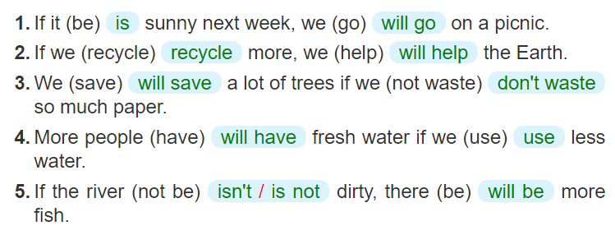
Write the correct form of each verb in brackets.

Slide 19

Combine each pair of sentences below to make a first conditional sentence.
1.
The air isn’t fresh. People cough.
If the air isn't fresh, people will cough.
2.
The water is dirty. A lot of fish die.
If the water is dirty, a lot of fish will die.
3.
We cut down trees in the forest. There are more floods.
If we cut down trees in the forest, there will be more floods.
4.
There is too much noise. People don’t sleep.
If there is too much noise, people will not / won't sleep.
5.
There is no water. Plants die.
If there is no water, plants will die.

Slide 20
* Extra exercise:
Make the first conditional
1.If I (finish)………a bottle of water, I (put).… …… .it into the recycling bin.
2. Many fishes (die)…..…….. if the river (be)…...polluted.
3. People (help)…………..the environment if they (walk) …….or cycle more.
4.If my brother (smoke) ………. in public, I (remind)… ………. him not to do that again.
5.People's health (be) ………. better if the air (be) ….. cleaner.
finish
will put
will die
is
will help
walk
smokes
will remind
will be
is

Slide 21


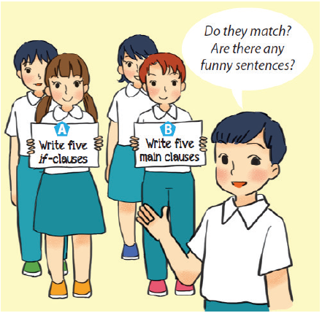
Fun matching
Work in groups, A and B.
Group A secretly writes five if-clauses on a sheet of paper.
Group B secretly writes five main clauses on another sheet of paper.
Match the if-clauses with the main clauses.
Do they match? Are there any funny sentences?

Slide 22
* Homework
Learn new words by heart.
Practise the exercises again.
Prepare: Comunication

Slide 23

Thank you!
Have a nice day!

