Slide 1


SONG VE SECONDARY SCHOOL
Hello every one !!!
love
NGUYỄN THỊ THU BA

Slide 2

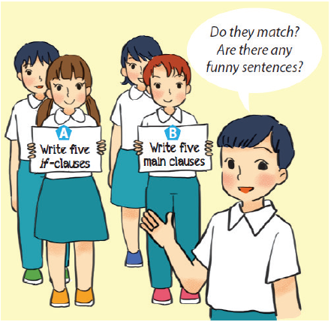

Fun matching
Work in groups, A and B.
Group A secretly writes five if-clauses on a sheet of paper.
Group B secretly writes five main clauses on another sheet of paper.
- Match the if-clauses with the main clauses.
- Do they match?
- Are there any funny sentences?

Slide 3

Giving warnings

Slide 4



LESSON 4:
* Everyday English
→ Giving warnings
* A survey on ways to go green

Slide 5



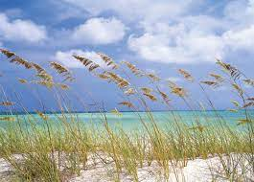
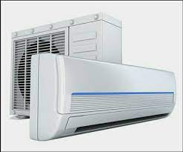


* Vocabulary
- Warning (n) /ˈwɔː.nɪŋ/:
- do a survey /ˈsɜːveɪ/ :
- Breeze (n) /briːz/:
- Air conditioner (n)
- Throw away (v):
- Decorate (v):
- Turn on (v):
Lời cảnh báo
làm một cuộc khảo sát
Làn gió nhẹ lướt qua
Điều hòa
Vứt đi , quẳng đi
Trang trí
Bật lên

Slide 6
* Checking Vocabulary
- Warning (n):
- do a survey :
- Breeze (n) :
- Air conditioner (n)
- Throw away (v):
- Decorate (v):
- Turn on (v):
Lời cảnh báo
làm một cuộc khảo sát
Làn gió nhẹ lướt qua
Điều hòa
Vứt đi , quẳng đi
Trang trí
Bật lên

Slide 7


Listen and read the dialogue between Mi and Mike. Pay attention to the highlighted sentences.
Mi: You are giving the goldfish too much food.
Don’t do that.
Mike: Why?
Mi: If you give them too much food, they will die.
Mike: I see. Thank you.

Slide 8

Work in pairs. Student A is watering ﬂowers in the garden. Student B is giving some warnings. Act out the dialogue. Remember to use the highlighted language in 1.
Example:
A: You are giving too much water to the flowers. Don’t water them too much!
B: Why?
A: If you give them too much water, they will die.
B: I see. Thank you.

Slide 9


A survey on ways to go green
The 3Rs Club in your school is doing a survey. Answer the following questions by choosing A, B, or C.

Slide 10
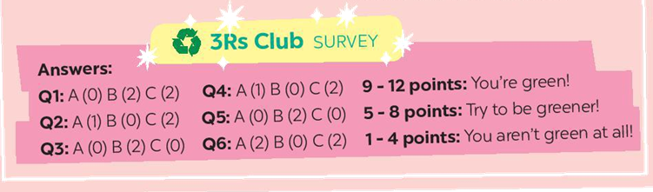
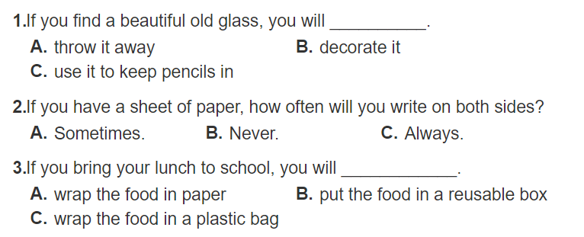

Slide 11
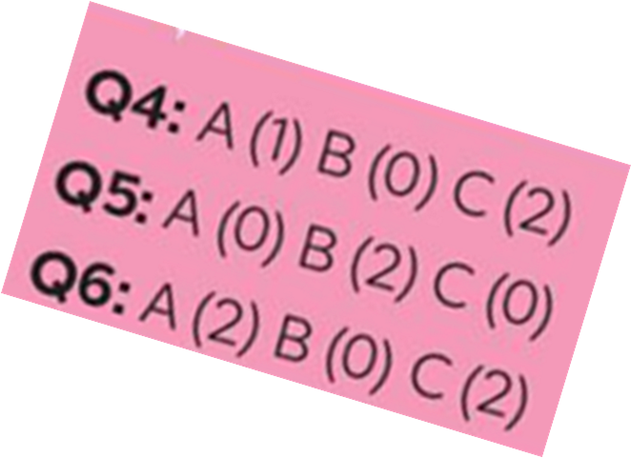
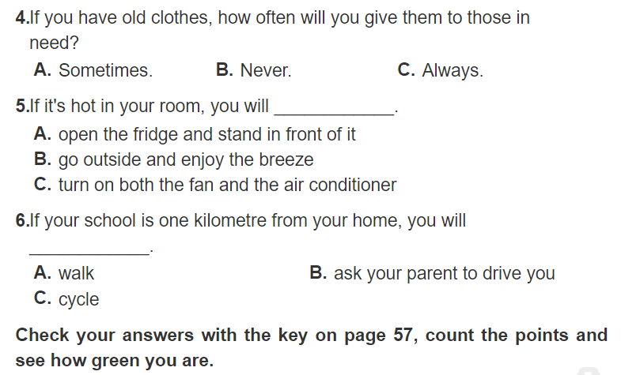

Slide 12

Check your answers with the key on page 57, count the points and see how green you are.
* Answer key:
Q1: A(0) B(2) C(2)
Q2: A(1) B(0) C(2)
Q3: A(0) B(2) C(0)
Q4: A(1) B(0) C(2)
Q5: A(0) B(2) C(0)
Q6: A(2) B(0) C(2)
9-12 points: You’re green!
5-8 points: Try to be green!
1-4 points: You aren’t green at all!

Slide 13

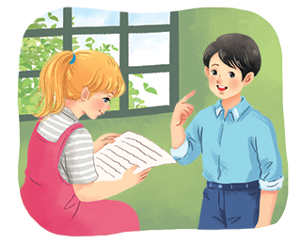
Interview a classmate, using the questions in 3. Compare your answers. How many different answers do you have?
Example:
A: What’s your answer to Question 1?
B: It’s A. What’s your answer?
...
Notes:
City landmarks phải ở trên mục 3

Slide 14
A: What’s your answer to Question 1?
B: It’s C. What’s your answer?
A: My answer is A. What’s your answer to Question 2?
B: It’s C. What’s your answer?
A: Oh, me too. What’s your answer to Question 3?
B: It’s B. What’s your answer?
A: Well, I choose A.

Slide 15
HOMEWORK
- Learn by heart new words
- Review some exercises.
- Prepare lesson 5 (Unit 11 Skills 1)

Slide 16

Goodbye.
See you again

