Slide 1
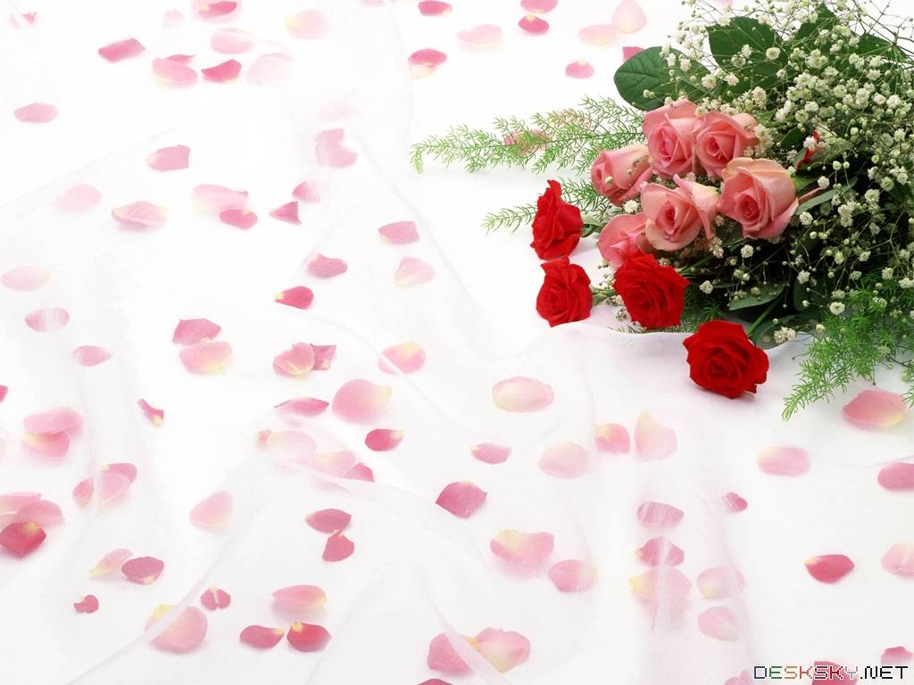
ENGLISH 6
HELLO EVERY ONE !!!

Slide 2
Warm up:
Game: Pelmanism
Match words with their meaning.
PROTECT
LÀM GIẢM
2
RECYCLE
3
REUSE
1
4
REDUCE
6
7
BẢO VỆ
ENVIRON-MENT
RUBBISH
5
8
9
10
RÁC THẢI
TÁI CHẾ
SỬ DỤNG LẠI
11
MÔI TRƯỜNG
12

Slide 3



Slide 4


LESSON 5:
* Reading
* Speaking

Slide 5

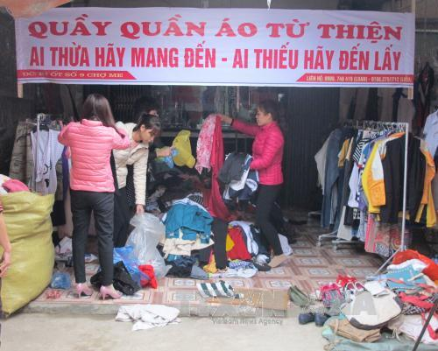

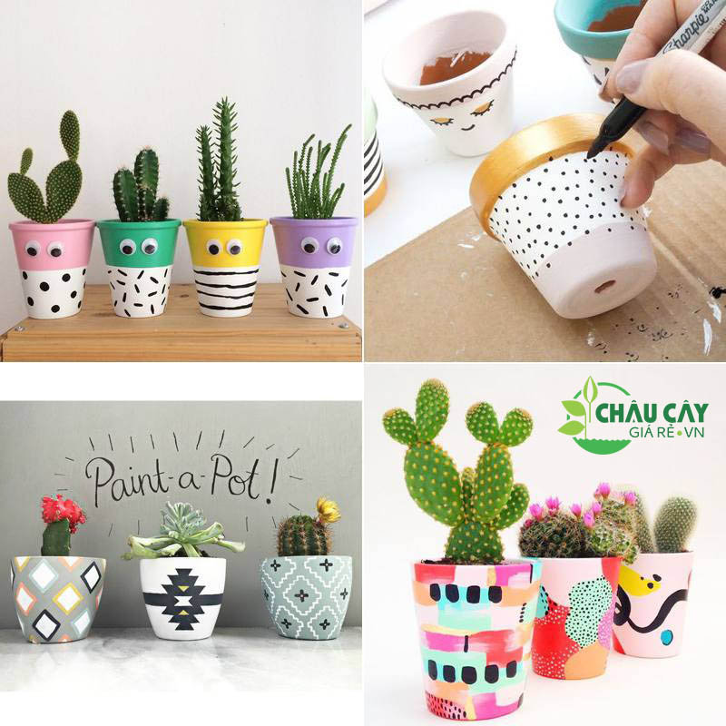

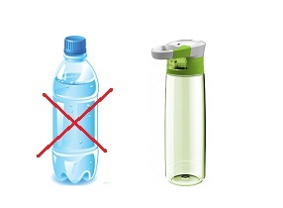
* Vocabulary
- instead of (prep) /ɪnˈsted əv/:
- charity (n) /ˈtʃær.ɪ.ti/:
- recycling bins (n) /ˌriːˈsaɪ.kl̩ng/:
- creative (a) /kriˈeɪ.tɪv/:
- exchange (v)/ɪksˈtʃeɪndʒ/=swap (v)
- reusable (a) /riˈjuː.zə.bl̩/:
thay vì
từ thiện
thùng rác tái chế
có tính sáng tạo
trao đổi
có thể sử dụng lại

Slide 6

* Checking vocab .
Say word in EL
Thay vì
instead of
Sáng tạo
creative
Từ thiện
charity
Trao đổi
exchange/ swap
Trao đổi
reusable
Có thể sử dụng lại
Thùng rác tái chế
recycling bins

Slide 7

I. Reading
A reporter is interviewing Nam, a member of the 3Rs Club. Read the interview. Find these words or phrases and underline them.
Reporter: Can you share with us some tips to make your school greener?
Nam: Sure. Firstly, we put recycling bins in every classroom.
Reporter: What about old books and uniforms?
Nam: We exchange them with our friends or give them to charity. We don’t throw them away.
Reporter: Anything else?
Nam: We borrow books from the school library instead of buying new ones.
Reporter: Great! You can save much paper.
Nam: And there’s another tip. We bring reusable water bottles to school. Reporter: I see lots of trees in your school. Is planting trees a good tip?
Nam: Yeah. It makes our school greener.
Reporter: Thanks for sharing. Do you want to add anything?
Nam: Finally, we usually find creative ways to reuse old items before throwing them away.
...

Slide 8
I. Reading
A reporter is interviewing Nam, a member of the 3Rs Club. Read the interview. Find these words or phrases and underline them.
instead of
exchange
recycling bins
reusable
charity

Slide 9
instead of
exchange
recycling bins
reusable
charity
Reporter: Can you share with us some tips to make your school greener?
Nam: Sure. Firstly, we put recycling bins in every classroom.
Reporter: What about old books and uniforms?
Nam: We exchange them with our friends or give them to charity. We don’t throw them away.
Reporter: Anything else?
Nam: We borrow books from the school library instead of buying new ones.
Reporter: Great! You can save much paper.
Nam: And there’s another tip. We bring reusable water bottles to school. Reporter: I see lots of trees in your school. Is planting trees a good tip?
Nam: Yeah. It makes our school greener.
Reporter: Thanks for sharing. Do you want to add anything?
Nam: Finally, we usually find creative ways to reuse old items before throwing them away.
...

Slide 10

Match the words / phrases with their meanings.
a. give something to a person and receive something from him / her
1. instead of
b. can be used again
2. charity
3. exchange
c. containers for things that can be recycled
4. reusable
d. giving things to people in need
5. recycling bins
e. in the place of somebody or something
* Answer key:
1. e 2. d 3. a 4 . b 5. c

Slide 11

Read the text again. Answer the questions.
1.
What is the interview about?
2.
What will they put in every classroom?
3.
What can they do with their old uniforms?
4.
What do they do instead of buying new books?
5.
What type of water bottles do they bring to school?

Slide 12
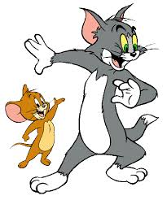
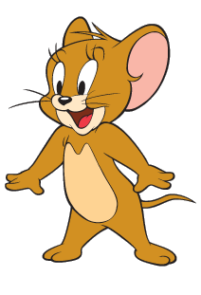
Questions: Lucky numbers
1
2
3
4
5
6
7
8

Slide 13

Read the text again. Answer the questions.
1. What is the interview about?
→Ways to become greener at school

Slide 14
Read the text again. Answer the questions.
2. What will they put in every classroom?
→ Recycing bins

Slide 15
Read the text again. Answer the questions.
3. What can they do with their old uniforms?
→Exchange old uniforms with friends or give them to charity

Slide 16
Read the text again. Answer the questions.
4. What do they do instead of buying new books?
→ Borrow books from the library

Slide 17
Read the text again. Answer the questions.
5. What type of water bottles do they bring to school?
→ Reusable water bottles

Slide 18


LUCKY NUMBER!
YOU GET A GIFT

Slide 19

LUCKY NUMBER!
you get 2 plus points

Slide 20
LUCKY NUMBER!
you get 2 plus points

Slide 21
Read the text again. Answer the questions.
1.
What is the interview about?
Ways to become greener at school.
2.
What will they put in every classroom?
Recycing bins.
3.
What can they do with their old uniforms?
Exchange old uniforms with friends or give them to charity.
4.
What do they do instead of buying new books?
Borrow books from the library.
5.
What type of water bottles do they bring to school?
Reusable water bottles.

Slide 22

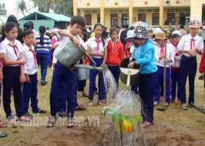
II.Speaking
*Some tips to make your school greener

Slide 23

II. Speaking
Nam mentions the following tips in the interview. Work in groups and discuss to put the tips in order from the easiest to the most difficult.
a.
Putting recycling bins in every classroom.
5
b.
Exchanging old books and uniforms with friends or giving them to charity.
3
c.
Borrowing books from the school library instead of buying new ones.
4
d.
Bringing reusable water bottles to school.
1
e.
6
Planting trees at school.
f.
Finding creative ways to reuse old items before throwing them away.
2
Can you add more tips to the list?

Slide 24

Tip f tells you to find creative ways to reuse old items. Can you think of any ways to reuse
a.
used gift wrap?
b.
used water bottles?
c.
used books?

Slide 25
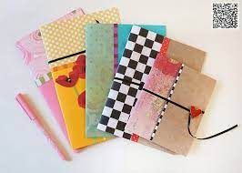
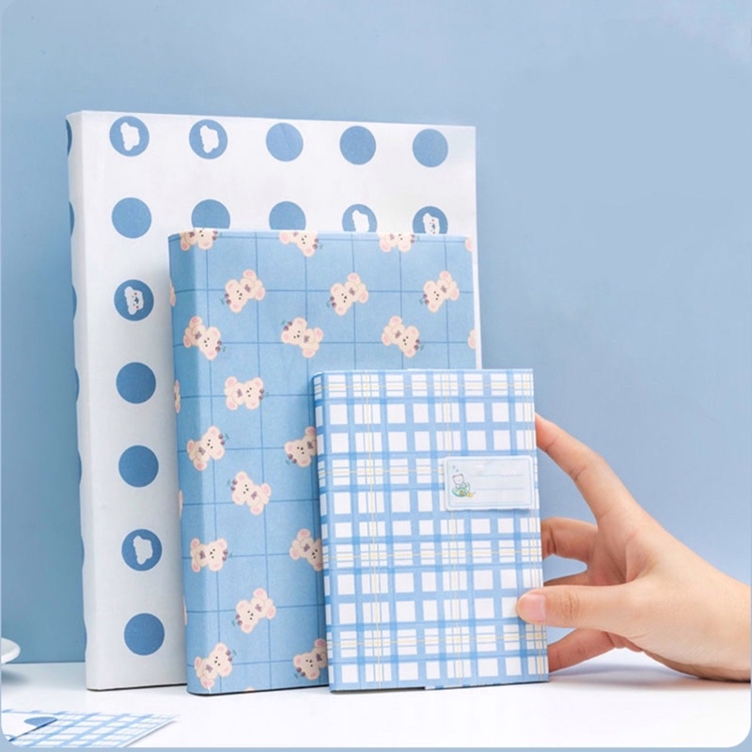
Tip f tells you to find creative ways to reuse old items. Can you think of any ways to reuse
a.
used gift wrap?
a. We can use used gift wrap to cover books, notebooks, cut them into beautiful shapes to decorate houses.

Slide 26
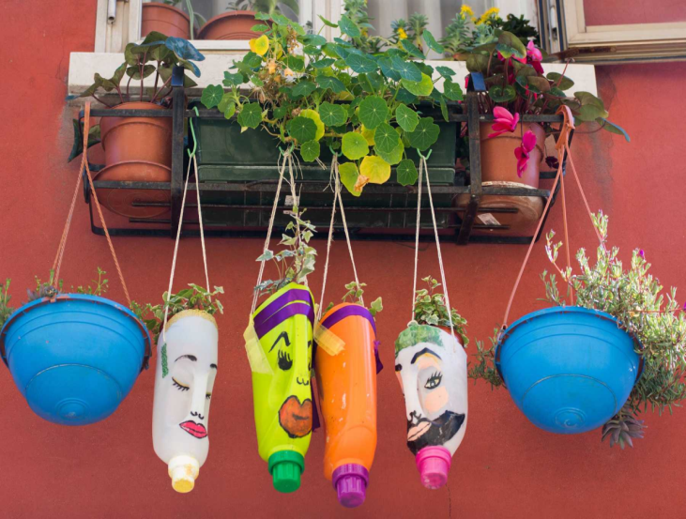
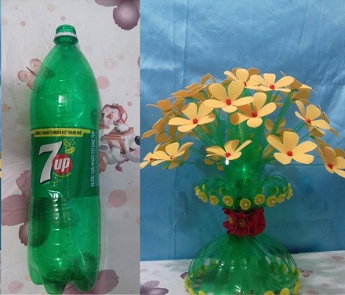
Tip f tells you to find creative ways to reuse old items. Can you think of any ways to reuse
b.
used water bottles?
We can use used water bottles to plant trees, keep pens, make toys.

Slide 27
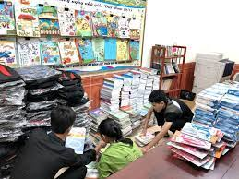
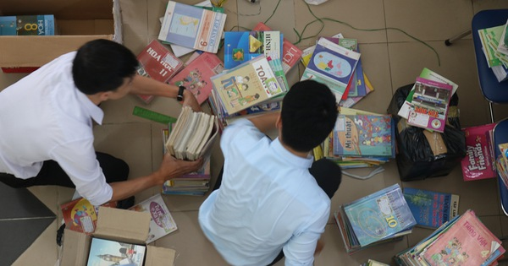
Tip f tells you to find creative ways to reuse old items. Can you think of any ways to reuse
c.
used books?
We can use used books to wrap things, give them to the school library or the local library.

Slide 28

HOMEWORK
Do Ex in WB
Find creative ways to reuse old items
- Prepare: Skills 2

Slide 29

Goodbye!
See you again
Thank you!
Have a nice day!

