Slide 1
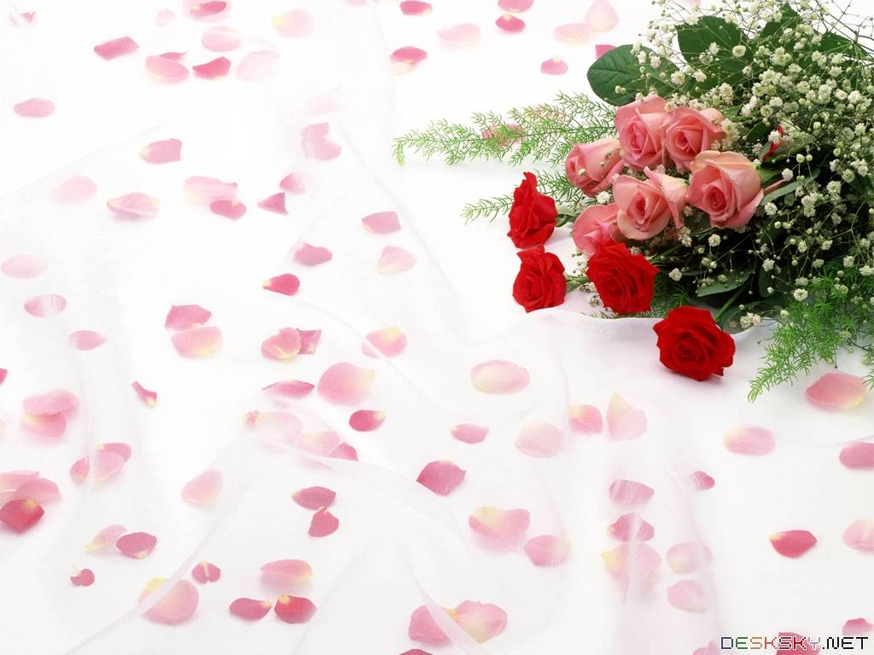

English 6
Song Ve Secondary School
MRS THU BA

Slide 2
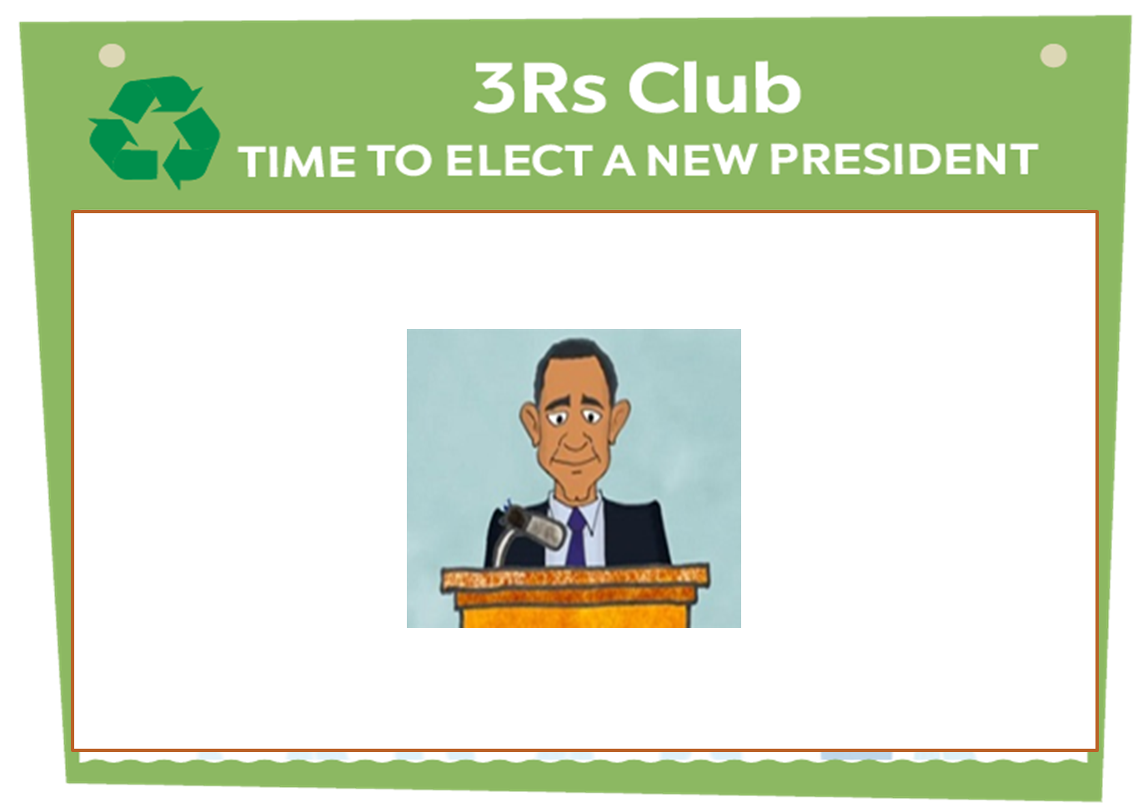
* WARM – UP:
Brainstorming
What are the necessary qualities of the club president ?
active
creative
confident
good knowledge,
patient
funny
responsible
friendly
disciplined
,, t,,,,, ….

Slide 3



LESSON 6:
* Listening
* Writing

Slide 4
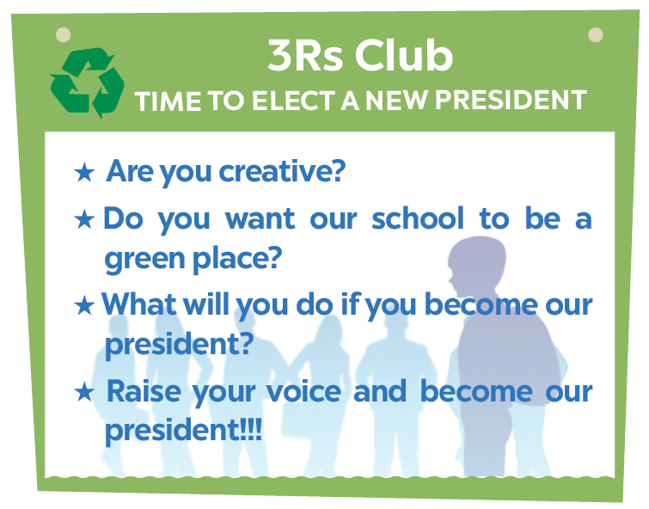
I. Listening

Slide 5


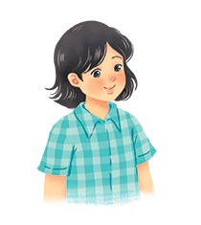
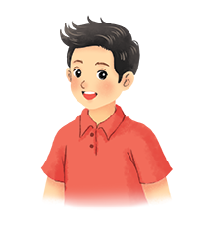
Listen to two students talking about what they will do if they become the president of the 3Rs Club. Fill each blank with a word or a number.
Mi
Nam

Slide 6
Name | Mi
Class | (1)
Ideal 1 | Putting a (2) bin in every classroom
Ideal 2 | Having (3) fairs
6A
recycling
book
Audio script

Slide 7
AUDIO SCRIPT
Mi: I'm Mi from class 6A. If I become the president of the Club, I'll first talk to my friends about putting a recycling bin in every classroom. We can reuse the things we have in these bins. Secondly, I'll organise some book fairs. Students can exchange their used books at these fairs.

Slide 8
Name | Nam
Class | (4)
Ideal 1 | Encouraging students to use (5)
Ideal 2 | Organising (6) fairs
6E
bus
uniform
Audio script

Slide 9
AUDIO SCRIPT
Nam: I'm Nam from class 6E. If I become the president of the Club, I'll encourage students to go to school by bus. It'll be fun and help the environment. Next, I'll organise some uniform fairs. This is where students can exchange used uniforms with other students.

Slide 10

Listen again and tick () T (True) or F (False).
 | T | F
1. Mi thinks they can recycle things in the bins.
2. At book fairs, students can exchange their old books.
3. Nam thinks students will save money if they go to school by bus.
4. Students can exchange their used uniforms at uniform fairs.




Audio script

Slide 11
AUDIO SCRIPT
Mi: I'm Mi from class 6A. If I become the president of the Club, I'll first talk to my friends about putting a recycling bin in every classroom. We can reuse the things we have in these bins. Secondly, I'll organise some book fairs. Students can exchange their used books at these fairs.
Nam: I'm Nam from class 6E. If I become the president of the Club, I'll encourage students to go to school by bus. It'll be fun and help the environment. Next, I'll organise some uniform fairs. This is where students can exchange used uniforms with other students.

Slide 12


II. Writing
Interview a classmate. Ask him/ her what two things he / she will do if he / she becomes the president of the 3Rs Club. Take notes below.
Name ....................................................
Idea 1 ...................................................
Idea 2 ...................................................
Study Skill - Writing
Giving explanations and / or examples is an important writing skill.
You should give explanations and / or examples to support your ideas.
Example:
Secondly, I’ll organise some book fairs. At these events students can exchange their used books.

Slide 13
Interview a classmate. Ask him/ her what two things he / she will do if he / she becomes the president of the 3Rs Club. Take notes below.
Example:
Name: Vy
Idea 1: encourage students to go to school by bike or bus .
Idea 2: find creative ways to reuse old items instead of throwing them away .
→Firstly I will encourage students to go to school by bike or bus (idea). It will be very friendly to the environment (explanation).
→ Secondly, I will find creative ways to reuse old items instead of throwing them away (idea). For example, I will use wine bottles to make lights or flower vases (example).

Slide 14

Write a paragraph about your classmate’s ideas in 3. Write about 50 words.
My classmate is _________________. If _______ becomes the president of the 3Rs Club, ______ will do two things. Firstly, ________________________

Slide 15
* Model writing - 1:
My classmate is Vy If she becomes the president of 3Rs Club. She will do two things. Firstly, she will encourage students to go to school by bike or bus. It will be very friendly to the environment. Secondly, she will organise recycling clubs and call students to join. In this club, they will make beautiful and helpful things from old things or recycled things. I think she will be a good club president.

Slide 16
* Model writing -2:
My classmate is Nam. If he becomes the president of the 3Rs Club, he will do two things. Firstly, he will talk to his friends about growing vegetables in the school garden. The school will become greener. Secondly, he will hold uniform fairs. We can exchange our used uniforms. We can save money and the environment. I think he will be a good president.

Slide 17
* Homework
- Rewrite the writing in the notebook.
- Prepare “ Looking back and project”.

Slide 18

Goodbye!
See you again!

