Slide 1
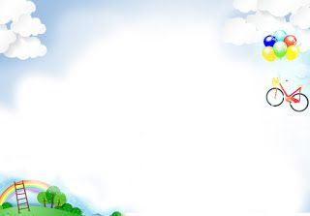

SONG VE SECONDARY SCHOOL
Hello every one !!!
love
NGUYỄN THỊ THU BA

Slide 2

* Game : Review Vocabulary
List some things that we can reduce, reuse or recycle
to save the environment:
reuse
Reduce
Recycle

Slide 3
* Game : Brainstorming
PAPER
ELECTRICITY
GAS
REDUCE
WATER
RUBBISH
SMOKE AND EXHAUSE FUME

Slide 4
PLASTIC BAG
Plastic / glass
BOTTLE
CAN
REUSE
ENVELOPES
LIGHT BULB
PAPER

Slide 5
PLASTIC BAG
BOOK
PLASTIC BOTTLE/BOX
RECYCLE
CAN
USED PAPER
GLASS

Slide 6




LESSON 7

Slide 7


* Grammar
Write a / an or the.
a
1. If I see .......... dog, I will run away.
2. Does your town have ............ at gallery?
3. ................. Moon is bright tonight.
4. There is a big temple in the town............ temple is very old.
5. - Is your mother............. teacher?
- No, she isn't. She's ........... artist.
an
The
The
a
an

Slide 8

Write the correct form of each verb in brackets.
1. If they (build) .......... an airport here, it (be) ............ very noisy.
2. People (save) ……........... the environment if they (reuse) .......... old items.
3. If we (grow) ............trees, our school (be) …........... greener.
4. If we (not have)…................. enough food. We (be) …......... hungry.
5. If we (be)............ hungry, we (be)…….. ...... tired.
build
will be
will save
reuse
grow
will be
don’t have
will be
are
will be

Slide 9

Combine each pair of sentences below to make a first conditional sentence.
1.
We walk or cycle. We are healthy.
If we walk or cycle, we will be healthy.
2.
We use the car all the time. We make the air dirty.
If we use the car all the time, we will make the air dirty.
3.
You reuse paper. You save trees.
If you reuse paper, you will save trees.
4.
You make noise. Your sister doesn’t sleep.
If you make noise, your sister will not / won’t sleep.
5.
I see a used bottle on the road. I put it in the bin.
If I see a used bottle on the road, I will put it in the bin.

Slide 10
* Production
* Complete the following sentences using the first conditional and the following verbs:
not get , have, throw, put, decrease, turn off
1. If all people ………. the garbage on the roads , the Earth will be flooded in the garbage.
2.The pollution……… if we find ways to reuse old items.
3. If Trung brings his lunch to his picnic, he…...…the food in a reusable box.
4. If I leave a room, I….…the lights and the fans.
5. You ……………a high mark in the exam tomorrow if you don't do all of your homework.
6. If Hoa …………old books and clothes, she will swap them with me.
Game :
Lucky number

Slide 11
LUCKY NUMBER!
1
2
3
4
5
6
7
8

Slide 12
* Complete the following sentences using the first conditional and the following verbs:
not get , have, throw, put, decrease, turn off
1. If all people ….………. the garbage on the roads , the Earth will be flooded in the garbage.
throw

Slide 13
* Complete the following sentences using the first conditional and the following verbs:
not get , have, throw, put, decrease, turn off
will decrease
2.The pollution…………….. ….if we find ways to reuse old items.

Slide 14
* Complete the following sentences using the first conditional and the following verbs:
not get , have, throw, put, decrease, turn off
3. If Trung brings his lunch to his picnic, he…...……the food in a reusable box.
will put

Slide 15
* Complete the following sentences using the first conditional and the following verbs:
not get , have, throw, put, decrease, turn off
4. If I leave a room, I….……......the lights and the fans.
will turn off

Slide 16
* Complete the following sentences using the first conditional and the following verbs:
not get , have, throw, put, decrease, turn off
won’t get
5. You …………a high mark in the exam tomorrow if you don't do all of your homework.

Slide 17
* Complete the following sentences using the first conditional and the following verbs:
not get , have, throw, put, decrease, turn off
6. If Hoa …….old books and clothes, she will swap them with me.
has

Slide 18

LUCKY NUMBER!
you get 2 plus points

Slide 19
LUCKY NUMBER!
you get 2 plus points

Slide 20



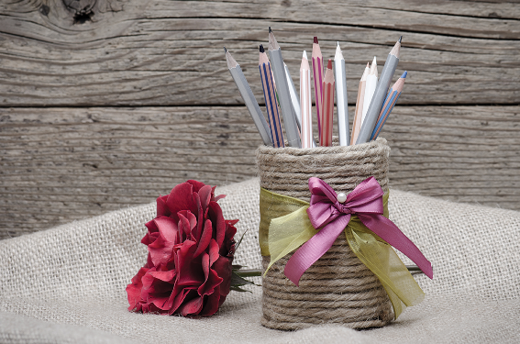
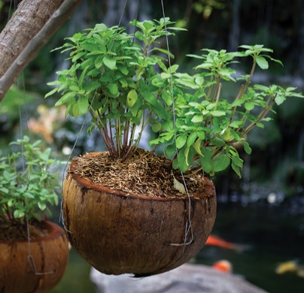


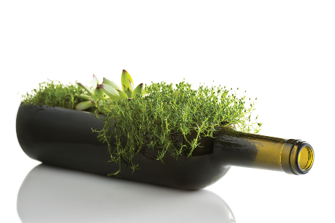
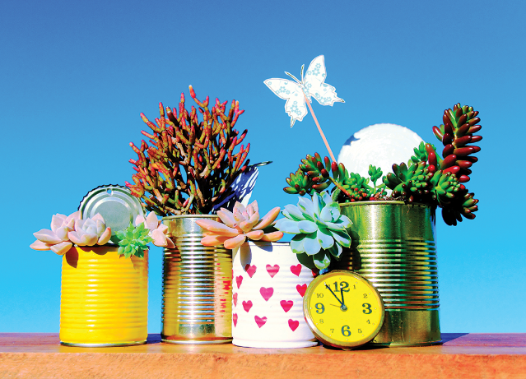

What can you see in each picture? What did people use to make the things in the pictures?
Now work in pairs or in groups to complete the project.
Choose a used object (a bottle, a sheet of paper, etc.).
Make something new from it and decorate it.
Bring it to class.
Do a “show and tell” about it.
Listen to other presentations and decide which is the best.

Slide 21
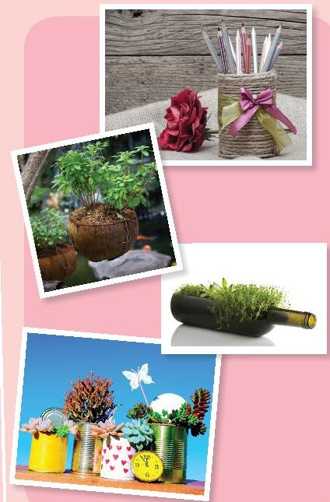
1. In the first picture, I can see a beautiful bookcase with many pens inside.
2. In the second picture, I can see small trees inside coconut shells.
3. In the third picture, I can see beautiful flower vases made from tins.

Slide 22


Answers:
Q1: A (0) B (2) C (2)
Q4: A (1) B (0) C (2)
9 - 12 points: You’re green!
Q2: A (1) B (0) C (2)
Q5: A (0) B (2) C (0)
5 – 8 points: Try to be greener!
Q3: A (0) B (2) C (0)
Q6: A (2) B (0) C (2)
1 – 4 points: You aren’t green at all!

Slide 23


homework
- Revise vocab and grammars of unit 11
- Make Project: “Creative ideas about reusing old things. ”
- Prepare Unit 12 ( Getting started).

Slide 24
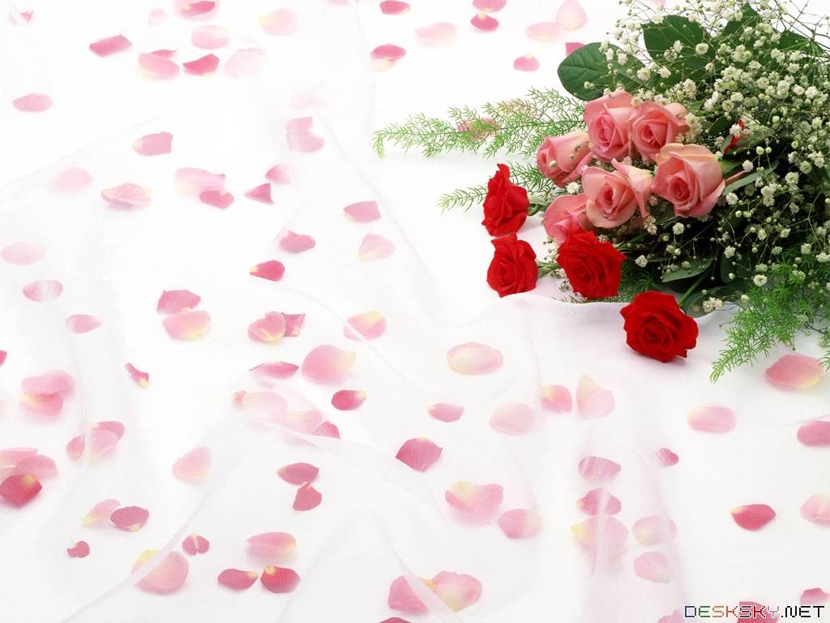
Goodbye.
See you again

Slide 25
Now I can … |  |  | 
use the words for things that can be reduced, reused and recycled.
say sentences with correct rhythm.
use the articles correctly.
use the first conditional to talk about possibilities.
give warnings.
read about ways to go green.
talk about tips for going green.
listen about ideas for a green club.
write a paragraph about ideas for a green club.
✓
✓
✓
✓
✓
✓
✓
✓
✓
✓
✓
✓
✓
✓
✓
✓
✓
✓
✓
✓
✓
✓
✓
✓
✓
✓
✓

Slide 26

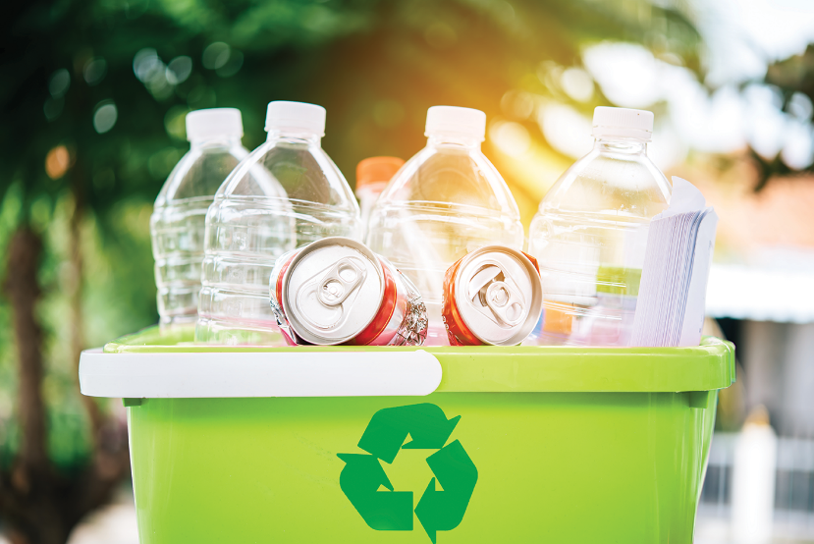
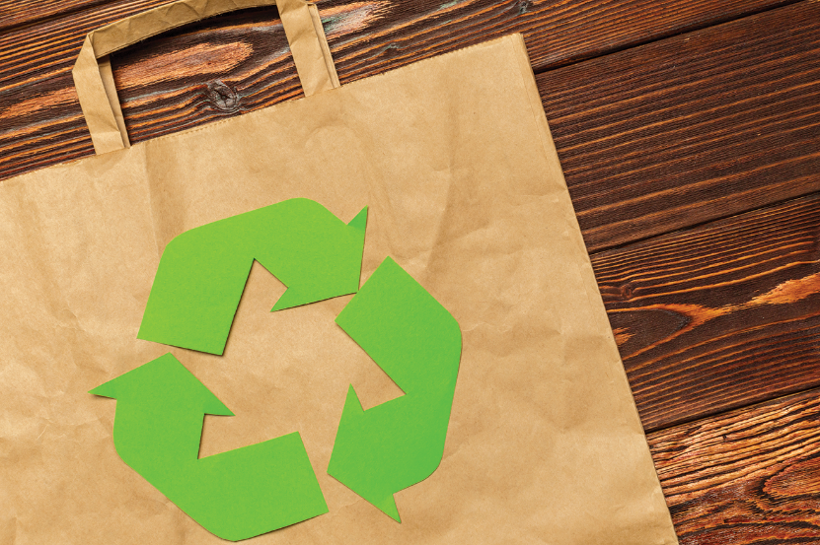
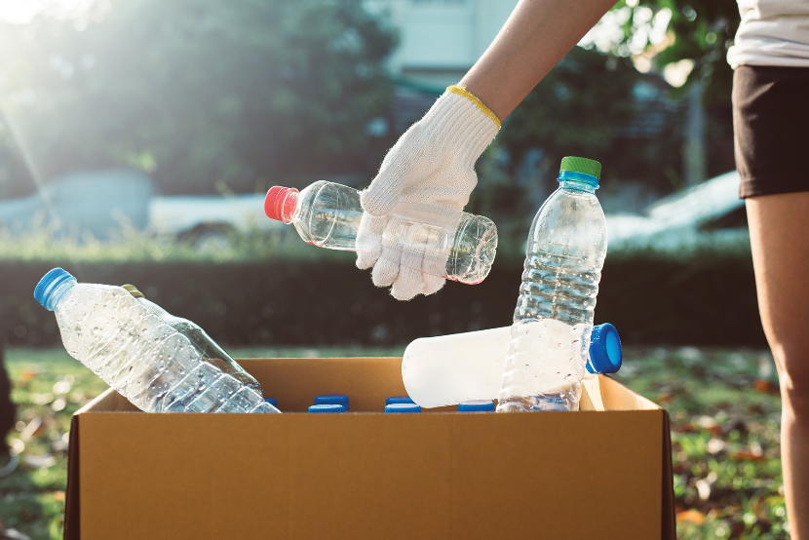
Add more words to the word webs below.

