Slide 1

Song Ve secondary school.
Good morning class!!!

Slide 2


UNIT 12. ROBOTS
LESSON 4
* Everyday English
Expressing agreement and disagreement

Slide 3
* Complete the spider web
Do the dishes
Look after the patients
Iron clothes
A robot can
Move heavy things
A robot can
Water plants
Work as a guard

Slide 4



Listen and read the dialogues.
Pay attention to the highlighted sentences.
A: I think robots can help us a lot in our daily life.
B: I agree with you.
A: Peter says robots can do everything like humans.
B: I don’t agree with him.

Slide 5
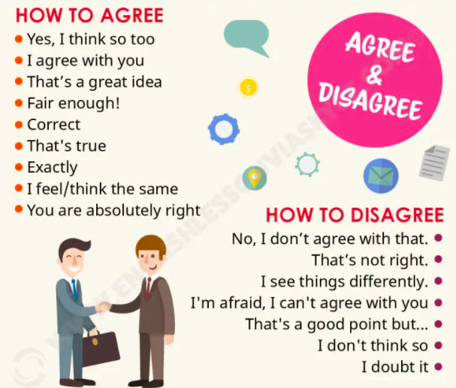
* Expressing agreement and disagreement

Slide 6

Work in pairs. Express your opinions about the following statements. Use the highlighted phrases in the dialogues above.
Home robots are the most useful of all types of robots.
Some people can use robots to do bad things.
Robots will use too much electricity in the future.

Slide 7
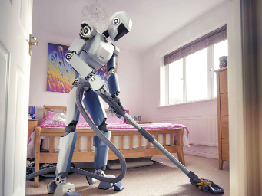
Work in pairs. Express your opinions about the following statements. Use the highlighted phrases in the dialogues above.
A: Home robots are the most useful of all types of robots.
B:
Ok, I feel / think the same.
I agree with you.

Slide 8
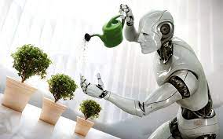
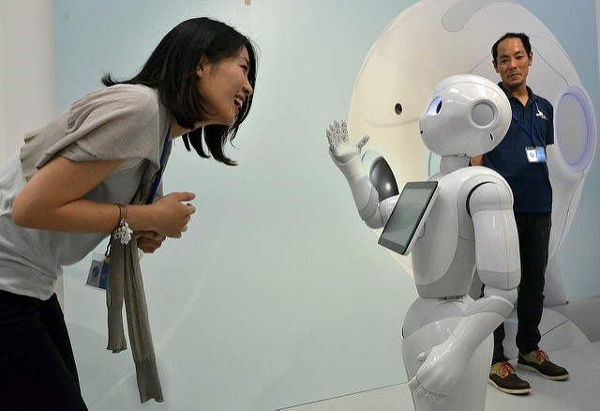
Work in pairs. Express your opinions about the following statements. Use the highlighted phrases in the dialogues above.
A: Robots will use too much electricity in the future.
B: I agree with you.

Slide 9
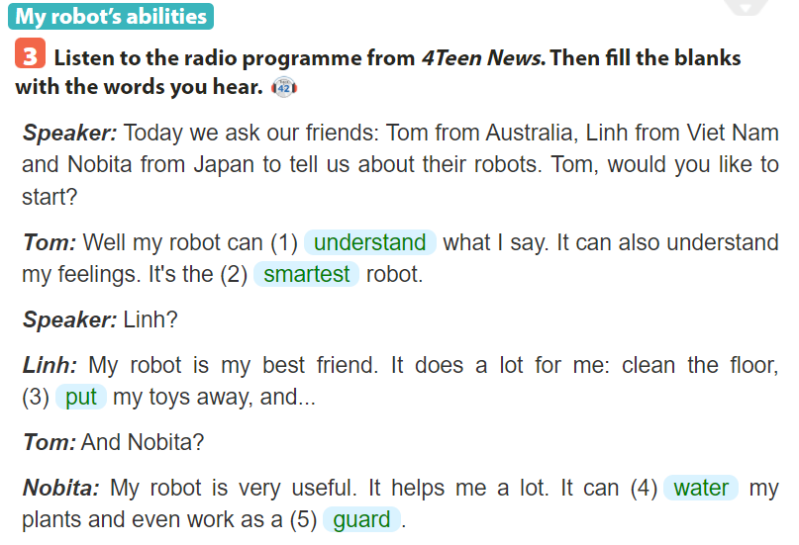

Slide 10

Interview three friends about what abilities they want their robots to have. Note their answers in the table below.
Friends |  | Abilities he / she wants his / her robot to have
1. | Giang | cook meals
2. | Hoai Anh | do her homework
3. | Kiet | play with him

Slide 11

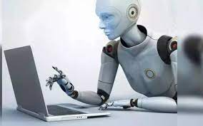
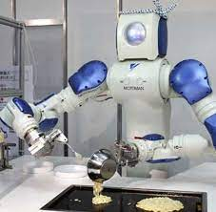
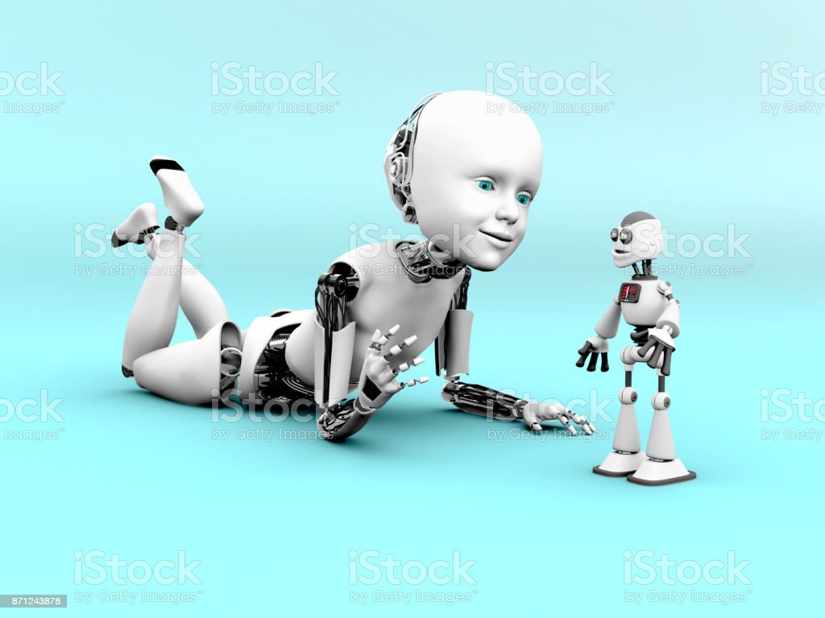
Report your results to the class.
I interviewed three of my friends about the abilities they want their robots to have. Giang wants her robots to cook meals. Hoai Anh wants her robot to do her homework. And Kiet wants his robot to play with him.

Slide 12


homework
-

Slide 13
homework
- Do exercises in workbook.
- Prepare for the next lesson: Unit 12 Skills 1.

Slide 14





