Slide 1

ENGLISH 6
HELLO EVERY ONE !!!

Slide 2


UNIT 12: ROBOTS
LESSON 5:
* Reading
* Speaking

Slide 3
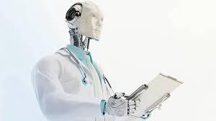
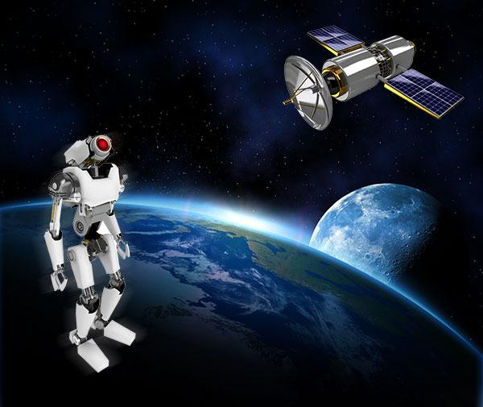
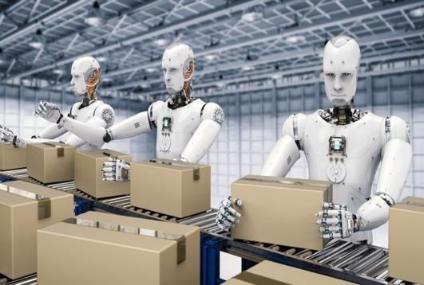
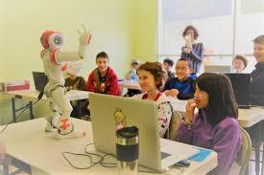
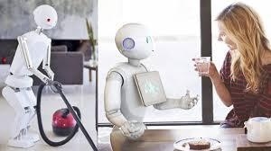
Brainstorming
What type of robot is that?
A. Home robot
B. Space robot
C. Teacher robot
D. Doctor robot
A. Worker robot
B. Space robot
C. Teacher robot
D. Doctor robot
A. Worker robot
B. Space robot
C. Teacher robot
D. Doctor robot
A. Worker robot
B. Space robot
C. Teacher robot
D. Doctor robot
A. Home robot
B. Space robot
C. Teacher robot
D. Doctor robot

Slide 4

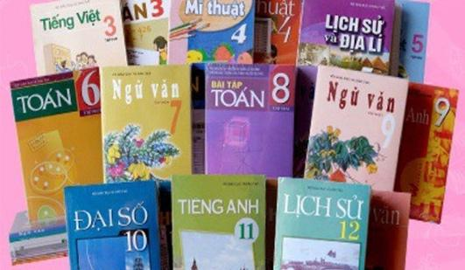
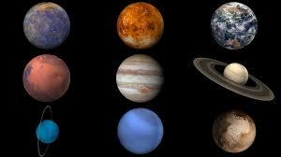
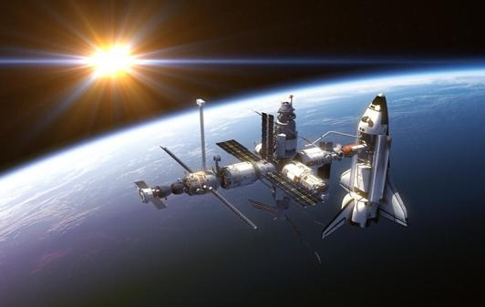
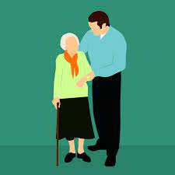

* Vocabulary
- literature (n)
/ˈlɪtrətʃər/
- subject (n)
/ˈsʌbdʒekt/
- planet (n)
/ˈplænɪt/
- space station (nph)
/ˈspeɪs steɪʃn/
- improve (v)
/ɪmˈpruːv/
- look after (phv)
/ˈlʊk æftər/
Văn học, Ngữ văn
Môn học
Hành tinh
Trạm không gian
Cải thiện
Chăm sóc

Slide 5
* Checking vocab : Rub out and remmember
- literature (n)
- subject (n)
- planet (n)
- space station (nph)
- improve (v)
- look after (phv)
Văn học, Ngữ văn
Môn học
Hành tinh
Trạm không gian
Cải thiện
Chăm sóc

Slide 6

Work in pairs. Discuss the following questions.
1.
What types of robots are there?
=> They are: home robots, teacher robots, space robots, doctor robots and worker robots.
2.
What robots are children interested in?
=> Teacher robots.

Slide 7

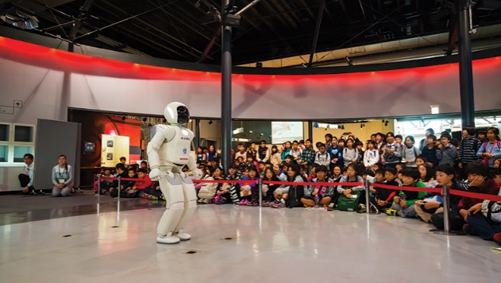
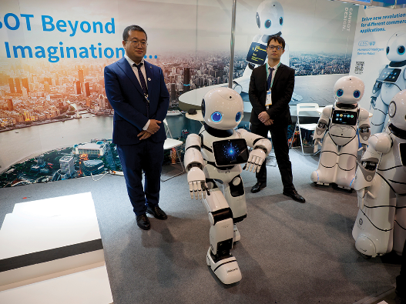
Read the text and choose the best answer to each of the questions.
Today there is an international robot show in Ha Noi. People can see many types of robots there.
Home robots are useful for housework. They can do most of the housework: cook meals, clean the house, do the washing, and iron clothes.
Teacher robots are the best choice for children. They can help them to study. They can teach them English, literature, maths and other subjects. They can also help children to improve their English pronunciation.
People are also interested in other types of robots at the show. Worker robots can build houses and move heavy things; doctor robots can look after sick people and space robots can build space stations on the Moon and on planets.

Slide 8
1.
What show is on in Ha Noi now?
A.
A fashion show
B.
A robot show
C.
A pet show
2.
Which type of robots can help children in their study?
A.
Home robots
B.
Worker robots
C.
Teacher robots
3.
Doctor robots can _______.
A.
help children to study
B.
build houses
C.
take care of sick people
4.
Which of the following sentences is NOT true according to the passage?
A.
Worker robots can build houses and move heavy things.
B.
Space robots can build space stations on the Moon.
C.
Home robots can’t do much of the housework.

Slide 9

Read the text again and fill the table below.
Types of robots | What they can do
Home robots
Teacher robots
Worker robots
Doctor robots
Space robots
cook meals, clean the house, do the washing and iron clothes
help children study, teach English, literature, maths and other subjects, help children improve English pronunciation
build houses, move heavy things
look after sick people
build space stations on the Moon and on planets

Slide 10

Work in pairs. Discuss what you think robots can do in the following places.
Places | What robots can do
Home
Schools
Factory
Hospital
Garden
Example:
A: What can robots do at home?
B: They can take care of children.

Slide 11

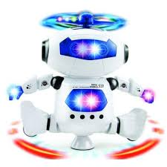
Work in groups. Take turns to talk about robots and what you think they can do. Can you think of other types of robots?
* Example:
I think another type of robot is entertainment robots. These robots can sing, dance and tell stories to make me happy.

Slide 12
* Homework
Learn new words by heart.
Choose a type of robot in reading text and write about what they can do..
Prepare: Skill 2.

Slide 13




