Slide 1

Song Ve secondary school.
Good morning class!!!
Mrs Thu Ba

Slide 2
UNIT 12. ROBOTS
Lesson 6: Skills 2
* Listening
* Writing

Slide 3
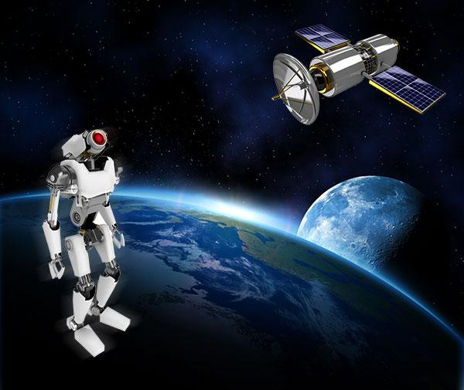
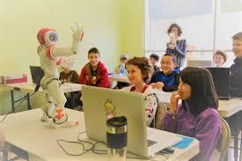
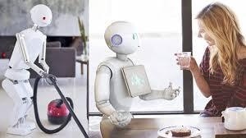
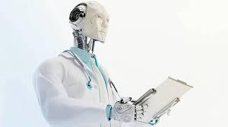
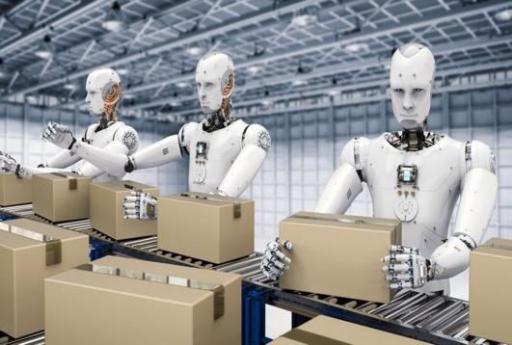
* Brainstorming:
What types of robots are these?
What can it do?
Space robot
teacher robot
home robot
help children study, teach English, literature, maths and other subjects, help children improve English pronunciation
build space stations, take measurements, collect samples, take pictures of planets
Doctor robot
worker robot
cook meals, clean the house, do the washing, iron clothes
look after sick people, do the surgery, help the doctors,
build houses, move heavy things

Slide 4



I. Listening
Listen to the conversation between Khang and Dr Adams and tick () the phrases you hear.

- look after sick people

- understand what we say

- build the very high buildings

- teach many subjects
- move heavy things

Slide 5

Listen to the conversation again and tick () T (True) or F (False).
 | T | F
1. Robots can’t do many things today.
2. Worker robots can build the very high buildings.
3. Teacher robots can teach on the internet.
4. Robots can talk to humans.
5. Robots can do everything like humans.





Audio script

Slide 6
AUDIO SCRIPT
Khang: Dr Adams, please tell me something about robots.
Dr Adams: Sure. Robots can do quite a lot today. Home robots can do housework. Doctor robots can look after sick people. And...
Khang: Can robots build houses?
Dr Adams: Yes. Worker robots can even build the very high buildings.
Khang: Can they teach?
Dr Adams: Yes. Teacher robots can teach many subjects in a classroom or online.
Khang: Can they understand what we say?
Dr Adams: Yes, they do. They can even speak to us.
Khang: Robots can do everything like humans?
Dr Adams: No, not everything. They can't understand our feelings or play football.

Slide 7

II. Writing
Imagine a robot you would like to have.
Make notes about it.
1. Name of your robot | _______________________________
2. Type of robot | _______________________________
3. Where it can work | _______________________________
4. What it can do for you | _______________________________

Slide 8
Imagine a robot you would like to have.
Make notes about it.
Name of your robot:
Type of your robot:
Mimi
Home robot
Where it can work:
What it can do for you:
Living room, bedroom, kitchen
Clean the house, wash dishes and cook meals

Slide 9
Imagine a robot you would like to have.
Make notes about it.
Name of your robot:
Type of your robot:
Home robot
Where it can work:
What it can do for you:
Living room, bedroom, kitchen
Clean the house, wash dishes and cook meals

Slide 10


Now write a paragraph of 50-60 words about the robot you would like to have. Use the information in 3 to help you.
My robot’s name is ____________________.
It is a ________________________________. _____________________________________ _____________________________________ _____________________________________ _____________________________________ _____________________________________

Slide 11
Now write a paragraph of 50-60 words about the robot you would like to have. Use the information in 3 to help you.
My robot’s name is Mimi. It is a home robot. It can work at home . It can clean the house, wash dishes and cook meals, It can also water flowers and vegetables in the garden. I like it so much.

Slide 12
Now write a paragraph of 50-60 words about the robot you would like to have. Use the information in 3 to help you.
My robot’s name is Funny. It is an entertainment robot. It can work at home and at school. It can sing, dance and tell stories to make me happy. It can also help me to do my homework and practice English. I like it so much.

Slide 13


homework
- Rewrite your writing.
- Do the exercises in workbook.
- Prepare LOOKING BACK AND PROJECT

Slide 14




