Slide 1


GOOD MORNING
EVERYONE !!!

Slide 2
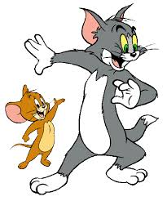
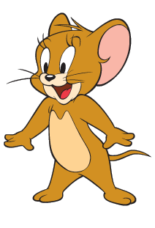
Questions: Lucky numbers
1
2
3
4
5
6
7
8

Slide 3

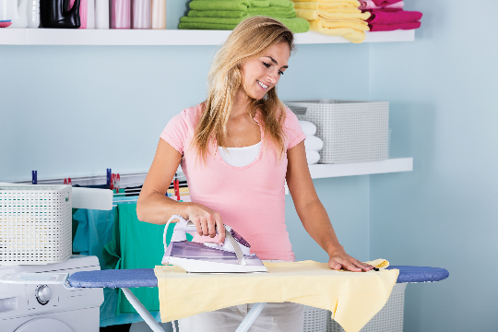
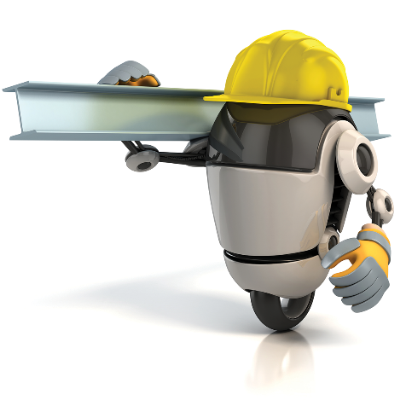
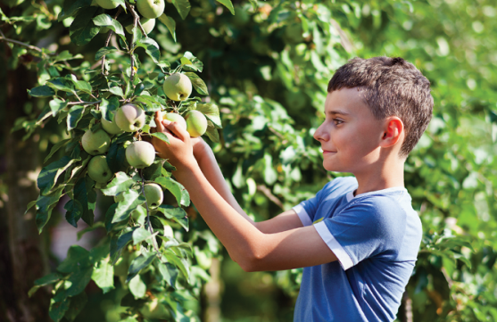
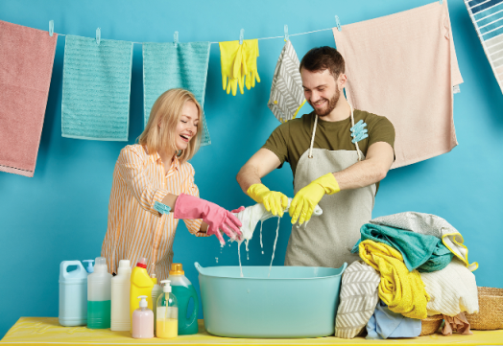
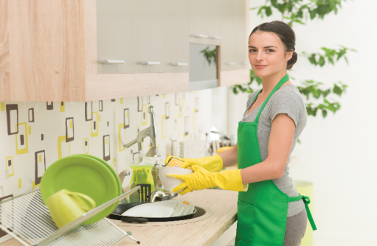

Task 1: Look at the picture and write the correct words to complete the phrases
1. ______the clothes
2. ______heavy things
3. _________fruit
4. do the ______
5. ________the dishes.
6. _____a broken machine

Slide 4
Questions: Lucky numbers
1
2
3
4
5
6
7
8

Slide 5
* Look at the picture and write the correct words to complete the phrases
iron
1. ________the clothes

Slide 6
* Look at the picture and write the correct words to complete the phrases
move
2. ______heavy things

Slide 7

* Look at the picture and write the correct words to complete the phrases
pick
3. _________fruit

Slide 8

Task 1: Look at the picture and write the correct words to complete the phrases
washing
4. do the _________

Slide 9

Task 1: Look at the picture and write the correct words to complete the phrases
wash
5. ________the dishes.

Slide 10

* Look at the picture and write the correct words to complete the phrases
repair
6. _______a broken machine

Slide 11

LUCKY NUMBER!
you get 2 plus points

Slide 12
LUCKY NUMBER!
you get 2 plus points

Slide 13



UNIT 12. ROBOTS
LESSON 7:

Slide 14



Task 1: Look at the picture and write the correct words to complete the phrases
1. iron the clothes
2. move heavy things
3. pick fruit
4. do the washing
5. wash the dishes

Slide 15

Fill the blanks with the verbs from the box.
water
make
repair
work
understand
1. Robots can ________ as guards when we're away.
2. We rarely go to restaurants because my father can ________ delicious meals at home.
3. Can you ________ my broken clock?
4. Can robots __________ our feelings?
5. My father and I ________ the plants in our garden
every morning.

Slide 16

Use the correct form of the adjectives in brackets to complete the paragraph.
Welcome to our company. We’ve made the (1. smart) robot in the world. It’s the (2. small) and the (3. light)
we’ve made but it can do many things in your house. It can even ﬂy to clean the ceilings. It can teach children all school subjects. It’s also the (4. strong) in our lab because it can move more than 200 kg. It’s not difficult to own a robot like this because it’s one of the (5. cheap) robots in the world.
smartest
smallest
lightest
strongest
cheapest

Slide 17

Complete the following sentences with superlative form of the adjectives in brackets.
1. What is the (high) ...highest …mountain in the world?
2. What is the (large) …largest… lake in Viet Nam?
3. What is the (long) …longest … beach in Viet Nam?
4. What is the (wide) … widest … river in the world?
5. What is the (hot) … hottest… desert in the world?
Do you know the answers?
1. Mount Everest is the highest mountain in the world.
2. Ba Be Lake is the largest lake in Viet Nam.
3. Tra Co Beach is the longest beach in Viet Nam.
4. The Amazon is the widest river in the world.
5. The Sahara is the hottest desert in the world.

Slide 18
Production
* Rewrite the following sentences with no change in the meaning.
1. Nobody is younger than my brother in my family.
→ My brother is…………………………………
2.The Sahara is the hottest desert in the world.
→No desert in the world ……………………………..
3.No one is busier than my mother in my family.
→My mother is ………………………………….
4.Nam is taller than his father
→His father ……………………………….

Slide 19

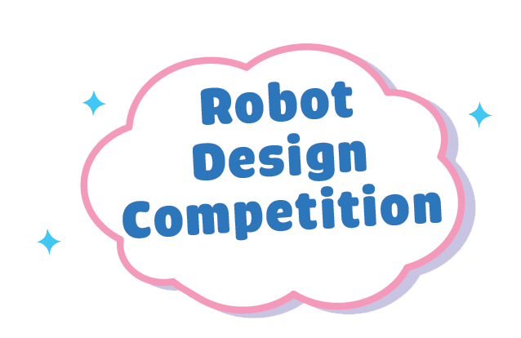


You are taking part in a robot design competition. Work in groups, decide what your robot is like and complete this table.
Robot name
Appearance (weight, height, etc.)
Where it can work
What it can do

Slide 20
You are taking part in a robot design competition. Work in groups, decide what your robot is like and complete this table.
Robot name | Funny
Appearance | 40 centimetres, 1 kilo, colors: red, yellow, green, blue
Where it can work | At home, at sc
What it can do | Sing, dance, tell stories, do homework, communicate

Slide 21

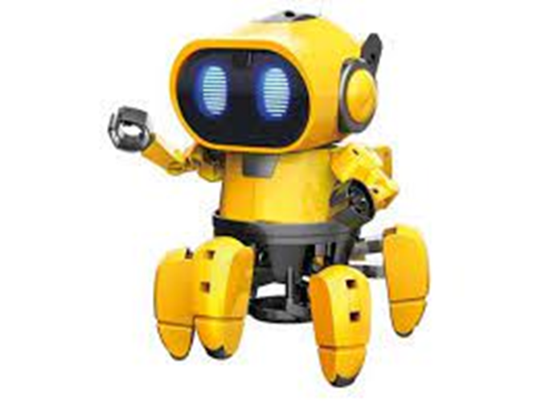
Present your designs to other groups. Vote on the best robot.
Draw your robot here
Hello everyone, this is the drawing of my favourite robot. Its name is Funny. It is an entertainment robot. It’s 40 centimetres high and 1 kilo heavy. It has colors of grey, pink, red, yellow, green and blue. It’s lovely with big eyes and a smiling face. It can work both at home and at school. It can sing, dance and tell stories. It can also help me do my homework and talk with me.

Slide 22
Now I can … |  |  | 
use the words for daily activities.
say statements with correct tones.
compare people and things using superlative adjectives.
express agreement and disagreement about something.
read about a robot show.
talk about what robots can do.
listen about what robots can do.
write a paragraph about a robot.
✓
✓
✓
✓
✓
✓
✓
✓
✓
✓
✓
✓
✓
✓
✓
✓
✓
✓
✓
✓
✓
✓
✓
✓

Slide 23
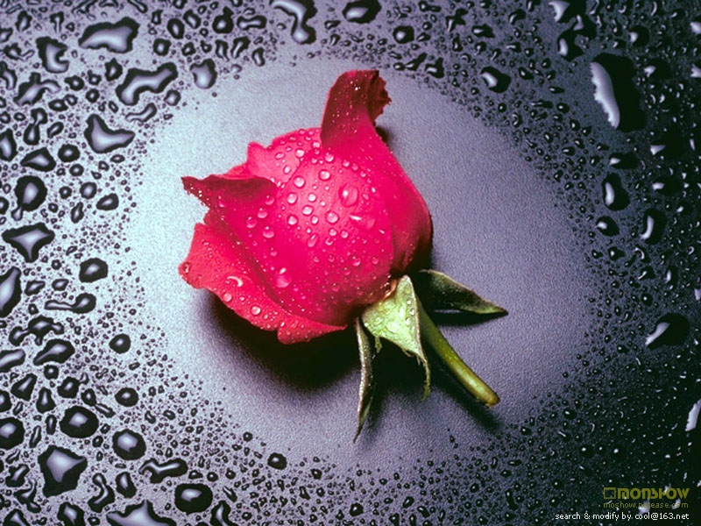
Thank you for your attention!

