Slide 1


Good morning class!!!

Slide 2
English 9 – Global success

Slide 3
* WARM UP
market
bank
hospital
zoo
places
hotel
school
cinema
museum
stadium
park

Slide 4
* WARM UP
Where do you live?
What are your neighbours like?
What do you like about neighbourhood?

Slide 5


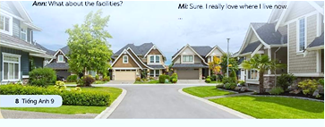
Unit
1
LOCAL COMMUNITY
LESSON 1: GETTING STARTED
I really love where I live now.
1

Slide 6
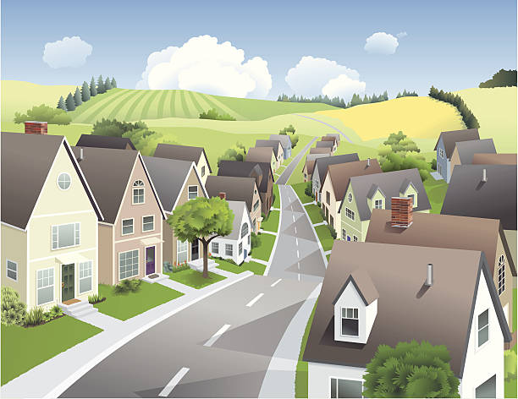

* Vocabulary
suburb (n)
/ˈsʌbɜːb/
vùng ngoại ô

Slide 7

* Vocabulary
facilities (n)
/fəˈsɪlətiz/
cơ sở vật chất

Slide 8

* Vocabulary
remind (v)
/rɪˈmaɪnd/
nhắc, làm nhớ lại

Slide 9
* Vocabulary
get on with (v.p):
/get ɒn wɪð/
hòa đồng với…

Slide 10
* Vocabulary
New words | Pronunciation | Meaning
1. suburb (n) | /ˈsʌbɜːb/ | vùng ngoại ô
2. facilities (n) | /fəˈsɪlətiz/ | cơ sở vật chất
3. remind (v) | /rɪˈmaɪnd/ | gợi nhớ, nhắc
4. get on with (v.p): | /get ɒn wɪð/ | hòa đồng với..

Slide 11
* Vocabulary
New words | Pronunciation | Meaning
1. | /ˈsʌbɜːb/ | vùng ngoại ô
2. | /fəˈsɪlətiz/ | cơ sở vật chất
suburb (n)
facilities (n)
3. | /rɪˈmaɪnd/ | gợi nhớ, nhắc
4. | /get ɒn wɪð/ | hòa đồng với..
remind (v)
get on with (v.p)

Slide 12
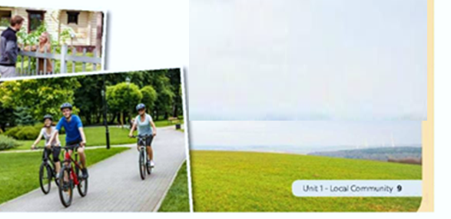
* PRACTICE
1
Listen and read.
What do you see in each picture?
What would life in the place in the pictures be like?

Slide 13
* PRACTICE
1
Listen and read.
Ann: Hi, Mi. Long time no see. How’re you doing?
Mi: I’m fine, thanks. By the way, we moved to a new house in a suburb last month.
Ann: Oh, that’s why I haven’t seen you in the Reading Club very often.
Mi: Yes. We’re still busy moving in, you know.
Ann: How’s your new neighbourhood?
Mi: It’s much bigger than our old one. The streets are wider, and there are fewer people.
Ann: What about the facilities?
Mi: It has all the things we need: shopping malls, parks, and hospitals. And there’s a craft village near our house.
Ann: Great! How’re your new neighbours?
Mi: They’re nice. Last Sunday when I was looking for the way to the bus station, a lady came and showed me the way. I think we will get on with them.
Ann: That reminds me of the time our family moved to Viet Nam. We didn’t know where to buy stuff for our
house, and the new neighbours in the community gave us useful advice. I guess you like your new place.
Mi: Sure. I really love where I live now.

Slide 14
* PRACTICE
1
Listen and read.
Ann: Hi, Mi. Long time no see. How’re you doing?
Mi: I’m fine, thanks. By the way, we moved to a new house in a suburb last month.
Ann: Oh, that’s why I haven’t seen you in the Reading Club very often.
Mi: Yes. We’re still busy moving in, you know.
Ann: How’s your new neighbourhood?
Mi: It’s much bigger than our old one. The streets are wider, and there are fewer people.
Ann: What about the facilities?
Mi: It has all the things we need: shopping malls, parks, and hospitals. And there’s a craft village near our house.
Ann: Great! How’re your new neighbours?
Mi: They’re nice. Last Sunday when I was looking for the way to the bus station, a lady came and showed me the way. I think we will get on with them.
Ann: That reminds me of the time our family moved to Viet Nam. We didn’t know where to buy stuff for our
house, and the new neighbours in the community gave us useful advice. I guess you like your new place.
Mi: Sure. I really love where I live now.

Slide 15
2
Read the conversation again. Fill in each blank with no more than TWO words from the conversation.
1. Mi’s family moved to a new house in a suburb ___________.
2. Her new neighbourhood is bigger with wider streets and ___________.
3. There is a ____________ near Mi’s house.
4. Mi thinks she will get on with her new___________.
5. People in Ann’s community gave her family ____________ on where to buy stuff.
last month
fewer people
craft village
neighbours
useful advices

Slide 16
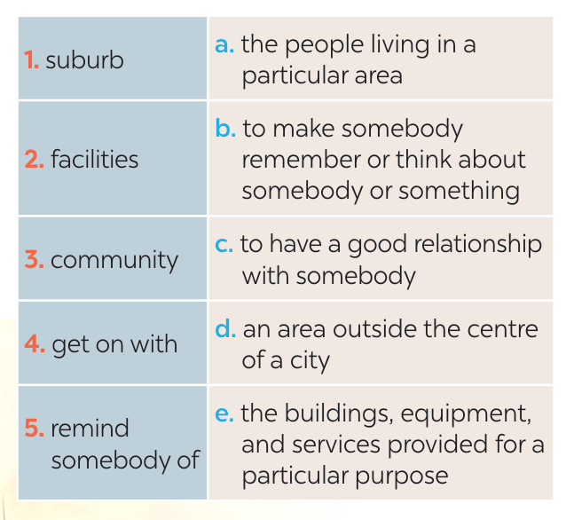
3
Match each word or phrase with its definition.
1. d
2. e
3. a
4. c
5. b

Slide 17
4
Complete each sentence with a word or phrase from 3.
1. They don’t live in the city centre but in a ________ of Ha Noi.
2. I love our new neighbourhood because we _____________ the people here.
3. There are enough sports ____________ for people of all ages in our local park.
4. Souvenirs _________ people ______ a place, an occasion, or a holiday.
5. The local ____________ encourages us to protect the environment and keep our neighbourhood clean.

Slide 18



LUCKY NUMBERS
1
2
3
4
5
6
A
2
4
6
8
10
12
14
B
2
4
6
8
10
12
14

Slide 19
4
Complete each sentence with a word or phrase from 3.
1. They don’t live in the city centre but in a ________ of Ha Noi.
suburb

Slide 20
4
Complete each sentence with a word or phrase from 3.
get on with
2. I love our new neighbourhood because we _____________ the people here.

Slide 21
4
Complete each sentence with a word or phrase from 3.
3. There are enough sports ____________ for people of all ages in our local park.
facilities

Slide 22


LUCKY NUMBERS

Slide 23
4
Complete each sentence with a word or phrase from 3.
4. Souvenirs _________ people ______ a place, an occasion, or a holiday.
remind of

Slide 24
4
Complete each sentence with a word or phrase from 3.
5. The local ____________ encourages us to protect the environment and keep our neighbourhood clean.
community

Slide 25
4
Complete each sentence with a word or phrase from 3.
suburb
1. They don’t live in the city centre but in a ________ of Ha Noi.
2. I love our new neighbourhood because we _____________ the people here.
3. There are enough sports ____________ for people of all ages in our local park.
4. Souvenirs _________ people ______ a place, an occasion, or a holiday.
5. The local ____________ encourages us to protect the environment and keep our neighbourhood clean.
get on with
facilities
remind of
community

Slide 26

* PRODUCTION
5
GAME: What is the place?
DO THE FOLLOWING QUIZ.
1. People watch sports such as football there.
2. People go there for health check-ups.
3. Parents take their children there so that they can
have fun.
4. Children learn to read and write there.
5. Visitors see objects from the past there.
stadium
hospital
playground
school
museum

Slide 27

* CONSOLIDATION
What have we learnt in this lesson?
identify the topic of the unit
use lexical items related to local community
identify the language features that are covered in the unit

Slide 28

* Homework
- Do exercises in the Workbook.
- Start preparing for the Project of the unit by working in groups of 5 to brainstorm about your community.

Slide 29





Slide 30
Website: hoclieu.vn
Fanpage: facebook.com/www.tienganhglobalsuccess.vn/

Slide 31


Slide 32
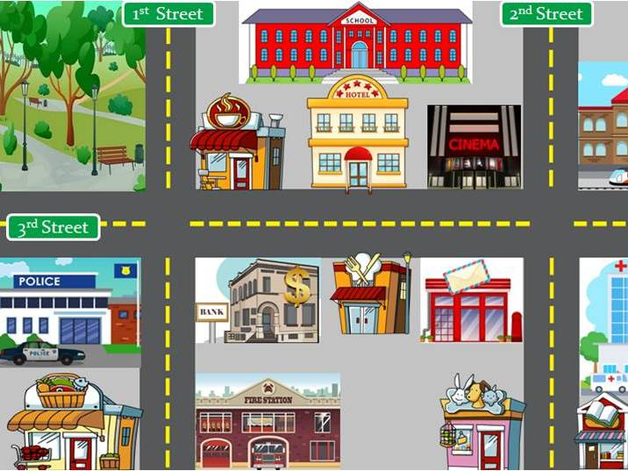
What can you see in this photo?

