Slide 1


love

Slide 2

* Listen a song

Slide 3
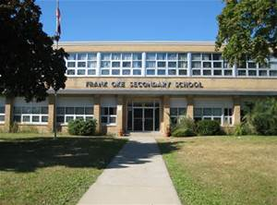
* Warm up: Chatting
What’s the name of your school?
Is your shool big or small?
How many students and teachers are there?
Do you like your new school? Why or why not?

Slide 4


UNIT 1: MY NEW SCHOOL
LESSON 5:
I. Reading

Slide 5
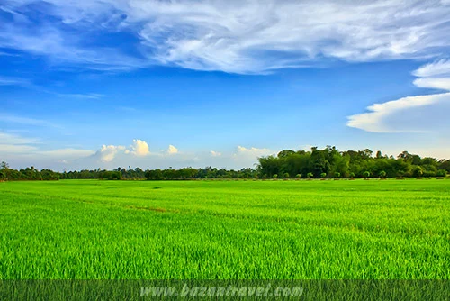

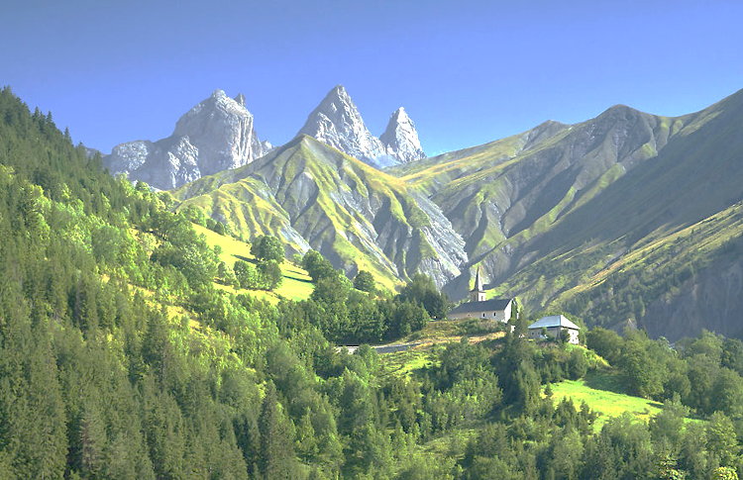
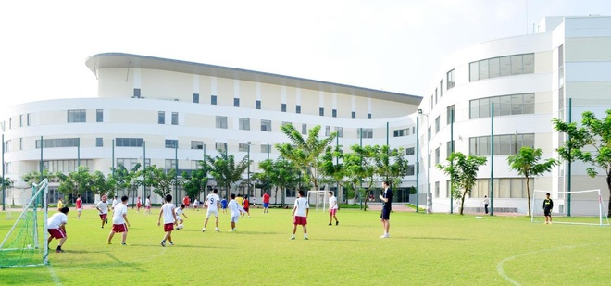
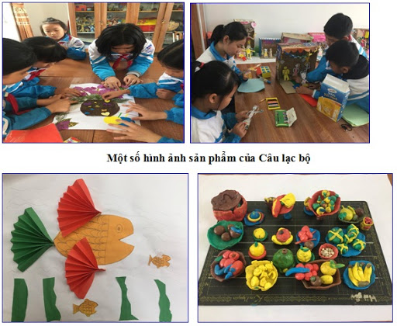
I. Reading
* Vocabulary:
- a green field (n):
đồng lúa
- a mountain (n) :
ngọn núi
- computer room (n) :
phòng máy tính
- join (v) :
tham gia
- International (adj) :
quốc tế
- art club (n) :
câu lạc bộ mĩ thuật

Slide 6
* Checking words:
What and Where
green field
international
computer
room
Join
art club
mountain

Slide 7

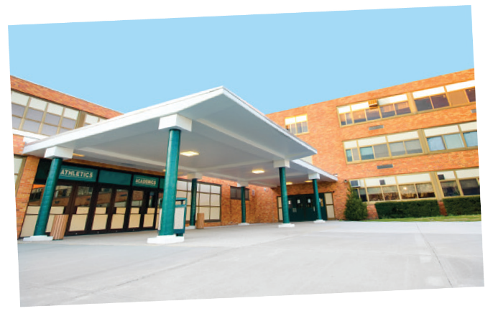
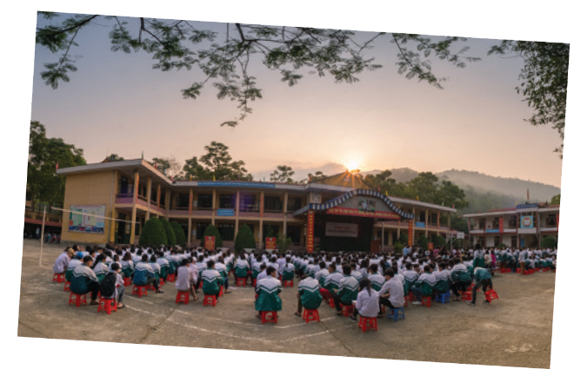

Look at the pictures and quickly read the passages. Match 1-3 with A-C.
Sunrise is a boarding school in Sydney. Students study and live there. About 1,200 boys and girls go to Sunrise. It has students from all over Australia. They study subjects like maths, science and English.
An Son is a lower secondary school in Bac Giang. It has only 8 classes. There are mountains and green fields around the school. There is a computer room and a library. There is also a school garden and a playground.
Dream is an international school. Here students learn English with English-speaking teachers. In the afternoon, they join many interesting clubs. They play sports and games. Some students do paintings in the art club.

Slide 8
1. Sunrise
A. a school in Bac Giang
C. a boarding school in Sydney
2. An Son
B. an international school
A. a school in Bac Giang
3. Dream
C. a boarding school in Sydney
B. an international school

Slide 9

Read the passages again and complete these sentences.
boarding
1.
Students live and study in a school. They only go home at weekends.
Sunrise is a school in .
2.
Sydney
There are around An Son School.
3.
mountains and green fields
4.
Dream school
has an art club.
5.
At Dream School, students learn English with
.
English speaking teachers

Slide 10

Game : Lucky star
Answer the questions.
1.
Which school is a boarding school?
2.
Where is An Son School?
3.
Is there a school garden in An Son School?
4.
What do Dream School students do in the afternoon?

Slide 11
Lucky star !
7
4
3
2
8
1
6
5

Slide 12
1. Which school is a boarding school?
Sunrise.

Slide 13
2. Where is An Son School?
It is in Bac Giang.

Slide 14

Lucky Number
Lucky Number

Slide 15
Lucky Number
Lucky Number

Slide 16
Lucky Number
Lucky Number

Slide 17
Lucky Number
Lucky Number

Slide 18
3. Is there a school garden in An Son School?
Yes. There is.

Slide 19
4. What do Dream School students do in the afternoon?
They join many interesting clubs.

Slide 20
Answer the questions.
1.
Which school is a boarding school?
Sunrise.
2.
Where is An Son School?
It is in Bac Giang.
3.
Is there a school garden in An Son School?
Yes. There is.
4.
What do Dream School students do in the afternoon?
They join many interesting clubs.

Slide 21
II. Speaking

Slide 22

Which school in 1 would you like to go to? Why or Why not? Complete the table.
Name of school | Reasons you like it | Reason you don’t like it
Sunrise An Son Dream
Then discuss your choice with a friend.
Example:
A: Which school would you like to go to?
B: I’d like to go to Sunrise School.
A: Why?
B: Because students study and live there. .

Slide 23
Name of school | Reasons you like it | Reasons you don't like it
Sunrise | It is a boarding school | Not have school garden
An Son | It has school garden. It has mountains and green fields. | It's small
Dream | It is modern and it has many interesting clubs | - It is expensive

Slide 24


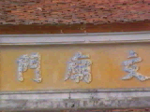
HOMEWORK
- Learn the new words by heart.
- Read the passages again.
-- Prepare for the next lesson:
Unit 1-Skills 2.
+

Slide 25

Goodbye
Thank you for your attention!!!

