Slide 1
WELCOME ALL TEACHERS TO CLASS 6B
- Yen My -
Secondary School

Slide 2





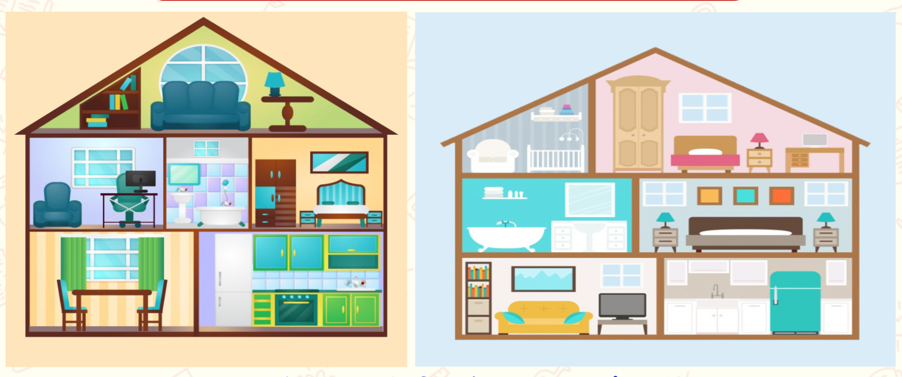




Tuesday, 30th September, 2025
UNIT 2: MY HOUSE
Lesson 3: A closer look 2

Slide 3

WARM-UP
Memory game
Students observe the things the M.C shows .
Students try to remember the things belonging to each person
Students answer the questions of the M.C.
The student who has the fastest answer is the winner.

Slide 4
PRESENTATION
Grammar
Possessive case

Slide 5
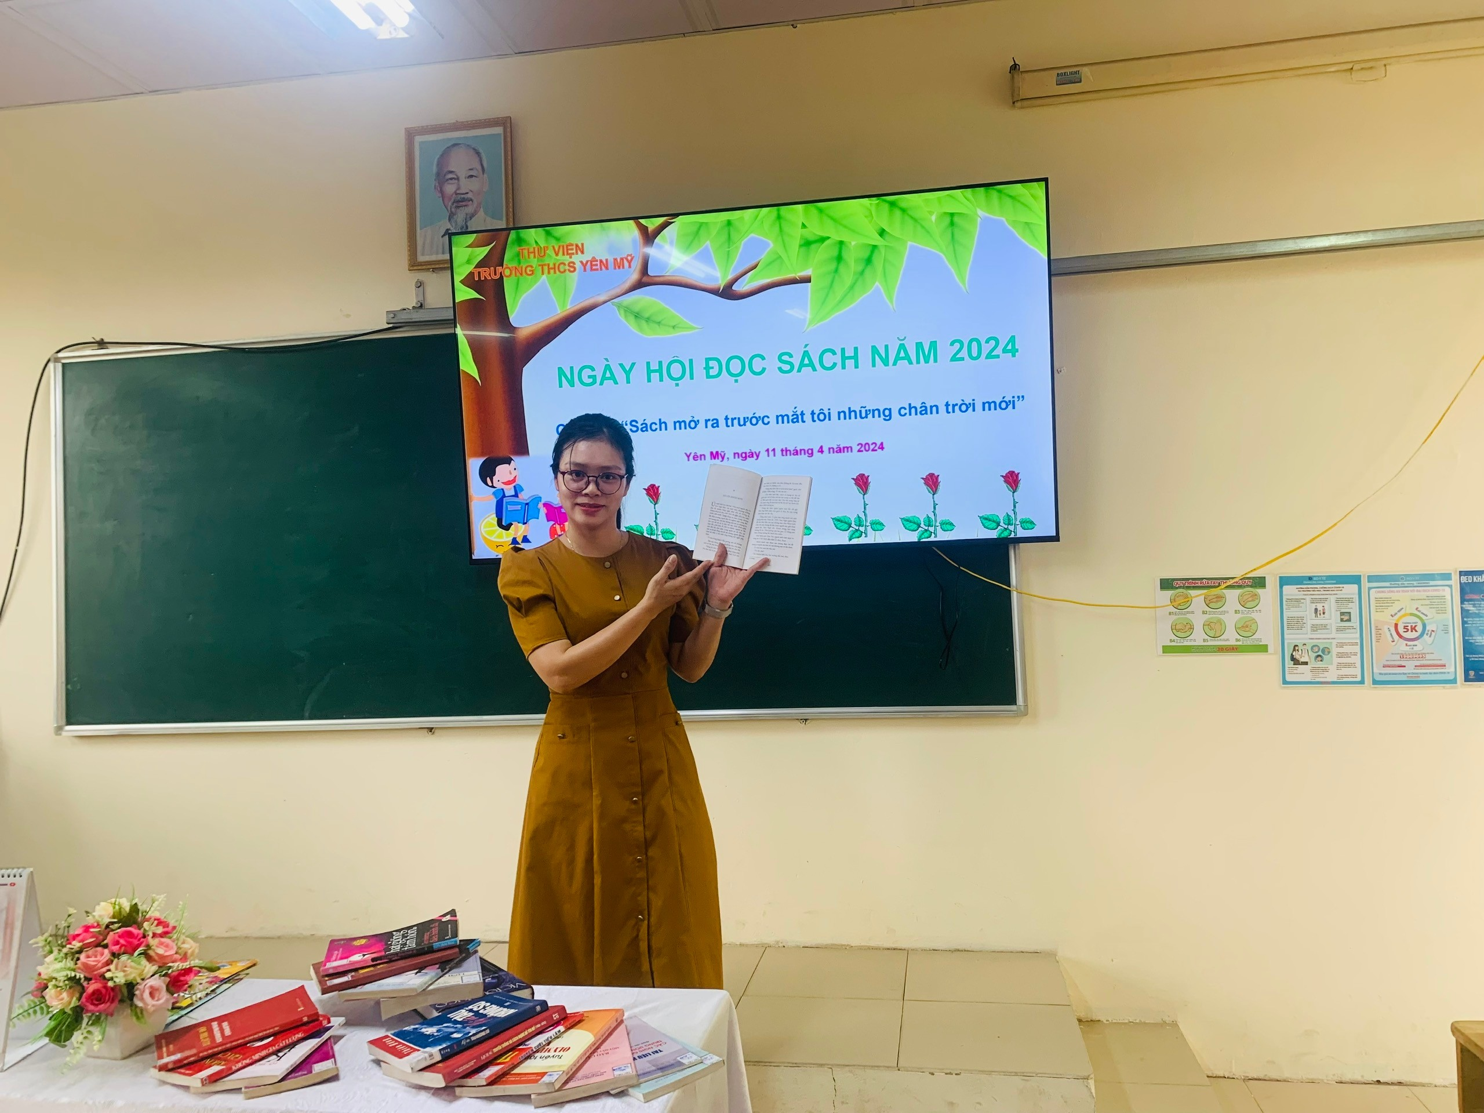
PRESENTATION

Slide 6
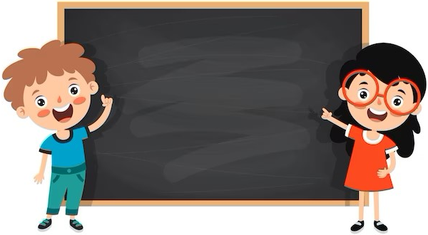
PRESENTATION
STRUCTURE
Name’s + noun
Example: Nhi’s pen
Singular noun’s + noun
Example: teacher’s book

Slide 7
PRACTICE
1
Choose the correct answer.
1. My (grandmothers / grandmother’s) house is in Ha Noi.
2. This is my (sister’s / sister’) desk.
3. My (cousin’s / cousin) dad is my uncle.
4. (Nam’s / Nam’) house is small.
5. There are two bedrooms in (Ans / An’s) flat.

Slide 8

PRACTICE
2
Complete the sentences with the correct possessive forms.
1. Thuc Anh is ______ cousin. (Mi)
2. This is their _________ chair. (teacher)
3. Where is _______ computer? (Nick)
4. My _________ motorbikes is in the garden. (father)
5. My _________ bedroom is next to the living room. (brother)
Mi’s
teacher’s
Nick’s
father’s
brother’s

Slide 9
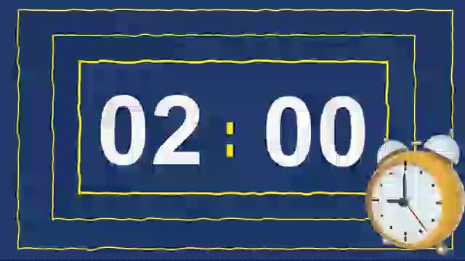
PRESENTATION
PREPOSITIONS OF PLACE

Slide 10



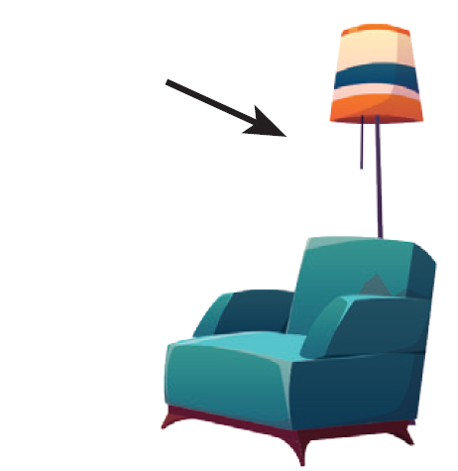
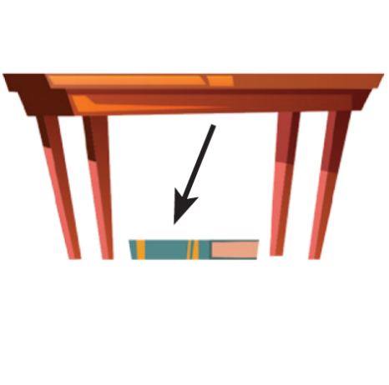

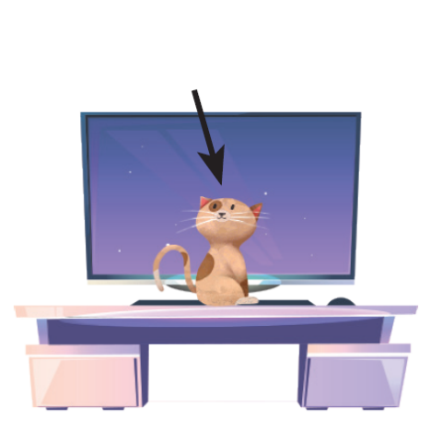
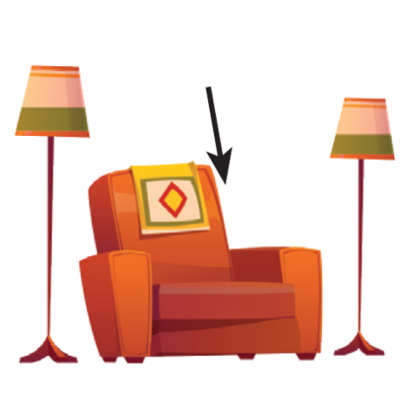
PRESENTATION
Prepositions of place describe where people or things are. These are some prepositions of place.
in
on
behind
under
next to
in front of
between

Slide 11
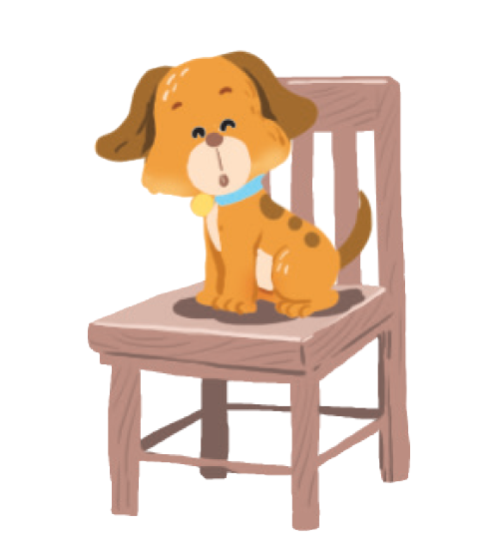
PRACTICE
3
Write the correct preposition in the box under each picture. Say a sentence to describe the picture
on
next to
behind
in
on
in front of
under
between
Example:
1.
on
The dog is on the chair.

Slide 12


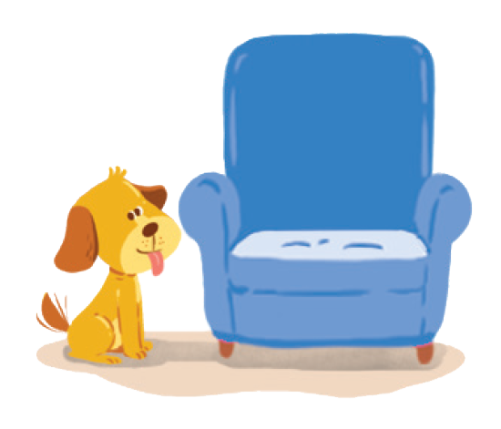

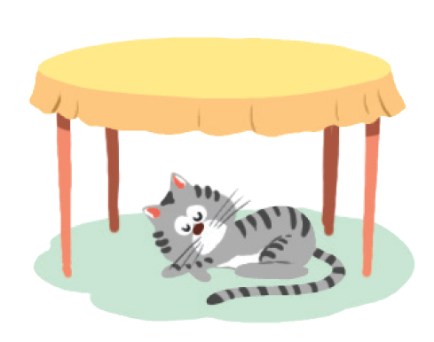

on
under
in
next to
behind
in front of
between
2.
3.
4.
5.
6.
7.

Slide 13
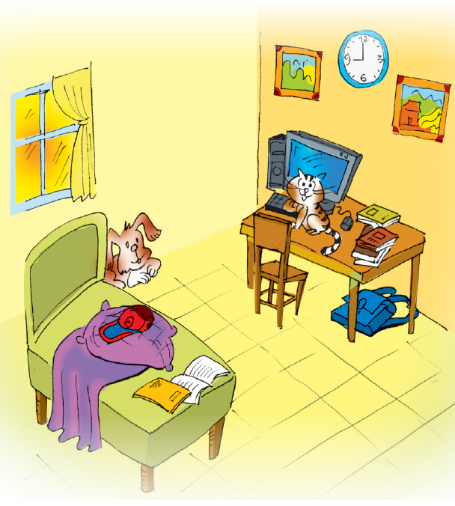
PRACTICE
4
Look at the picture and write T (True) or F (False) for each sentence. Correct the false ones.
Example: The books are under the table. ______
→ The books are on the table.
F
1. The dog is behind the bed. ______
2. The school bag is on the table. ______
3. The picture is between the clocks. ______
4. The cat is in front of the computer. ______
5. The cap is under the pillow. ______

Slide 14


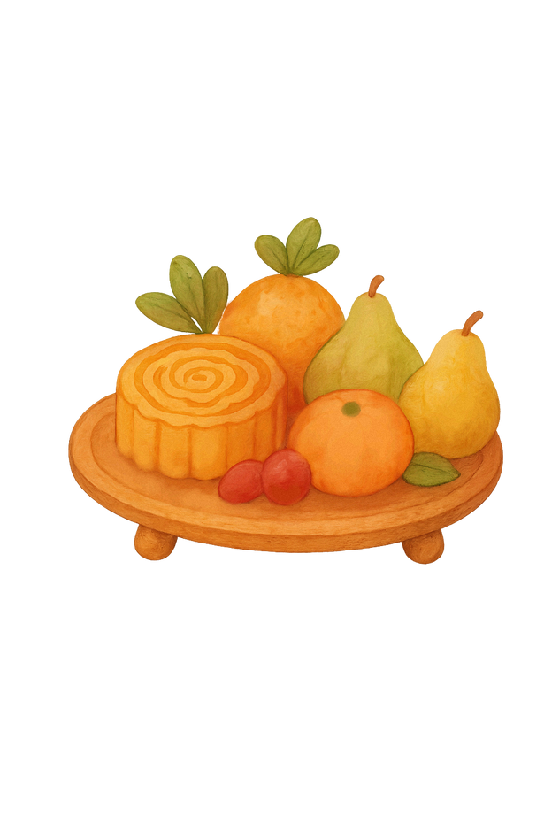

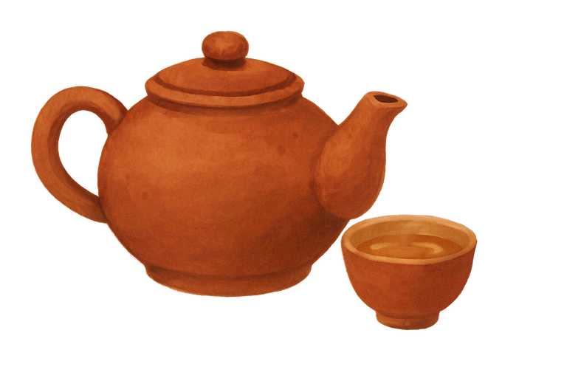
MID - AUTUMN
FESTIVAL
2025
gift

Slide 15


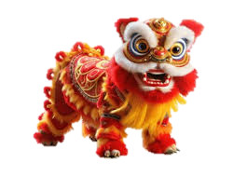

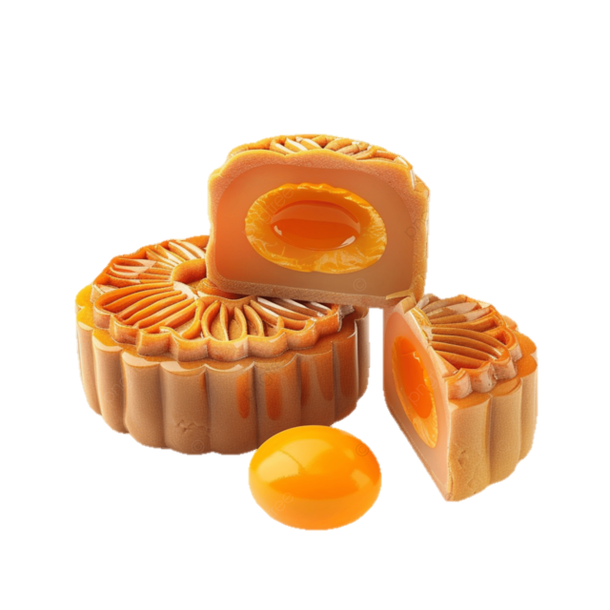



Slide 16










1. The dog is behind the bed. ______
T
9 Points
GO HOME

Slide 17


2. The school bag is on the table. ______
F
--> The school bag is under the table.
8 Points
GO HOME

Slide 18


3. The picture is between the clocks. ______
F
--> The clock is between the (two) pictures.
8 Points
GO HOME

Slide 19


4.What do people say about the film?
4. The cat is in front of the computer. _____
T
10 Points
GO HOME

Slide 20


5. The cap is under the pillow. _____
F
--> The cap is on the pillow.
8 Points
GO HOME

Slide 21


LUCKY GIFT FOR YOU
10 Points
GO HOME

Slide 22
PRODUCTION
5
GAME: Memory challenge
- Work in pairs.
- Look at the picture carefully in 30 seconds then cover it.
- Ask and answer questions about the position of the things in the picture.
Example:
A: Where are the books?
B: They’re on the table.

Slide 23
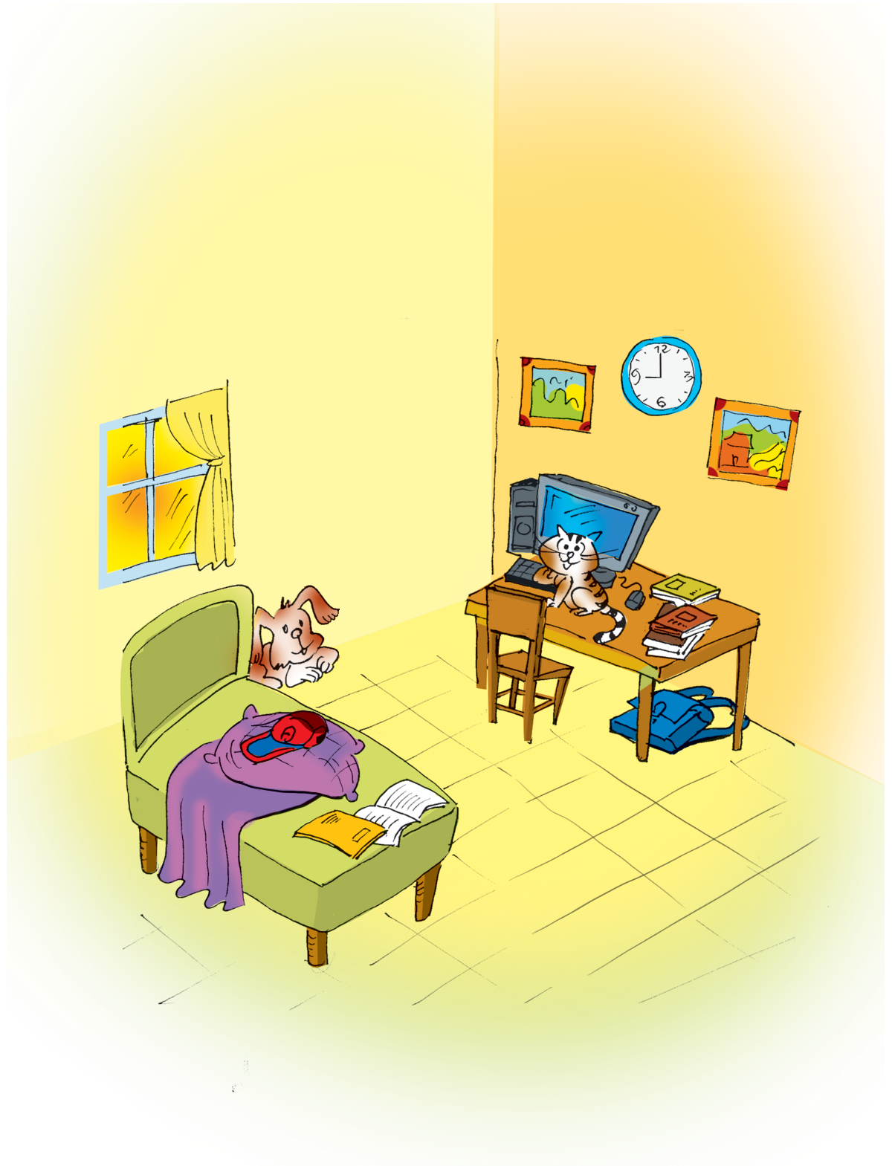



Slide 24

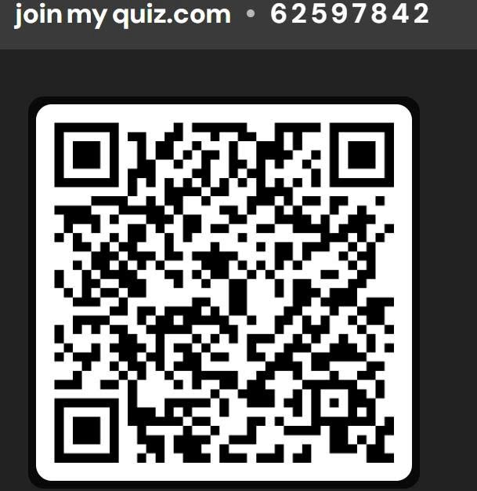
CONSOLIDATION
Homework
Do exercises 3,4,5 on page 11 in the workbook
Prepare for the next lesson: Communication
Do the following exercise on the quizzi

Slide 25
THANK YOU

