Slide 1
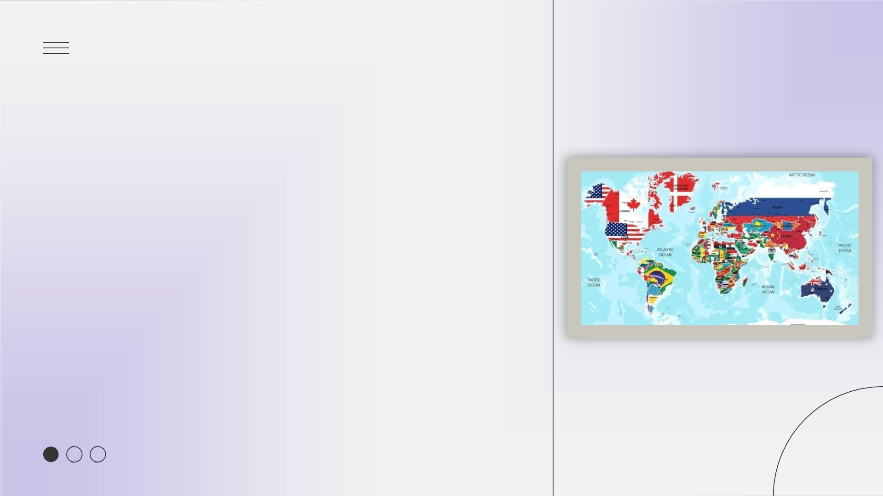
UNIT 9: LESSON 5 – SKILLS 1
PERIOD 73:UNIT 9
WORLD ENGLISHES
Lesson 5: Skills 1

Slide 2

UNIT 9: LESSON 5 – SKILLS 1
WARM-UP

Slide 3
UNIT 9: LESSON 5 – SKILLS 1
VOCABULAR

Slide 4

UNIT 9: LESSON 5 – SKILLS 1
Expanding Circle
/3ɪ k. sˈpændɪŋ ˈsɜːrkl/
Outer Circle
2.
/ˈaʊtər ˈsɜːrkl/
Inner Circle
/ˈɪnər ˈsɜːrkl/
1.

Slide 5

I.Newwords:
1.Inner Circle (n) : /ˈɪnər ˈsɜːrkl/ : vòng tròn bên trong
2.>< Outer Circle (n): /ˈaʊtər ˈsɜːrkl/ : vòng tròn bên ngoài
3.Expanding Circle (n) : /ɪksˈpændɪŋ ˈsɜːrkl/ : vòng tròn mở rộng
4.Official language (n) : /əˈfɪʃəl ˈlæŋɡwɪdʒ/ : ngôn ngữ chính thức
5.Second language (n) : /ˈsɛkənd ˈlæŋɡwɪdʒ/ : ngôn ngữ thứ hai
6.standard (n) : /ˈstændərd/ : tiêu chuẩn
7. establish (n): /ɪˈstæblɪʃ/ : thành lập
Vietnamese is the …………………………of Vietnam.
found/ set up
=
official language
English is the………………………………… of Vietnam

Slide 6
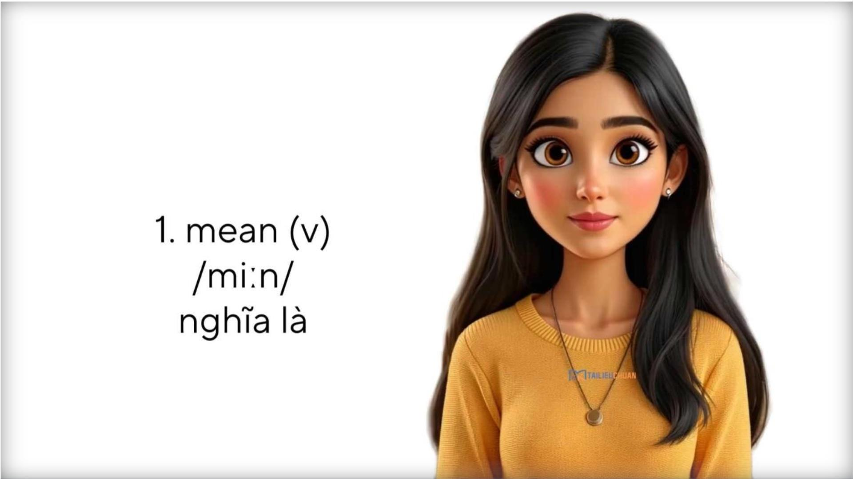

Slide 7
UNIT 9: LESSON 5 – SKILLS 1
REVIEW
VOCABULAR

Slide 8


Slide 9

How to play: The bus will come to pick you up and go
to each question, if you answer correctly the bus will
stop, click on the arrow in the left corner to continue,
go to all the questions in turn and you will win the
game.

Slide 10


Slide 11

"A group of countries where
English is the first language"
A. Outer Circle
B. Inner Circle
C. Expanding Circle

Slide 12
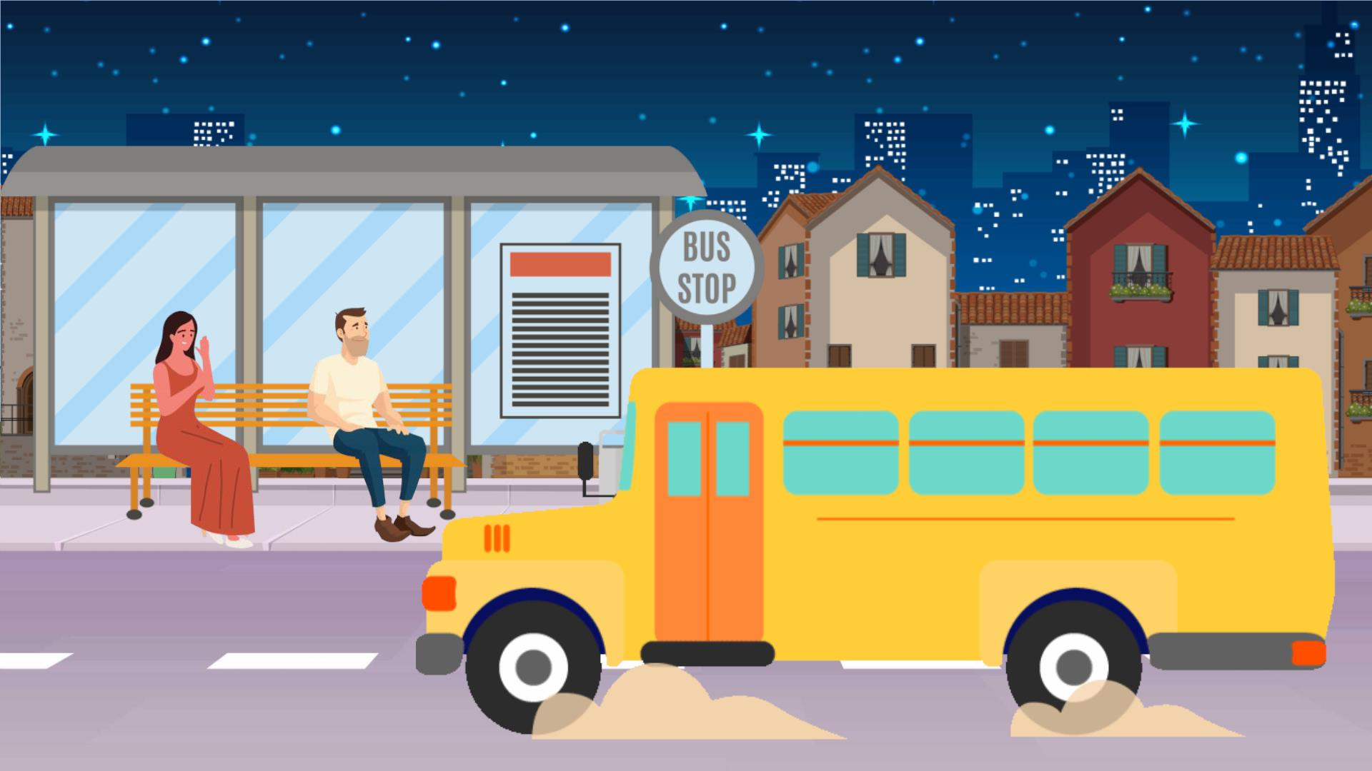

Slide 13

English is the ___________in
many countries around the world
A. means
B. official language
C. model

Slide 14
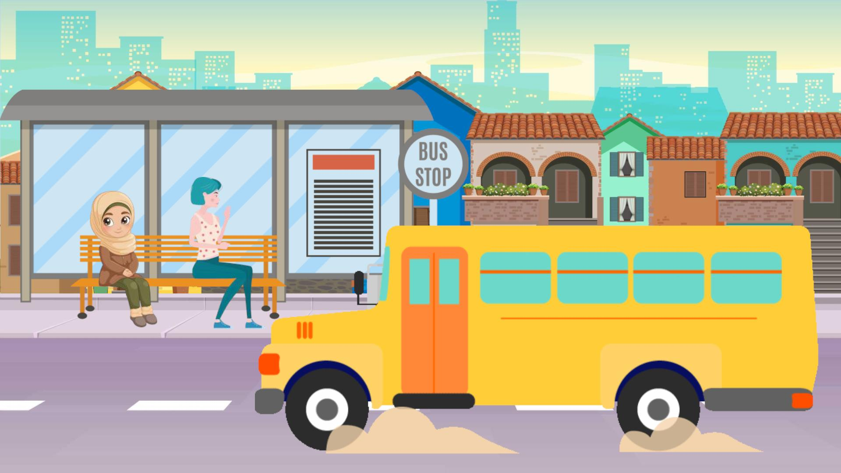

Slide 15

The company was ______ in 1990.
A. established
B. consisted
C. proposed

Slide 16
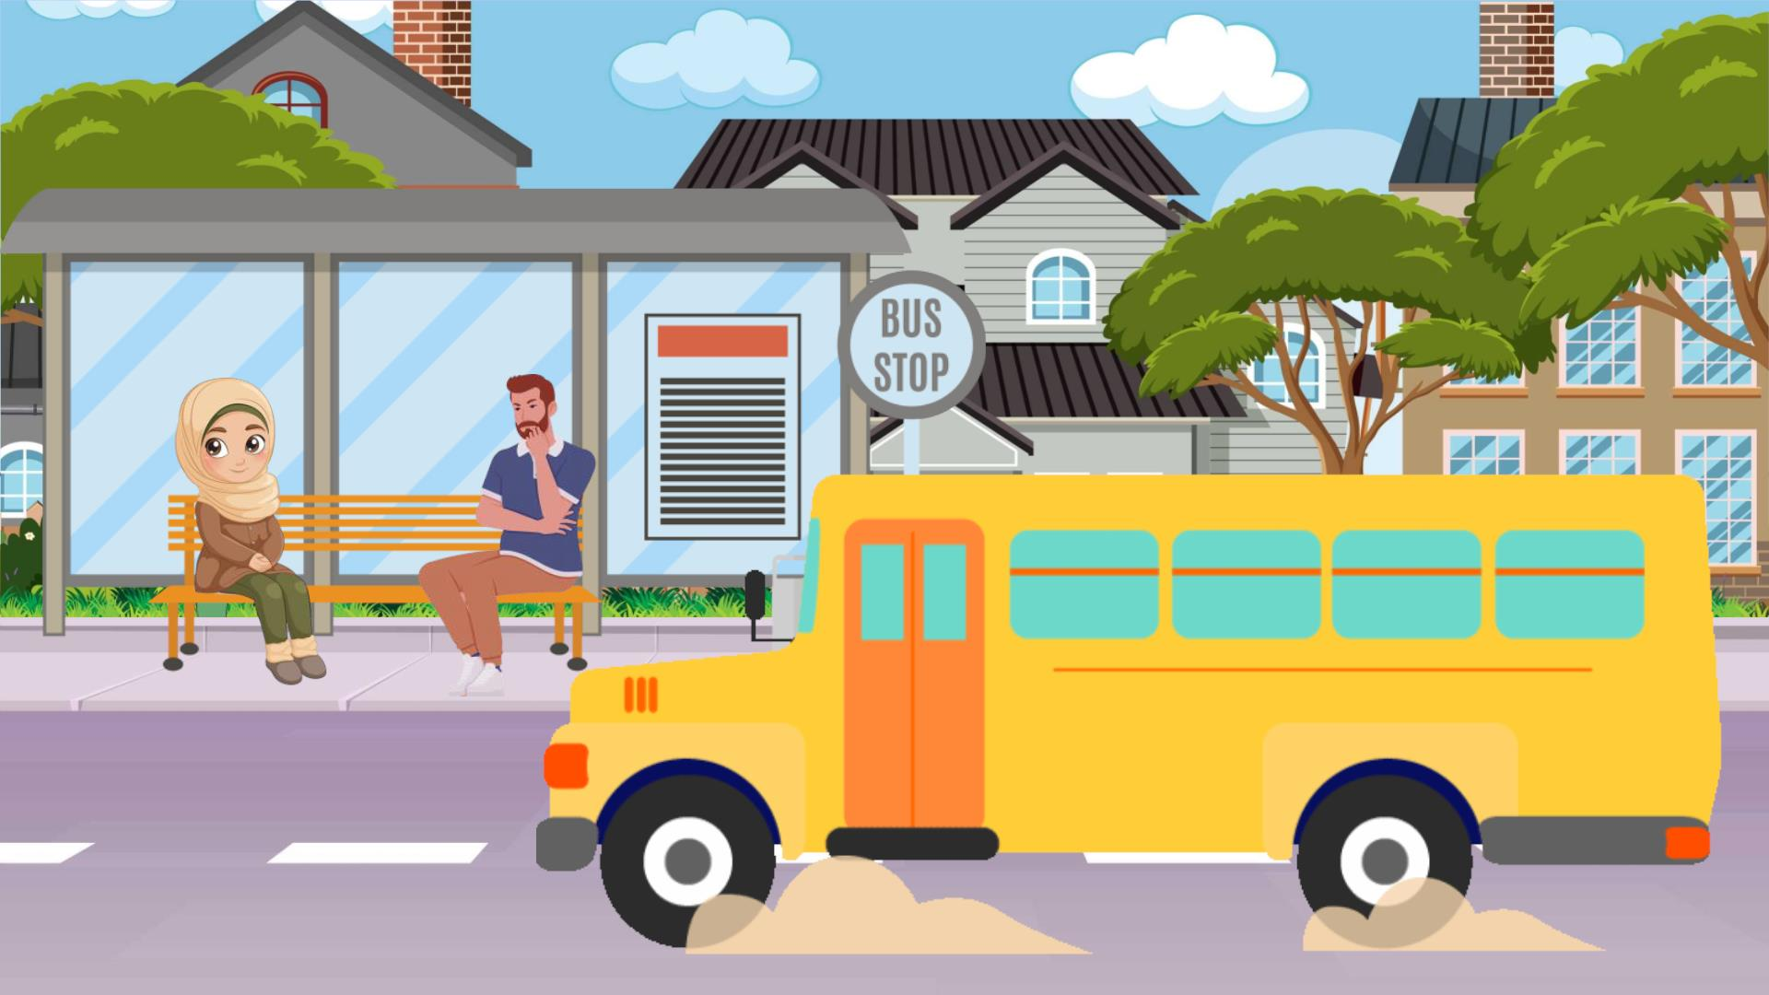

Slide 17

"A rule or level of quality that
people accept as normal"
A. mean
B. consist
C. standard

Slide 18


Slide 19

Singapore is in the ______
because English is used as a
second language there.
A. Inner Circle
B. Outer Circle
C. Expanding Circle

Slide 20


Slide 21

Many people learn English as a
___________to communicate
internationally.
A. second language
B. standard
C. official language

Slide 22
UNIT 9: LESSON 5 – SKILLS 1
READING

Slide 23

UNIT 9: LESSON 5 – SKILLS 1
LOOK AT THE DIAGRAM. PUT THE NAMES OF THE COUNTRIES WHERE
ENGLISH IS SPOKEN IN THE CORRECT CIRCLE.
Expanding Circle
3.
Malaysia
Viet Nam
Singapore
The UK
Russia
Outer Circle
Inner Circle
New Zealand
2.
1.

Slide 24

UNIT 9: LESSON 5 – SKILLS 1
READ THE TEXT AND CHOOSE THE CORRECT ANSWER A, B, C, OR D.
1. What is the text mainly about?
Braj Kachru was a Professor of Linguistics who invented the term ‘World Englishes’. The term refers to the fact that
English has become a global means of communication with a lot of varieties.
A. Professor Braj Kachru
B. The three circles of World Englishes
D. The development of English
In 1985, Kachru proposed a model of the different uses of English around the world. There are three concentric circles in
C. Native speakers of English.
the model.
2. The word “model” in paragraph 2 means ______.
The first of these circles is the Inner Circle, which consists of the traditional English speaking countries, such as the UK,
the USA, Australia, New Zealand, and Canada. In these regions, English is the first language, and their speakers provide
A. an excellent person
the standards of English.
C. a small copy of something
B. an example to copy
D. a description of a system
The next circle is the Outer Circle where English is not the first language but the second or official language. The
3. The phrase “this circle” in paragraph 5 refers to the ______.
countries in this circle include India, Singapore, the Philippines, Pakistan, Malaysia, etc. The speakers of these places
^{f}A^{ol}.^{l o}m^{w}o^{th}d^{e}e^{s}ltandards which the countries in thB^{e}. ^{I}I^{n}n^{n}n^{e}e^{r}r^{ci}C^{rc}i^{l}r^{e}c^{p}le^{rovide.}
The last circle is the Expanding Circle. People in this circle speak English as a foreign language. Some of the countries in
C. Outer Circle
D. Expanding Circle
the Expanding Circle are Brazil, Japan, Russia, and Viet Nam. Speakers of English in these places follow the rules which
the people in the Inner Circle have established.

Slide 25
UNIT 9: LESSON 5 – SKILLS 1
REVIEW READIN

Slide 26
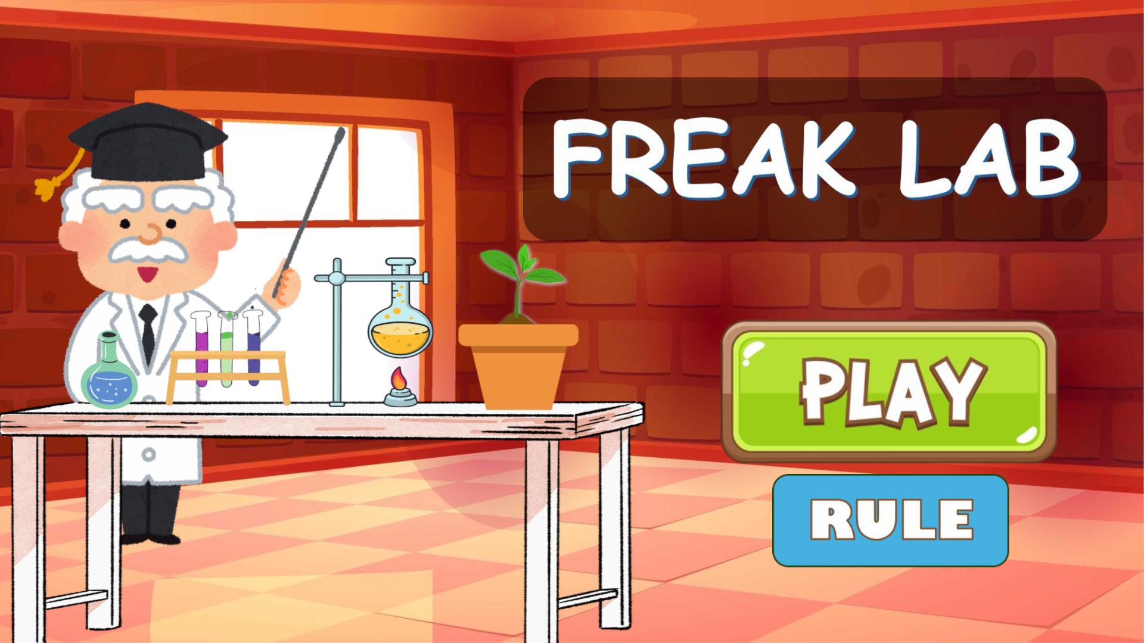

Slide 27
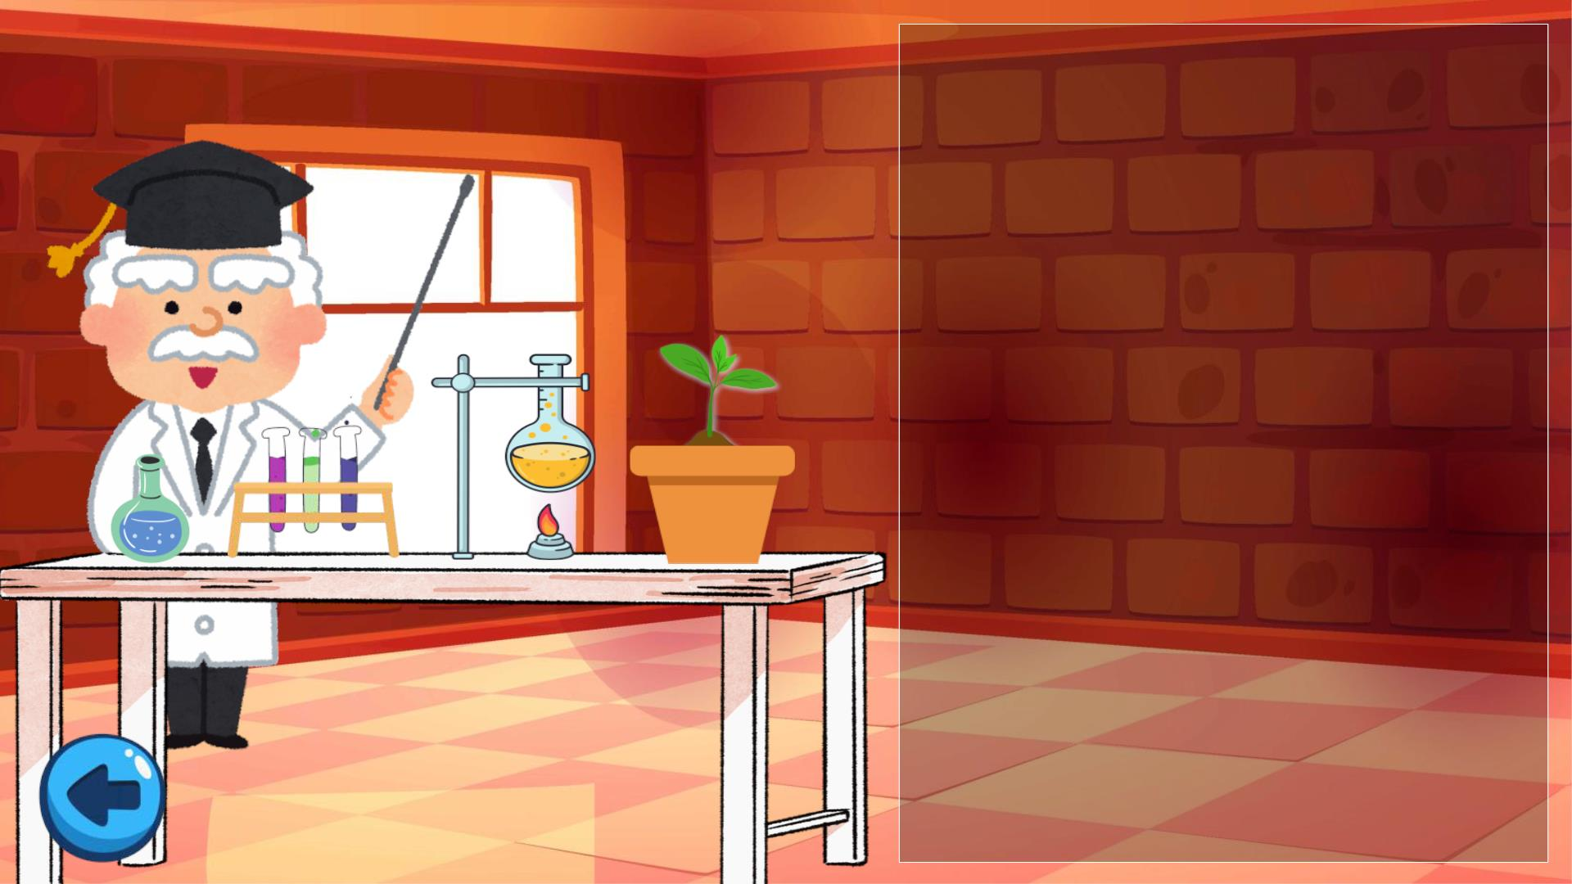
RULE
ꢀ Welcome to the Wacky Lab! ꢀ
You need to find the correct
answers to each question to
uncover
the strange and special
Surprises that await.ꢀ✨
Have fun exploring! ꢁ

Slide 28
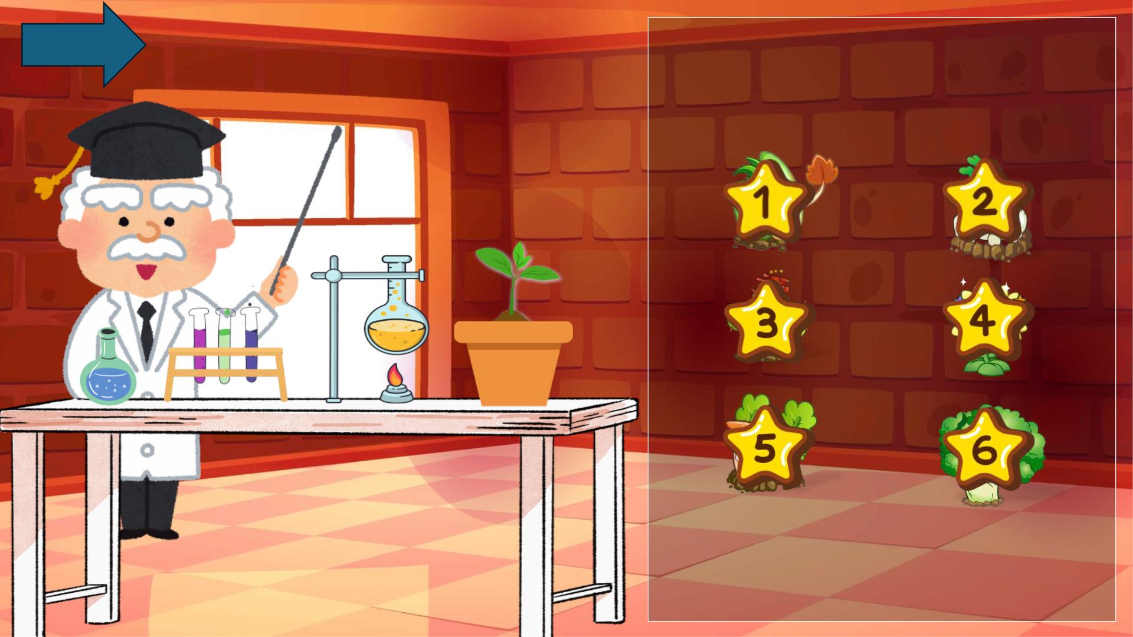
END

Slide 29
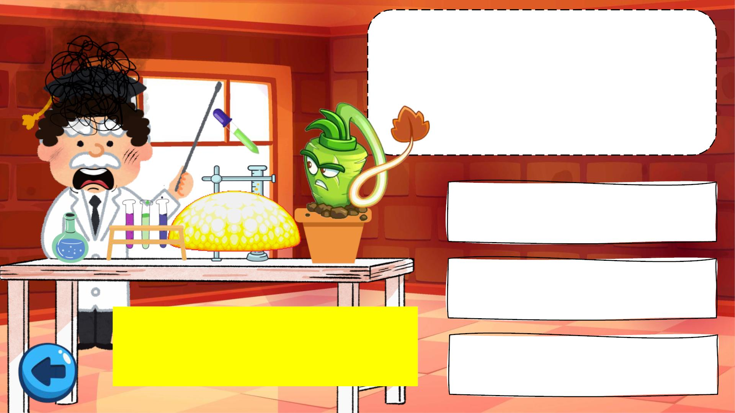
Who invented the
term “World
Englishes”?
A. David Crystal
B. Noam Chomsky
C. Braj Kachru
“Braj Kachru was a Professor of
Linguistics who invented the
term ‘World Englishes’.”

Slide 30

The word “model”
in paragraph 2
means…….
A. an excellent
person
B. an example
to copy
C.a small copy
of something
D.a
description of

Slide 31

The phrase “this circle”
in paragraph 5 refers to
the……
A.model
B. Inner Circle
C. Outer Circle
D.Expanding Circle

Slide 32
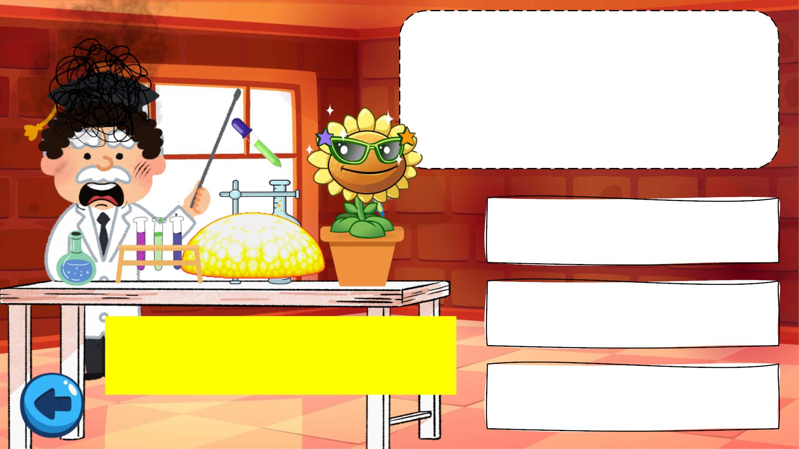
In which circle do
people speak English as
a foreign language?
A. Inner Circle
B. Outer Circle
“The last circle is the Expanding
Circle. People in this circle speak
English as a foreign language.”
C. Expanding Circle

Slide 33
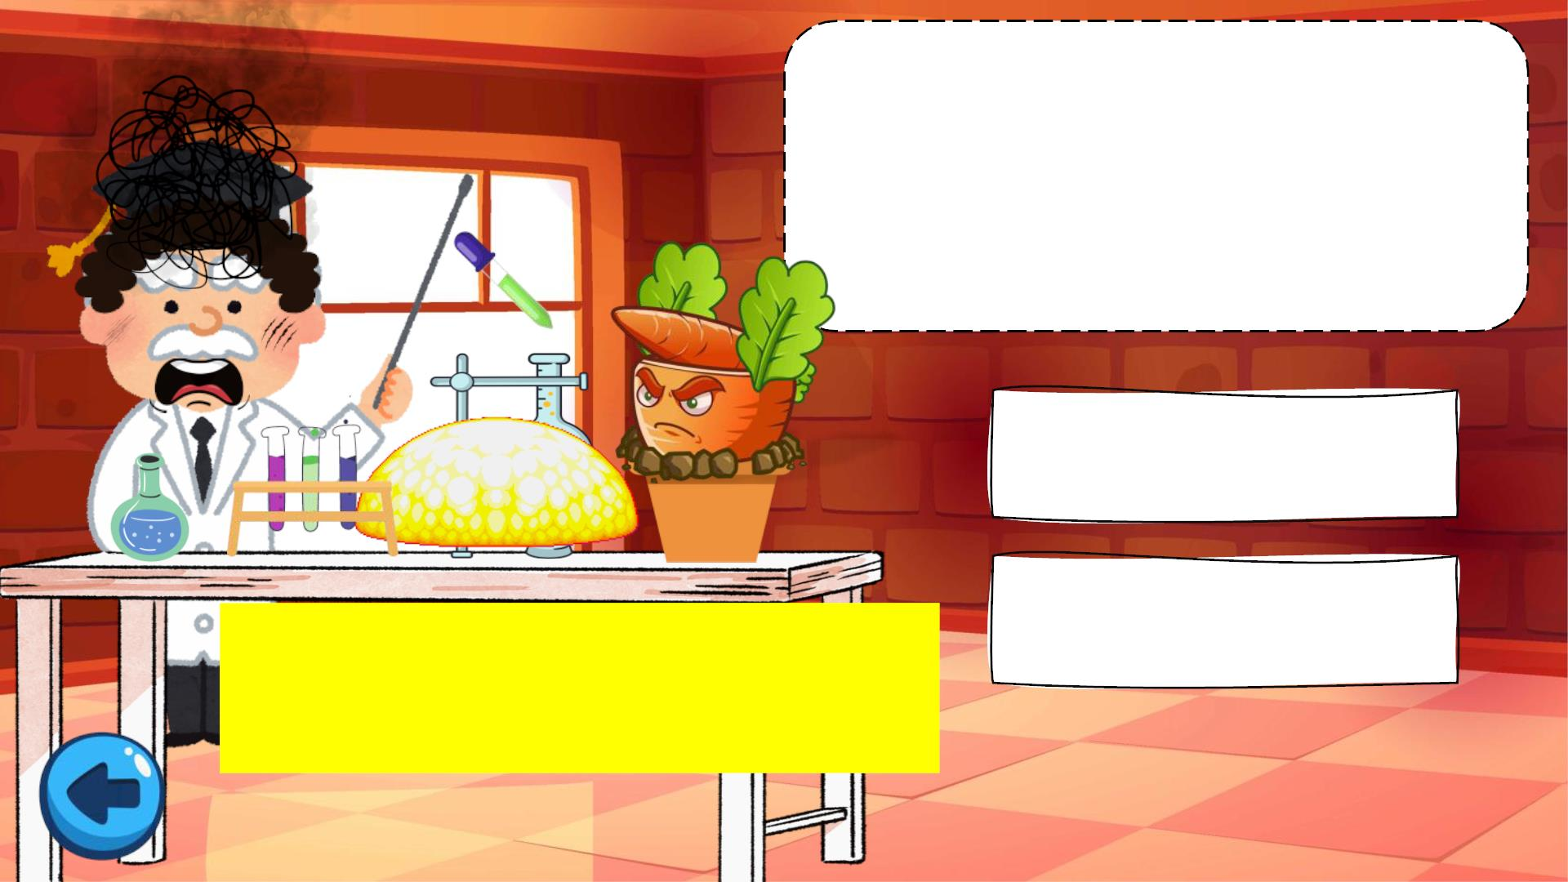
People in the Expanding
Circle follow the rules
made by speakers in the
Inner Circle.
A. True
B. False
“Speakers of English in these
places follow the rules which the
people in the Inner Circle have
established.”

Slide 34

What is the text
mainly about?
A. Professor Braj
Kachru.
B.The three circles of
World Englishes.
C.Native speakers of
English.
D.The development of
English.

Slide 35

UNIT 9: LESSON 5 – SKILLS 1
READ THE TEXT AGAIN AND FILL IN EACH BLANK IN THE
SUMMARY WITH NO MORE THAN TWO WORDS.
Kachru’s Model
first language
– English is the (1) ____________________.
– Countries: the UK, the USA, Australia, etc.
– Speakers provide the standards.
Inner Circle
Outer Circle
– English is the second or (2) _o_f_f_i_c_i_a_l_ language.
– Countries: India, Singapore, the Philippines, etc.
follow
– Speakers (3) ________________ the standards.
– English is a (4) f_o_ _r_e_i_g_n_ _l_a_n_ _g_u_ _a_g_e__.
Expanding Circle
– Countries: Brazil, Russia, Viet Nam, etc.
rules
– Speakers follow the (5) __________ established

Slide 36
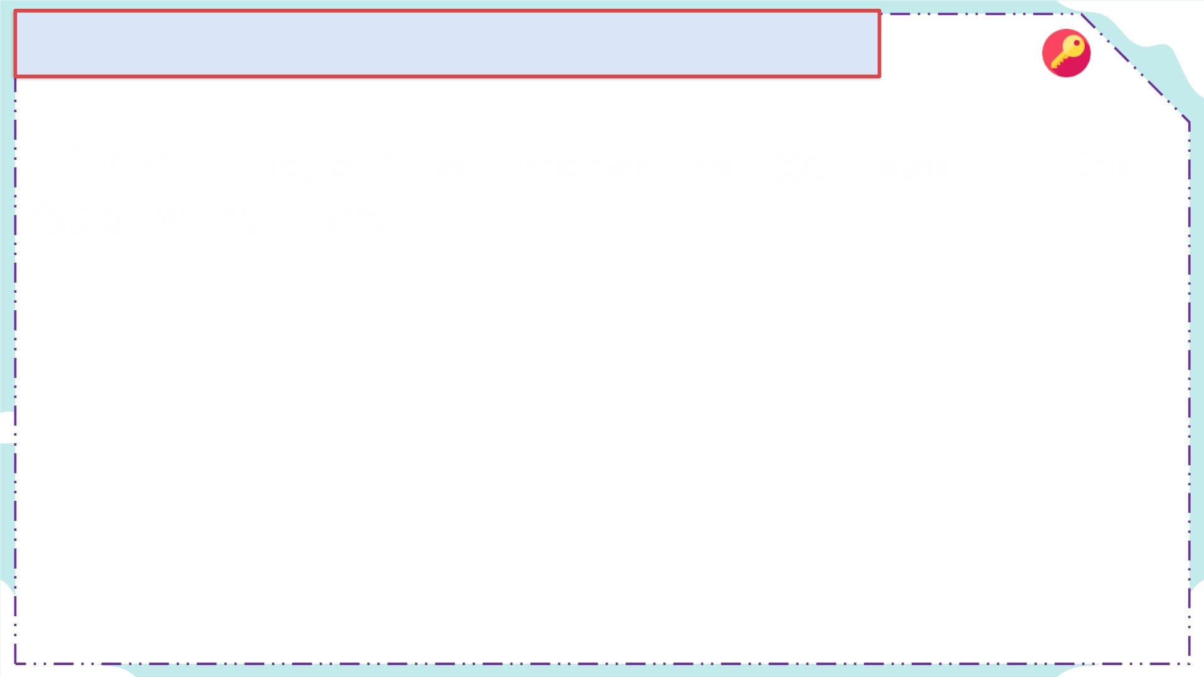
Transition from Reading to Speaking:
- Work in pairs to summarise the text based on the
table of information.
- English has borrowed many words from other
languages. Do you know any Vietnamese words that
have been used in English?
Pho, Banh Mi, Goi Cuon, Bun, Banh Cuon, ao dai,
non la.

Slide 37

UNIT 9: LESSON 5 – SKILLS 1
WORK IN PAIRS. READ THE FOLLOWING WORDS. WHAT DO ALL
THE WORDS HAVE IN COMMON?
banh mi, sushi, robot, piano, kung fu
They are the words which English borrowed from other languages.

Slide 38

SPEAKING
Work in groups. Discuss and write the
meaning/explanation
Vietnamese is the official language of Vietnam.
-Group 1: sushi - Group 2: kung fu
-Group 3:robot - Group 4: piano

Slide 39
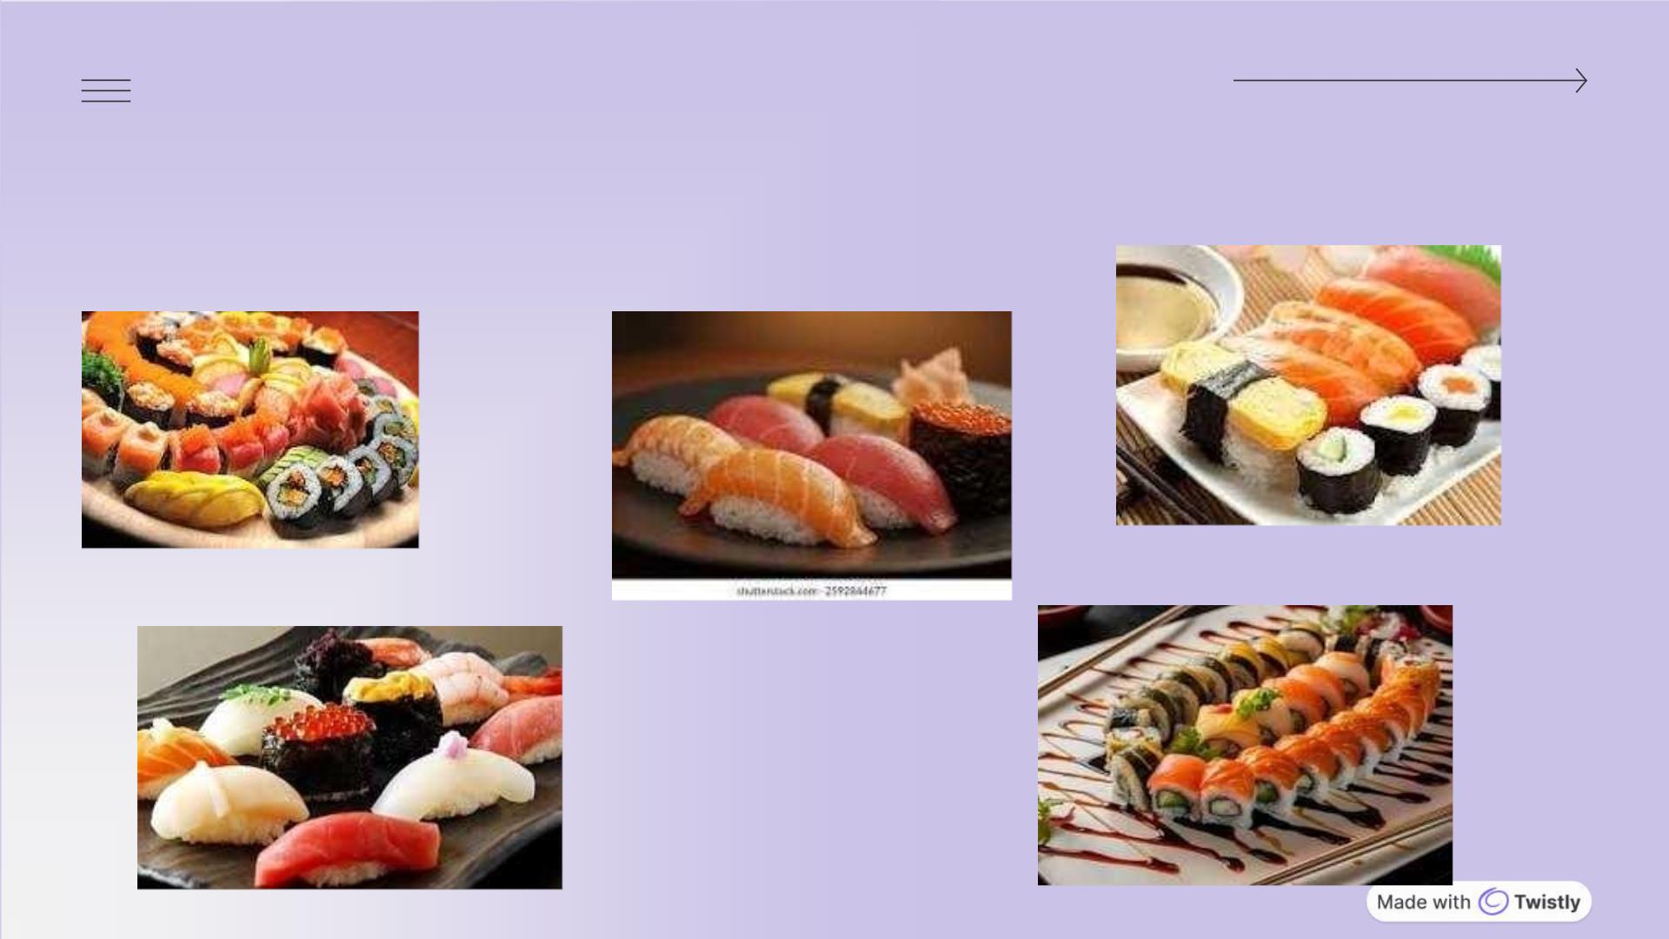
GROUP 1: SUSHI

Slide 40
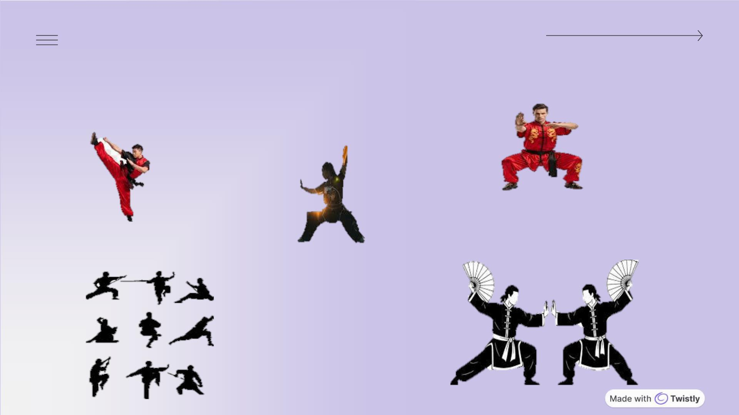
GROUP 2: KUNGFU

Slide 41
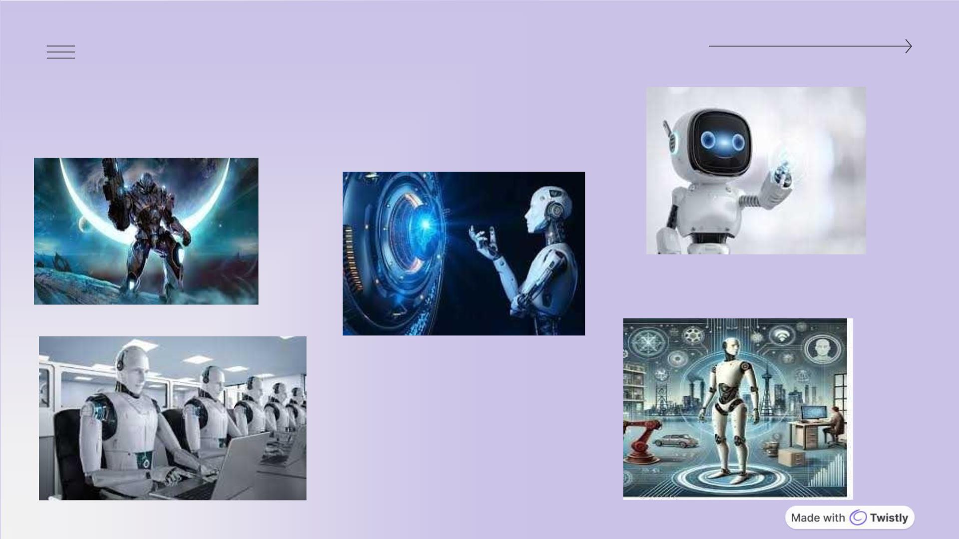
GROUP 3 : ROBOT

Slide 42
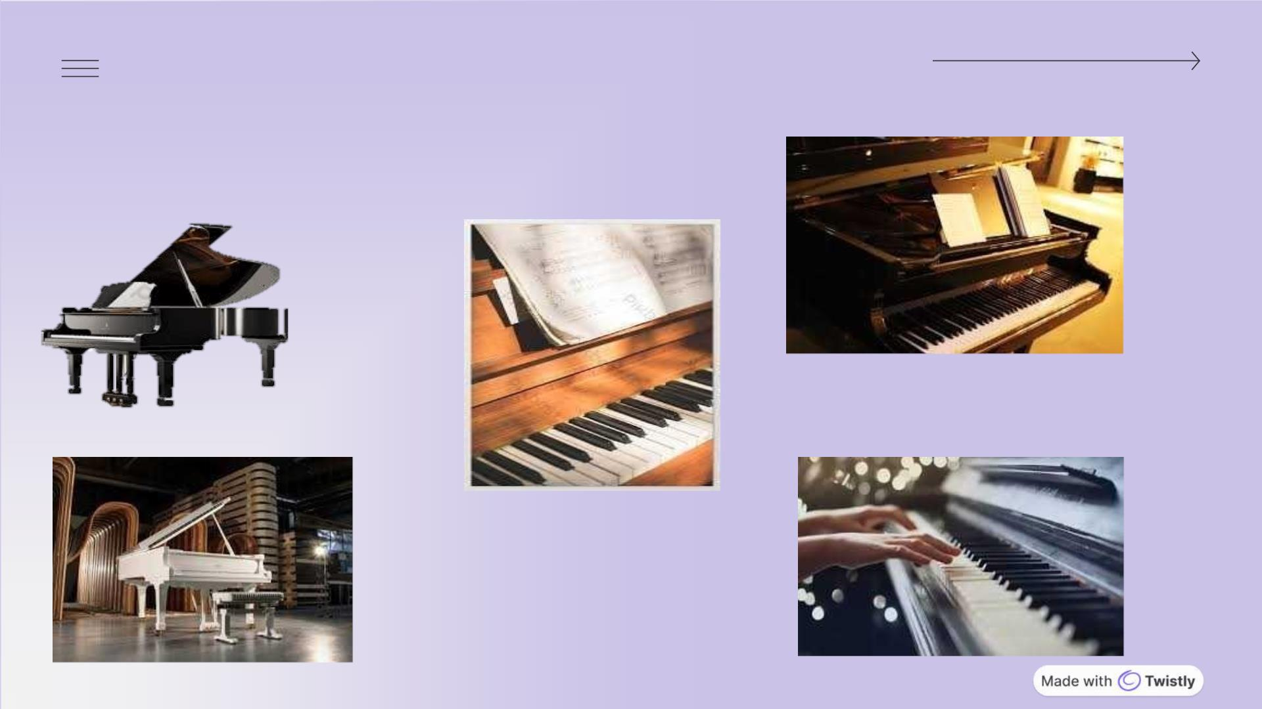
GROUP 4: PIANO

Slide 43

UNIT 9: LESSON 5 – SKILLS 1
CONSOLIDATION
WRAP - UP
HOMEWORD
What have we learnt in this lesson?
- Do exercises in the workbook.
ü Read for general and specific information about - Learn by heart the newwords
the three circles in English.
- Prepare for the next lesson: Unit 9- Lesson 6:
Skills 2
ü Talk about BORROWED WORDS

Slide 44
UNIT 9: LESSON 5 – SKILLS 1
THANK
YOU!

