Slide 1

Unit 1. My new school
Lesson 4. Communication

Slide 2

Objectives
By the end of this lesson, students will be able to:
-
Use the lexical items related to the topic My new
school.
-
-
Know how to introduce someone.
Ask appropriate questions when making friends at
school, know what good qualities a good friend should
have.

Slide 3

Lucky numbers
Rule:
-
-
Divide class into 2 teams.
Choose the number and guess the meaning in each
suggestion.
-
-
The correct answer gets stars following each question.
The team with the most stars will win.

Slide 4

Lucky numbers
1 2 3
4 5 6
7 8 9

Slide 5
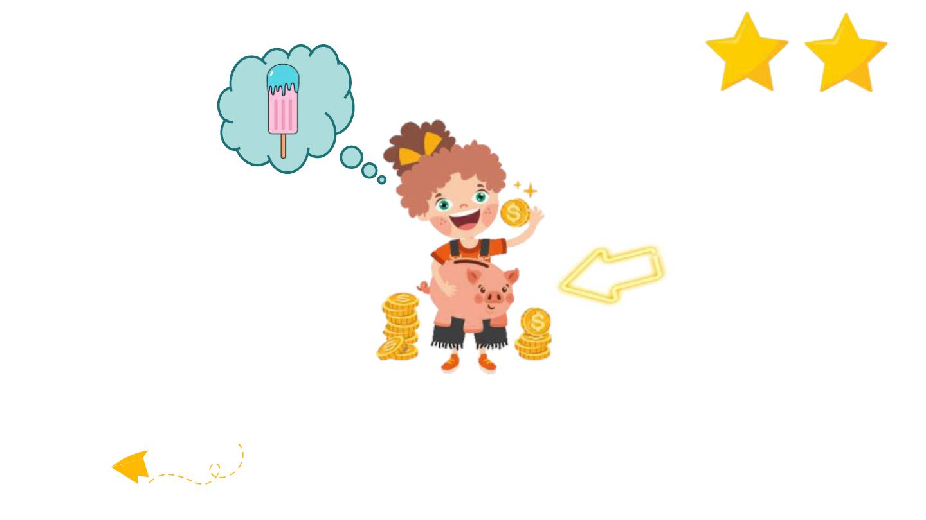
pocket money

Slide 6

go shopping

Slide 7

You get a star!

Slide 8
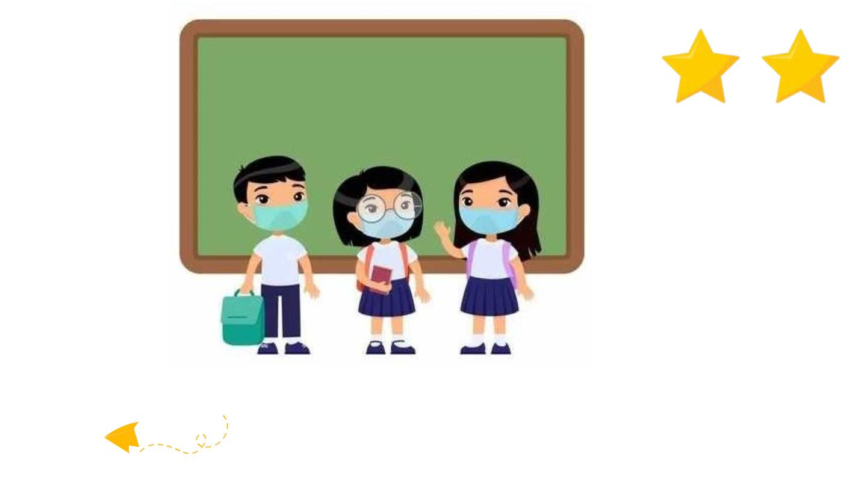
classmate

Slide 9

Lose half of your point ☺

Slide 10

share

Slide 11

Don’t tell anyone
this story!
secret

Slide 12
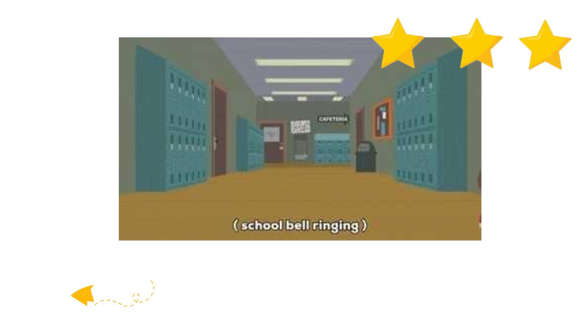
at break time

Slide 13
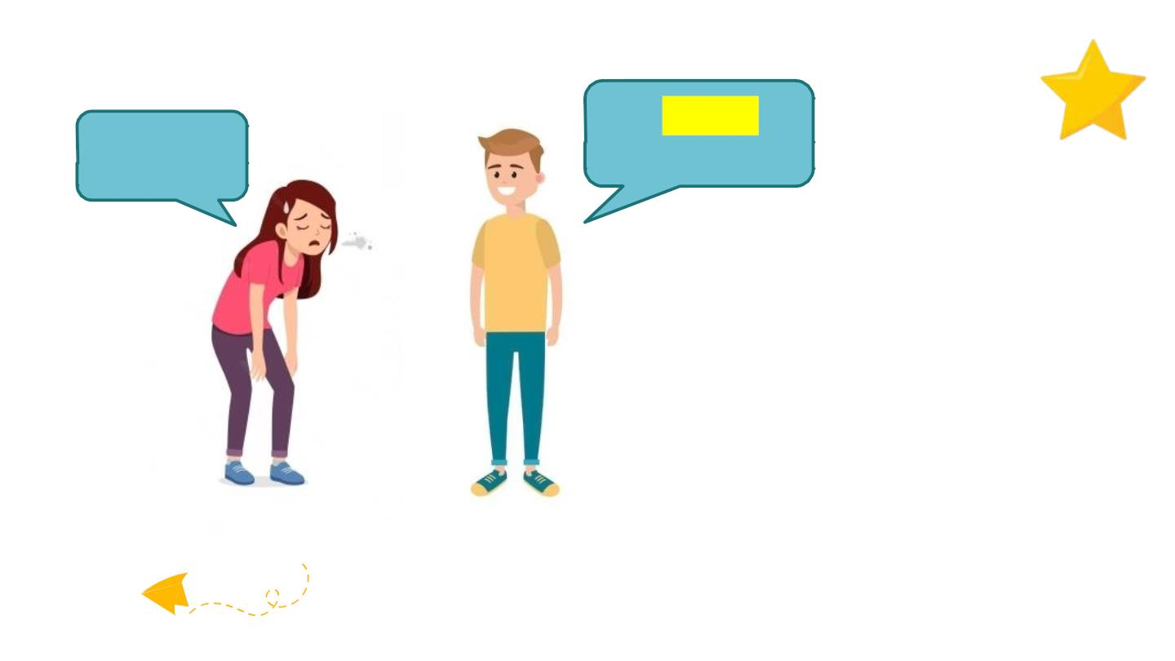
You should go
to bed.
I’m tired.
advice

Slide 14
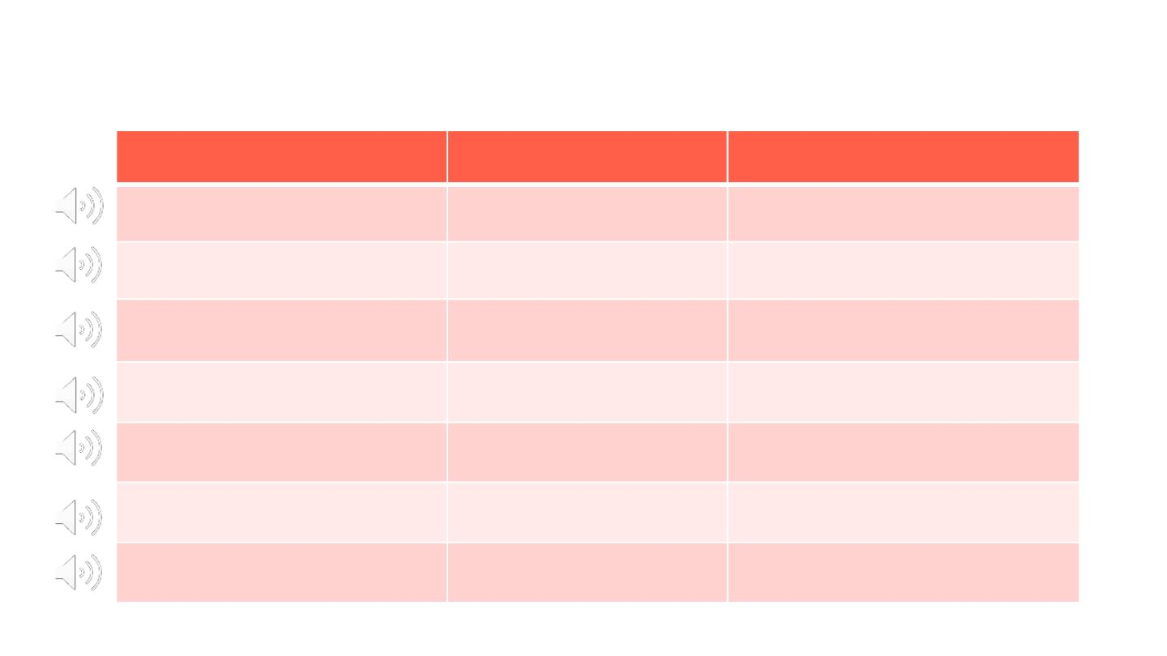
Vocabulary
New words
1. pocket money (n)
2. go shopping (v)
3. classmate (n)
4. share (v)
Pronunciation
Meaning
tiền tiêu vặt
đi mua sắm
/ˈpɒkɪt mʌni/
/ɡəʊ ˈʃɒpɪŋ/
/ˈklɑːsmeɪt/
/ʃeə(r)/
bạn cùng lớp
chia sẻ
5. secret
/ˈsiːkrət/
bí mật
6. at break time
7. advice (n)
/ət ˈbreɪk taɪm/ vào giờ nghỉ giải lao
/ədˈvaɪs/ lời khuyên

Slide 15
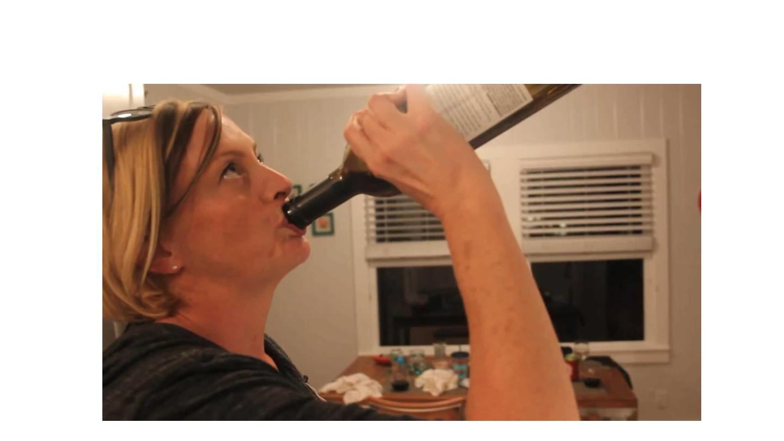
Watch video and answer question:
What are they doing in their first meeting?

Slide 16
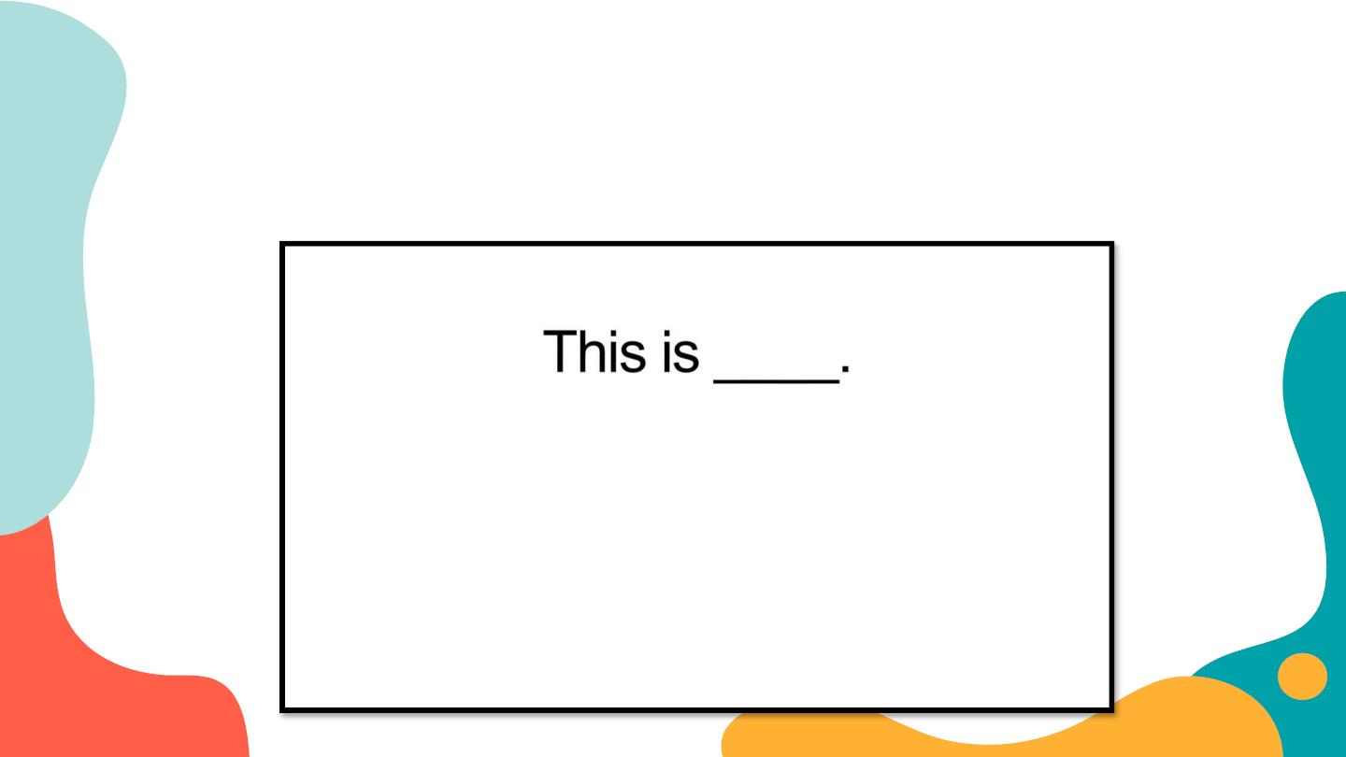
After the video
What phrases do they use to introduce someone?

Slide 17

Everyday
English
Introducing someone

Slide 18
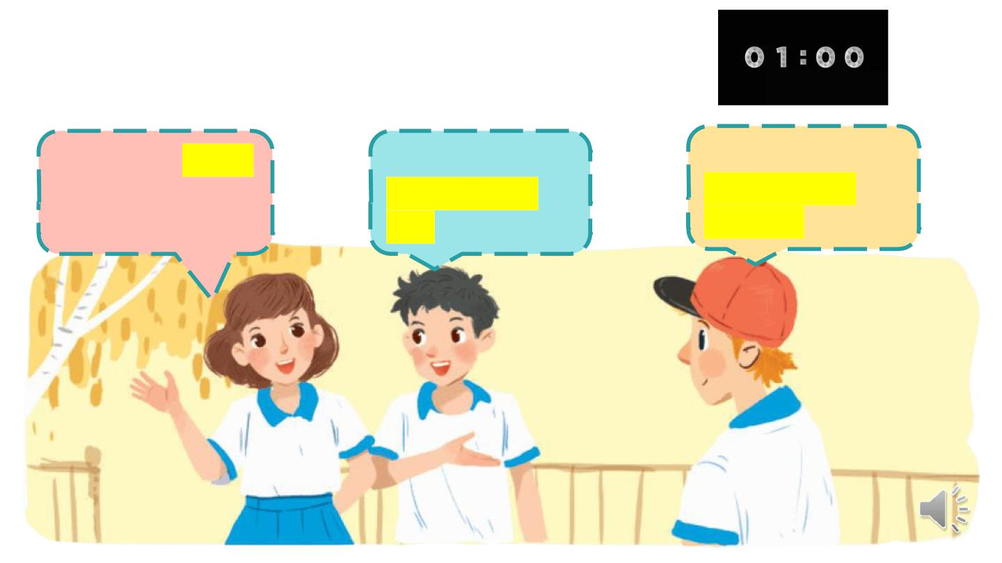
Ex 2. (p 11) Work in groups in 1 minute.
Practice introducing a friend to someone else.
Vy: Phong, this is
Duy, my new
friend.
Phong: Hi, Duy.
Nice to meet
you.
Duy: Hi, Phong.
Nice to meet
you, too.

Slide 19


New friends at school

Slide 20

Ex 3. (p 11) Read and tick the questions you think are suitable to ask a new friend at school?
✓ Are you from around here?
✓ Do you like music?
3. How much money do you get?
✓ What is your favourite subject at school?
5. Are you hungry now?
Write two more
✓ Do you play football?
questions on the
paper.
✓ How do you go to school every day?
8. Where do you often go shopping?

Slide 21
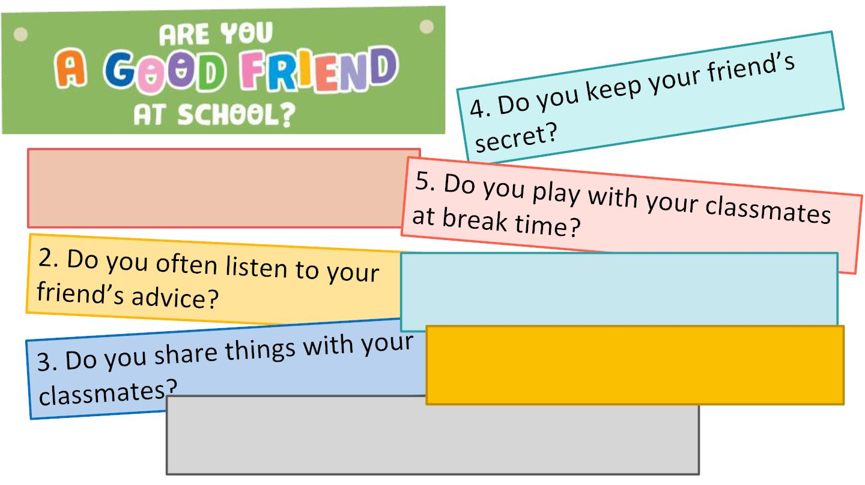
Ex 4. (p 11) Answer the questions.
1. Do you remember all your
new classmate’s names?
6. Do you help your classmates
with their homework?
7. Do you go to school with your
friends?
8. Do you listen when your classmates are
talking?

Slide 22
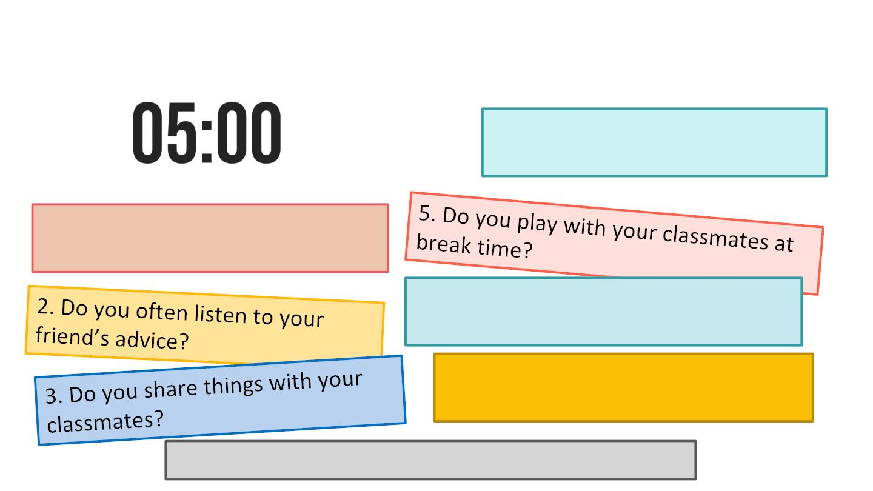
Ex 5. (p 11) Work in groups in 5 minutes. Take turns to interview the others. Use the
questions above.
4. Do you keep your friend’s
secret?
1. Do you remember all your new
classmate’s names?
6. Do you help your classmates with
their homework?
7. Do you go to school with your
friends?
8. Do you listen when your classmates are talking?

Slide 23

Presentation!!!
Tell about your
good friend
at school?

Slide 24

RECAP
What have you learnt today?
A Talking about you at school.
Introducing someone –
B
talking about new friends at school.
C Meeting new friends.

Slide 25

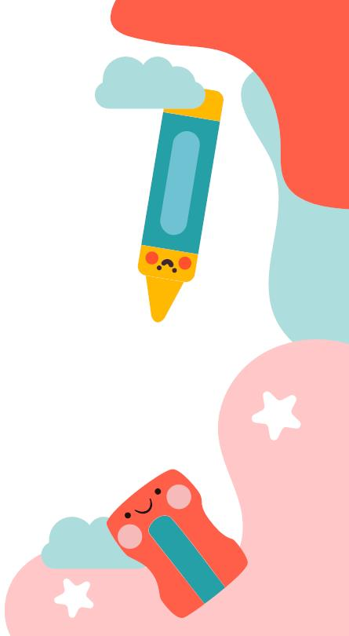
Thank
you!

