Slide 1

Unit 2: My house
Lessonꢀ5ꢀ–ꢀSkillsꢀ1

Slide 2

Objectives
Read for specific information about rooms and furniture.
Describe one room and positions of things in the room.

Slide 3
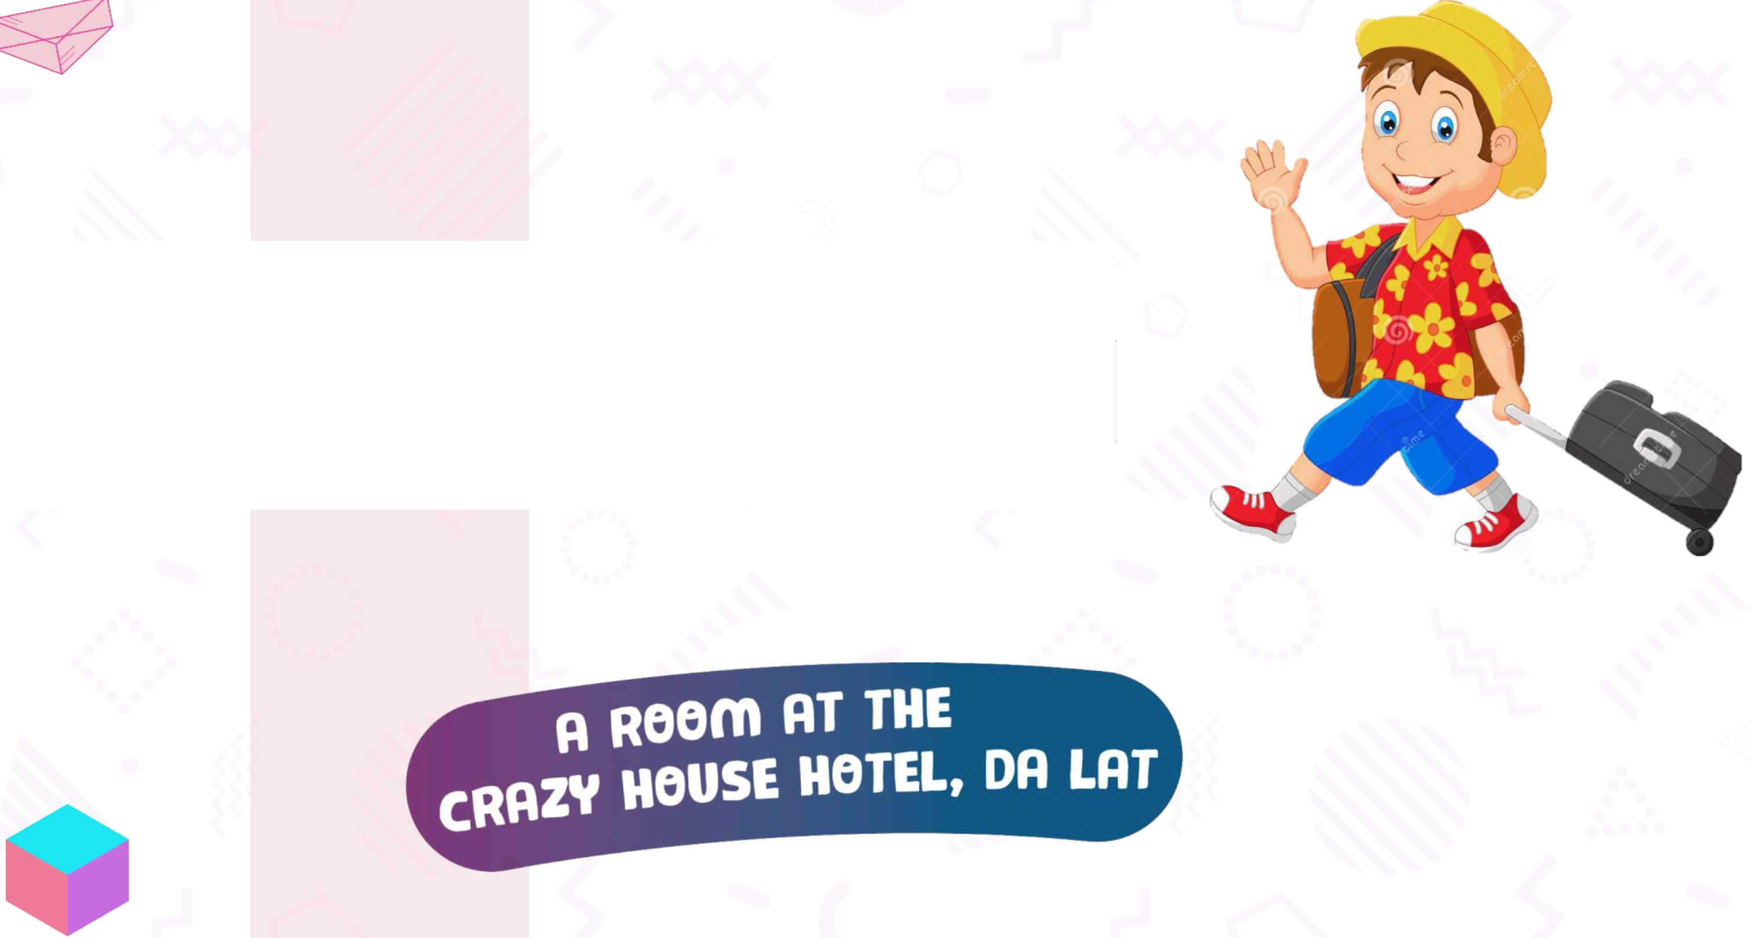
ThisꢀisꢀNick.ꢀHeꢀisꢀhavingꢀaꢀtripꢀtoꢀDaꢀLat.
Heꢀisꢀstayingꢀinꢀaꢀhotelꢀwithꢀaꢀspecial name
Guessꢀtheꢀletters.

Slide 4
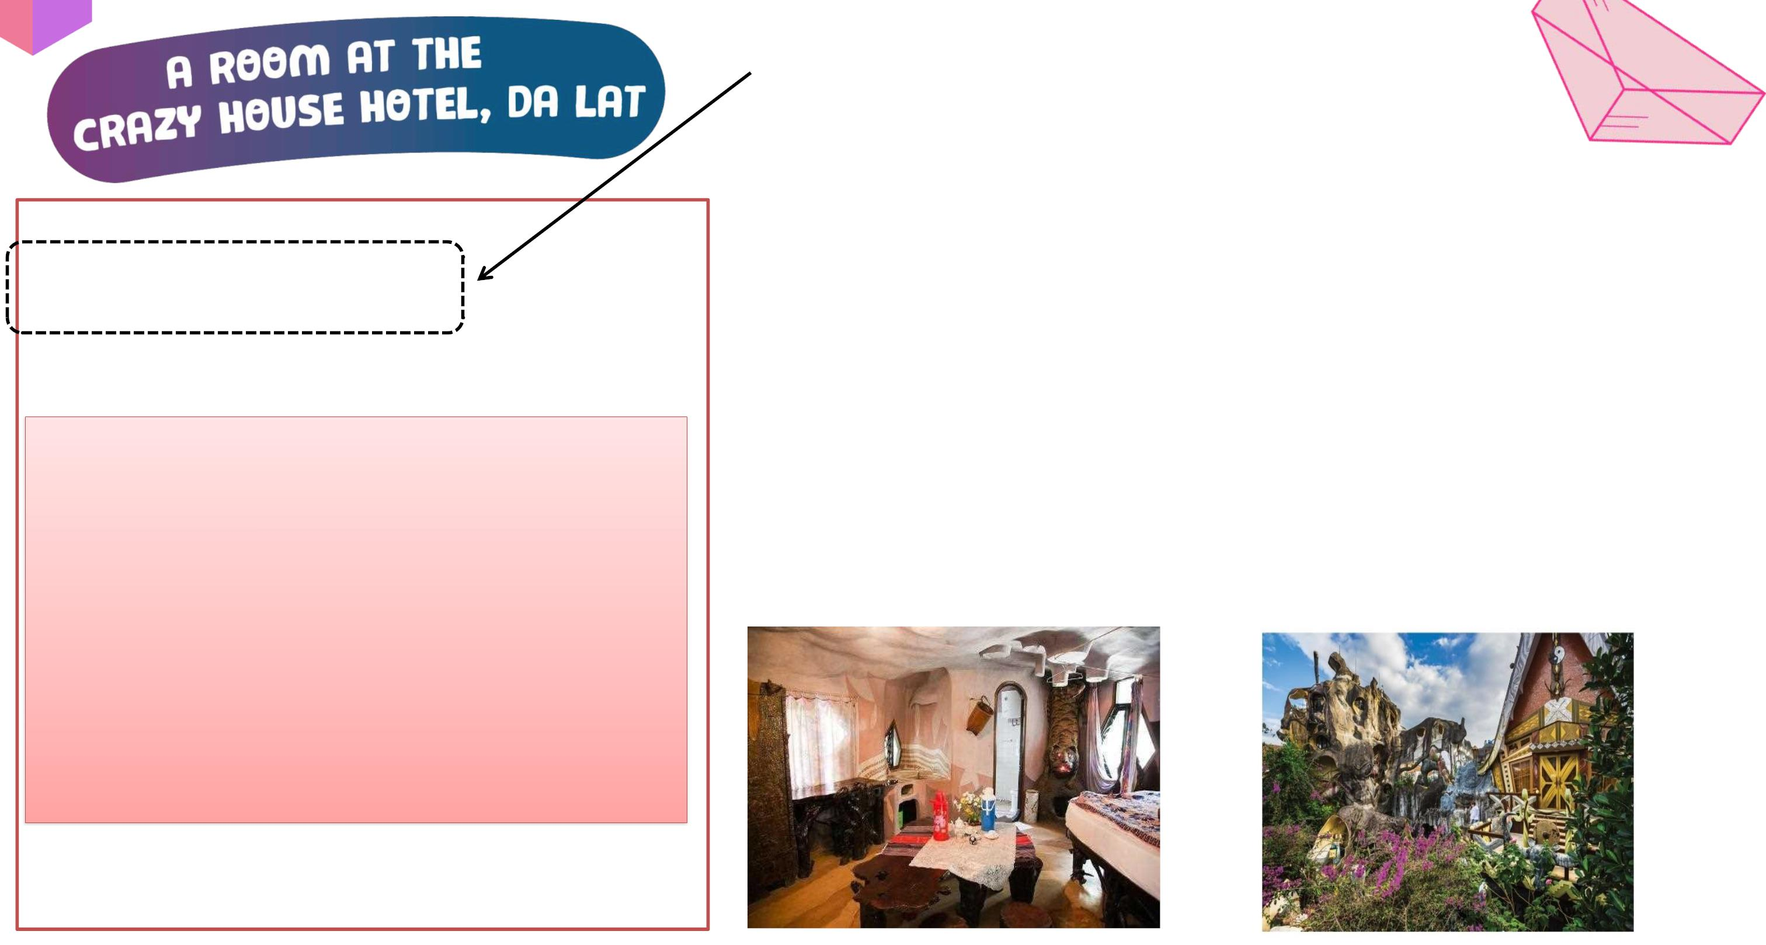
email addresses
Before we read the text, can you guess?
To:ꢀphong@webmail.com;
mi@webmail.com
1.ꢀIsꢀitꢀanꢀemailꢀorꢀaꢀletter?
Subject:ꢀAꢀroomꢀatꢀtheꢀCrazyꢀHouseꢀHotel
HiꢀPhongꢀandꢀMi,ꢀ
=> It’s an email.
2.ꢀWhatꢀisꢀtheꢀtextꢀabout?
ꢀ
ꢀ
=> Nick's room at the Crazy House Hotel.
Seeꢀyouꢀsoon!
Nick

Slide 5

Reading skill: Predicting
Predictingꢀmakesꢀreadingꢀeasier.
Beforeꢀreading,ꢀlookꢀatꢀtheꢀpictures,ꢀdesignꢀandꢀtittleꢀtoꢀgu
theꢀtopicꢀofꢀtheꢀtext.
Thinkꢀaboutꢀwhatꢀyouꢀknowꢀaboutꢀtheꢀtopic.

Slide 6
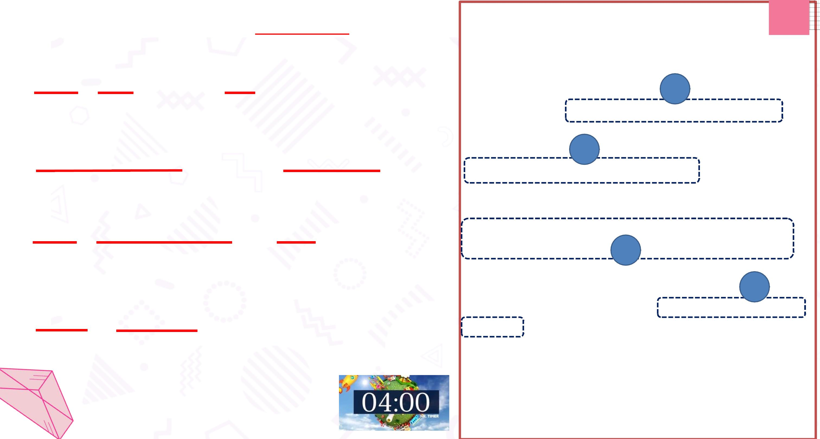
Ex.3 - Read the email and answer these questions
To:ꢀphong@webmail.com;
mi@webmail.com
Subject:ꢀAꢀroomꢀatꢀtheꢀCrazyꢀHouseꢀHotel
1. Who is Nick in Da Lat with?
HiꢀPhongꢀandꢀMi,ꢀ 1
→ His parents.
Howꢀareꢀyou?ꢀI'mꢀinꢀDaꢀLatꢀwithꢀmyꢀparents.ꢀWeꢀ
areꢀstayingꢀatꢀtheꢀCrazyꢀHouseꢀHotel.ꢀWow!ꢀItꢀ
reallyꢀisꢀcrazy.ꢀ
2
2. How many rooms are there in the hotel?
Thereꢀareꢀtenꢀroomsꢀinꢀtheꢀhotel.ꢀThere’sꢀaꢀ
KangarooꢀRoom,ꢀanꢀEagleꢀRoom,ꢀandꢀevenꢀanꢀ
AntꢀRoom.ꢀI’mꢀstayingꢀinꢀtheꢀTigerꢀRoom.ꢀIt’sꢀ
calledꢀtheꢀTigerꢀRoomꢀbecauseꢀthere’sꢀaꢀbigꢀ
→ There are ten rooms.
3. Why is the room called the Tiger room?
tigerꢀonꢀtheꢀwall.
3
→ Because there's a big tiger on the wall.
Theꢀtigerꢀisꢀbetweenꢀtheꢀbathroomꢀdoorꢀandꢀtheꢀ
window.ꢀTheꢀbedꢀisꢀunderꢀtheꢀwindow,ꢀbutꢀtheꢀ
windowꢀisꢀaꢀstrangeꢀshape.ꢀIꢀputꢀmyꢀbagꢀunderꢀ
theꢀbed.ꢀThere’sꢀaꢀlamp,ꢀaꢀwardrobeꢀandꢀaꢀdesk.ꢀ
YouꢀshouldꢀstayꢀhereꢀwhenꢀyouꢀvisitꢀDaꢀLat.ꢀIt’sꢀ
great.
4. Where is Nick’s bag?
→ Under the bed.
Youꢀshouldꢀvisitꢀhere,ꢀit'sꢀgreat.
Seeꢀyouꢀsoon!
Nick

Slide 7

Enter the link in the chat box.
Go to Liveworksheetand choose the things in
the Tiger room
To:ꢀphong@webmail.com;
mi@webmail.com
Subject:ꢀAꢀroomꢀatꢀtheꢀCrazyꢀHouseꢀHotel
HiꢀPhongꢀandꢀMi,ꢀ
a wardrobe
a cupboard
a lamp
Howꢀareꢀyou?ꢀI'mꢀinꢀDaꢀLatꢀwithꢀmyꢀparents.ꢀWeꢀ
areꢀstayingꢀatꢀtheꢀCrazyꢀHouseꢀHotel.ꢀWow!ꢀItꢀ
reallyꢀisꢀcrazy.ꢀ
Thereꢀareꢀtenꢀroomsꢀinꢀtheꢀhotel.ꢀThere’sꢀaꢀ
KangarooꢀRoom,ꢀanꢀEagleꢀRoom,ꢀandꢀevenꢀanꢀ
AntꢀRoom.ꢀI’mꢀstayingꢀinꢀtheꢀTigerꢀRoom.ꢀIt’sꢀ
calledꢀtheꢀTigerꢀRoomꢀbecauseꢀthere’sꢀaꢀbigꢀ
tigerꢀonꢀtheꢀwall.
a window
a cooker
a shelf
The tiger is between the bathroomo odroꢀaonrdaꢀtnhdeꢀ
the window. The bed is under theww,ꢀibnudtoꢀtwh e,ꢀ
but the window is a strange shapeꢀb.aIgpꢀuuntdmeyrꢀ
bag under the bed. There’s a lamepꢀa, nadꢀaꢀdesk.ꢀ
wardrobe and a desk. You shouldꢀ DstaaꢀLyaht.eꢀIrte’sꢀ
when you visit Da Lat. It’s great.
Youꢀshouldꢀvisitꢀhere,ꢀit'sꢀgreat.
a desk
a tiger
Room’s name
To describe a room, what
should we include?
Things and their
Seeꢀyouꢀsoon!
position in the room
Nick

Slide 8
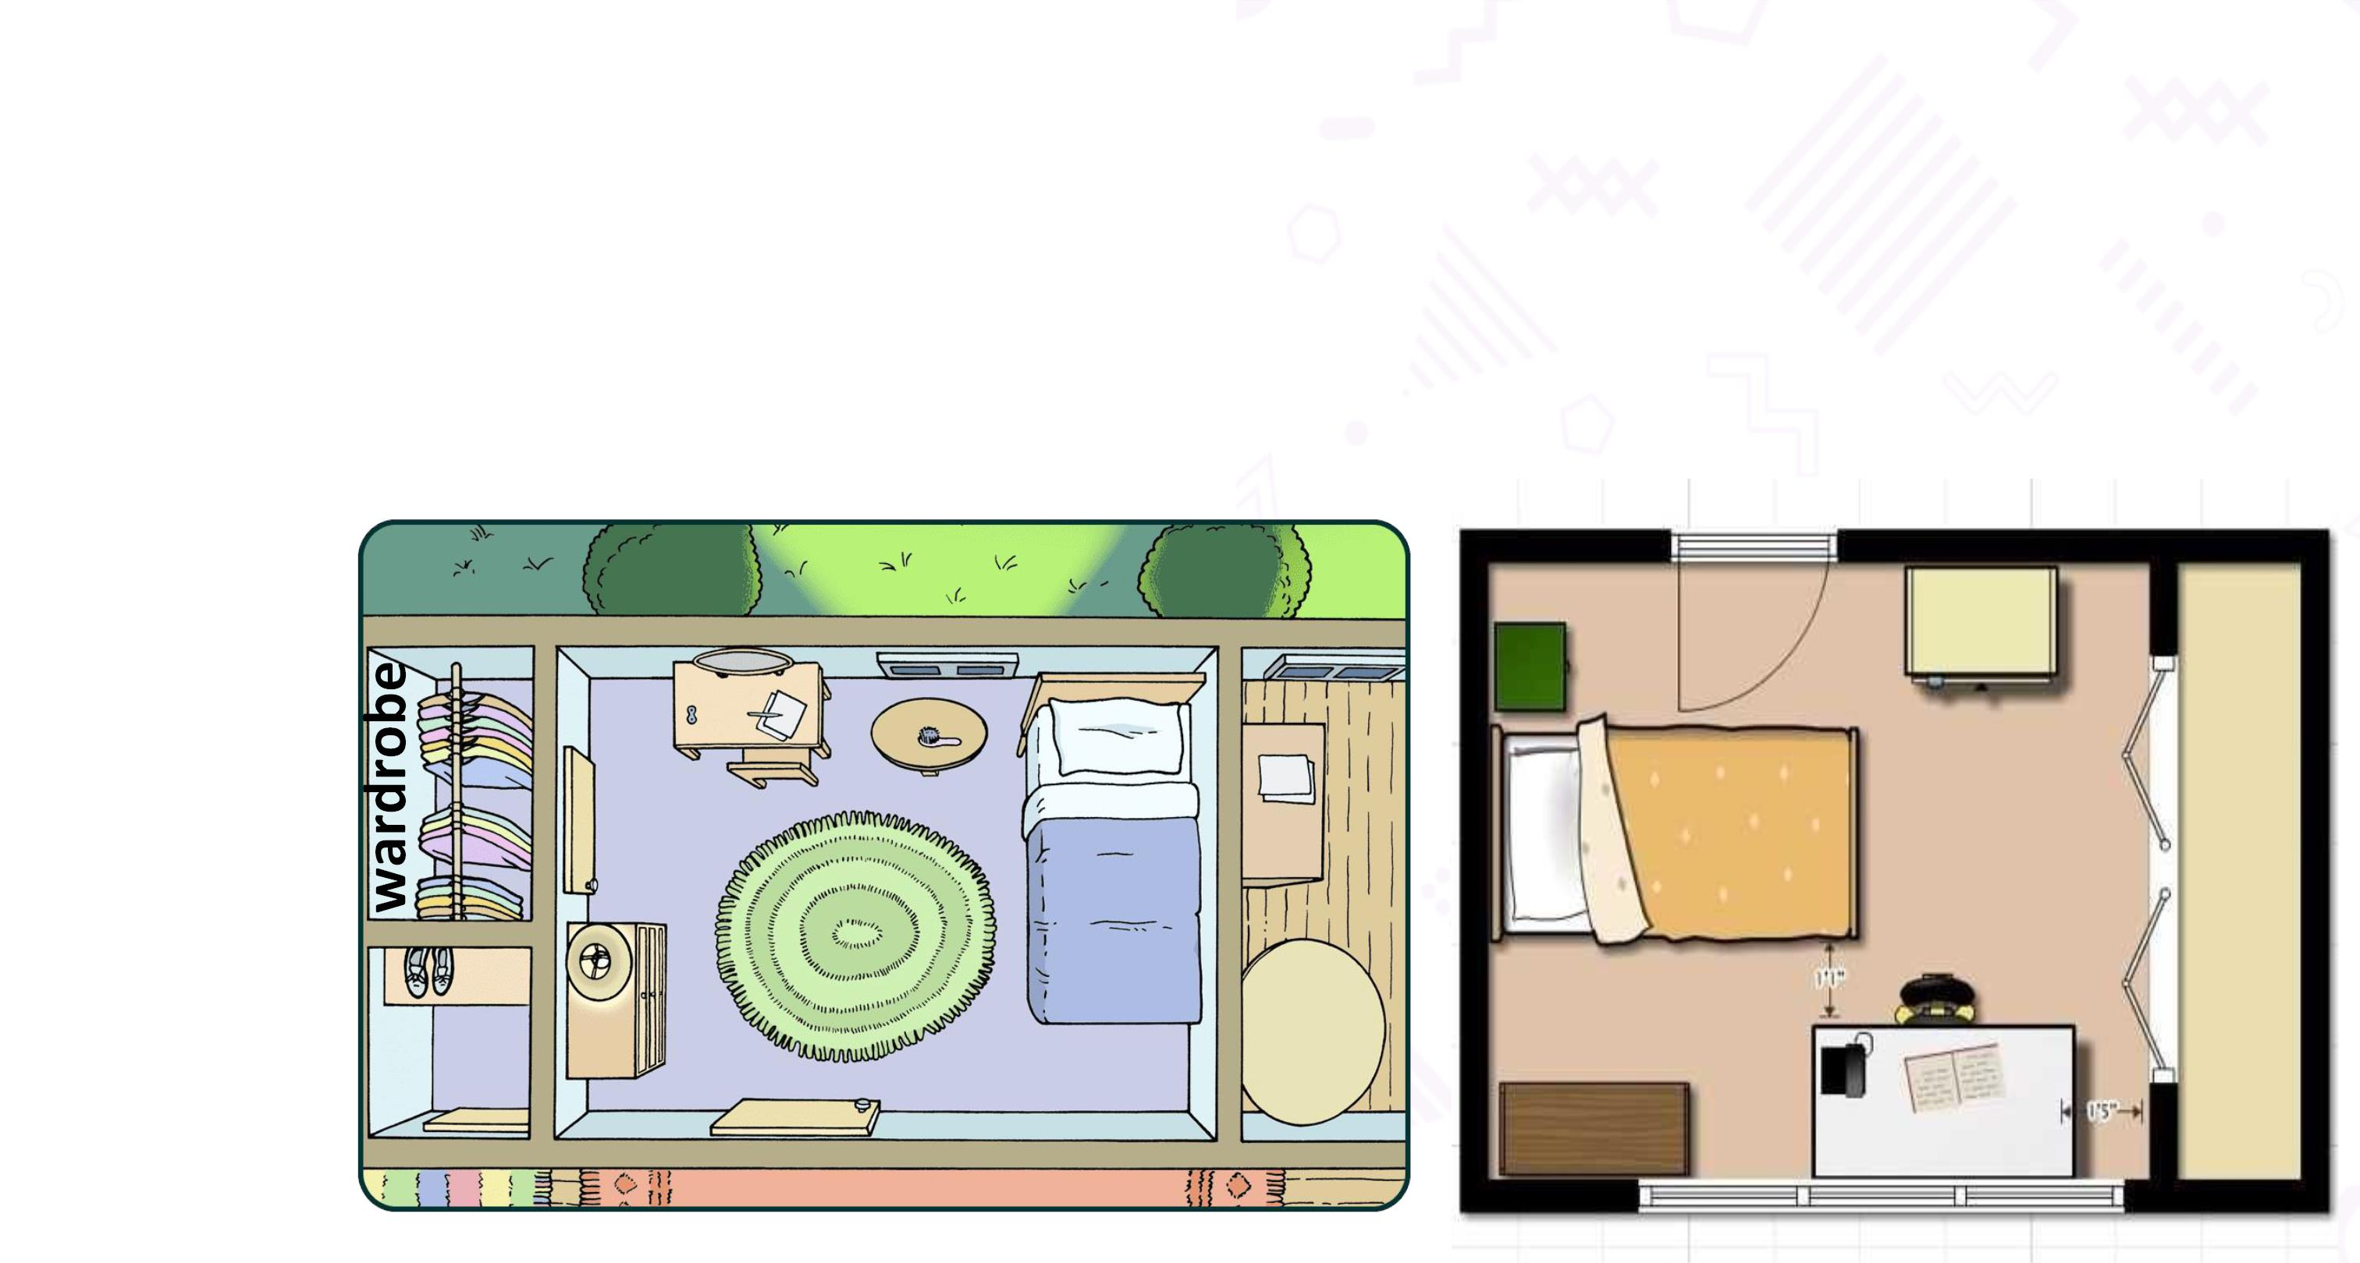
To attract more people, the Crazy House Hotel is going to add
a new room.
In group of 6,
Draw a plan for the new room and talk about it.
Example:
window
desk
bed

Slide 9
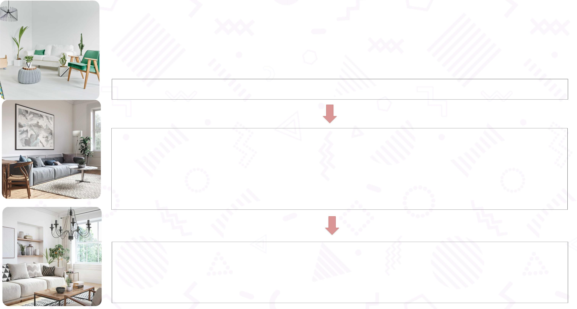
Procedure of group work
Step 1: Go to the private room and join your group
Step 2: Decide the role of each person in your group:
o Who is leader? (trưởng nhóm)
o Who are room designers? (người thiết kế phòng)
o Who are presenters? (người thuyết trình)
Step 3: Go to Google Jamboard and create the new room
(8 minutes)
Your Room number in Teams is your Group number

Slide 10

Show time!

Slide 11

Wrap-up
1.ꢀWhatꢀskillsꢀhaveꢀyouꢀlearnedꢀtoday?ꢀ
Readingꢀ&ꢀspeaking
2.ꢀWhatꢀisꢀtheꢀmainꢀtopicꢀofꢀtheꢀtext?
Nick’sꢀroomꢀatꢀtheꢀCrazyꢀHouseꢀhotel
3.ꢀToꢀdescribeꢀaꢀroom,ꢀwhatꢀshouldꢀweꢀinclude?
Room’sꢀnameꢀ&ꢀthingsꢀinꢀtheꢀroom

Slide 12

Thank You
And See You
Next Time

Slide 13

Presentation check-list
Yes No
1. Does the talk have 3 parts: Opening, body and closing?
2. Does the speaker give a name for the new room?/ Is there a
photo/picture/drawing of it?
3. What things are there in the room? Where are they?
4. What prepositions do they use?
5. Does the speaker use the present simple?
6. Does the speaker talk in the limited time (2 mins)?

