Slide 1

UNIT 4:
My neighbourhood
Lesson 4: Communication

Slide 2

How can you identify places
and give directions in a city?

Slide 3

This lesson, we will...
● Ask for and give directions to places
● identify places and give directions in a city
● use first, then, after that and finally
● make an audio guide

Slide 4

Asking for and giving
directions

Slide 5
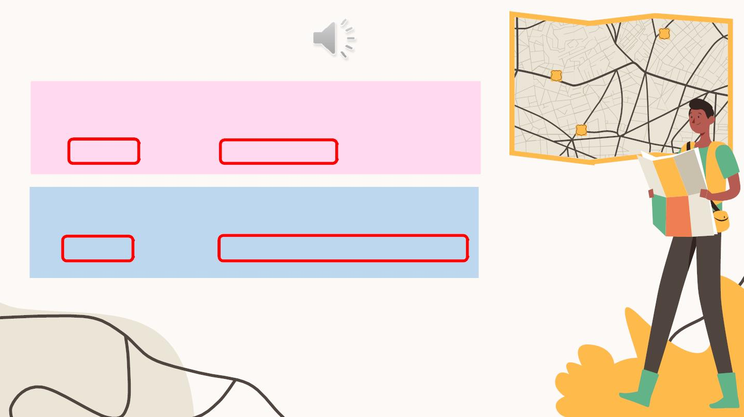
1. Listen and read.
A: Excuseꢀme.ꢀCouldꢀyouꢀtellꢀmeꢀtheꢀwayꢀtoꢀtheꢀcinema,ꢀ
please?ꢀ
B: Goꢀalongꢀthisꢀstreet.ꢀIt’sꢀonꢀyourꢀleft.
A: Excuseꢀme.ꢀWhere’sꢀtheꢀnearestꢀpostꢀoffice,ꢀplease?ꢀ
B: Goꢀoutꢀofꢀtheꢀstation.ꢀTakeꢀtheꢀfirstꢀturningꢀonꢀtheꢀright.

Slide 6
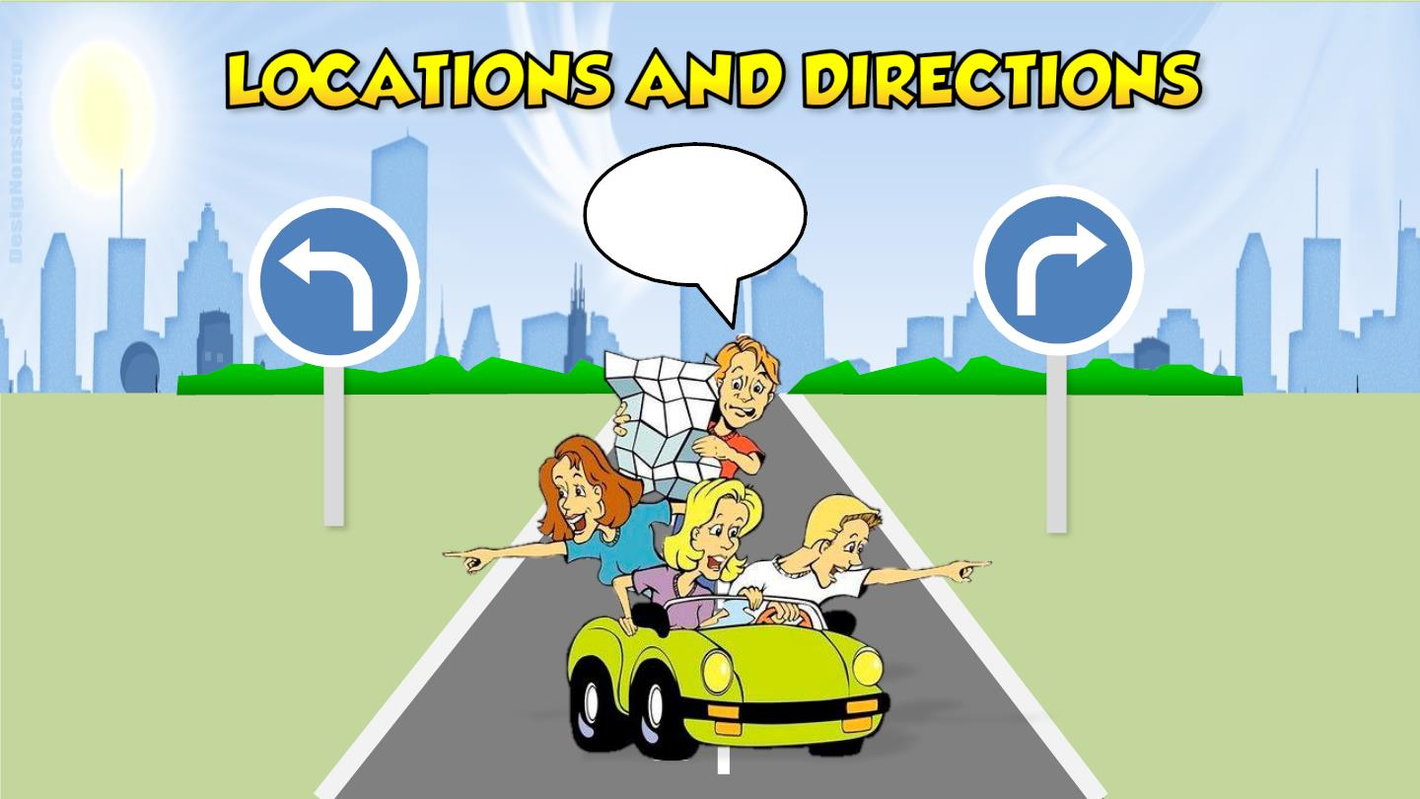
?
RBER

Slide 7
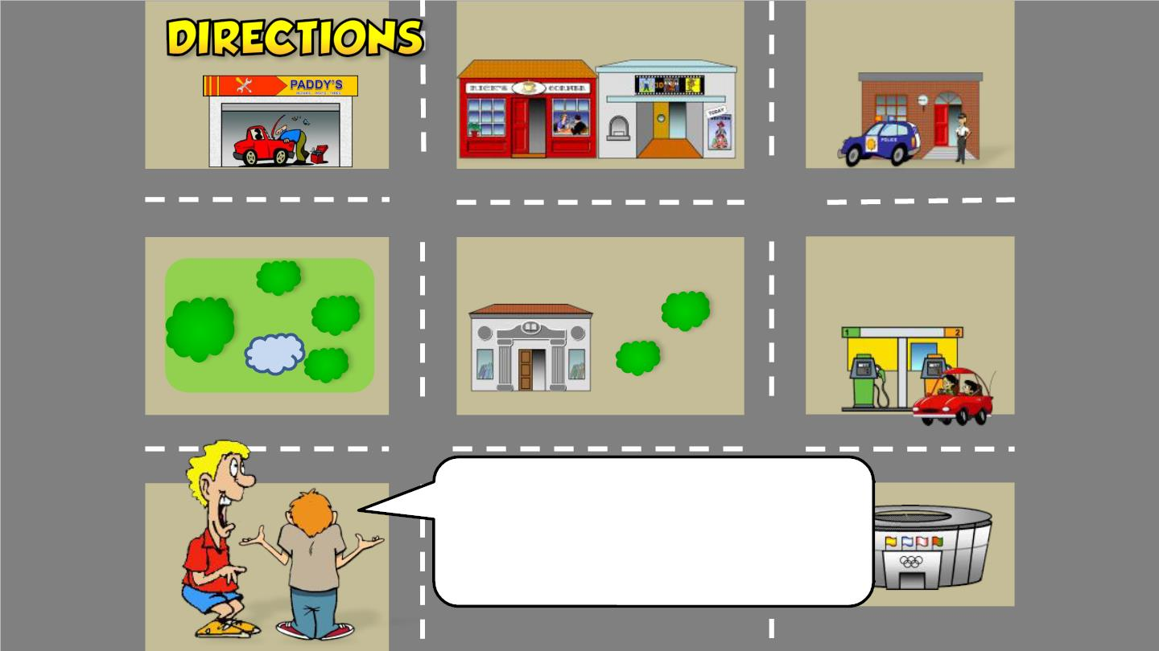
How do I get to
the police station?

Slide 8
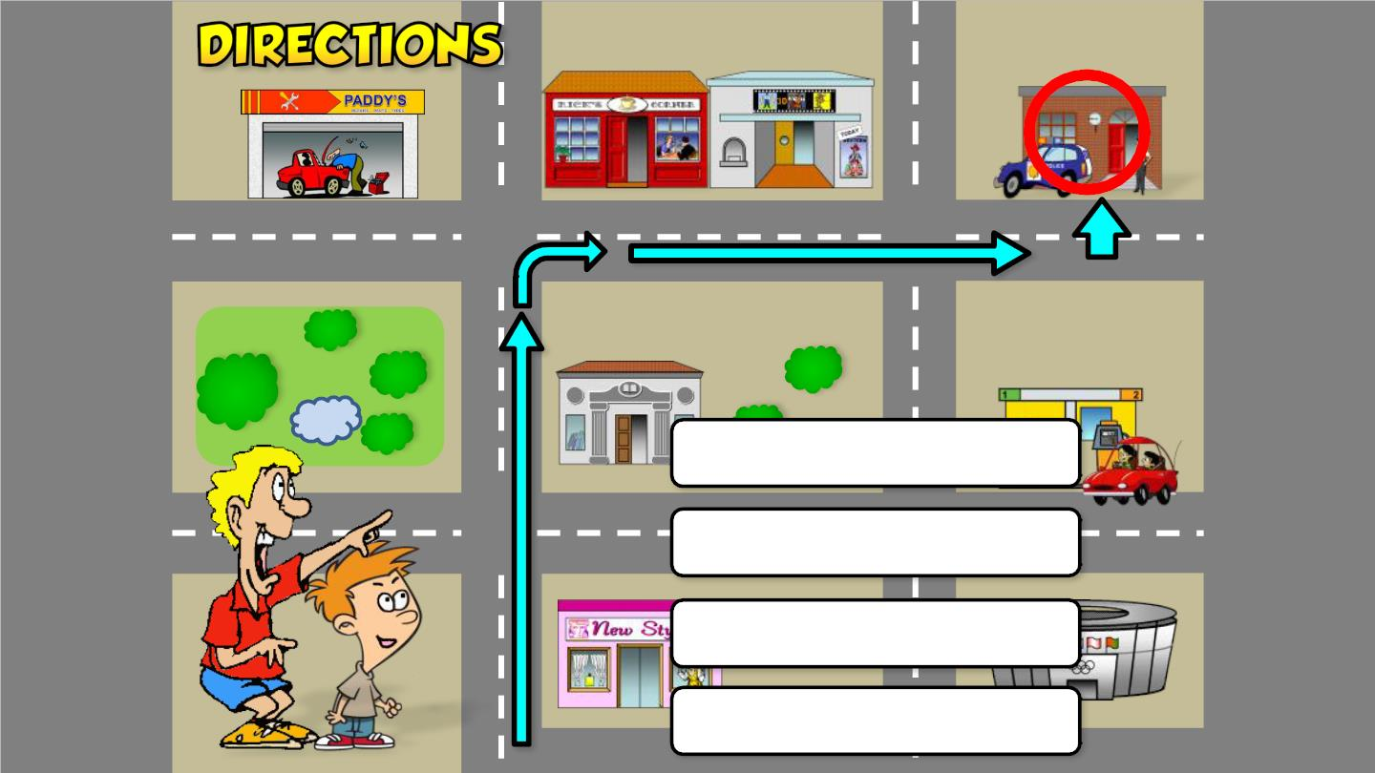
1. Go two blocks
2. Turn on the right
3. Go one block
4. It’s on the left

Slide 9
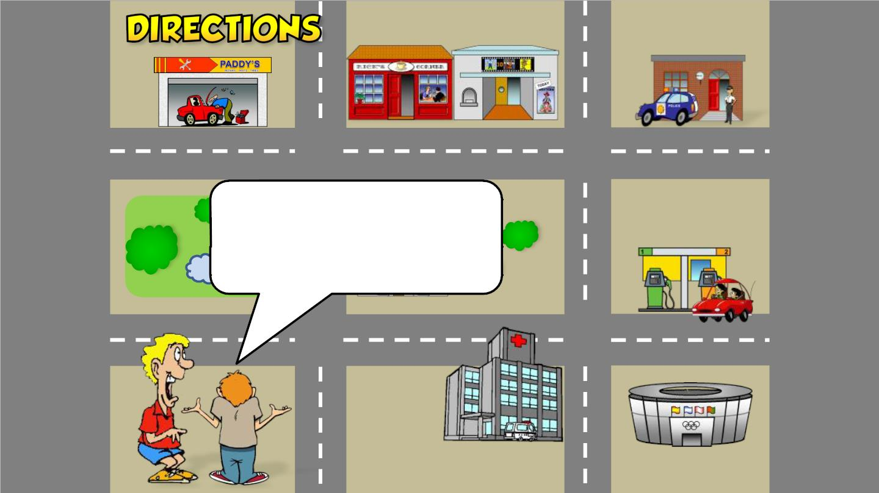
How do I get to
the hospital?
Oak Street

Slide 10
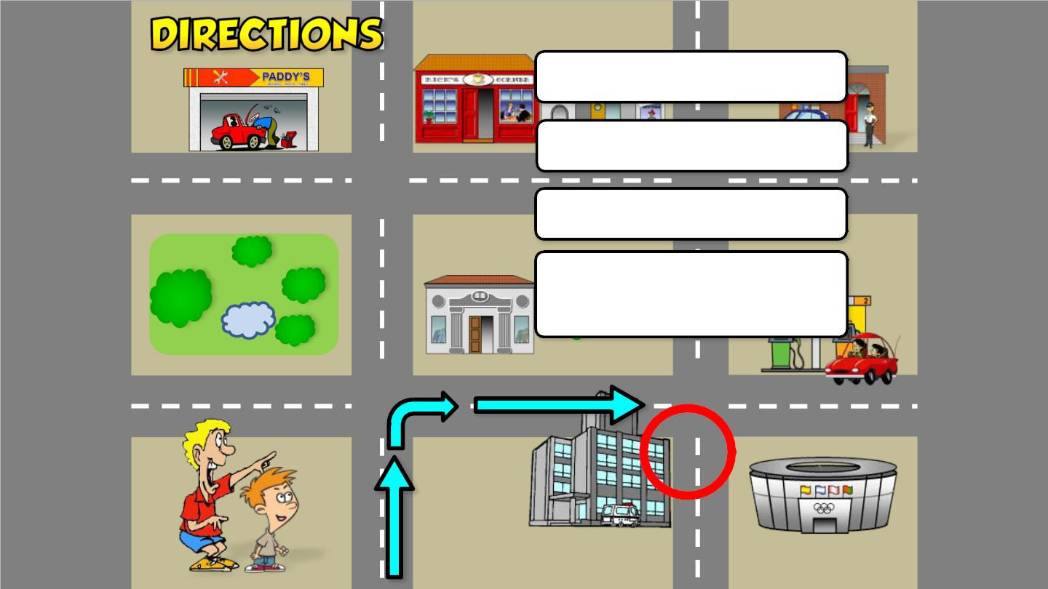
1. Go to the corner
2. Turn right
3. Go straight on
4. It’s at the corner of
Park Ave. and Oak St.
Oak Street

Slide 11
How do I get to
the stadium?
Oak Street

Slide 12
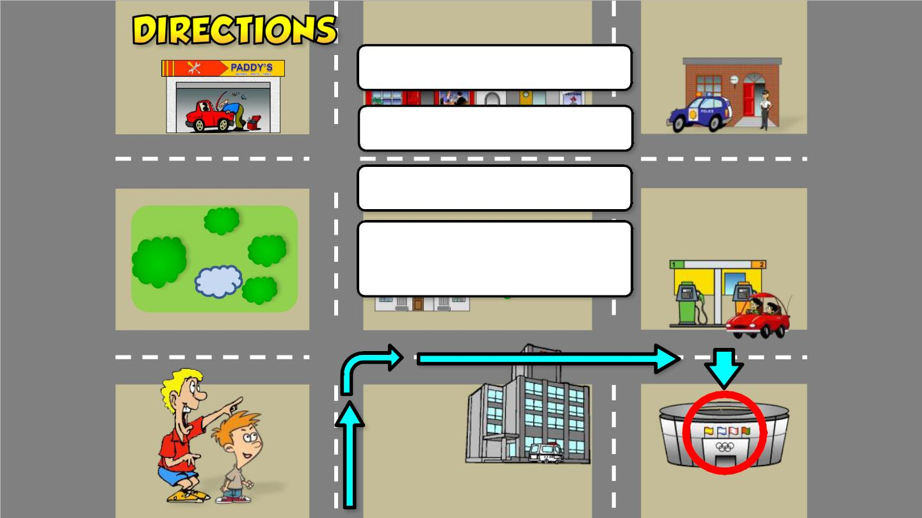
1. Go to the corner
2. Turn right
3. Go two blocks
4. It’s on the right
opposite the gas station
ak reet

Slide 13
How do I get to
the garage?
Oak Street

Slide 14
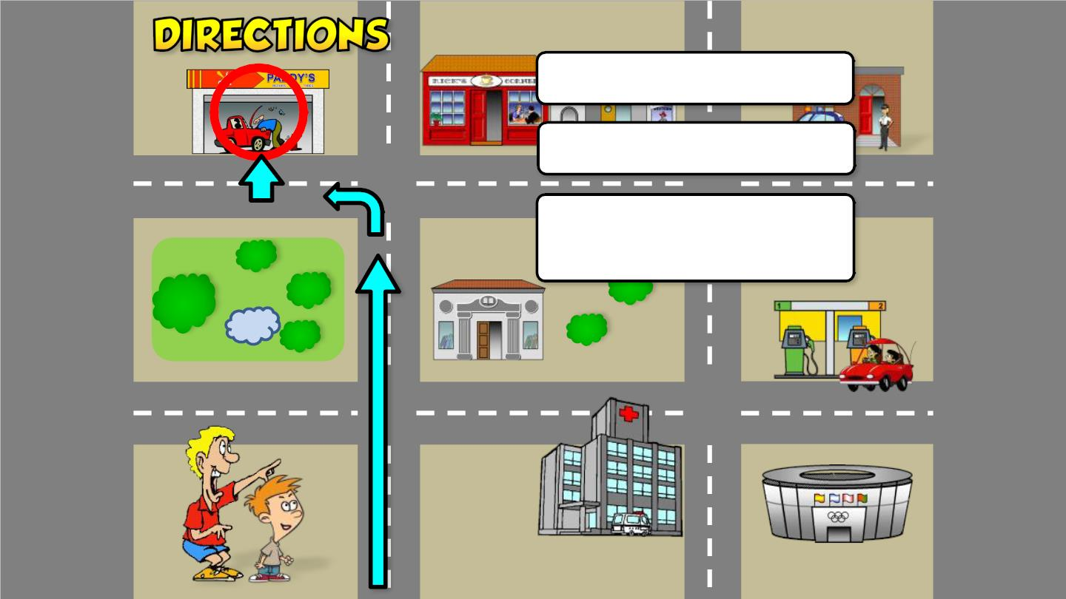
1. Go two blocks
2. Turn left
4. It’s on the right across
from the park
Oak Street

Slide 15
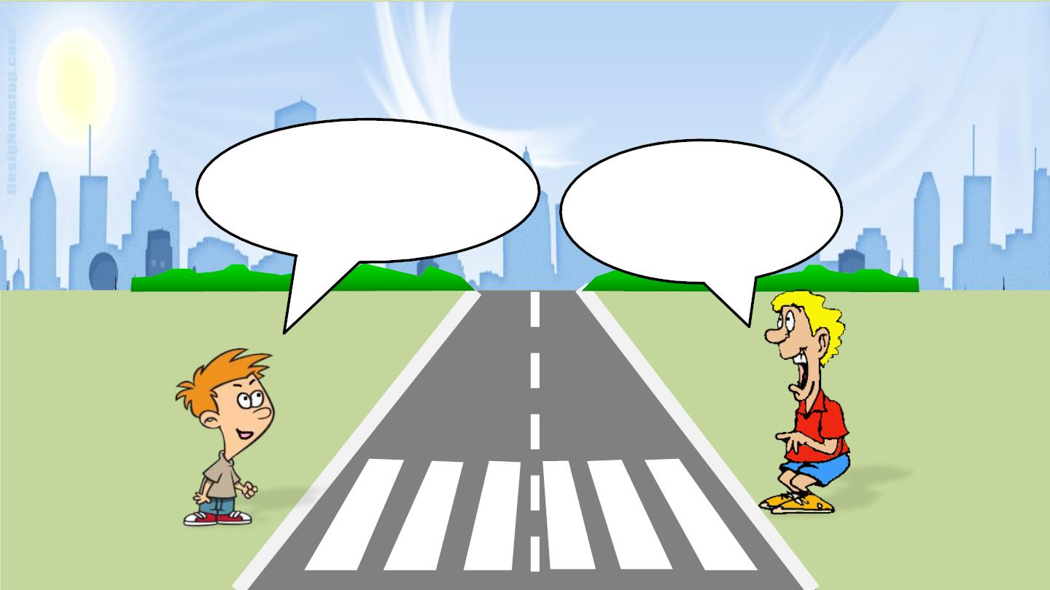
THANK YOU FOR
YOUR HELP!
YOU’RE
WELCOME!

Slide 16
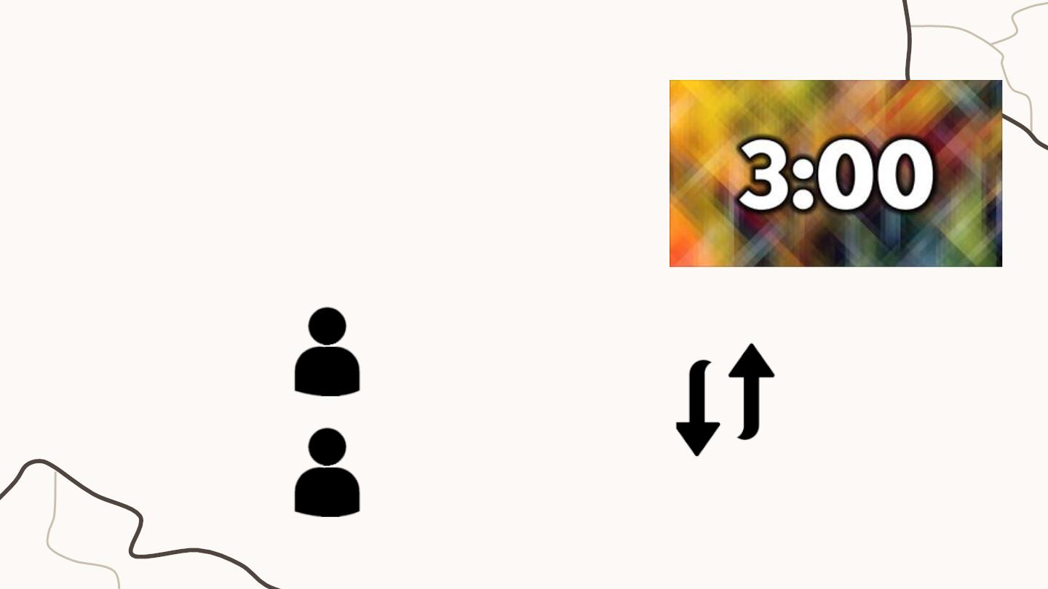
2. Asking for and giving directions
- Workꢀinꢀpairs.ꢀ
- 3ꢀminsꢀ
- Chooseꢀaꢀplaceꢀaroundꢀyourꢀschool.ꢀ
- Askꢀforꢀandꢀgiveꢀdirectionsꢀtoꢀtheꢀplace.ꢀꢀ
StudentꢀAꢀ
StudentꢀB
Askꢀ
take turns
Giveꢀdirectionsꢀꢀ

Slide 17
An audio guide
to a place

Slide 18
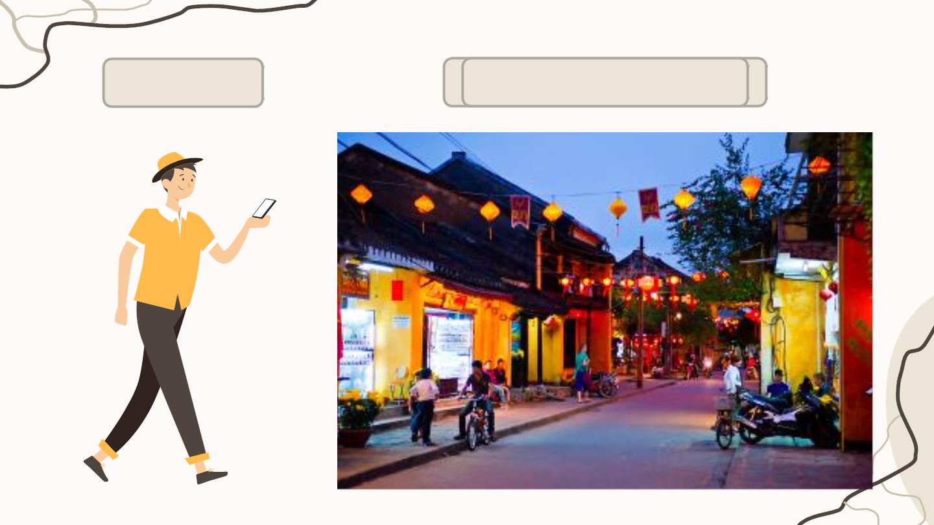
Nick
in Hoi An

Slide 19
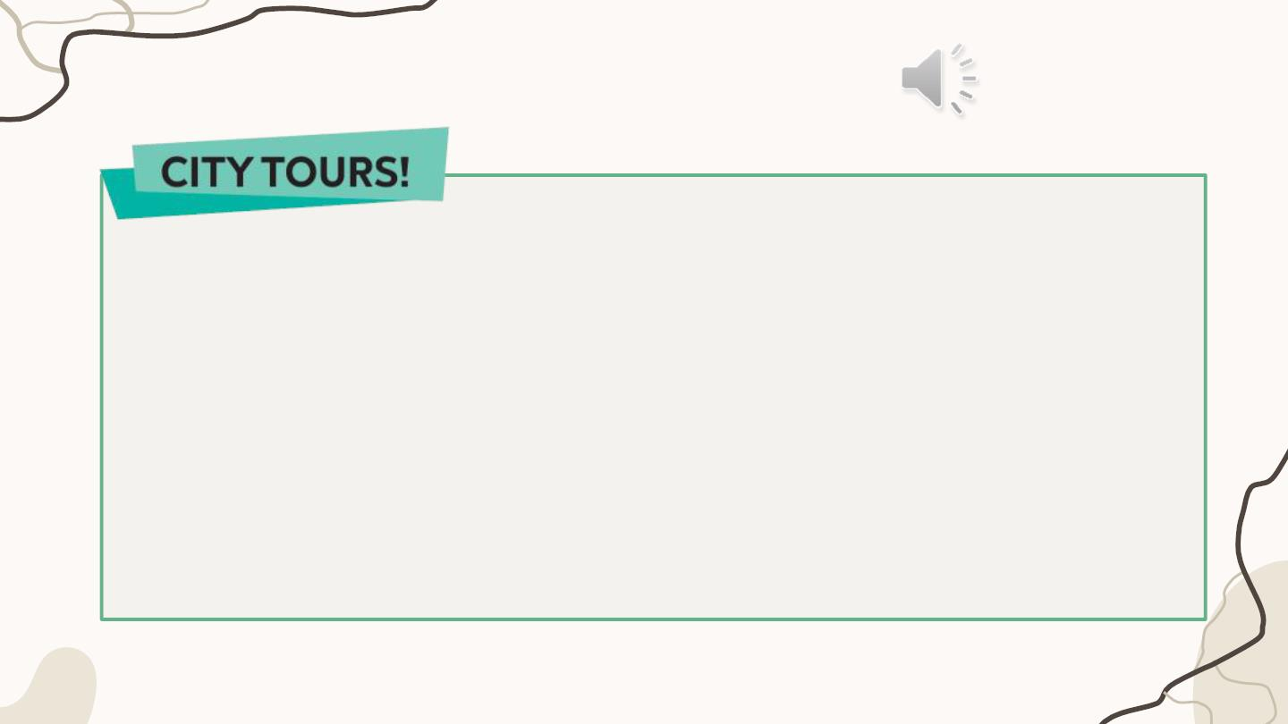
3. Listen and fill
Let'sꢀstartꢀourꢀtourꢀinꢀHoiꢀAn.ꢀWeꢀareꢀinꢀTranꢀPhuꢀStreetꢀnow.ꢀFirst,ꢀgoꢀtoꢀ
straight
OngꢀPagoda.ꢀToꢀgetꢀthere,ꢀgoꢀ(1)ꢀ___________alongꢀtheꢀstreetꢀforꢀfiveꢀ
minutes.ꢀIt'sꢀonꢀyourꢀleft.ꢀNext,ꢀgoꢀtoꢀtheꢀMuseumꢀofꢀSaꢀHuynhꢀCulture.ꢀ
second
right
Takeꢀtheꢀ(2)ꢀ___________ꢀturningꢀonꢀyourꢀleft.ꢀTurnꢀ(3)ꢀ___________ꢀandꢀ
it'sꢀonꢀyourꢀright.ꢀFinally,ꢀgoꢀtoꢀHoaꢀNhapꢀWorkshopꢀtoꢀbuyꢀsomeꢀpresents.ꢀ
next to
Turnꢀleftꢀandꢀthenꢀright.ꢀIt'sꢀ(4)ꢀ___________TanꢀKyꢀHouse.

Slide 20
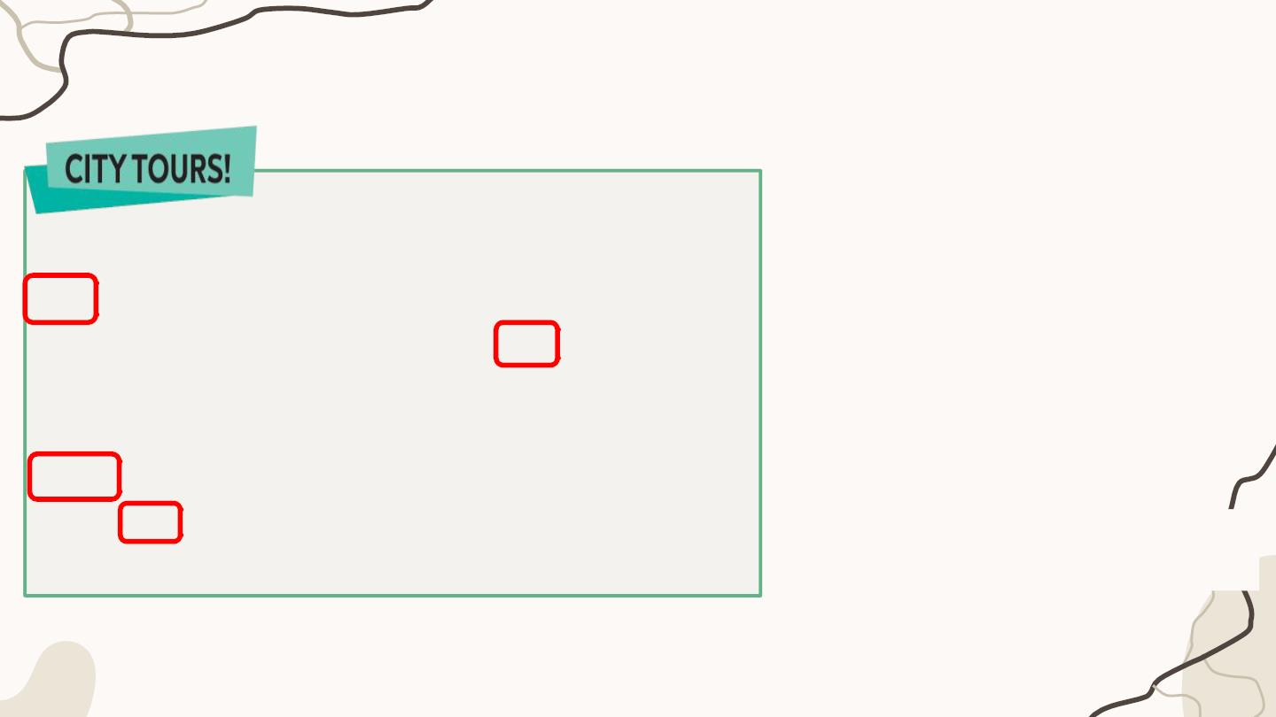
Summary
1.ꢀWhereꢀexactlyꢀareꢀyouꢀinꢀHoiꢀAn?
TranꢀPhuꢀStreet.
Let'sꢀstartꢀourꢀtourꢀinꢀHoiꢀAn.ꢀWeꢀareꢀinꢀTranꢀPhuꢀStreetꢀnow.ꢀ
straight
First,ꢀgoꢀtoꢀOngꢀPagoda.ꢀToꢀgetꢀthere,ꢀgoꢀ(1)ꢀ___________alongꢀ
2.ꢀAreꢀthereꢀanyꢀbeautifulꢀplacesꢀ
andꢀrestaurantsꢀnearꢀyou?
theꢀstreetꢀforꢀfiveꢀminutes.ꢀIt'sꢀonꢀyourꢀleft.ꢀNext,ꢀgoꢀtoꢀtheꢀ
second
Yes,ꢀthereꢀareꢀOngꢀPagoda,ꢀ
MuseumꢀofꢀSaꢀHuynhꢀCulture,ꢀ
HoaꢀNhapꢀWorkshopꢀandꢀTanꢀKyꢀ
House.ꢀ
MuseumꢀofꢀSaꢀHuynhꢀCulture.ꢀTakeꢀtheꢀ(2)ꢀ___________ꢀturningꢀ
right
onꢀyourꢀleft.ꢀTurnꢀ(3)ꢀ___________ꢀandꢀit'sꢀonꢀyourꢀright.ꢀFinally,ꢀ
goꢀtoꢀHoaꢀNhapꢀWorkshopꢀtoꢀbuyꢀsomeꢀpresents.ꢀTurnꢀleftꢀandꢀ
next to
thenꢀright.ꢀIt'sꢀ(4)ꢀ___________TanꢀKyꢀHouse.
3.ꢀDoꢀyouꢀgiveꢀdirectionsꢀtoꢀtheseꢀ
places?ꢀ
Yes.ꢀ

Slide 21
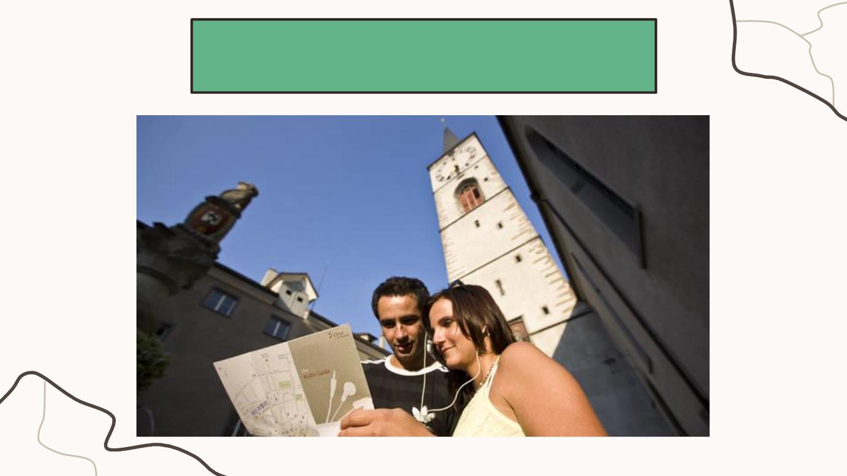
Let’s make an audio guide!

Slide 22
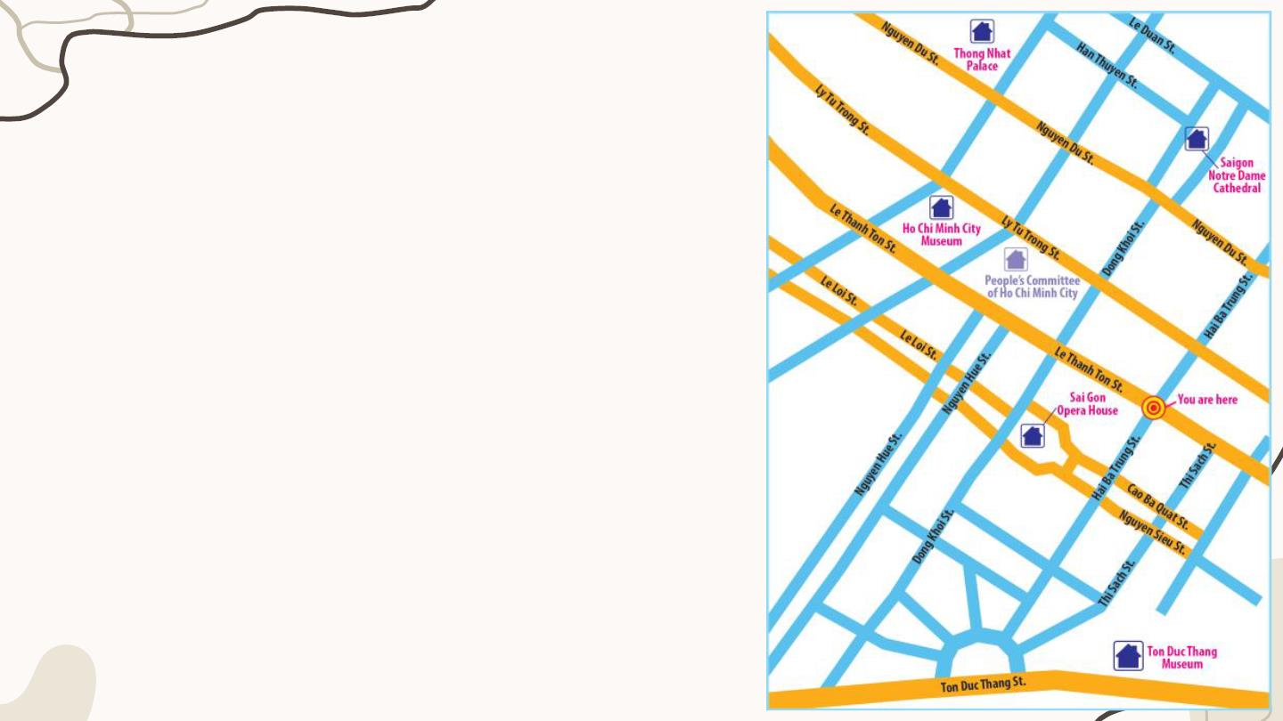
Answer three questions
1.ꢀWhereꢀexactlyꢀareꢀyouꢀinꢀHoꢀChiꢀMinhꢀCity?
2.ꢀAreꢀthereꢀanyꢀbeautifulꢀplacesꢀandꢀrestaurantsꢀ
nearꢀyou?
3.ꢀCanꢀyouꢀgiveꢀdirectionsꢀtoꢀtheseꢀplaces?ꢀ

Slide 23
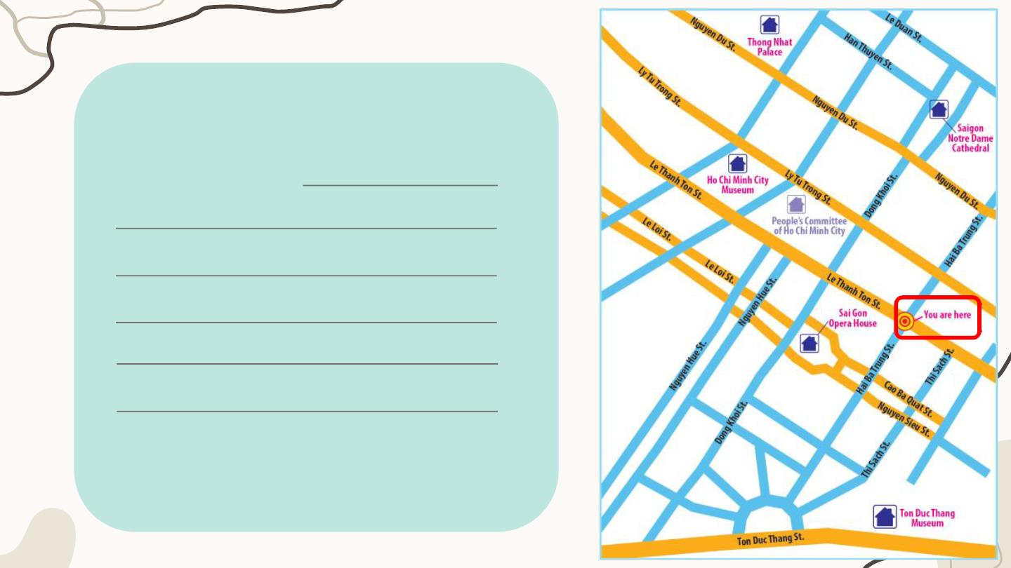
Let’s start our tour in Ho Chi Minh
City. We are in Hai Ba Trung street
now. First, go to

Slide 24
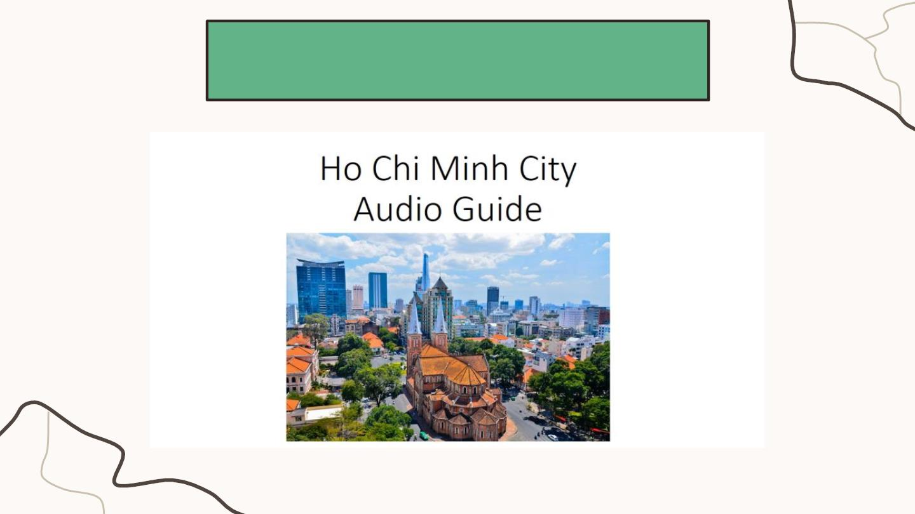
YOUR TURN!

Slide 25
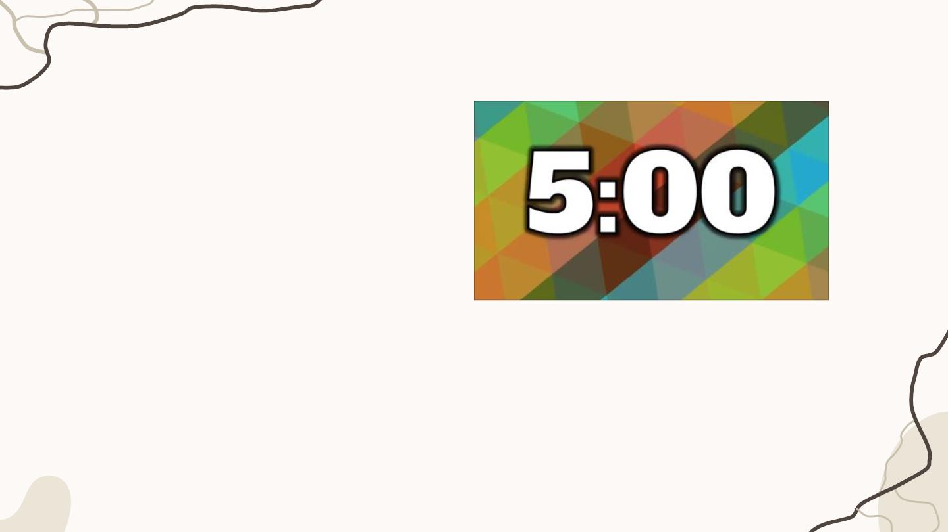
Make an audio guide
Groups of 3
Leader?
Idea thinker(s)?
Script writer(s)?
Guider(s)?
• chooseꢀatꢀleastꢀthreeꢀdifferentꢀplaces
• giveꢀdirectionsꢀ
5 mins
• useꢀfirst, then, after thatꢀandꢀfinallyꢀ

Slide 26
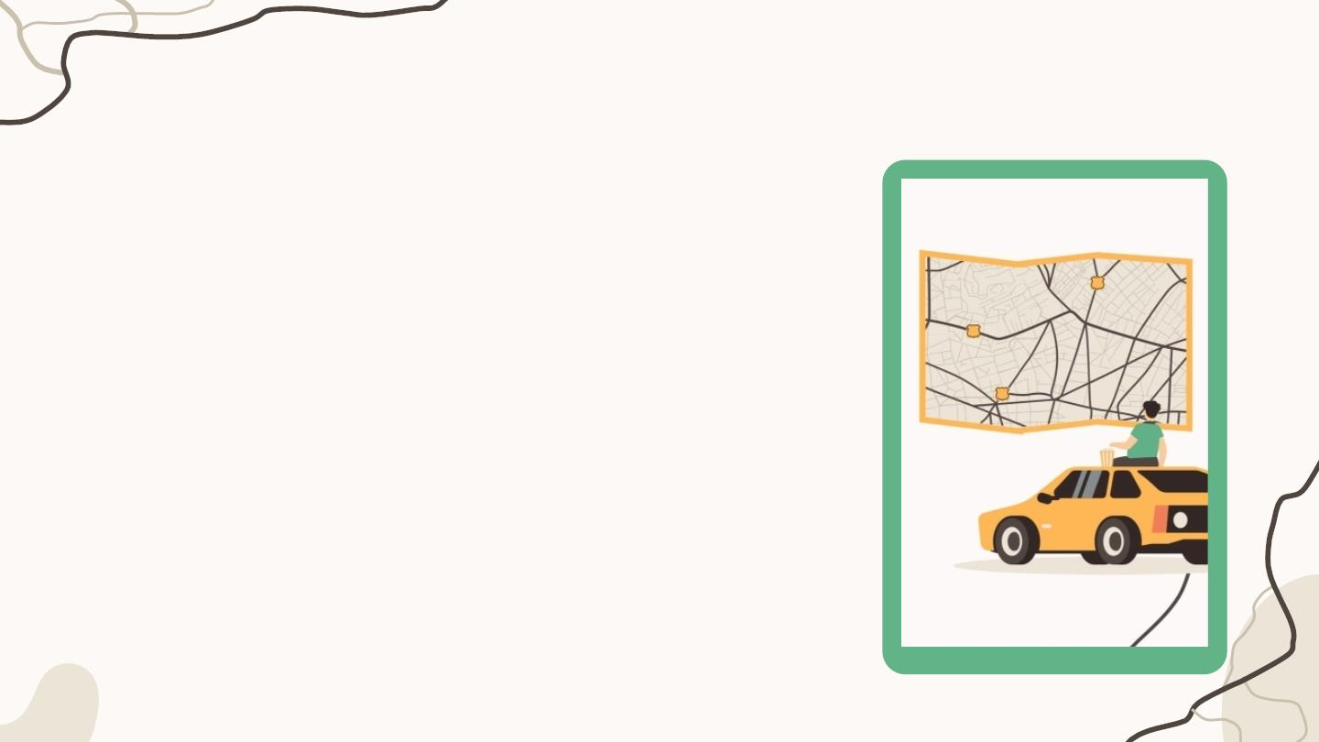
Time to record
• A group records/ presents
• Other groups listen
• Talk  - 1 point

Slide 27

Giving feedback

Slide 28
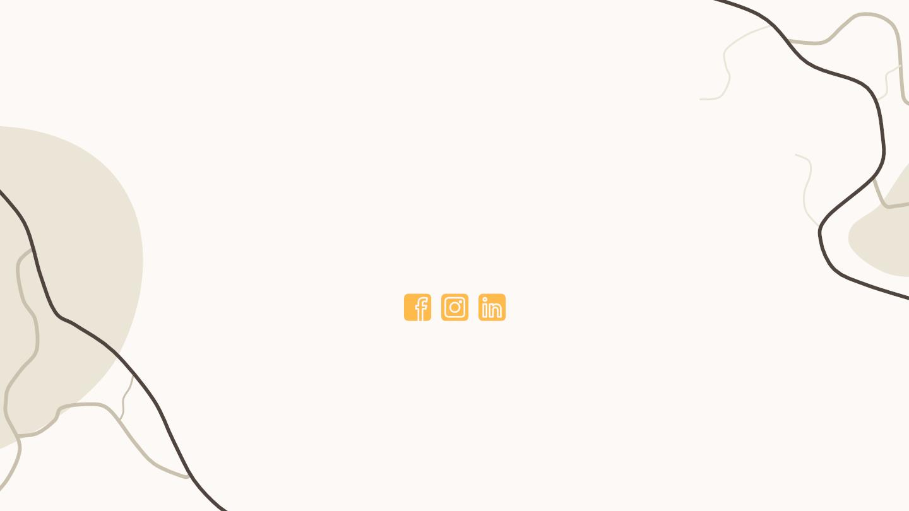
THANKS!
Do you have any questions?
CREDITS: This presentation template was
created by Slidesgo, including icons by
Flaticon, infographics & images byFreepik
and illustrations by Storyset
Please, keep this slide for attribution

Slide 29

ALTERNATIVE RESOURCES

