Slide 1
UNIT 4: REMEMBERING THE PAST
LESSON 5: SKILLS 1

Slide 2
OBJECTIVES
By the end of the lesson, students will be able to:
Read for specific information about how English people continue their culinary traditions
Talk about a typical traditional Vietnamese dish

Slide 3


NEW WORDS
deep-rooted (adj)
/ˌdiːp ˈruːtɪd/
lâu đời, ăn sâu bén rễ

Slide 4

NEW WORDS
Associated (adj)
/əˈsəʊsieɪtɪd/
liên kết
= connected

Slide 5
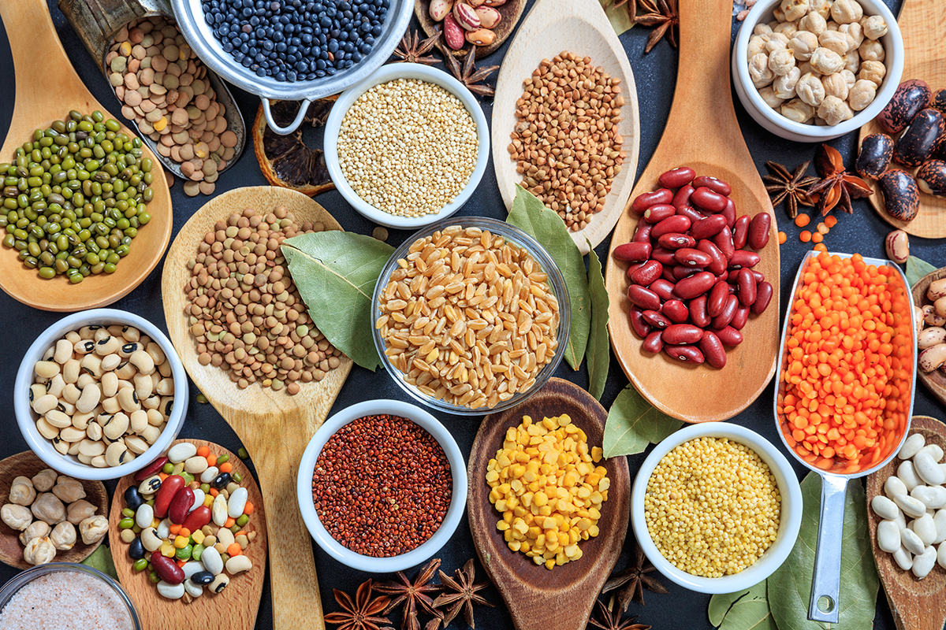
NEW WORDS
Ingredient (n)
/ɪnˈɡriːdiənt/
nguyên liệu

Slide 6
NEW WORDS
Words | Pronunciation | Meanings
 |  | lâu đời, ăn sâu bén rễ
 |  | liên kết
 |  | nguyên liệu
deep-rooted (adj) | /ˌdiːp ˈruːtɪd/
associated (adj) | /əˈsəʊsieɪtɪd/
ingredient (n) | /ɪnˈɡriːdiənt/

Slide 7
1. READING

Slide 8
Ex1: Work in groups. Discuss the following questions.
What do you know about England?
Possible answer:
+ England:
+ Capital:
+ Population:
+ Area:
+ National language:
+ National dishes:
+ ...
one of the 4 parts of the UK (England, Scotland, Wales, the Northern Ireland)
London
over 56 million (2021)
130,279 km²
English
Fish and Chips, Sunday Roast, Full English Breakfast, …

Slide 9
Ex2: Read the text and write the underlined words in the box.
England’s traditions have been around for hundreds, even thousands of years. English cuisine is among the deep-rooted traditions that English people are proud to keep alive.
Typical English cuisine has developed over many centuries, and people say that fish and chips is the most English dish of all. It is believed that fish and chips appeared in England in the 19th century. The earliest fish and chip shop opened in London during the 1860s. Since then people have considered fish and chips to be England’s national dish, and it is now a common takeaway in the United Kingdom.
The basic ingredients of the dish are fried fish served with chips. People in different places may add peas, vinegar, lemon, or ketchup. Fish and chips is served hot as the main dish in England. Although there is oil and carbohydrates in fish and chips, it is healthier than other takeaway dishes.
Now there are fish and chip shops in many countries, and it is becoming more and more popular in other countries too. Preserving and promoting fish and chips is the way English people keep themselves associated with the past

Slide 10
Ex2: Read the text and write the underlined words in the box.
deep-rooted
appeared
basic
associated
bám rễ sâu
đã xuất hiện
nền tảng
có liên quan
Meaning/Explanation | Word
1. Linked or connected
2. Difficult to change or destroy
3. Started to be seen
4. Necessary and important
associated
deep-rooted
appeared
basic

Slide 11
Ex3: Read the text again and tick (√) T (True) or F (False) for each sentence.
Meaning/Explanation | T | F
1. English people take great pride in their traditions.
2. Fish and chips has been around for hundreds of years.
3. The earliest fish and chip shop opened in London in 1860.
4. Peas, vinegar, lemon, or ketchup are necessary for fish and chips.
5. Fish and chips is not healthy as it has a lot of oil.
6. Fish and chips is sold in many countries now.

Slide 12
Ex3: Read the text again and tick (√) T (True) or F (False) for each sentence.
Meaning/Explanation | T | F
1. English people take great pride in their traditions.
2. Fish and chips has been around for hundreds of years.
3. The earliest fish and chip shop opened in London in 1860.
4. Peas, vinegar, lemon, or ketchup are necessary for fish and chips.
5. Fish and chips is not healthy as it has a lot of oil.
6. Fish and chips is sold in many countries now.
✓
English cuisine is among the deep-rooted traditions that English people are proud to keep alive.

Slide 13
Ex3: Read the text again and tick (√) T (True) or F (False) for each sentence.
Meaning/Explanation | T | F
1. English people take great pride in their traditions.
2. Fish and chips has been around for hundreds of years.
3. The earliest fish and chip shop opened in London in 1860.
4. Peas, vinegar, lemon, or ketchup are necessary for fish and chips.
5. Fish and chips is not healthy as it has a lot of oil.
6. Fish and chips is sold in many countries now.
✓
✓
Typical English cuisine has developed over many centuries, and people say that fish and chips is the most English dish of all. It is believed that fish and chips appeared in England in the 19th century.

Slide 14
Ex3: Read the text again and tick (√) T (True) or F (False) for each sentence.
Meaning/Explanation | T | F
1. English people take great pride in their traditions.
2. Fish and chips has been around for hundreds of years.
3. The earliest fish and chip shop opened in London in 1860.
4. Peas, vinegar, lemon, or ketchup are necessary for fish and chips.
5. Fish and chips is not healthy as it has a lot of oil.
6. Fish and chips is sold in many countries now.
✓
✓
✓
The earliest fish and chip shop opened in London during the 1860s.

Slide 15
Ex3: Read the text again and tick (√) T (True) or F (False) for each sentence.
Meaning/Explanation | T | F
1. English people take great pride in their traditions.
2. Fish and chips has been around for hundreds of years.
3. The earliest fish and chip shop opened in London in 1860.
4. Peas, vinegar, lemon, or ketchup are necessary for fish and chips.
5. Fish and chips is not healthy as it has a lot of oil.
6. Fish and chips is sold in many countries now.
✓
✓
✓
✓
The basic ingredients of the dish are fried fish served with chips. People in different places may add peas, vinegar, lemon, or ketchup.

Slide 16
Ex3: Read the text again and tick (√) T (True) or F (False) for each sentence.
Meaning/Explanation | T | F
1. English people take great pride in their traditions.
2. Fish and chips has been around for hundreds of years.
3. The earliest fish and chip shop opened in London in 1860.
4. Peas, vinegar, lemon, or ketchup are necessary for fish and chips.
5. Fish and chips is not healthy as it has a lot of oil.
6. Fish and chips is sold in many countries now.
✓
✓
✓
✓
✓
Although there is oil and carbohydrates in fish and chips, it is healthier than other takeaway dishes.

Slide 17
Ex3: Read the text again and tick (√) T (True) or F (False) for each sentence.
Meaning/Explanation | T | F
1. English people take great pride in their traditions.
2. Fish and chips has been around for hundreds of years.
3. The earliest fish and chip shop opened in London in 1860.
4. Peas, vinegar, lemon, or ketchup are necessary for fish and chips.
5. Fish and chips is not healthy as it has a lot of oil.
6. Fish and chips is sold in many countries now.
✓
✓
✓
✓
✓
✓
Now there are fish and chip shops in many countries, and it is becoming more and more popular in other countries too.

Slide 18
1. Do the Vietnamese people feel proud of their traditions and customs? 2. Is the Vietnamese cuisine famous? Do foreigners like it? 3. What are some popular Vietnamese dishes?
REMEMBER CHECK
Work in pairs to ask and answer the questions.

Slide 19
2. SPEAKING

Slide 20
Ex4: Work in pairs. Match 1 - 5 in column A with a - e in column B
A
B
1. name of the dish
a. glutinous rice, green beans, pork
1 – c
2. history
b. at Tet, on the Hung Kings’ anniversary
2 – e
3. basic ingredients
c. banh chung
3 – a
4. on what occasion it’s eaten
d. traditional dish
4 – b
5. type of dish
e. originated in 6th Hung King’s time
5 – d

Slide 21
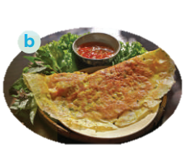
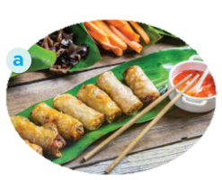
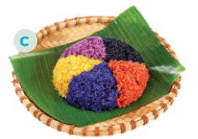
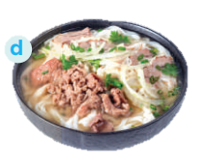
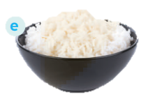
Ex5: Work in groups. Match the Vietnamese dishes with their names in English
1. pancake
2. five-colour sticky rice
3. beef noodle soup
4. white rice
5. spring rolls

Slide 22
Ex5: Work in groups. Match the Vietnamese dishes with their names in English
1. pancake
2. five-colour sticky rice
3. beef noodle soup
4. white rice
5. spring rolls
pancake: bánh xèo
five – colour sticky rice: xôi ngũ sắc
beef noodle soup: phở bò
white rice: cơm trắng
spring rolls: nem rán
5. spring rolls
1. pancake
2. five-colour sticky rice

Slide 23
Ex5: Work in groups. Match the Vietnamese dishes with their names in English
1. pancake
2. five-colour sticky rice
3. beef noodle soup
4. white rice
5. spring rolls
pancake: bánh xèo
five – colour sticky rice: xôi ngũ sắc
beef noodle soup: phở bò
white rice: cơm trắng
spring rolls: nem rán
3. beef noodle soup
4. white rice

Slide 24
SPEAKING
Think about one traditional dish and prepare to talk about it.
Your talk should include:
– the name of the dish
– the basic ingredients
– when / on what occasion it is eaten
– whether you like it or not

Slide 25
Sample:
Well… One of Vietnamese dishes that I like is Fried rice (Cơm rang). It’s a kind of popular street food. We can make and eat it every day, but I’d like to have it at the weekend. The main ingredients of this dish are cooked rice, meat or sausage and colourful vegetables chopped up into small pieces and mixed together. Then we fry the ingredients slowly with cooking oil and one or two eggs. When you fry the rice, you must stir it constantly with a wooden spoon.

Slide 26
SWAP AND CHECK
Check for spelling
Do the words spell correctly?
Check for ideas
Did your friend talk about one traditional dish?
Check for comprehension
Does the speaking part make sense?
Check for grammar
Does the speaking part use the correct tenses and structures?

Slide 27
EXTRA ACTIVITY
Summarise the reading text in 50 – 70 words.
There are some clues:
- English cuisine …
- Fish and chips …
- The earliest fish and chip shop …
- Basic ingredients …
……
- People sell it in many countries now

Slide 28
Example:
English cuisine is one of the traditions that English people are proud to keep alive. Typical English cuisine, fish and chips, has developed for many centuries. The earliest fish and chip shop opened in London in the 1860s. The basic ingredients of the dish are fried fish served with chips. People sell fish and chips in many countries now.

Slide 29
SWAP AND CHECK
Check for spelling
Do the words spell correctly?
Check for ideas
Did your friend write down enough of the given clues?
Check for comprehension
Does the writing make sense?
Check for grammar
Does the writing use the correct tenses and structures?

Slide 30
WRAP - UP
What have we learnt in this lesson?
Read for specific information about how English people continue their culinary traditions
Talk about a typical traditional Vietnamese dish

Slide 31
THANK YOU!

