Slide 1
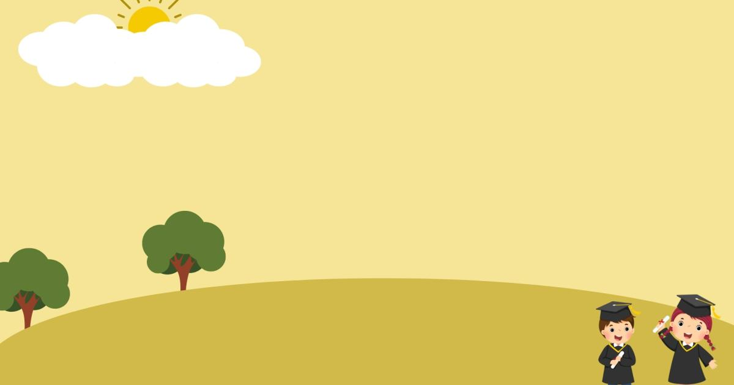
WELCOME TO OUR CLASS
Presented by: Phi Hai Duyen

Slide 2
WARM-UP
GUESS THE TOPIC

Slide 3
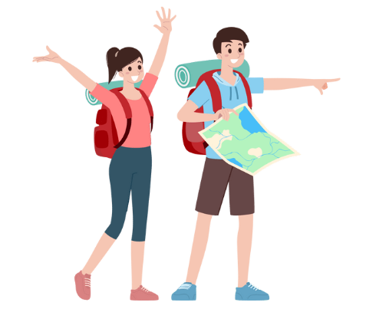
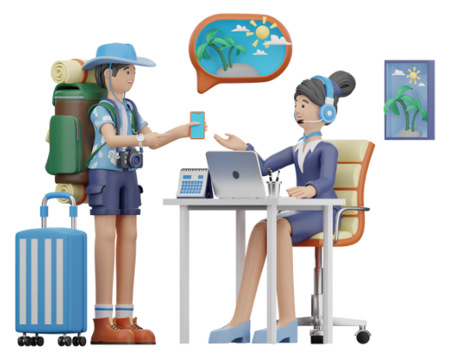
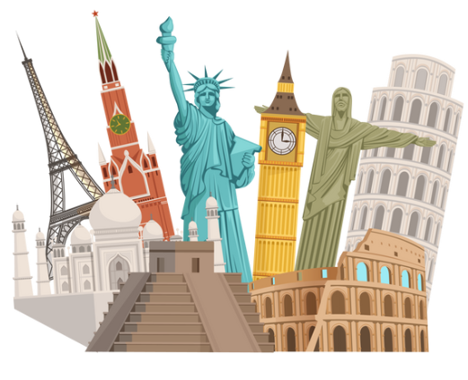
SET 1
UNIT 8: TOURISM
Notes:
Unit 8 Tourism:
1. holidaymaker/traveller/ tourist,
2. travel agency,
3. tourist attractions/ destinations

Slide 4



SET 2
UNIT 9: WORLD ENGLISHES
Notes:
Unit 9 World Englishes
1. bilingual,
2. immigration,
3. English speaking countries

Slide 5
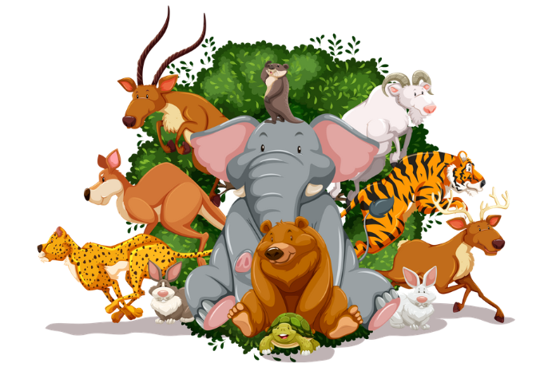
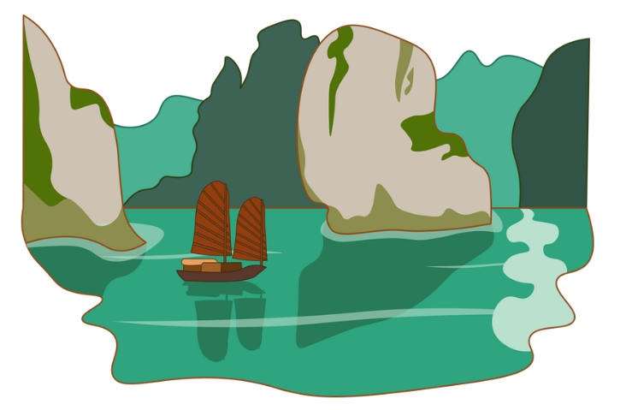
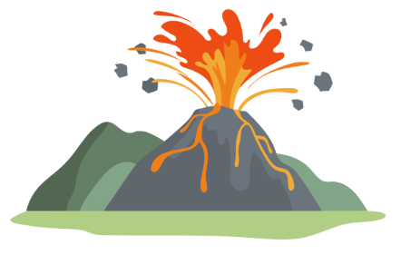
SET 3
UNIT 7: NATURAL WONDERS OF THE WORLD
Notes:
Unit 7: Natural wonders of the world:
1. wildlife
2. ha long bay/ natural wonder
3. volcano

Slide 6
REVIEW 3
Lesson 1: Language

Slide 7
PRONUNCIATION
UNIT 7:
Sounds: /sl/ and /sn/
UNIT 8:
Stress in words ending in -ic and -ious
UNIT 9:
Stress in words ending in -ion and -ity

Slide 8

1.Listen and repeat the sentences. Mark the stress in the underlined words.
1. This snack is nutritious and easy to prepare.
2. He is a bit slow, but he’s ambitious.
3. Seafood is a local speciality, but I’m allergic to it.
4. The electronic dictionary includes some animations.
5. The celebration continued with a fantastic activity.
Notes:
1. This snack is nu`tritious and easy to prepare.
2. He is a bit slow, but he’s am`bitious.
3. Seafood is a local speci`ality, but I’m a`llergic to it.
4. The elec`tronic dictionary includes some ani`mations.
5. The cele`bration continued with a fan`tastic ac`tivity.

Slide 9
VOCABULARY
UNIT 7:
Natural wonders
UNIT 8:
Tourism
UNIT 9:
Planet Earth
Habitats
Flora and fauna

Slide 10
2. Choose the correct answer A, B, C, or D to complete each sentence.
1. Mount Everest, which is ______ on the border between China and Nepal, attracts climbers of all ages.
A. founded B. placed
C. positioned D. located
2. The view of my village and the paddy fields from the mountain top was ______.
A. magnificent B. conservative
C. interested D. beneficial

Slide 11
2. Choose the correct answer A, B, C, or D to complete each sentence.
3. Our ______ includes a visit to Stonehenge – a famous tourist attraction.
A. calendar B. itinerary
C. voyage D. touring
4. When you ______ a word in the dictionary, remember to learn its pronunciation.
A. pick up B. try on
C. look up D. get to
5. The landscape there is amazing, but boat is the only way to ______ it.
A. get access to B. enter
C. admit D. open

Slide 12
3. Complete the sentences with the words and phrases from the box.
package tour promotes flora and fauna
varieties native speaker
1. One advantage of tourism is that it __________ international understanding and cooperation
2. A _________________ is a person who speaks a language as their first language.
3. A _____________ is a holiday that is organised by a company at a fixed price and that includes everything.
4. There are many different __________ of English around the world.
5. The Amazon Rainforest has very rich ________________ but services and facilities there are limited.
promotes
native speaker
package tour
varieties
flora and fauna
Notes:
1. promotes 2. native speaker 3. package tour
4.varieties 5. flora and fauna

Slide 13
GRAMMAR
UNIT 7:
Relative pronouns
UNIT 8:
Defining relative clauses
UNIT 9:
Non-defining relative clauses

Slide 14
4. Rewrite the sentences in reported questions.
1. “Is the plane arriving soon?” they asked Jane.
→
2. The teacher asked: “Can you write a report after your visit to the Dolomites?”
→
3. “Does the tour guide have your telephone number?” she asked me.
→
They asked Jane if / whether the plane was arriving soon.
The teacher wanted to know/ asked me if / whether I could write a report after my visit to the Dolomites.
She asked me if / whether the tour guide had my telephone number.
Notes:
1. They asked Jane if / whether the plane was arriving soon.
2. The teacher wanted to know/ asked me if / whether I could write a report after my visit to the Dolomites.
3. She asked me if / whether the tour guide had my telephone number.
4. I asked Kate if / whether anybody would meet her at the airport the next day.
5. I asked them if / whether they were sure about the quality of those English courses.

Slide 15
4. Rewrite the sentences in reported questions.
4. I asked Kate: “Will anybody meet you at the airport tomorrow?”
→ ______________________________
5. “Are you sure about the quality of these English courses?” I asked them.
→ ______________________________
I asked Kate if / whether anybody would meet her at the airport the next day.
I asked them if / whether they were sure about the quality of those English courses.
Notes:
1. They asked Jane if / whether the plane was arriving soon.
2. The teacher wanted to know/ asked me if / whether I could write a report after my visit to the Dolomites.
3. She asked me if / whether the tour guide had my telephone number.
4. I asked Kate if / whether anybody would meet her at the airport the next day.
5. I asked them if / whether they were sure about the quality of those English courses.

Slide 16
5. Join each pair of sentences, using a relative pronoun.
1. The path was made by walkers. They cross the mountains each summer.
2. I know an English restaurant. The restaurant serves excellent fish and chips.
3. The local people were very friendly and helpful. We met them last week.
The path was made by walkers who cross the mountains each summer.
I know an English restaurant which serves excellent fish and chips.
The local people who we met last week were very friendly and helpful.
Notes:
1. The path was made by walkers who cross the mountains each summer.
2. I know an English restaurant which serves excellent fish and chips.
3. The local people who we met last week were very friendly and helpful.
4. Ms Linda teaches a class of students whose native language is not English.
5. The English dictionary which I can’t afford to buy is very useful.

Slide 17
5. Join each pair of sentences, using a relative pronoun.
4. Ms Linda teaches a class of students. Their native language is not English.
________________________________
5. The English dictionary is very useful. I can’t afford to buy it.
________________________________
Ms Linda teaches a class of students whose native language is not English.
The English dictionary which I can’t afford to buy is very useful.
Notes:
1. The path was made by walkers who cross the mountains each summer.
2. I know an English restaurant which serves excellent fish and chips.
3. The local people who we met last week were very friendly and helpful.
4. Ms Linda teaches a class of students whose native language is not English.
5. The English dictionary which I can’t afford to buy is very useful.

Slide 18
WRAP-UP
What have we learnt in this lesson?
review the vocabulary and grammar of Unit 7, 8, 9

Slide 19
HOMEWORK
Do the exercises in the workbook.

Slide 20
THANK YOU!

