Slide 1
Unit 5
Natural wonders of Vietnam
Lesson 3: A closer look 2

Slide 2
After this lesson, students will be able to:
□ use countable and uncountable nouns;
□ use the modal verb must / mustn’t to give orders;

Slide 3
01
Countable and uncountable nouns

Slide 4
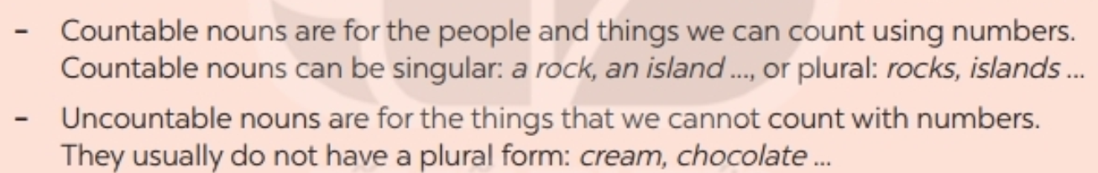
How many?
1/a flower
2 flowers
3 flowers
flower
(countable noun)
singular
plural

Slide 5


How much?
1/a ice
cream?
2 ice
creams?
3 ice
creams?
ice cream
(uncountable noun)

Slide 6
Ex 1 (p.51) Is the underlined noun countable or uncountable? Write C (countable) or U (uncountable).
1. The children are very tired after a day of fun. ____
2. Be careful! The water is deep. ____
3. My mother uses real butter in the cakes she bakes. ____
4. Remember to bring the necessary travel items. ____
5. - How about meeting in the canteen for some tea? ____
- Sure. What time?
C
U
U
C
U

Slide 7
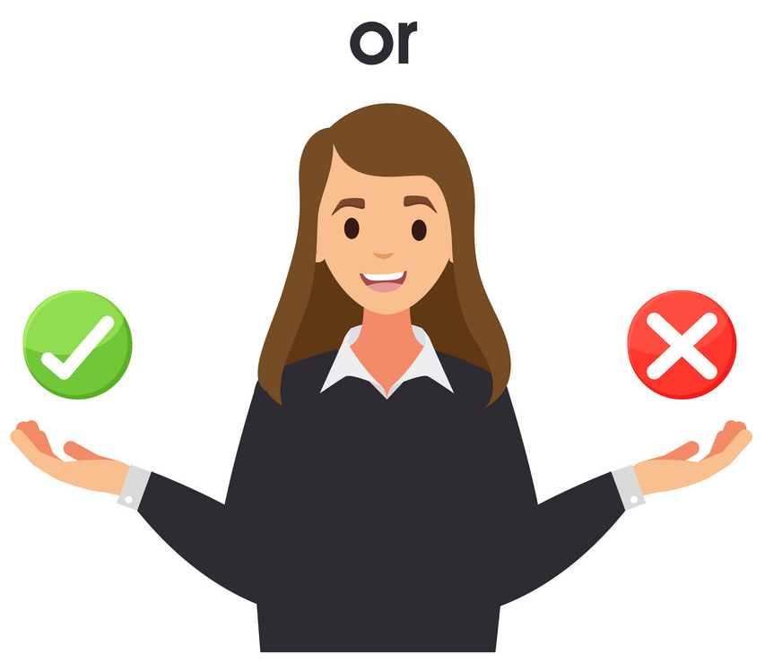

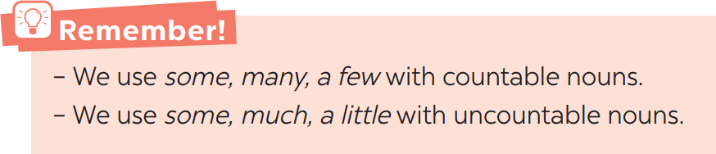
Is it right or wrong?
I have _____ questions to ask you.
A. a few B. a little
countable noun

Slide 8
Ex 2 (p.52) Choose the correct option for each sentence.
1. I have _____ questions to ask you.
A. a few B. a little
2. Australia is very nice. It has _____ natural wonders.
A. much B. many
3. This is a difficult lesson, so only _____ students can understand it.
A. a few B. many
4. It is a very dry area. There isn’t _____ rain in summer.
A. a little B. much
5. We've got very _____ time before our train leaves. We must hurry up!
A. little B. much
question (C)
wonder (C)
student (C)
a few a small number >< many a large number
rain (UC)
a little a small amount >< much a large amount
time (UC)
little not much

Slide 9
Ex 3 (p.52) Fill in each blank with a, any, some, much, many.
1. How _____ books are there in your bag?
2. There isn’t _____ milk in the fridge. It's empty
3. How _____ sugar do you need for your tea, Mum?
4. We need to buy _____ new furniture for the house.
5. There is _____ big cave in this area.
many
book (C)
any
milk (UC)
any (negative)
much
sugar (UC)
some
furniture (UC)
some (positive)
a
There is singular noun

Slide 10
Modal verb: must/ mustn’t
02

Slide 11

List some rules in your school.

Slide 12

Watch and note down the school rules in Lim’s school.

Slide 13
Modal verb: must/ mustn’t
You must go to school on time
You must wear a uniform
You must raise your hand to speak.
We use must to say that something is very necessary or very important.
You mustn’t speak loudly.
You mustn’t sleep in the class.
We use mustn’t to say that doing something is not allowed.
must + V

Slide 14
Ex 4 (p.52) Fill each blank with must or mustn't.
1. You ________ leave the hotel room before 12 o'clock.
2. You ________ make lots of noise in the museum.
3. My mum says you ________ always tell the truth.
4. You know you ________ go to bed with your shoes on.
5. I want to speak English better. I ________ practice more.
must
mustn’t
must
mustn’t
must

Slide 15
Ex 5 (p.52) Read the classroom rules below. Write some more rules for you and your classmates.
1. We must arrive on time.
2. We mustn't pick flowers in the school garden.
3. We must ______________.
4. We mustn’t ____________.
5. ______________________.

Slide 16
Wrap-up
03

Slide 17
Read these sentences and decide if they are True or False. If they are False, correct them.
T
- Watermelon and bottle are countable nouns.
- We use some, many, a few with uncountable nouns.
- We use mustn’t to say that something is very necessary or very important.
countable nouns.
F
We use some, much, a little with uncountable nouns.
must
F
We use mustn’t to say that doing something is not allowed.

Slide 18
Thanks for your attention!
Please keep this slide for attribution

Slide 19
Alternative resources

Slide 20
Fonts & colors used
This presentation has been made using the following fonts:
Patrick Hand
(https://fonts.google.com/specimen/Patrick+Hand)
Nanum Gothic
(https://fonts.google.com/specimen/Nanum+Gothic)
#ffec81
#fad49f
#ffa56c
#594abf
#9080ff
#89d7c3
#4cc2a3
#3e9e84
#ffeebe
#3a4258

