Slide 1
Warm-up:
Can you guess?
Look at the picture and guess their names

Slide 2

The Voice kids
What show is it?

Slide 3
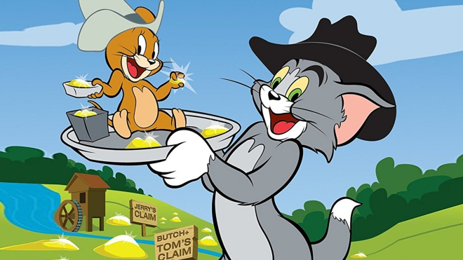
Tom and Jerry
What is its name?

Slide 4
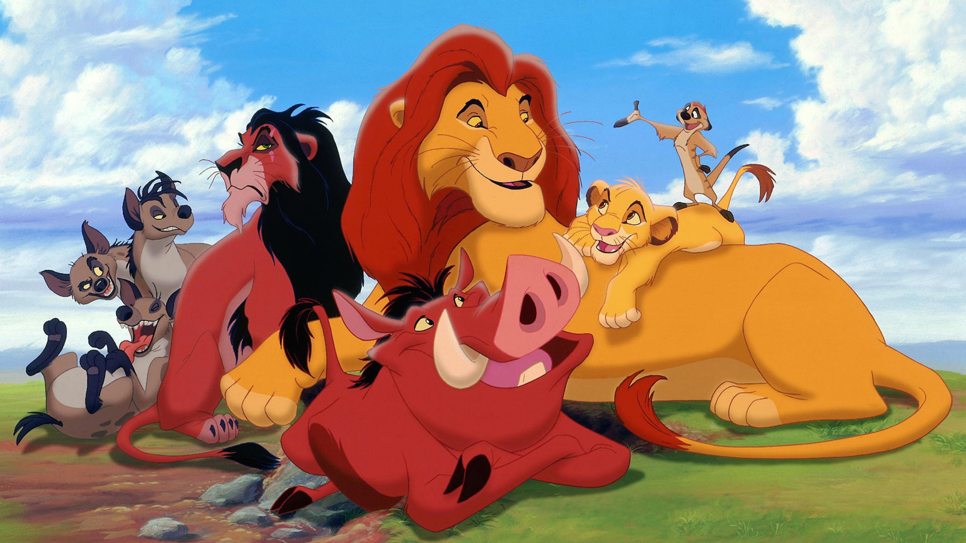
What film is it?
The Lion King

Slide 5
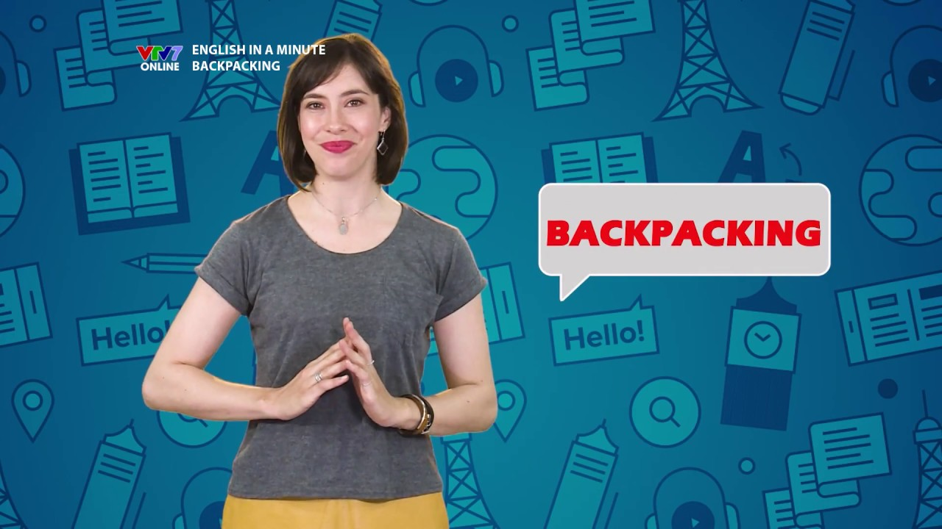
English in a minute – VTV 7
What programme is it?

Slide 6
Unit 7: Television
Lesson 1: Getting started

Slide 7

NEW WORDS
TV programme
/ˌtiːˈviː ˈprəʊ.ɡræm/
Chương trình ti vi

Slide 8

NEW WORDS
channel
/ˈtʃæn.əl/
Kênh truyền hình

Slide 9
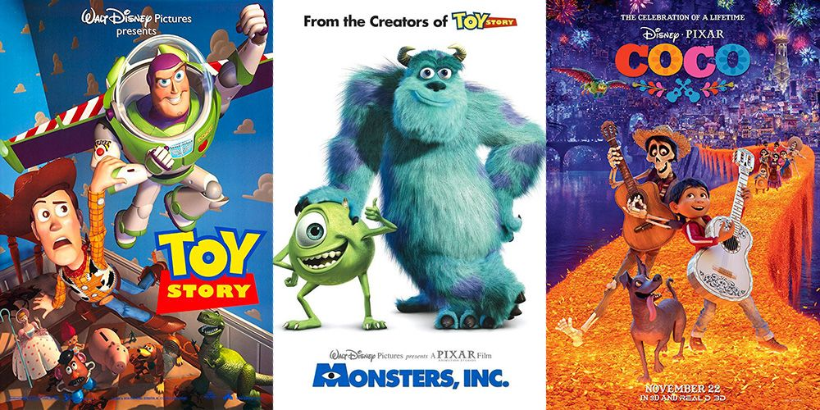
NEW WORDS
animated film
/ˈæn.ɪ.meɪ.tɪd fɪlm/
Phim hoạt hình thiết kế bằng đồ họa máy tính

Slide 10
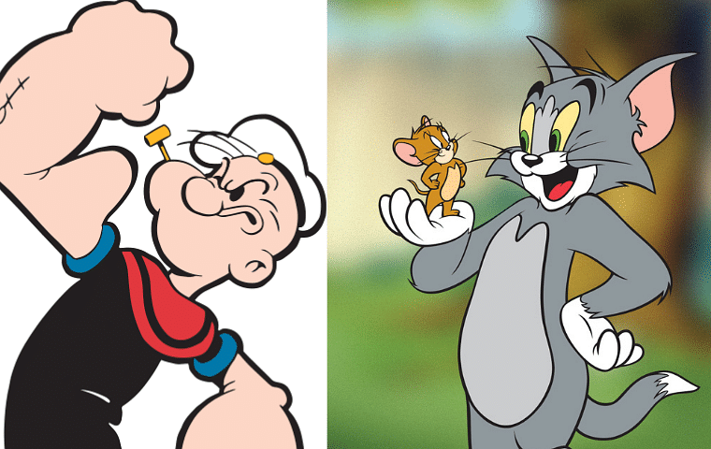
NEW WORDS
cartoon
/kɑːˈtuːn/
phim hoạt hình
vẽ tay

Slide 11

NEW WORDS
educational programme
/ˌedʒ.ʊˈkeɪ.ʃən.əl ˈprəʊ.ɡræm/
Chương trình
giáo dục

Slide 12
NEW WORDS
New words | Pronunciation | Meaning
1. TV programme | /ˌtiːˈviː ˈprəʊ.ɡræm/ | chương trình TV
2. channel | /ˈtʃæn.əl/ | kênh truyền hình
3. animated film | ˈæn.ɪ.meɪ.tɪd fɪlm | phim hoạt hình (đồ họa)
4. cartoon | /kɑːˈtuːn/ | phim hoạt hình (vẽ tay)
5. educational programme | /ˌedʒ.ʊˈkeɪ.ʃən.əl ˈprəʊ.ɡræm/ | chương trình giáo dục

Slide 13
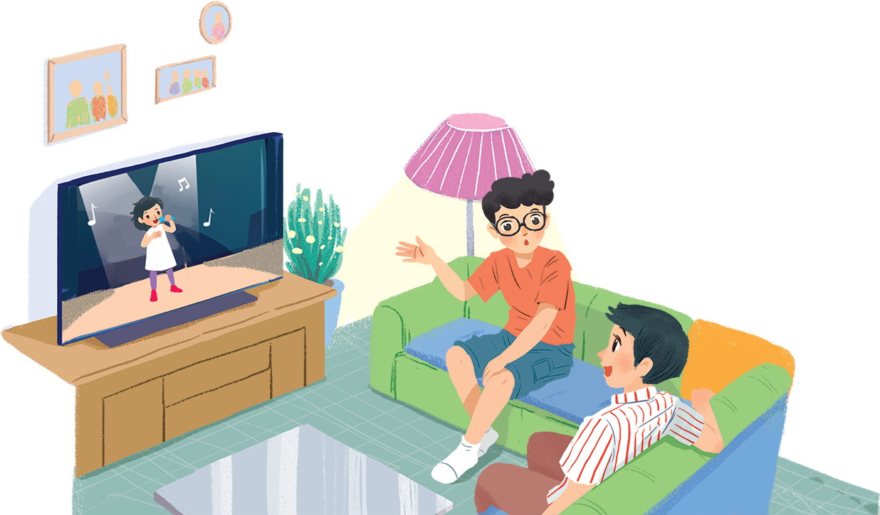
What’s on today?
1. Who are they?
Phong and Hung
2. Where are they?
They’re at home in the living room
3. What are they doing?
They’re watching TV and talking to each other.

Slide 14
2. Listen and choose the correct answer A, B or C.
1. Phong and Hung are talking about ____________.
A. The Voice Kids programme
B. English in a Minute programme
C. different TV programmes
2. Phong likes ____________.
A. animated films B. cartoons C. talent shows
3. When you're viewing a TV programme, you say: “I'm ____________ TV.”
A. watching B. seeing C. looking
4. When a programme teaches you something, it's ____________.
A. educational B. funny C. clever
Underline key words.
Let’s listen.

Slide 15
2. Listen and choose the correct answer A, B or C.
Phong: What are you watching, Hung?
Hung: The Voice Kids.
Phong: That music talent show is very interesting.
Hung: It is. What programme do you often watch, Phong?
Phong: Films. I like animated films like The Lion King.
…
Hung: Do you know any English programmes for children?
Phong: Yes. I watch English in a Minute on VTV 7. This channel has many educational programmes.
1. Phong and Hung are talking about _____.
A. The Voice Kids programme
B. English in a Minute programme
C. different TV programmes
2. Phong likes _____.
A. animated films B. cartoons C. talent shows
3. When you're viewing a TV programme, you say: “I'm _____ TV.”
A. watching B. seeing C. looking
4. When a programme teaches you something, it's _____.
A. educational B. funny C. clever

Slide 16
2. Listen and choose the correct answer A, B or C.
1. Phong and Hung are talking about _____.
A. The Voice Kids programme
B. English in a Minute programme
C. different TV programmes
2. Phong likes _____.
A. animated films B. cartoons C. talent shows
3. When you're viewing a TV programme, you say: “I'm _____ TV.”
A. watching B. seeing C. looking
4. When a programme teaches you something, it's _____.
A. educational B. funny C. clever
Hung: What programme do you often watch, Phong?
Phong: Films. I like animated films like The Lion King.
Hung: I love them, too. They’re wonderful.

Slide 17
2. Listen and choose the correct answer A, B or C.
1. Phong and Hung are talking about _____.
A. The Voice Kids programme
B. English in a Minute programme
C. different TV programmes
2. Phong likes _____.
A. animated films B. cartoons C. talent shows
3. When you're viewing a TV programme, you say: “I'm _____ TV.”
A. watching B. seeing C. looking
4. When a programme teaches you something, it's _____.
A. educational B. funny C. clever

Slide 18
3. Read again and match.
1. The Voice Kids
2. The Lion King
3. Tom and Jerry
4. VTV 7
5. English in a minute
a. animated film
c
a
b. channel
e
c. music talent show
b
d. educational programme
d
e. cartoon

Slide 19
What do you like to watch?
Can you describe it?

Slide 20
4. Find and write the adjectives in the conversation.
1. The Voice Kids
2. animated films
3. Jerry the mouse
4. programmes on VTV7
interesting
wonderful
clever
educational

Slide 21
INTERVIEW What’s you favourite TV programmes?

Slide 22
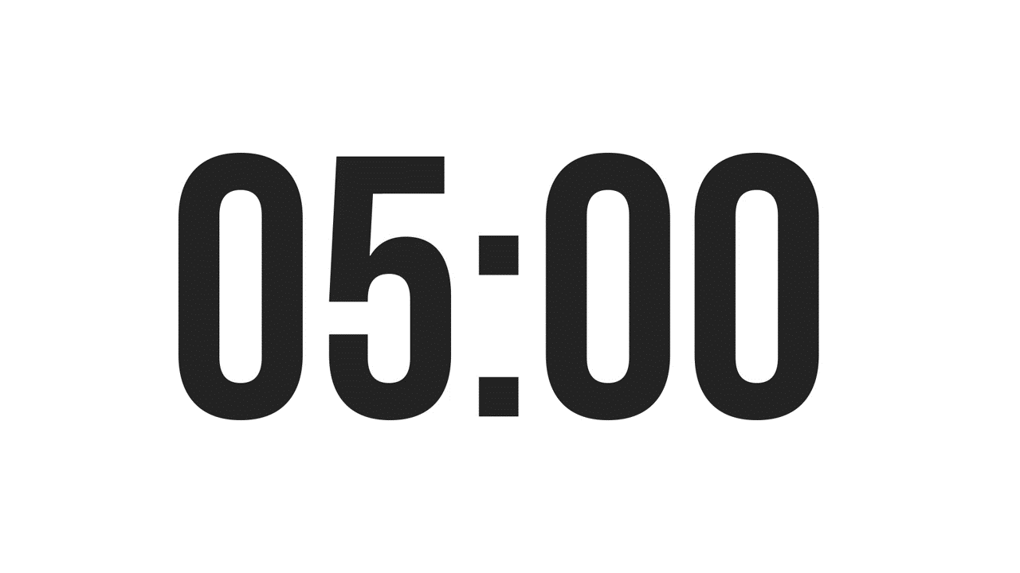
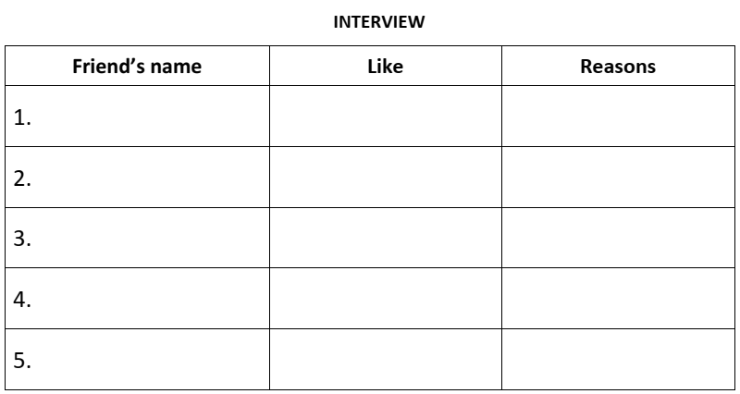
5. Interview your partners.
Work in groups of 6.
Interview your partners:
What are their favourite TV programmes?
Why?
5 minutes
Report in front of the class.

Slide 23
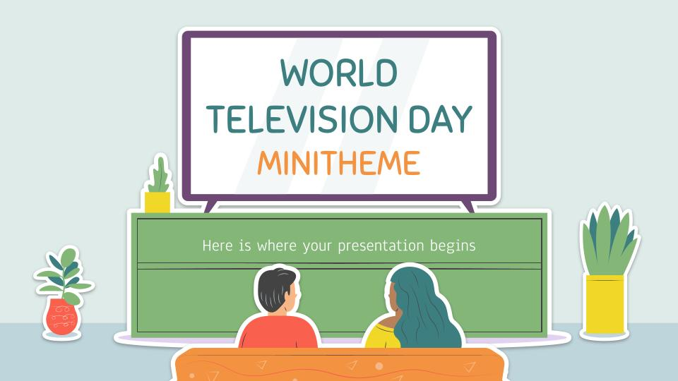
THANK YOU!

