Slide 1

UNIT 3. COMMUNITY SERVICE
Lesson 4: A CLOSER LOOK 2 (part 2)

Slide 2

UNIT 3. COMMUNITY SERVICE
Lesson 4: A Closer look 2 (part 2)
Review:
Past simple and present perfect

Slide 3
1. Past simple
Use:
Diễn tả hành động đã xảy ra và kết thúc tại một thời điểm được xác định trong quá khứ.
Form
Tobe
(+) I/ he/ she/ it + was + ……. You/we/ they + were + …..
(-) I/ he/ she/ it + wasn’t + ……. You/we/ they + weren’t + …..
(?) Was + I/ he/ she/ it + ……? Were + you/we/ they + …..?
Verb (Động từ thường)
(+) S + V- ed/ V _{BQT}
(-) S + didn’t + V
(?)Did + S + V?
Yes, S + did
No, S + didn’t

Slide 4
1. Past simple
Signals:
- yesterday (hôm qua)
- last…. (trước/ vừa qua)
last night/week/month/…(Tối qua/tuần trước/tháng trước/…)
-… ago (cách đây)
two hours ago: cách đây 2 giờ/two weeks ago: cách đây hai tuần
- in + thời gian trong quá khứ (eg: in 1990)

Slide 5
2. Present perfect
Use:
- Diễn tả 1 hành động đã xảy ra trong quá khứ nhưng không biết rõ thời gian hoặc không đề cập đến thời gian cụ thể.
Form
(+) S + have/has + PII
(-) S + haven’t/ hasn’t + PII
(?) Have/Has + S + PII?
I/you/we/they/ Danh từ số nhiều + have
She / He / It / Danh từ số ít + has
Signals
for + khoảng thời gian: for two days, for ten years,...
since + mốc thời gian: since 1994, since February,...
never (chưa từng), ever (đã từng), just ( vừa mới), already (đã rồi) , so far ( cho đến bây giờ), yet (…chưa?), several times (vài lần)

Slide 6
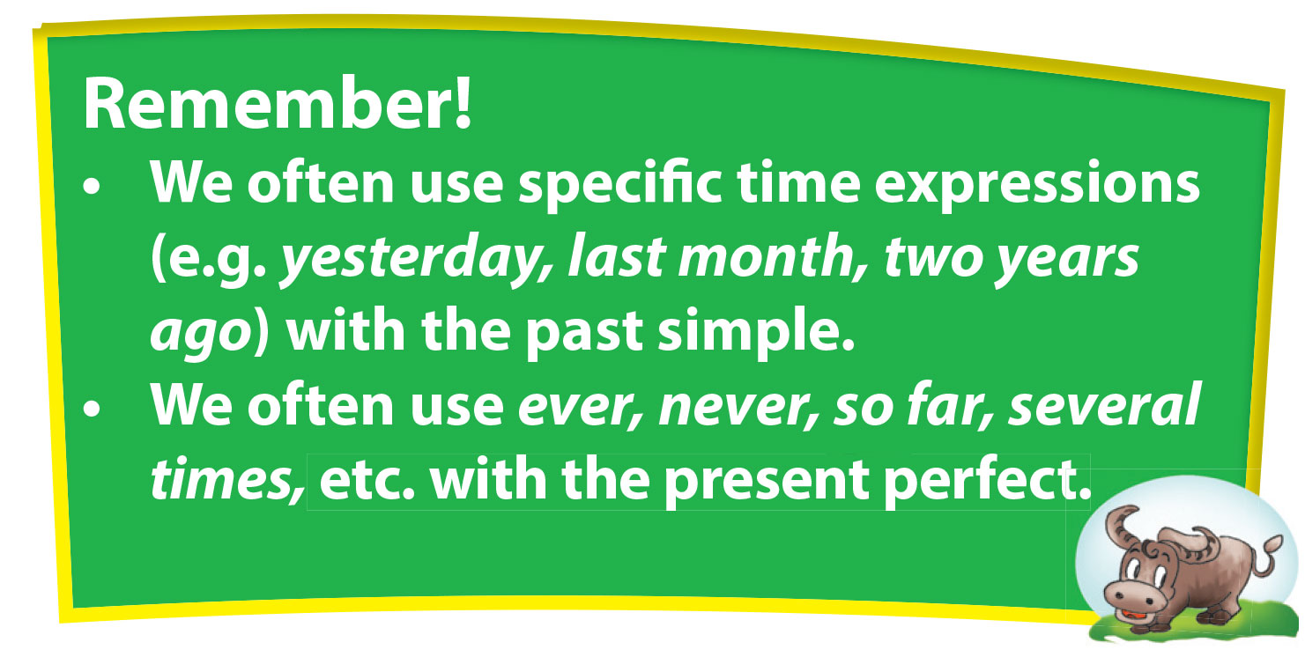

Slide 7
UNIT 3. COMMUNITY SERVICE
Lesson 4: A Closer look 2 (part 2)
II. Practice

Slide 8

2. Write the sentences in positive form (+), negative form (-) and question (?)
1.
(+) They provided evening classes for 50 children last year.
(-) ________________________________________________________________.
(?) ________________________________________________________________?
2.
(+) ________________________________________________________________.
(-) There were not homeless people here ten years ago.before.
(?) ________________________________________________________________?
3.
(+) Jane often went to school on foot 3 years ago.
(-) _________________________________________________________________.
(?) _________________________________________________________________?
They didn’t provide evening classes for 50 children last year.
Did they provide evening classes for 50 children last year?
There were homeless people here ten years ago.
Were there homeless people here ten years ago?
Jane didn’t often go to school on foot 3 years ago.
Did Jane often go to school on foot 3 years ago?

Slide 9
2. Write the sentences in positive form (+), negative form (-) and question (?)
1.
(+) He has collected clothes for street children for two years.
(-) ________________________________________________________________.
(?) ________________________________________________________________?
2.
(+) ________________________________________________________________.
(-) Tom hasn’t been to Singapore before.
(?) ________________________________________________________________?
He hasn’t collected clothes for street children for two years.
Has he collected clothes for street children for two years?
Tom has been to Singapore before.
Has Tom been to Singapore before?

Slide 10
3. Underline the correct answers.
1. I saw/ have seen that film already.
2. We went/ have gone to the movies three times last month.
3. Did you ever do/ Have you ever done volunteer work?
4. I had/ have had five tests so far .
5. This is my grandparents’ house. They lived/ have lived here for more than 50 years.
6. She bought/ has bought a new mobile phone two days ago.
7. Did you see/ Have you seen Peter at the party last night?
8. I read/ have read this book twice.
9. They didn’t play/ haven’t played football yesterday.

Slide 11
4. Past simple or Present perfect? Put the verb into the correct form.
haven’t seen
1. They (not see) the film Titanic yet.
2. Tom (donate) many books for street children yesterday.
3. Nancy (be) to Viet Nam several times.
4. My uncle (move) to Da Lat in 2005.
5. Peter (be) to many countries in the world so far.
6. We (go) to that village to do volunteer work several times.
7. We (visit) Ha Long Bay last July.
8. He (send) the email an hour ago.
My friend to lots of countries.
Last summer, she to India. (go)
10. We _____________ (not see) Beth at Mike’s house yesterday morning.
donated
has been
moved
has been
have gone
visited
sent
has gone
went
didn’t see

Slide 12
III. Wrap- up
UNIT 3
A CLOSER LOOK 2 (part 2)
Grammar
The past simple
The present prefect

Slide 13

IV. Homework
Learn by heart the form, the uses and the signals of two tenses
Do exercises in Workbook
Prepare: Unit 3 – Skills 1

