Slide 1
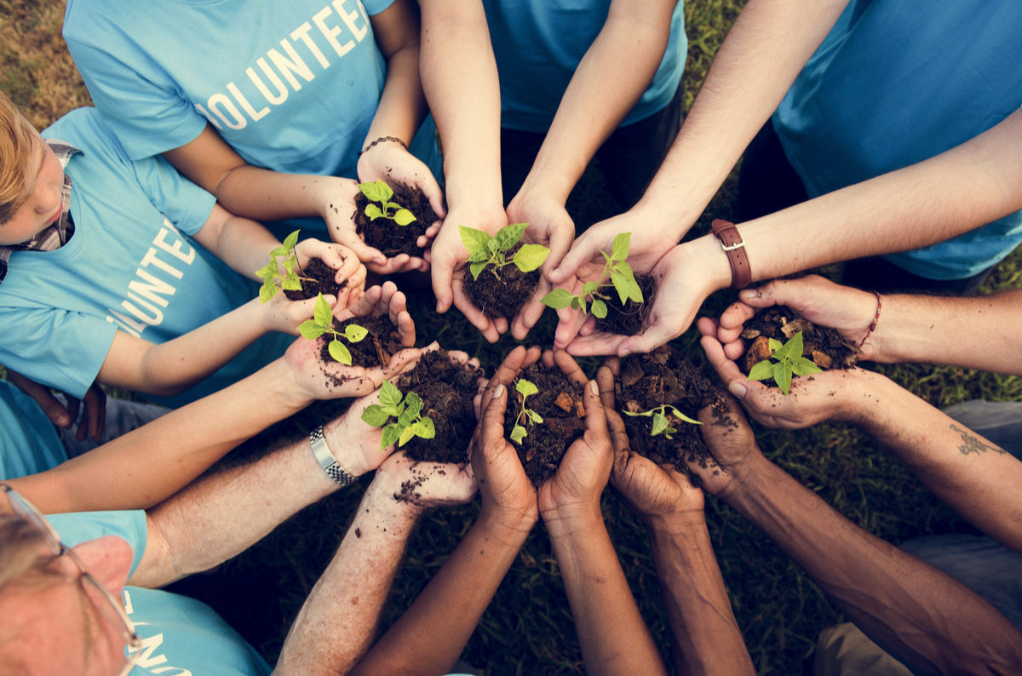
UNIT 3. COMMUNITY SERVICE
Lesson 7: Looking back & project

Slide 2

MINDMAP
COMMUNITY SERVICE
Vocabulary
Grammar
community service
volunteer work
Past simple and present perfect tense

Slide 3

UNIT 3. Community service
Lesson 7: Looking back and project
I. Looking back
1. Vocabulary

Slide 4



Vocabulary
1. Match the verbs in blue with the correct word in the box
evening class
food
care
the community
books
education
homeless people
clothing
attention
the elderly
blood
the disabled
DONATE
PROVIDE
HELP
food
evening class
homeless people
books
food
the community
clothing
care
the elderly
blood
books
the disabled
education
clothing
attention

Slide 5
UNIT 3. Community service
Lesson 7: Looking back and project
Looking back
2. Grammar

Slide 6




GRAMMAR
2. Circle the best answer
1. Because Minh has ever/never/ago worked for a charity shop, he really wants to do it.
2. Already/Last week/So far we visited sick children in Viet Duc Hospital.
3. Nhung has already/many times/ever finished all the homework.
4. Have you read that book yet/ever/never?
5. Yes, I finished it three times/so far/yesterday.

Slide 7
GRAMMAR
3. Put the verbs in the past simple or the present perfect
1.He thinks she’s the most kind-hearted girl he ________ever (meet) _____________
2.She (visit) ____________ Hue when she was a child.
3.She (visit) _______________ Hue once.
4.How many plays _____ Shakespeare (write) ________?
5.How many plays ________ she (write) _________ so far?
has
met
visited
has visited
did
write
has
written

Slide 8
GRAMMAR
4. Finish the sentences below
1.They’ve decided to buy that car because ____________________
2.Put on your warm coat because ___________________________
3.We like her because ____________________________________
4.Let’s help the street children because ______________________
5.Because she loves her students, ___________________________
the engine is very good
it is going to be cold this evening
she’s kind
they are not as lucky as we are
she always works hard to teach well

Slide 9
UNIT 3. Community service
Lesson 7: Looking back and project
Looking back
3. Communication

Slide 10



Communication
5. Role-play: Reporter and a volunteer
Student A
You joined Our Town 6 months ago because you wanted to introduce Vietnamese culture to foreigners, and to practise English. You have given tours in English, and helped visitors to play traditional Vietnamese games. Last month you felt happy when you received a thank-you letter from two Australian visitors who liked the tours very much.
• When did you start working for your organisation?
• Why did you decide to volunteer?
• What have you done so far with (name of organisation)?
• Was there anything that made you happy with your work last month?
Student B
You joined Big Heart 2 years ago because you wanted to help people in hospital. You have donated blood twice, and given presents to sick children. Last month you felt happy when you made a Mid-Autumn Festival lantern yourself and gave it to a little girl in hospital who loved it so much.

Slide 11

Finished! Now I can...
Finished! Now I can... | ✓ | ✓✓ | ✓✓✓
● talk about community service and volunteer work
● use because to give reasons
● know when to use the past simple and when to use the present perfect

Slide 12
UNIT 3. Community service
Lesson 7: Looking back and project
II. Project

Slide 13
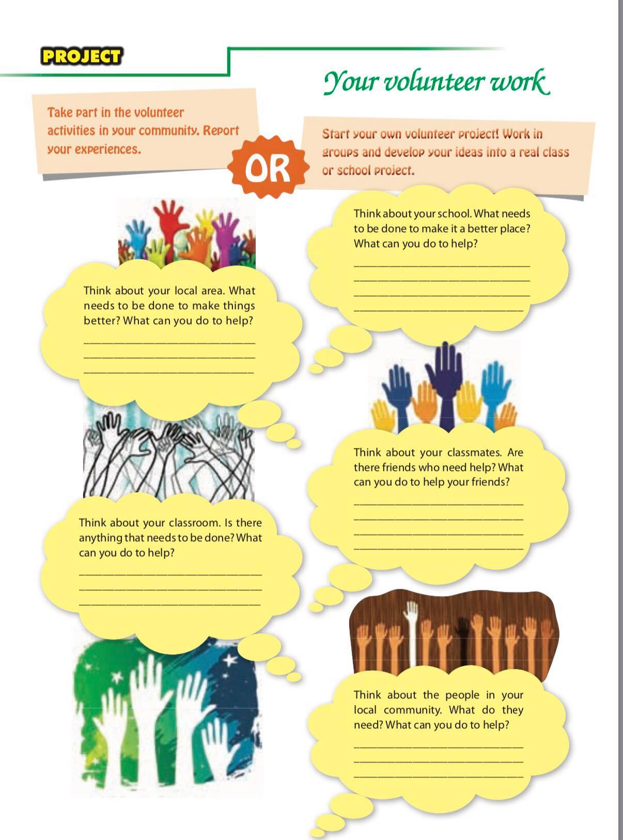


Slide 14
SUGGESTION
=> I think that my local area needs to be cleaned up, because there is much rubbish in the street at my neighbourhood. I will ask my neighbour friends to collect rubbish and clean up the street.
=> I think we should plant more trees and flowers in school garden. I will ask my classmates do it with me.
=> I think I should decorate my classroom and put some flower vases in the classroom. I will ask my classmates do it with me. We will hang some pictures of protecting environment that we find from Internet. We will buy the flower in local market.
=> I think my classmate, Lan needs the help. She is not good at English. I will tutor her, mentor her study English, help her do English homework.
=> I think the homeless people in my community need the meals. I will ask my friend to provide food for homeless people 3 times a week. We will collect money and cook the meal for them: rice with meat, fish, vegetables....

Slide 15
III. Wrap- up
UNIT 3
LOOKING BACK & PROJECT
Vocabulary
Grammar
Project
Review:
Volunteer work
donate books
provide food
help the disabled
…..
The present prefect
S + has/have + PII
The past simple
S + V-ed / V BQT

Slide 16

IV. Homework
Prepare: Review 1
Do exercises in Workbook

