Slide 1
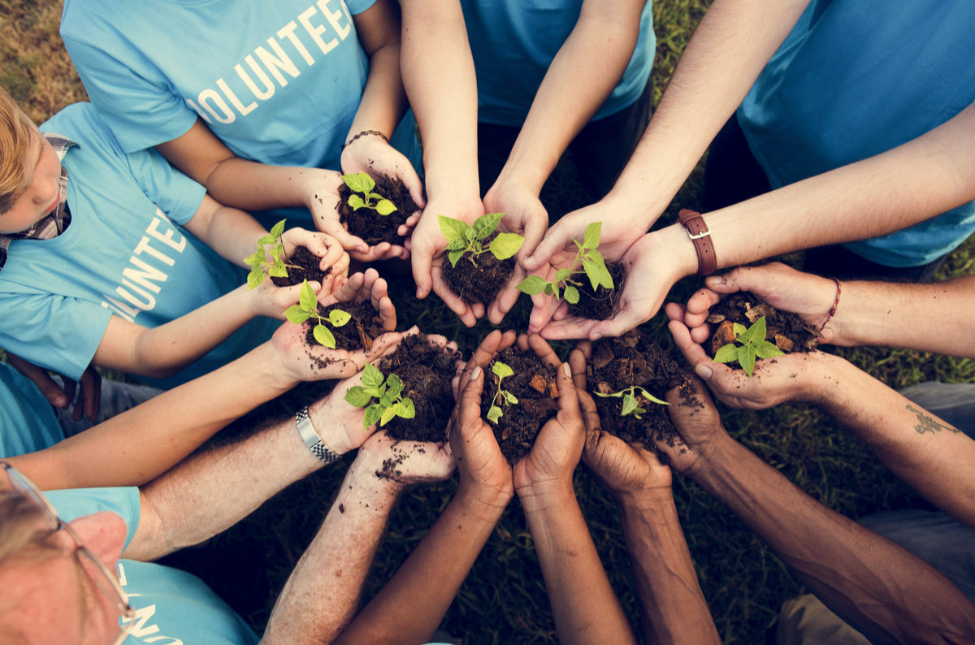
UNIT 3. COMMUNITY SERVICE
Lesson 5: Skills 1

Slide 2


Slide 3

UNIT 3. Community service
Lesson 5: Skills 1
Reading
*Vocabulary
1. raise money (n): quyên góp tiền
2. raise funds (v): gây quỹ
3. labour (n): lao động
4. repair (v): sửa chữa
5. transportation (n): phương tiện đi lại
6. tutor (v,n): dạy kèm, gia sư
7. be forced to do sth (v): bị ép buộc làm việc gì đó

Slide 4


Reading
1. Read the text about volunteer work in the United States
In the United States, almost everyone, at one time or another, has been a volunteer. According to U.S. government statistics, about one-fifth of the American population does volunteer work each year. Americans have had the tradition of volunteering and helping one another since the early days of the country.
Americans volunteer not because they are forced or paid to do it. They enjoy it! Traditional volunteer activities include raising money for people in need, cooking and giving food, doing general labour (such as clean-up projects and home repair), providing transportation (such as giving rides to the elderly), and tutoring/mentoring young people.
(adapted from “Volunteering: An American Tradition” by Susan J. Ellis and Katherine H. Campbell in eJournal USA: The Spirit of Volunteerism. U.S. Department of State, 2012).

Slide 5

Reading
2. DECIDE IF THE FOLLOWING STATEMENTS ARE TRUE (T) OR FALSE (F)
 | T | F
1.According to the text, nearly every American has done volunteer work in his or her life.
2.Every year almost one in five Americans works as a volunteer.
3.Americans have been volunteering for less than 50 years.
4.Americans volunteer because they are forced to do it.
Q4
(9+10) Americans volunteer not because they are forced or paid to do it. They enjoy it!
Q1
(1+2) In the United States, almost everyone, at one time or another, has been a volunteer.
Q2
(3+4+5) According to U.S. government statistics, about one-fifth of the American population does volunteer work each year
Q3
(6+7+8) Americans have had the tradition of volunteering and helping one another since the early days of the country.

Slide 6
3. Which activities below are traditional volunteer activities in the United States.
Tick (v) the boxes.
 | T | F
1.providing care for animals
2.raising money
3.cooking meals
4.donating blood
5.cleaning streets
6. teaching young children

Slide 7
Traditional volunteer activities include raising money for people in need, cooking and giving food, doing general labour (such as clean-up projects and home repair), providing transportation (such as giving rides to the elderly), and tutoring/mentoring young people.
Back

Slide 8
UNIT 3. Community service
Lesson 5: Skills 1
Speaking:
Volunteer activities

Slide 9

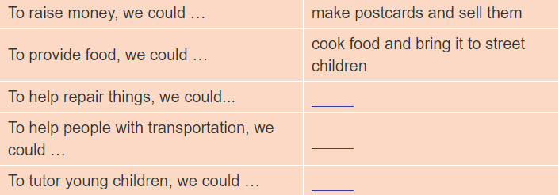
4. IDEAL BANK: Fill the table with your ideas for volunteer activities

Slide 10
Speaking
4. IDEAL BANK: Fill the table with your ideas for volunteer activities
-To raise money, we could……
make postcards and sell them.
collect used bottles and sell them
make food and sell it
collect old things such as books, toys and sell them
To provide food, we could ……
cook food and bring it to street children.
cook a meal at a for homeless people
offer meals at 5,000VND for the poor
To help repair things, we could…….
repair tables, chairs, blankets in the house.
To help people with transportation, we could……
give the rides to the elderly.
help elderly people cross the street
To tutor young children, we could ……
study young children English, Maths or Vietnamese
help them do homework
donate books or school things

Slide 11
Speaking
5. Work in groups. Share the ideas in your idea bank with your group members. Then, use the most interesting ideas to create a new group idea bank and share it with the class.
Example:
A: We could make postcards and sell them to raise money.
B: What types of postcards?
C: Where should we sell them?
We could ………………………..to ………………….

Slide 12
Speaking
IDEAL BANK: Volunteer activities
-To raise money, we could make postcards and sell them.
A: We could make postcards and sell them to raise money.
B: What types of postcards?
A: Greeting cards: Happy Birthday, Happy New Year, Congratulation.
B: Where can we sell them?
A: We can sell them to students in our school.
To provide food, we could cook food and bring it to street children.
A: We could cook food and bring it to street children.
B: What kind of food?
A: Rice with fish and meat, vegetable soup.
B: How often do we bring food to them?
A: 3 times a week.
To help repair things, we could repair tables, chairs
A: We could repair tables, chairs to help repair things.
We will help the elderly people, the people in need.
B: How often do you help do?
A: Once a week
To help people with transportation, we could give the rides to the elderly.
A: We could give the rides to the elderly, to help the with transportation.
B: How often do we help them?
A: Five times a week.
To tutor young children, we could mentor them to do homework and help them study the lesson.
A: We could help young children do homework, help them study Maths and English.
B: How often do we help them?
A: 3 times a week.

Slide 13
IV. Wrap- up
UNIT 3
SKILLS 1
READING
SPEAKING
Volunteer work in the United States
Volunteer activities

Slide 14

V. Homework
Learn by heart all the vocabulary
Prepare: Unit 3 – Skills 2

