Slide 1
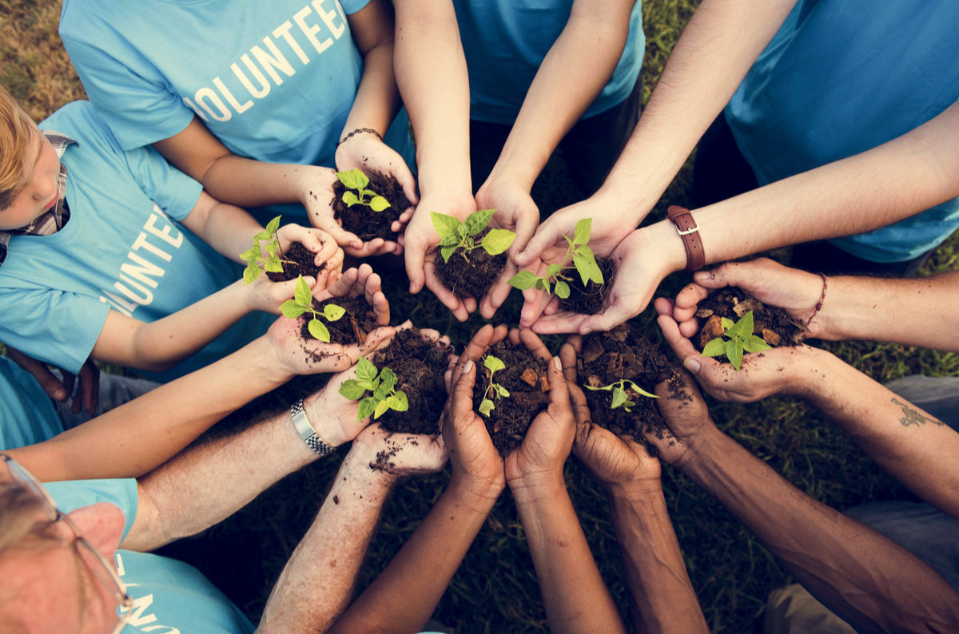
UNIT 3. COMMUNITY SERVICE
Lesson 6: SKILLS 2

Slide 2




LISTENING
1. DISCUSS THE FOLLOWING QUESTION
SUGGESTION IDEAS
- I think all people benefit from volunteer work, the people in need and the volunteer.
-The volunteer enjoy it and they feel happy to do it.
The people in need feel happy when they receive the help.
• Who do you think benefits from volunteer work?
• How do people benefit from volunteer work?

Slide 3

UNIT 3. Community service
Lesson 6: Skills 2
Listening
*Vocabulary
confident (adj): tự tin, tin tưởng
self-confident (adj): tự tin vào bản thân
make a difference (v): tạo nên sự khác biệt, làm thay đổi

Slide 4


LISTENING
2. Listen and answer the questions
1.Why does Phuc do volunteer work?
→ Phuc does volunteer work because he thinks it makes a difference in the community.
2.Why does Phuc feel more self-confident?
→ Phuc feels more self-confident because he has made many new friends.
3.Why does the reporter think Phuc is confident?
→ The reporter thinks Phuc is confident because Phuc has answered the interview very well.
4.Why does Mai think volunteering is special?
→ Mai thinks volunteering is special because she can help others, and because she can see how happy the children are when they learn.

Slide 5

LISTENING
3. Listen and fill in the blank
1.I _________ because I can make a difference in our community.
2.I’ve made many new friends, and I _________ much more self-confident.
3.Volunteering is special to me _________ I can help others.
4.It’s special _________ I can see how happy the _______________ are when they learn.
volunteer
feel
because
because
children

Slide 6
UNIT 3. Community service
Lesson 6: Skills 2
Writing
Volunteer work

Slide 7
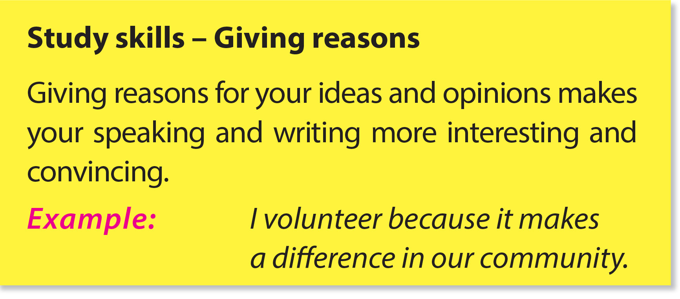

Slide 8
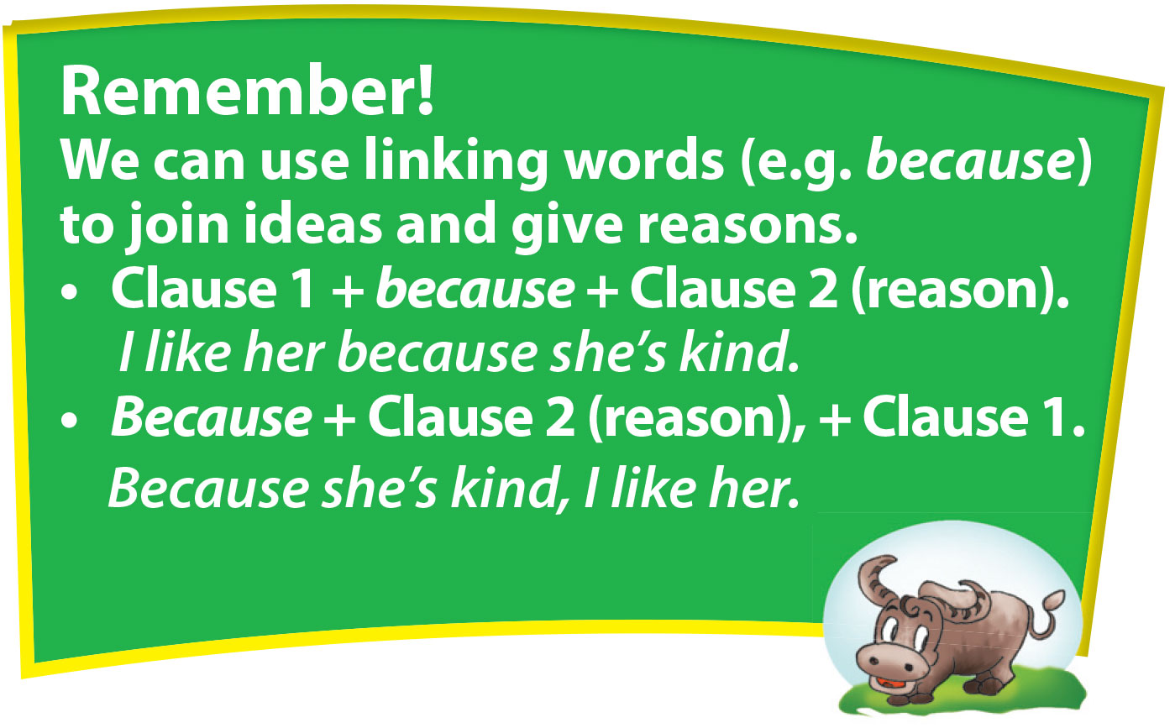

Slide 9
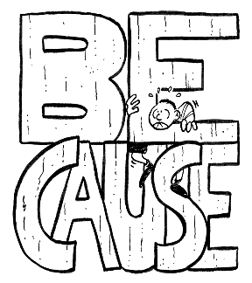
Writing
4. Combine the two sentences using because
1. He didn’t wear enough warm clothes. He’s had a cold for two days.
→ Because he didn’t wear enough warm clothes, he’s had a cold for two days.
2. It rained. I stayed home.
→ I stayed home because it rained.
3. The lake is full of rubbish. They’ve decided to clean it up.
→ Because the lake is full of rubbish, they’ve decided to clean it up.
4. She works in that small town. She’s lived in that small town for three years.
→ Because she works in that small town, she’s lived there for three years.
5. The neighbourhood is nice and quiet. They think they should move there.
→ They think they should move there because the neighbourhood is nice and quiet.

Slide 10

Writing
5. Write a short paragraph about your volunteer idea
Example
I want to raise funds for street children.
I want to do it because we will be able to provide them with food and books. They will no longer be hungry. They will be able to read. I will ask my friends to help me. We will make postcards and sell them.
• What do you want to do?
• Why do you want to do it?
(Why is it necessary?
Why is it interesting?)
• How are you going to do it?

Slide 11
IDEAL BANK: Volunteer activities
-To raise money, we could……
make postcards and sell them.
collect used bottles and sell them
make food and sell it
To help repair things, we could…….
repair tables, chairs, blankets, lights in the house.
To provide food, we could ……
cook food and bring it to street children.
cook a meal at a for homeless people
offer meals at 5,000VND for the poor
To tutor young children, we could ……
study young children English, Maths or Vietnamese
help them do homework
donate books or school things

Slide 12
Writing
5. Write a short paragraph about your volunteer idea
Example
I want to raise funds for street children.
I want to do it because we will be able to provide them with food and books. They will no longer be hungry. They will be able to read. I will ask my friends to help me. We will make postcards and sell them.
I want to raise funds for……………..
I want to do it because we will be able to provide them with………………………….. They will no longer……………………..
They will be able to…………………..
I will ask my ……………….to help me.
We will………………………………………..
I want to provide food, clothes for street children. I want to do it because I want to share the things with children who are in need. They will no longer be hungry and cold. I will cook food and bring it to street children on the weekends. I will also encourage my friends to donate clothes to them.

Slide 13
III. Wrap- up
UNIT 3
SKILLS 2
LISTENING
WRITING
Benefits from volunteer work
Volunteer work

Slide 14

IV. Homework
Complete your writing
Prepare: Unit 3 – Looking back
Do exercises in Workbook

