Slide 1
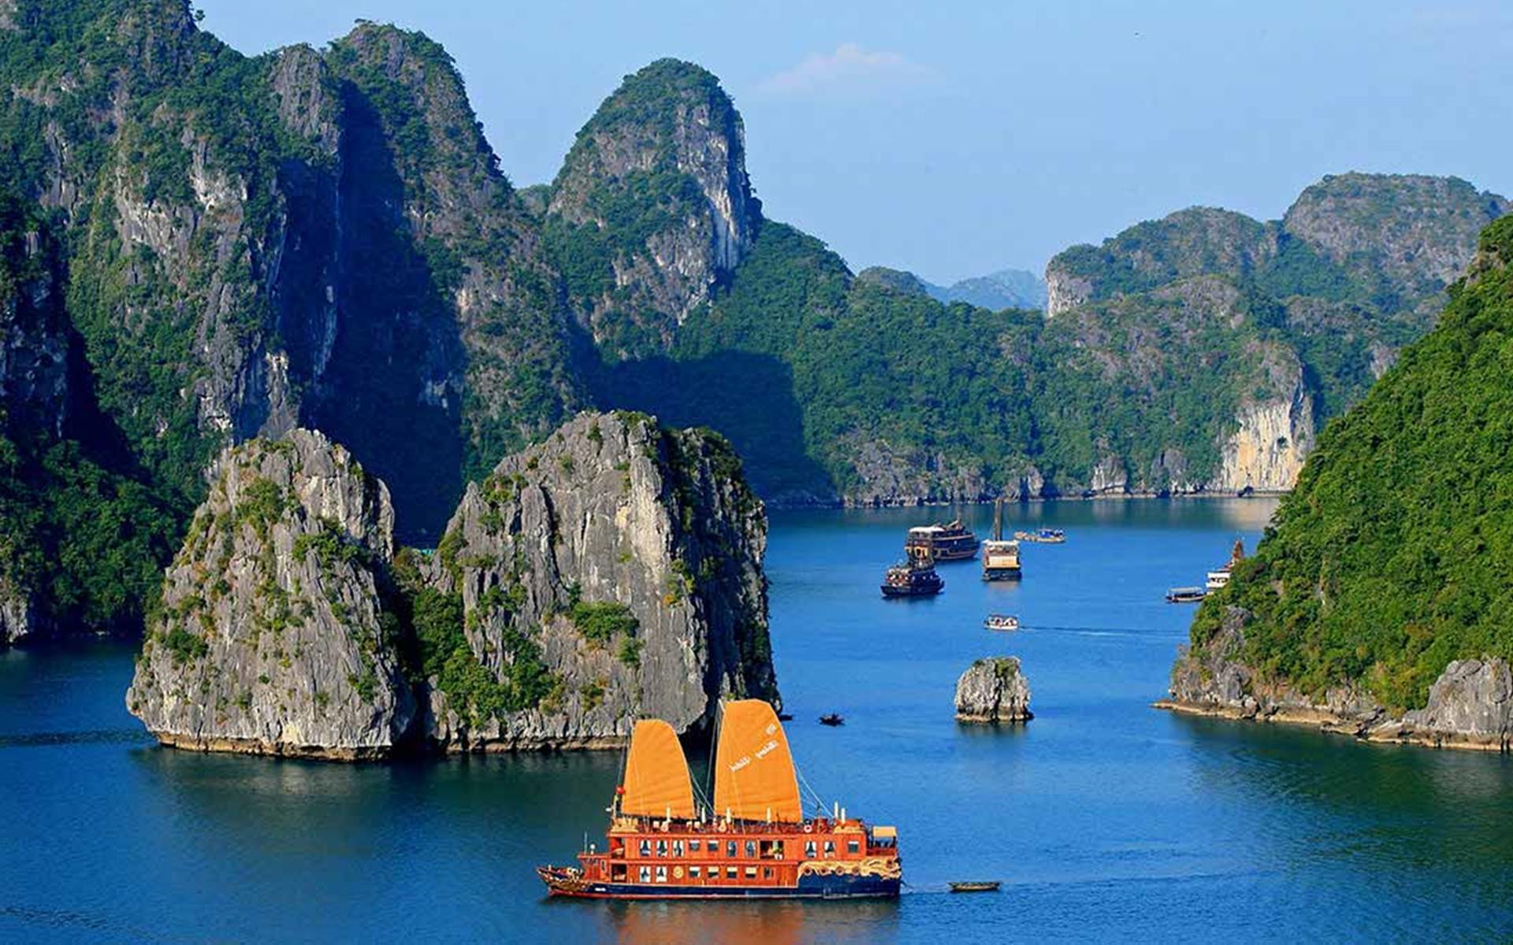
UNIT 5:
NATURAL WONDERS OF VIETNAM
LESSON 5: SKILLS 1

Slide 2








Reading
Speaking
Before you read, look at the pictures below. Make predictions about the reading. Then read and check your ideas.
Work in pairs. Make notes about one of the places in the reading. You can add your own ideas.
Some foreign visitors are visiting your city / town / area. You are their tour guide. Tell them some interesting things about the place as well as what they must and mustn’t do there.
Complete the sentences, using the words from the box.
Read the text again. Answer the following questions.

Slide 3
I. Reading

Slide 4


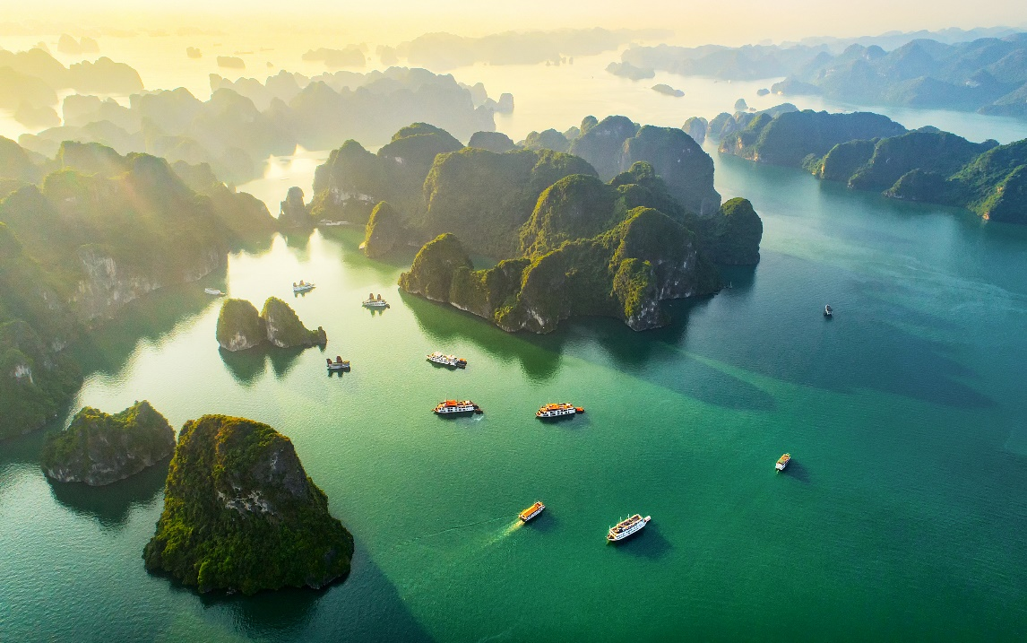
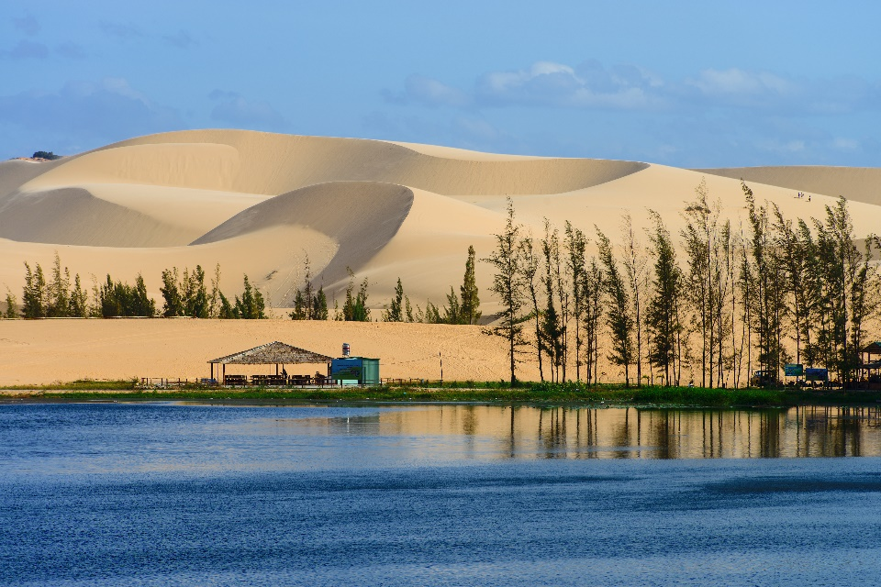
Before you read, look at the pictures below. Make predictions about the reading. Then read and check your ideas.
1.
What is the reading about?
2.
What do you know about these places?

Slide 5
Before you read, look at the pictures below. Make predictions about the reading. Then read and check your ideas.
Note:
Tuan Chau: a large island in Ha Long Bay, a popular tourist destination
Mui Ne: a tourist attraction in Binh Thuan Province

Slide 6

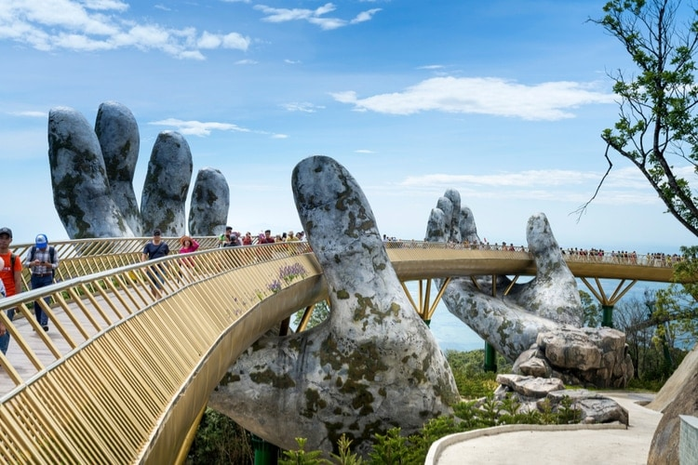
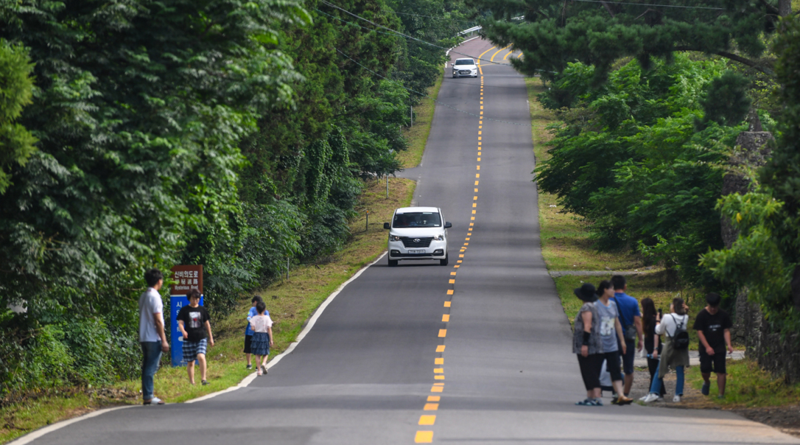
UNIT 5. NATURAL WONDERS OF VIETNAM
Lesson 5: Skills 1
Reading
*Vocabulary
Tourist attraction (n):
điểm tham quan du lịch, điểm thu hút khách du lịch
2. slope (n):
dốc, đường dốc
Golden Bridge Ba Na Hills

Slide 7
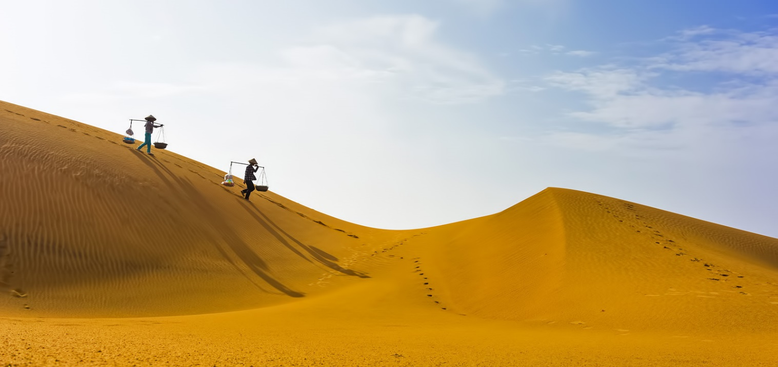
UNIT 5. NATURAL WONDERS OF VIETNAM
Lesson 5: Skills 1
Reading
*Vocabulary
3. Dune (n): cồn cát
Mui Ne Sand Dunes

Slide 8
UNIT 5. NATURAL WONDERS OF VIETNAM
Lesson 5: Skills 1
Reading
*Vocabulary
1. | tourist attraction | (n) | điểm tham quan du lịch
2. | slope | (n) | dốc, đường dốc
3. | dune | (n) | cồn cát
4. | landscape | (n) | phong cảnh
5. | join in | (v) | tham gia

Slide 9

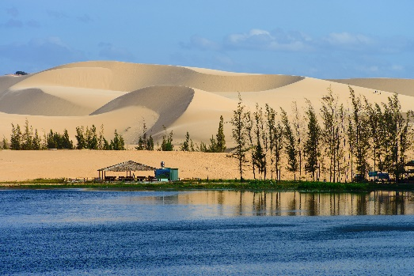
Ha Long Bay is in Quang Ninh. It has many islands and caves. Tuan Chau, with its beautiful beaches, is a popular tourist attraction in Ha Long Bay. There you can enjoy great seafood. And you can join in exciting activities. Ha Long Bay is Viet Nam’s best natural wonder.
Mui Ne is popular for its amazing landscapes. The sand has different colours: white, yellow, red ... It’s like a desert here. You can ride a bike down the slopes. You can also fly kites, or have a picnic by the beach. The best time to visit the Mui Ne Sand Dunes is early morning or late afternoon. Remember to wear suncream and bring water.

Slide 10

Complete the sentences, using the words from the box.
desert
visit
wonder
islands
remember
islands
1.
Ha Long Bay is the famous for its beautiful .
wonder
2.
Ha long Bay is the number one natural in Viet Nam.
desert
3.
A is a large area of land with very little water.
Remember to bring an umbrella, as it often rains there.
4.
to bring an umbrella, as it often rains there.
5.
A lot of people Ly Son Island in the summer.
visit

Slide 11

Read the text again. Answer the following questions.
Ha Long Bay is in Quang Ninh. It has many islands and caves. Tuan Chau, with its beautiful beaches, is a popular tourist attraction in Ha Long Bay. There you can enjoy great seafood. And you can join in exciting activities. Ha Long Bay is Viet Nam’s best natural wonder.
1.
Where is Ha Long Bay?
It is in Quang Ninh.
2.
What can you do at Ha Long Bay?
We can enjoy (great) seafood
and join in exciting activities.
3.
Is there a desert in Mui Ne?
No, there isn’t.
Mui Ne is popular for its amazing landscapes. The sand has different colours: white, yellow, red ... It’s like a desert here. You can ride a bike down the slopes. You can also fly kites, or have a picnic by the beach. The best time to visit the Mui Ne Sand Dunes is early morning or late afternoon. Remember to wear suncream and bring water.
4.
Where can you have a picnic in Mui Ne?
By the beach.
5.
What is the best time to
visit the Mui Ne Sand Dunes?
Early morning or late afternoon.

Slide 12
II. Speaking

Slide 13

Work in pairs. Make notes about one of the places in the reading. You can add your own ideas.
Ha Long Bay | Mui Ne
interesting islands
a beautiful place
Then tell your partner about the place.
Example:
Ha Long Bay has a lot of interesting islands. It …

Slide 14

Some foreign visitors are visiting your city / town / area. You are their tour guide. Tell them some interesting things about the place as well as what they must and mustn’t do there.
Example:
You must follow all the rules.
You mustn’t take photos when you are in the City Museum.

Slide 15
III. Wrap- up
SKILLS 1
READING
SPEAKING

Slide 16

IV. Homework
Learn by heart the vocabulary
Do exercises in Workbook
Prepare: Unit 5 – Skills 2

