Slide 1
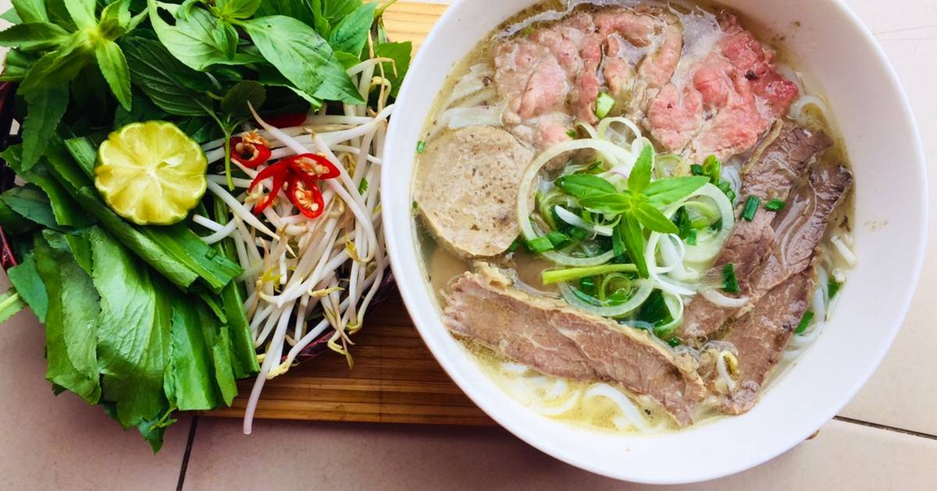
UNIT 5. VIETNAMESE FOOD AND DRINK
Lesson 5: SKILLS 1

Slide 2


Reading

Slide 3

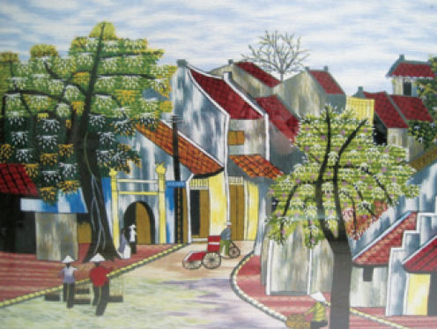
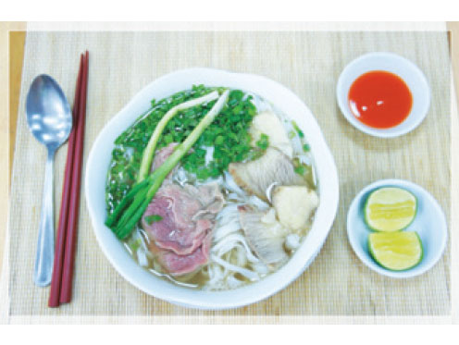
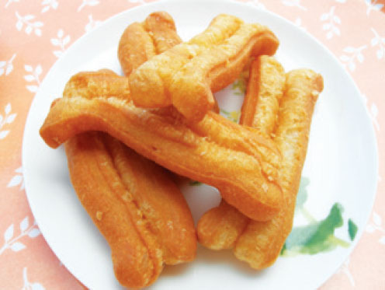
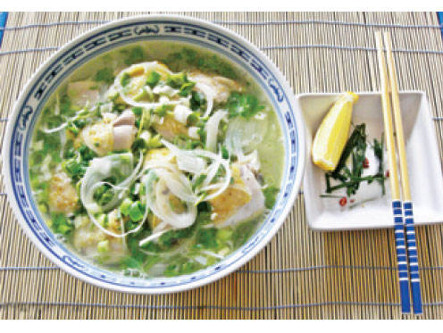



Reading
1. READ PHONG’S BLOG AND UNDERLINE THESE WORD FROM THE BOX
stewing bones broth bonelesss slices
Sun, Feb 24,... PHO - A POPULAR DISH IN HA NOI Among the many special dishes in Ha Noi, pho is the most popular. It is a special kind of Vietnamese soup. We can enjoy pho for all kinds of meals during the day, from breakfast to dinner, and even for a late night snack. Pho has a very special taste. The rice noodles are made from the best variety of rice. The broth for pho bo (beef noodle soup) is made by stewing the bones of cows for a long time in a large pot. The broth for another kind of pho, pho ga (chicken noodle soup) is made by stewing chicken bones. The chicken meat served with pho ga is boneless and cut into thin slices... It's so delicious! Tell me about a popular dish where you live! Posted by Phong at 5:30 p.m.

Slide 4


Slide 5
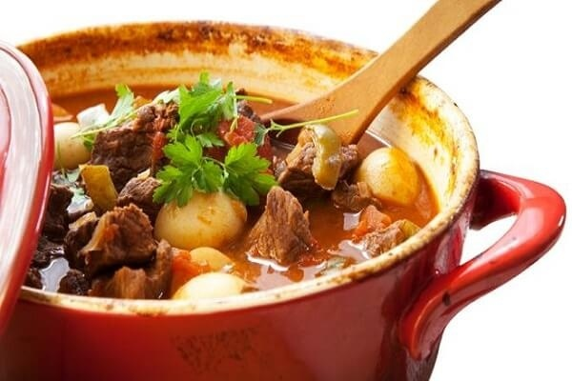
1. STEWING (n): ninh, hầm

Slide 6
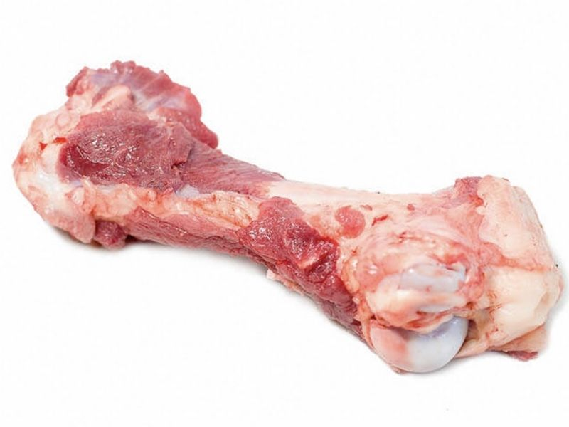
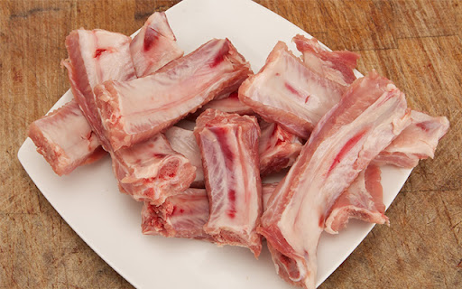
2. BONE (n): xương

Slide 7
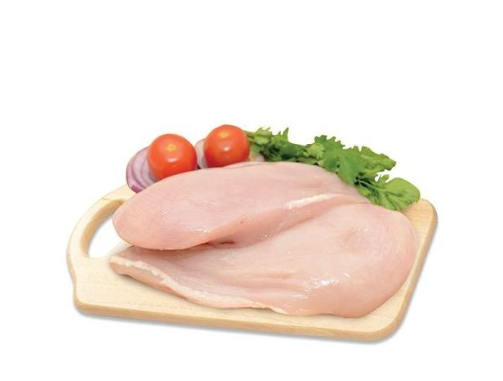
3. BONELESS (adj): không có xương

Slide 8
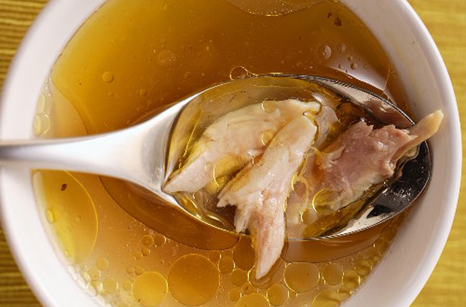
4. BROTH (n): nước xuýt

Slide 9
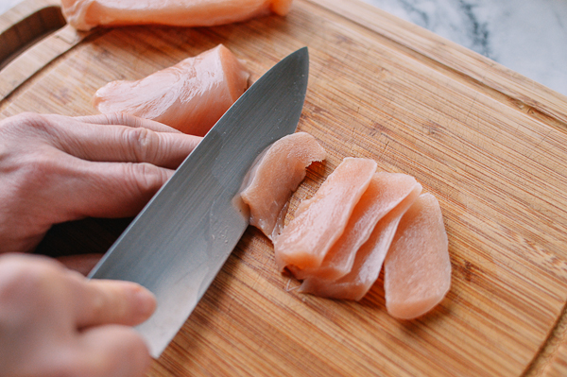
5. SLICE (n): miếng, lát mỏng

Slide 10

UNIT 5. VIETNAMESE FOOD AND DRINK
Lesson 5: Skills 1
Reading
*Vocabulary
1. | stewing | (n) | ninh, hầm
2. | bone | (n) | xương
3. | boneless | (adj) | không có xương
4. | broth | (n) | nước xuýt
5. | slice | (n) | miếng, lát mỏng

Slide 11





Reading
2. READ PHONG’S BLOG AGAIN AND ANSWER THE QUESTIONS
Sun, Feb 24,... PHO - A POPULAR DISH IN HA NOI Among the many special dishes in Ha Noi, pho is the most popular. It is a special kind of Vietnamese soup. We can enjoy pho for all kinds of meals during the day, from breakfast to dinner, and even for a late night snack. Pho has a very special taste. The rice noodles are made from the best variety of rice. The broth for pho bo (beef noodle soup) is made by stewing the bones of cows for a long time in a large pot. The broth for another kind of pho, pho ga (chicken noodle soup) is made by stewing chicken bones. The chicken meat served with pho ga is boneless and cut into thin slices... It's so delicious! Tell me about a popular dish where you live! Posted by Phong at 5:30 p.m.
1.When can we enjoy pho?
→ We can enjoy pho for all kinds of meals during a day, from breakfast to dinner, and even for a late night snack.
2.What are the noodles made from?
→ They are made from the best variety of rice.
3.How is the broth for pho bo (beef noodle soup) and pho ga (chicken noodle soup) made?
→ The broth for pho bo is made by stewing the bones of cows for a long time in a large pot. The broth for pho ga is made by stewing chicken bones.
4.How is the chicken meat served with pho ga?
→ It is boneless and cut into thin slices.

Slide 12
UNIT 5. VIETNAMESE FOOD AND DRINK
SKILLS 1
II. Speaking

Slide 13
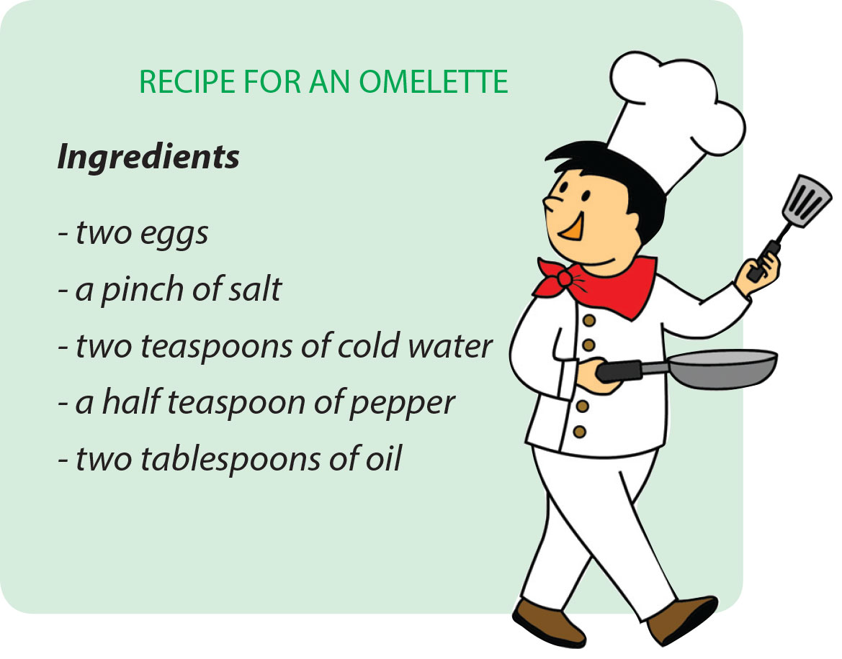
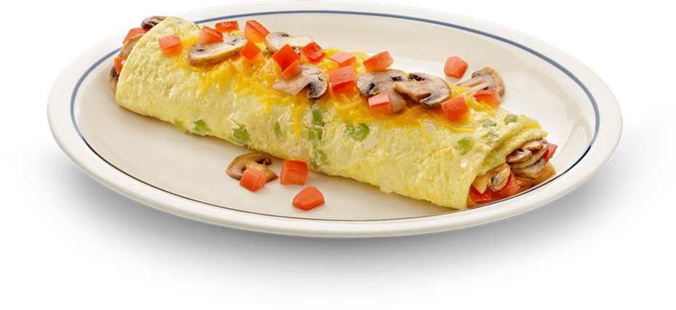
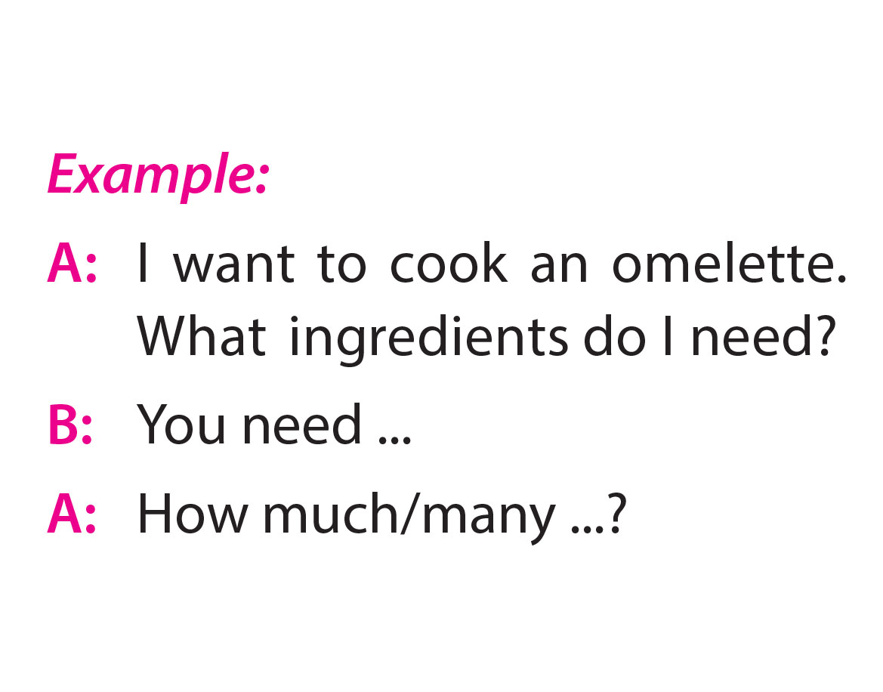
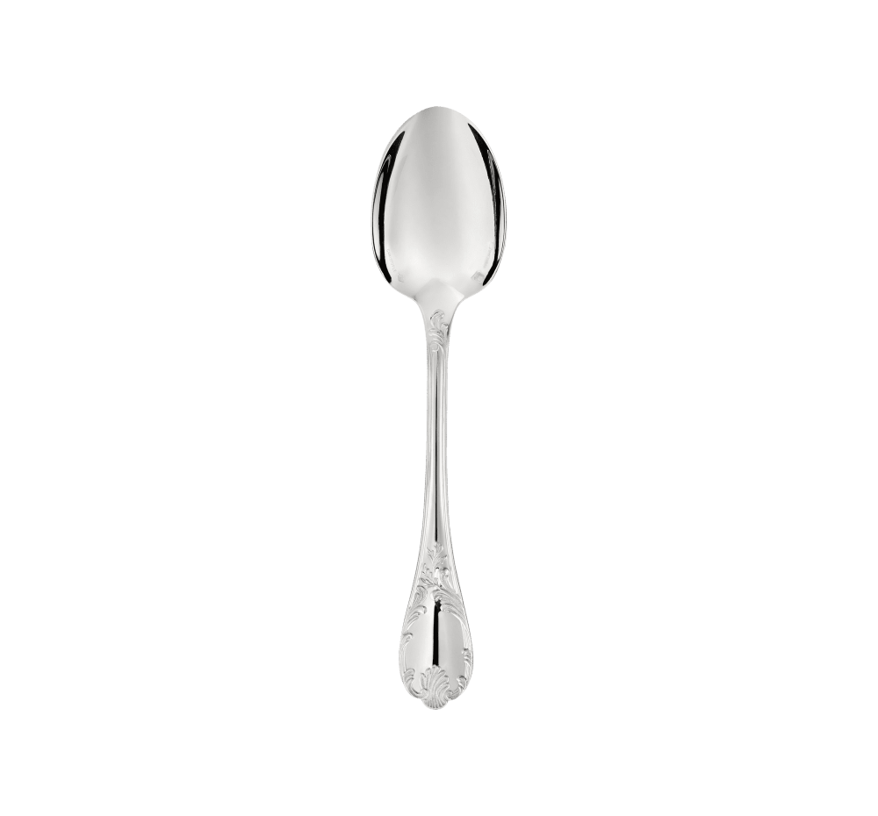
SPEAKING
3. Look at the list of ingredients below. Work in pairs. Ask and answer questions about the ingredients for an omelette.

Slide 14
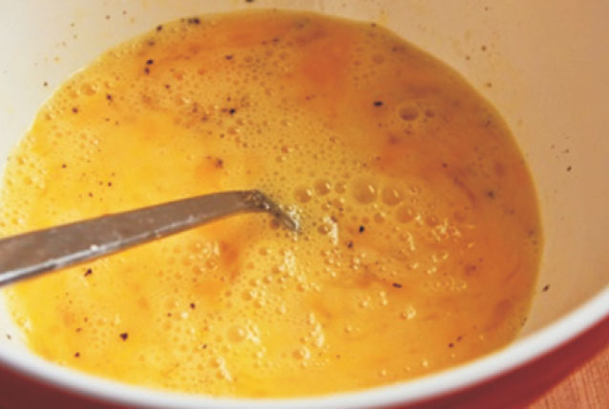
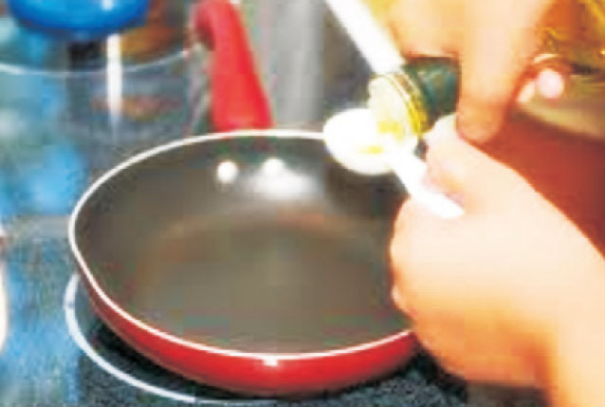
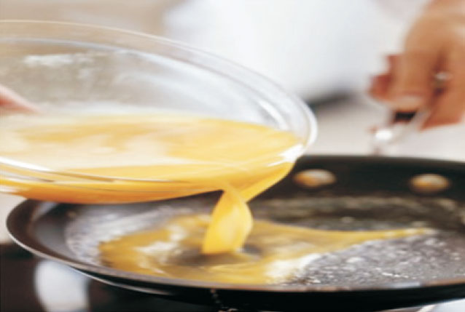
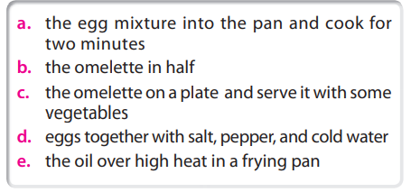
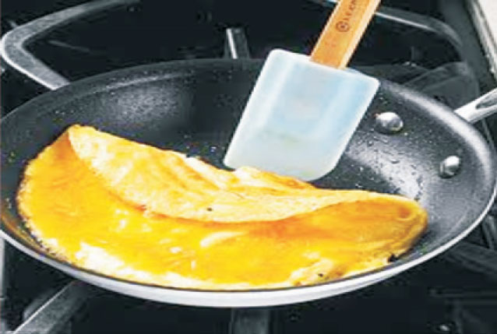
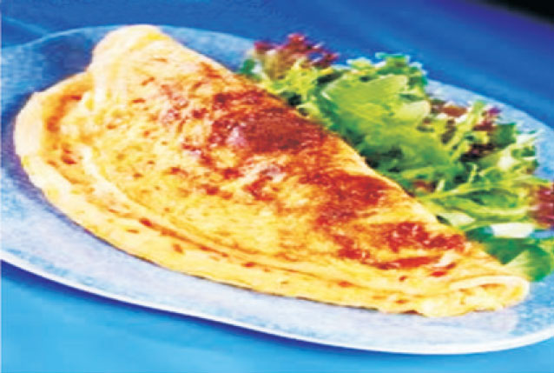
Speaking
4. Look at the pictures of how to cook an omelette. Use the phrases in this box to complete the above instructions
RECIPE FOR AN OMELETTE
1. First, beat_______________
2. Then, heat_________________
3. Next, pour________________.
4. After that, fold_____________.
5. Finally, put______________

Slide 15
Speaking
4. Look at the pictures of how to cook an omelette. Use the phrases in this box to complete the above instructions
RECIPE FOR AN OMELETTE
1. First, beat the eggs together with salt pepper and cold water.
2. Then, heat the oil over high heat in a frying pan.
3. Next, pour the egg mixture into the pan and cook for two minutes.
4. After that, fold the omelette in half.
5. Finally, put the omelette on a plate and serve it with some vegetables.

Slide 16
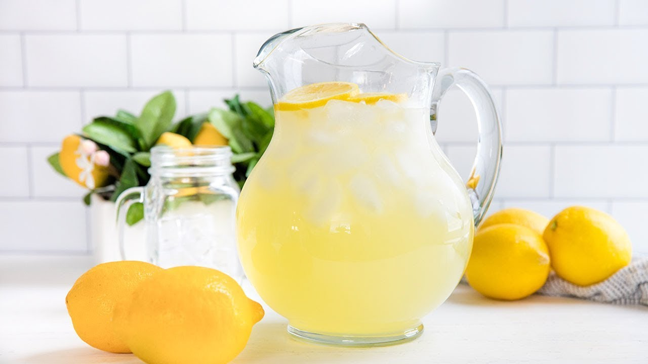
Speaking
5. WORK IN PAIRS: PRACTICE GIVING INSTRUCIONS ON HOW TO MAKE A DISH OR DRINK
Example:
A: Can you tell me how to cook the rice, please? What should I do first?
B: First, put some water in a pot and heat it until it boils.
A: And then?

Slide 17
III. Wrap- up
SKILLS 1
READING
SPEAKING

Slide 18

IV. Homework
Learn by heart the vocabulary
Do exercises in Workbook
Prepare: Unit 5 – Skills 2

