Slide 1

UNIT 2. MY HOUSE
Lesson 2: A Closer look 1

Slide 2


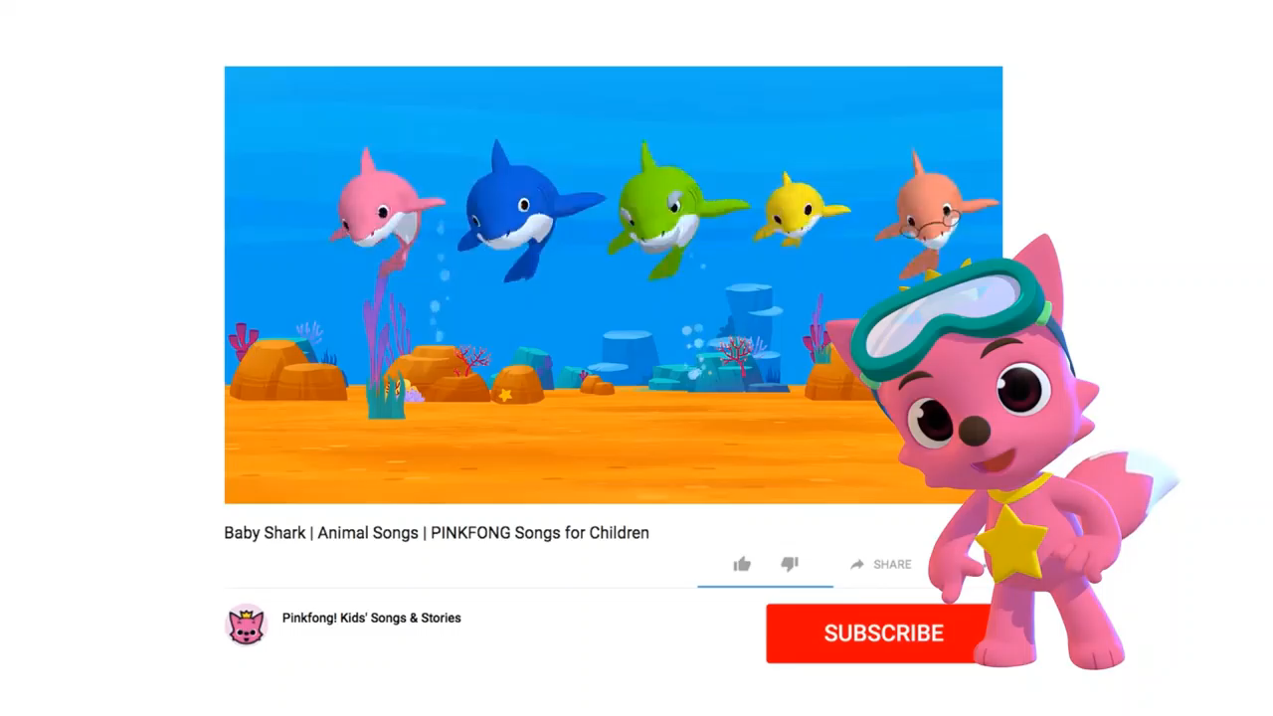
HOW MANY ROOMS ARE THERE IN THIS VIDEO?

Slide 3
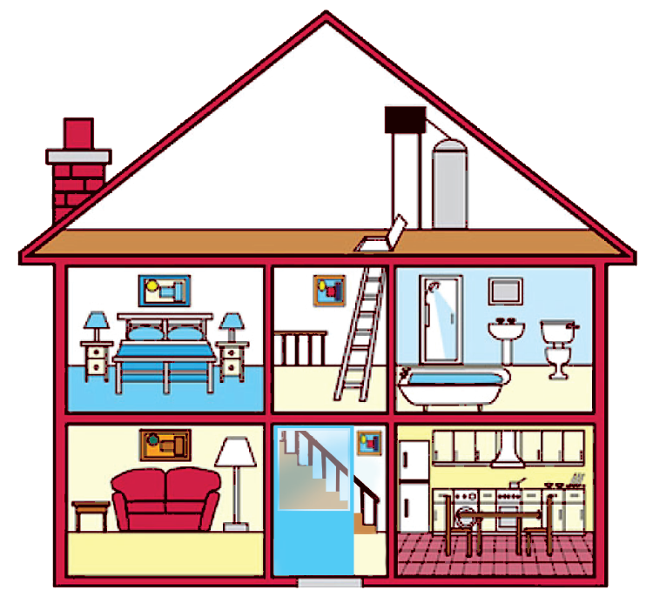
HOW MANY ROOMS ARE THERE IN YOUR HOUSE?

Slide 4







Look at the house.
Name the rooms in it.
hall
bathroom
hall
bathroom
living room
kitchen
living room
kitchen
bedroom
bedroom
c.
bedroom
d.
bathroom
b.
living room
e.
kitchen
a.
hall

Slide 5

UNIT 2. MY HOUSE
Lesson 2: A closer look 1
Vocabulary:
Rooms and furniture

Slide 6
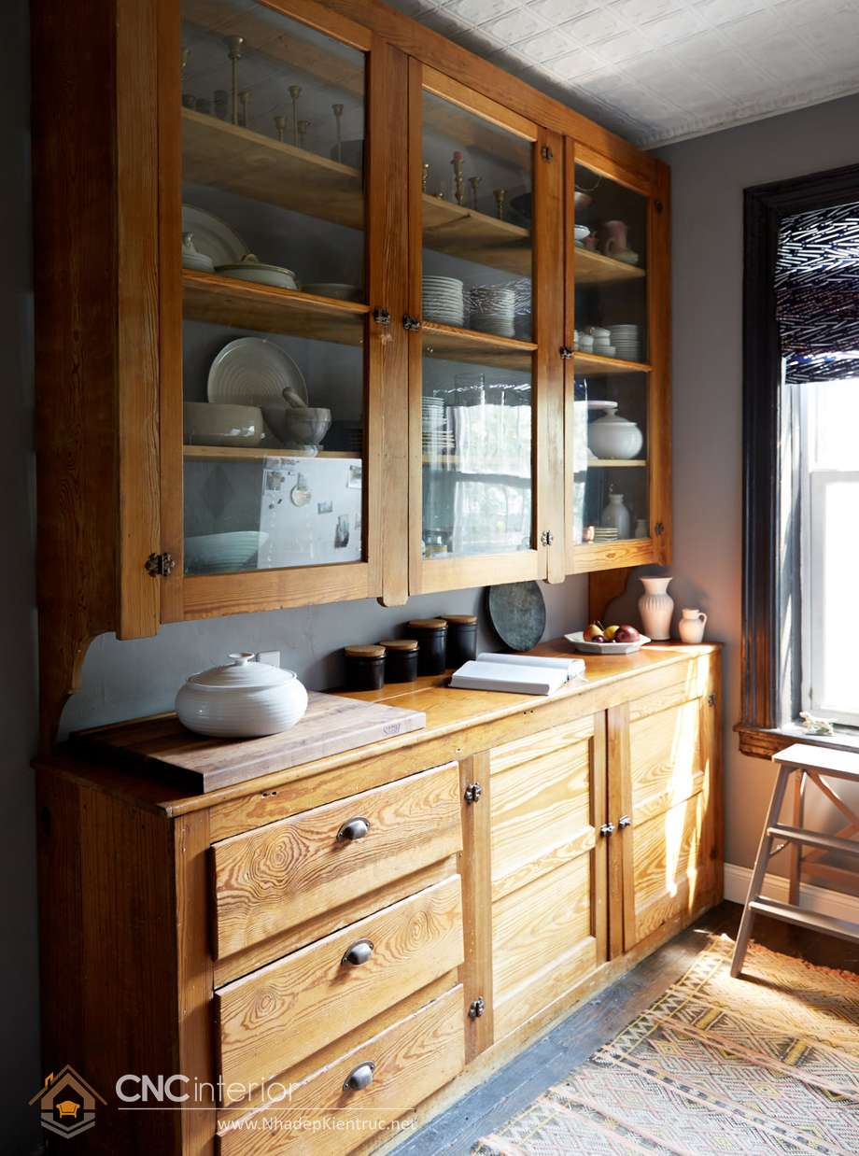
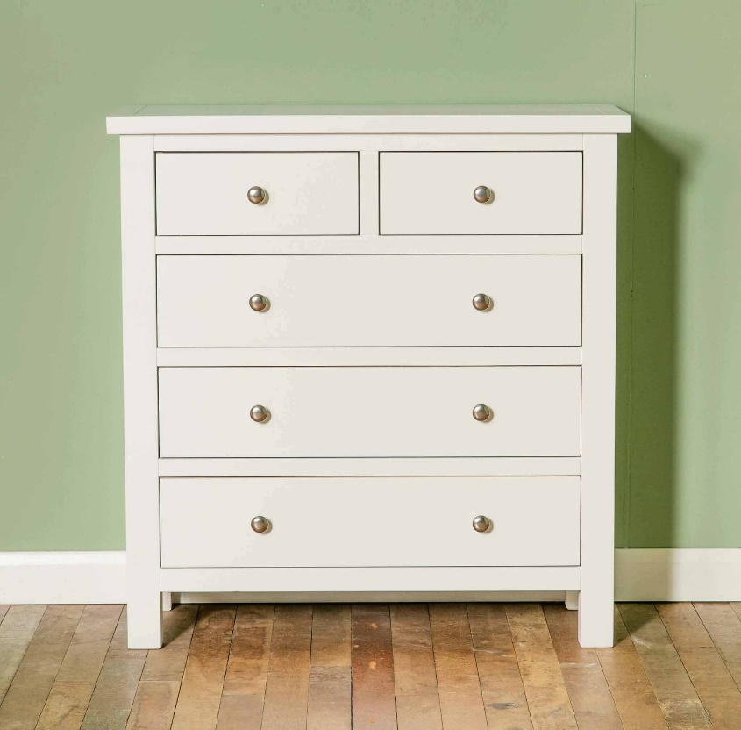
UNIT 2. MY HOUSE
Lesson 2: A closer look 1
I. Vocabulary: Rooms and furniture
cupboard
chest of drawers

Slide 7
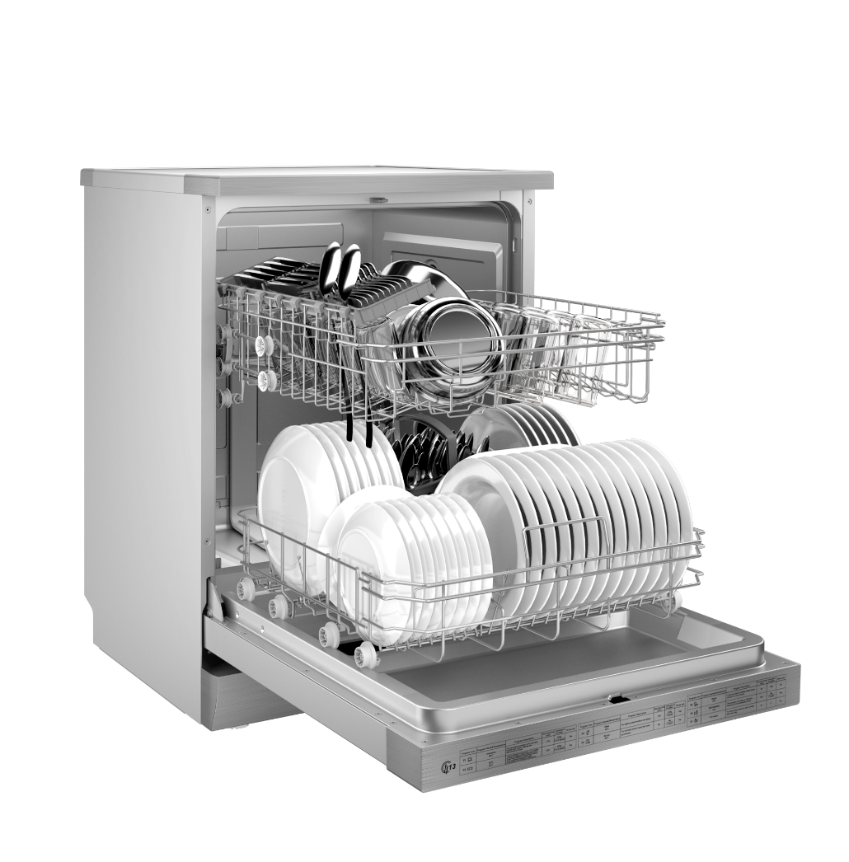
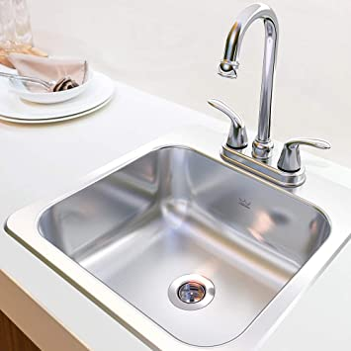
UNIT 2. MY HOUSE
Lesson 2: A closer look 1
I. Vocabulary: Rooms and furniture
dishwasher
sink

Slide 8

UNIT 2. MY HOUSE
Lesson 2: Getting started
I. Vocabulary: Rooms and furniture
1. | hall | (n) | sảnh | /hɔːl/
2. | cupboard | (n) | tủ chén tủ đựng bát đĩa | /ˈkʌb·ərd/
3. | chest of drawers | (n) | tủ có ngăn kéo | /ˌtʃest əv ˈdrɔːrz/
4. | dishwasher | (n) | máy rửa bát đĩa | /ˈdɪʃˌwɑʃər/
5. | sink | (n) | bồn rửa bát | /sink/

Slide 9

Name the things in each room in 1. Use the word list below. (You may use a word more than once.)
lamp
toilet
picture
cupboard
dishwasher
sink
fridge
shower
sofa
chest of drawers
hall | kitchen | bedroom | bathroom | living room
picture
fridge
lamp
shower
lamp
cupboard
picture
sink
sofa
dishwasher
toilet
picture
chest of drawers
sink

Slide 10

Think of a room in your house.
In pairs, ask and answer questions to guess it.
Example:
A: What’s in your room?
B: A sofa and a television.
A: Is it the living room?
B: Yes.
A: What’s in your room?
B:…………………………………...
A: Is it the ……………………….?
B: Yes./No, it’s the…………...

Slide 11
lamps
a cupboard
a lamp
cupboards
a sink
sinks
a sofa
sofas

Slide 12



Listen and repeat these words.
/s/
/z/
lamps
cupboards
sinks
sofas
flats
kitchens
toilets
rooms
1
2

Slide 13
UNIT 2. MY HOUSE
Lesson 2: A closer look 1
II. Pronunciation:
Final sounds: /s/ and /z/

Slide 14
II. Pronunciation: Final sounds: /s/ and /z/
lamps
/p/
sinks
/k/
sinks
/s/
/t/
flats
flats
toilets
toilets
cupboards
/d/
/l/
cupboards
kitchens
/n/
/ŋ/ (ng)
kitchens
/z/
rooms
rooms
/m/
sofas
sofas
vowel sounds

Slide 15

Listen to the conversation. Underline the final s in the words and put them into the correct column.
Mi: Mum, are you home?
Mum: Yes, honey. I’m in the kitchen. I’ve bought these new bowls and chopsticks.
Mi: They’re beautiful, Mum. Where did you buy them?
Mum: In the department store near our house. They have a lot of things for homes.
Mi: Don’t forget we need two lamps for my bedroom, Mum.
Mum: Let’s go there this weekend.
bowls
chopsticks
things
homes
lamps
/s/ | /z/
chopsticks
bowls
lamps
things
homes

Slide 16
III. Wrap- up
UNIT 2
A CLOSER LOOK 1
Vocabulary
Pronunciation
ROOMS:
FURNITURE:
Final sounds:
/s/ and /z/
/s/: lamps, sinks
/z/: sofas, kitchens
- hall
kitchen
bedroom
living room
bathroom
- cupboard
chest of drawers
dishwasher
sink

Slide 17

IV. Homework
Learn by heart the vocabulary
Do exercises: part A, B.2,3 in Workbook
(page 9,10)
Prepare: Unit 2 – A Closer look 2

