Slide 1
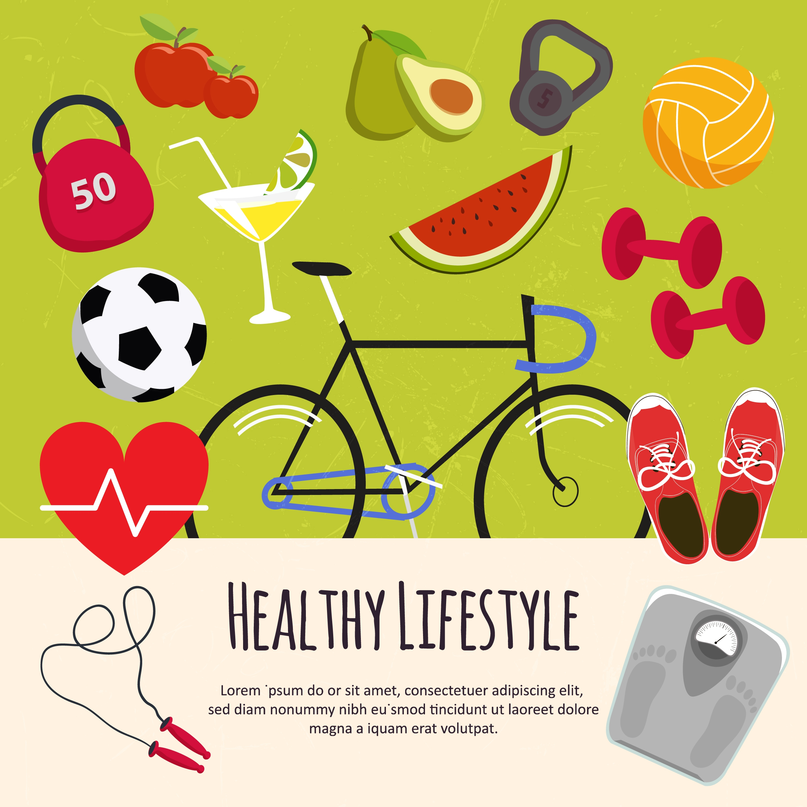
UNIT 2. HEALTH
LESSON 2: A CLOSER LOOK 1

Slide 2


Slide 3


UNIT 2. HEALTH
LESSON 2: A CLOSER LOOK 1
Vocabulary
cough (n): ho /kɒf/
headache (n):đau đầu /ˈhedeɪk/
earache (n): đau tai /ˈɪəreɪk/
toothache (n): đau răng /ˈtuːθeɪk/
stomachache (n): đau bụng, đau dạ dày /ˈstʌmək eɪk/
sore throat (n): đau họng / sɔːr θrəʊt/
temperature (n): sốt /ˈtemprətʃə(r)/

Slide 4
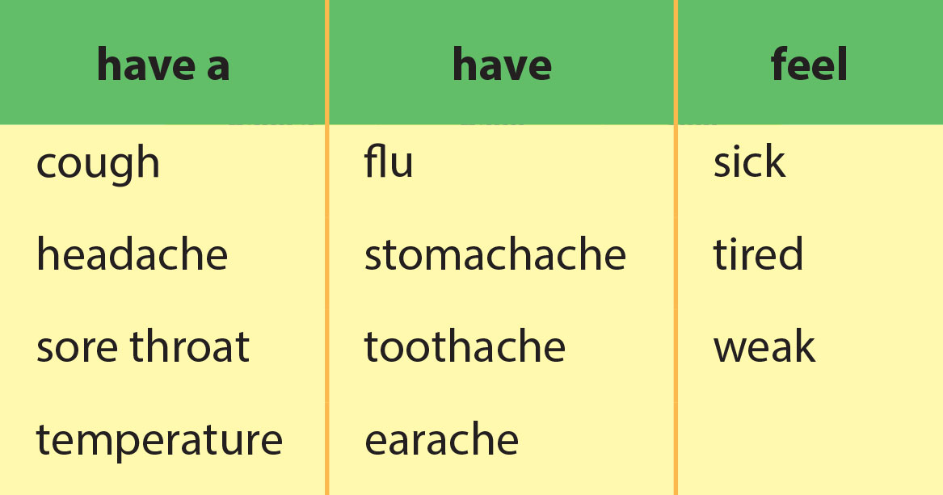
VOCABULARY

Slide 5


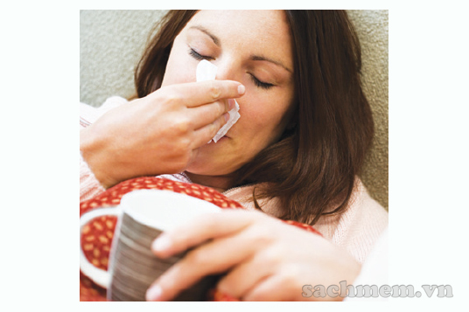
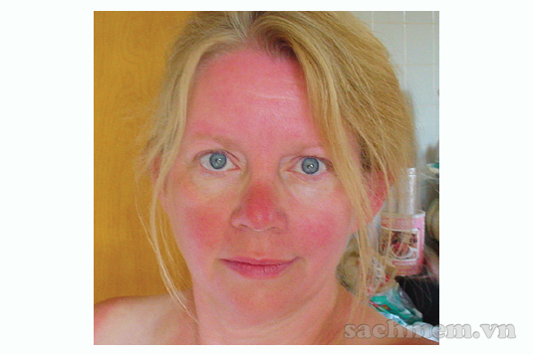
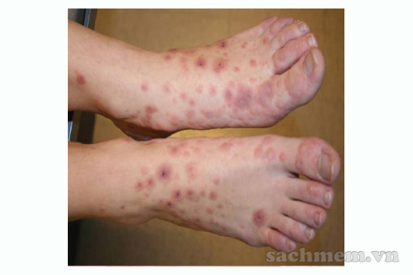

VOCABULARY
Task 1. Look at the picture.
Write problem below the picture of each patient
1
2
flu
sunburn
3
4
allergy
tired/ weak

Slide 6
Vocabulary
Task 2. Read the doctor’s notes about his patients and fill the missing words.
Patient 1: She looks very red. She was outdoors all day yesterday.
I think she has ________
Patient 2: He keeps sneezing and coughing. I think he has _______
Patient 3: He looks so _______. He can’t keep his eyes open!
He’s very hot too – he has a _____________
Patient 4: He ate some seafood yesterday. Now he feels _____ .
He says he has a _____________ too.
Patient 5: He is holding his neck. I think he has a ___________.
sunburn
flu
tired
temperature
sick
stomachache
sore throat

Slide 7
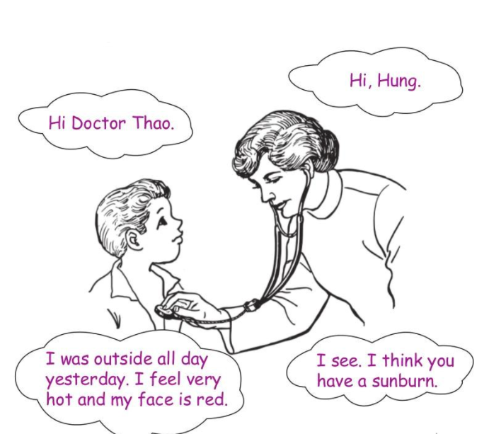
Task 3. Role-play the meeting with the doctor. Use the cues in 1, 2 or your own health problems.

Slide 8

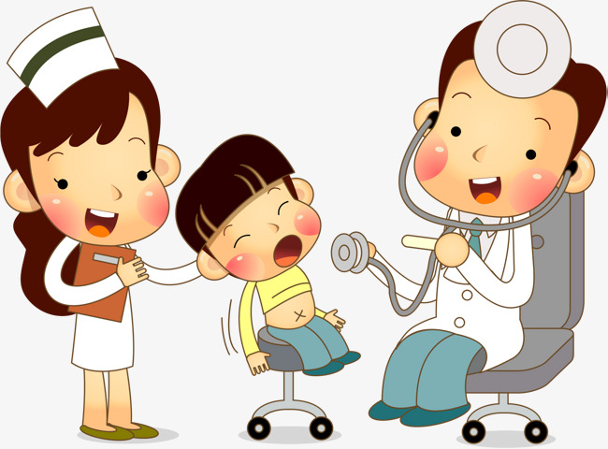
Vocabulary
Task 4. Choose a health problem. Tell your class about the last time you had that problem.
Example:
A: I had flu two weeks ago.
B: Me too! I felt so weak.
C: Oh. I had a sore throat yesterday.
D: I had toothache. I think I ate too many sweets.
Can you extend your conversation?

Slide 9
UNIT 2. HEALTH
LESSON 2: A CLOSER LOOK 1
II. Pronunciation: /f/ and /v/
/f/ : flu, seafood, phone, safe, laugh
/v/: very, move, of

Slide 10



Pronunciation
Task 5. Listen and circle the word you hear
1.A.fat B.vat
2.A.ferry B.very
3.A.fast B.vast
4.A.fault B.vault
5.A.safe B.save
6.A.leaf B.leave
/f/
/v/

Slide 11







Pronunciation
Task 6. Listen and circle the words
with the /f/ or /v/ sounds
1.Fast food isn't healthy.
2.I have felt sick all day.
3.Obesity is a problem – people are getting fatter.
4.Having a healthy lifestyle is important.
5.Too many sweets give you toothache.

Slide 12
III. Wrap- up
UNIT 2
A CLOSER LOOK 1
Vocabulary
Vocabulary
Health problems
/f/
/v/

Slide 13

IV. Homework
Learn by heart all the vocabulary
Do exercises in Workbook
Prepare: Unit 2 – A Closer look 2

