Slide 1
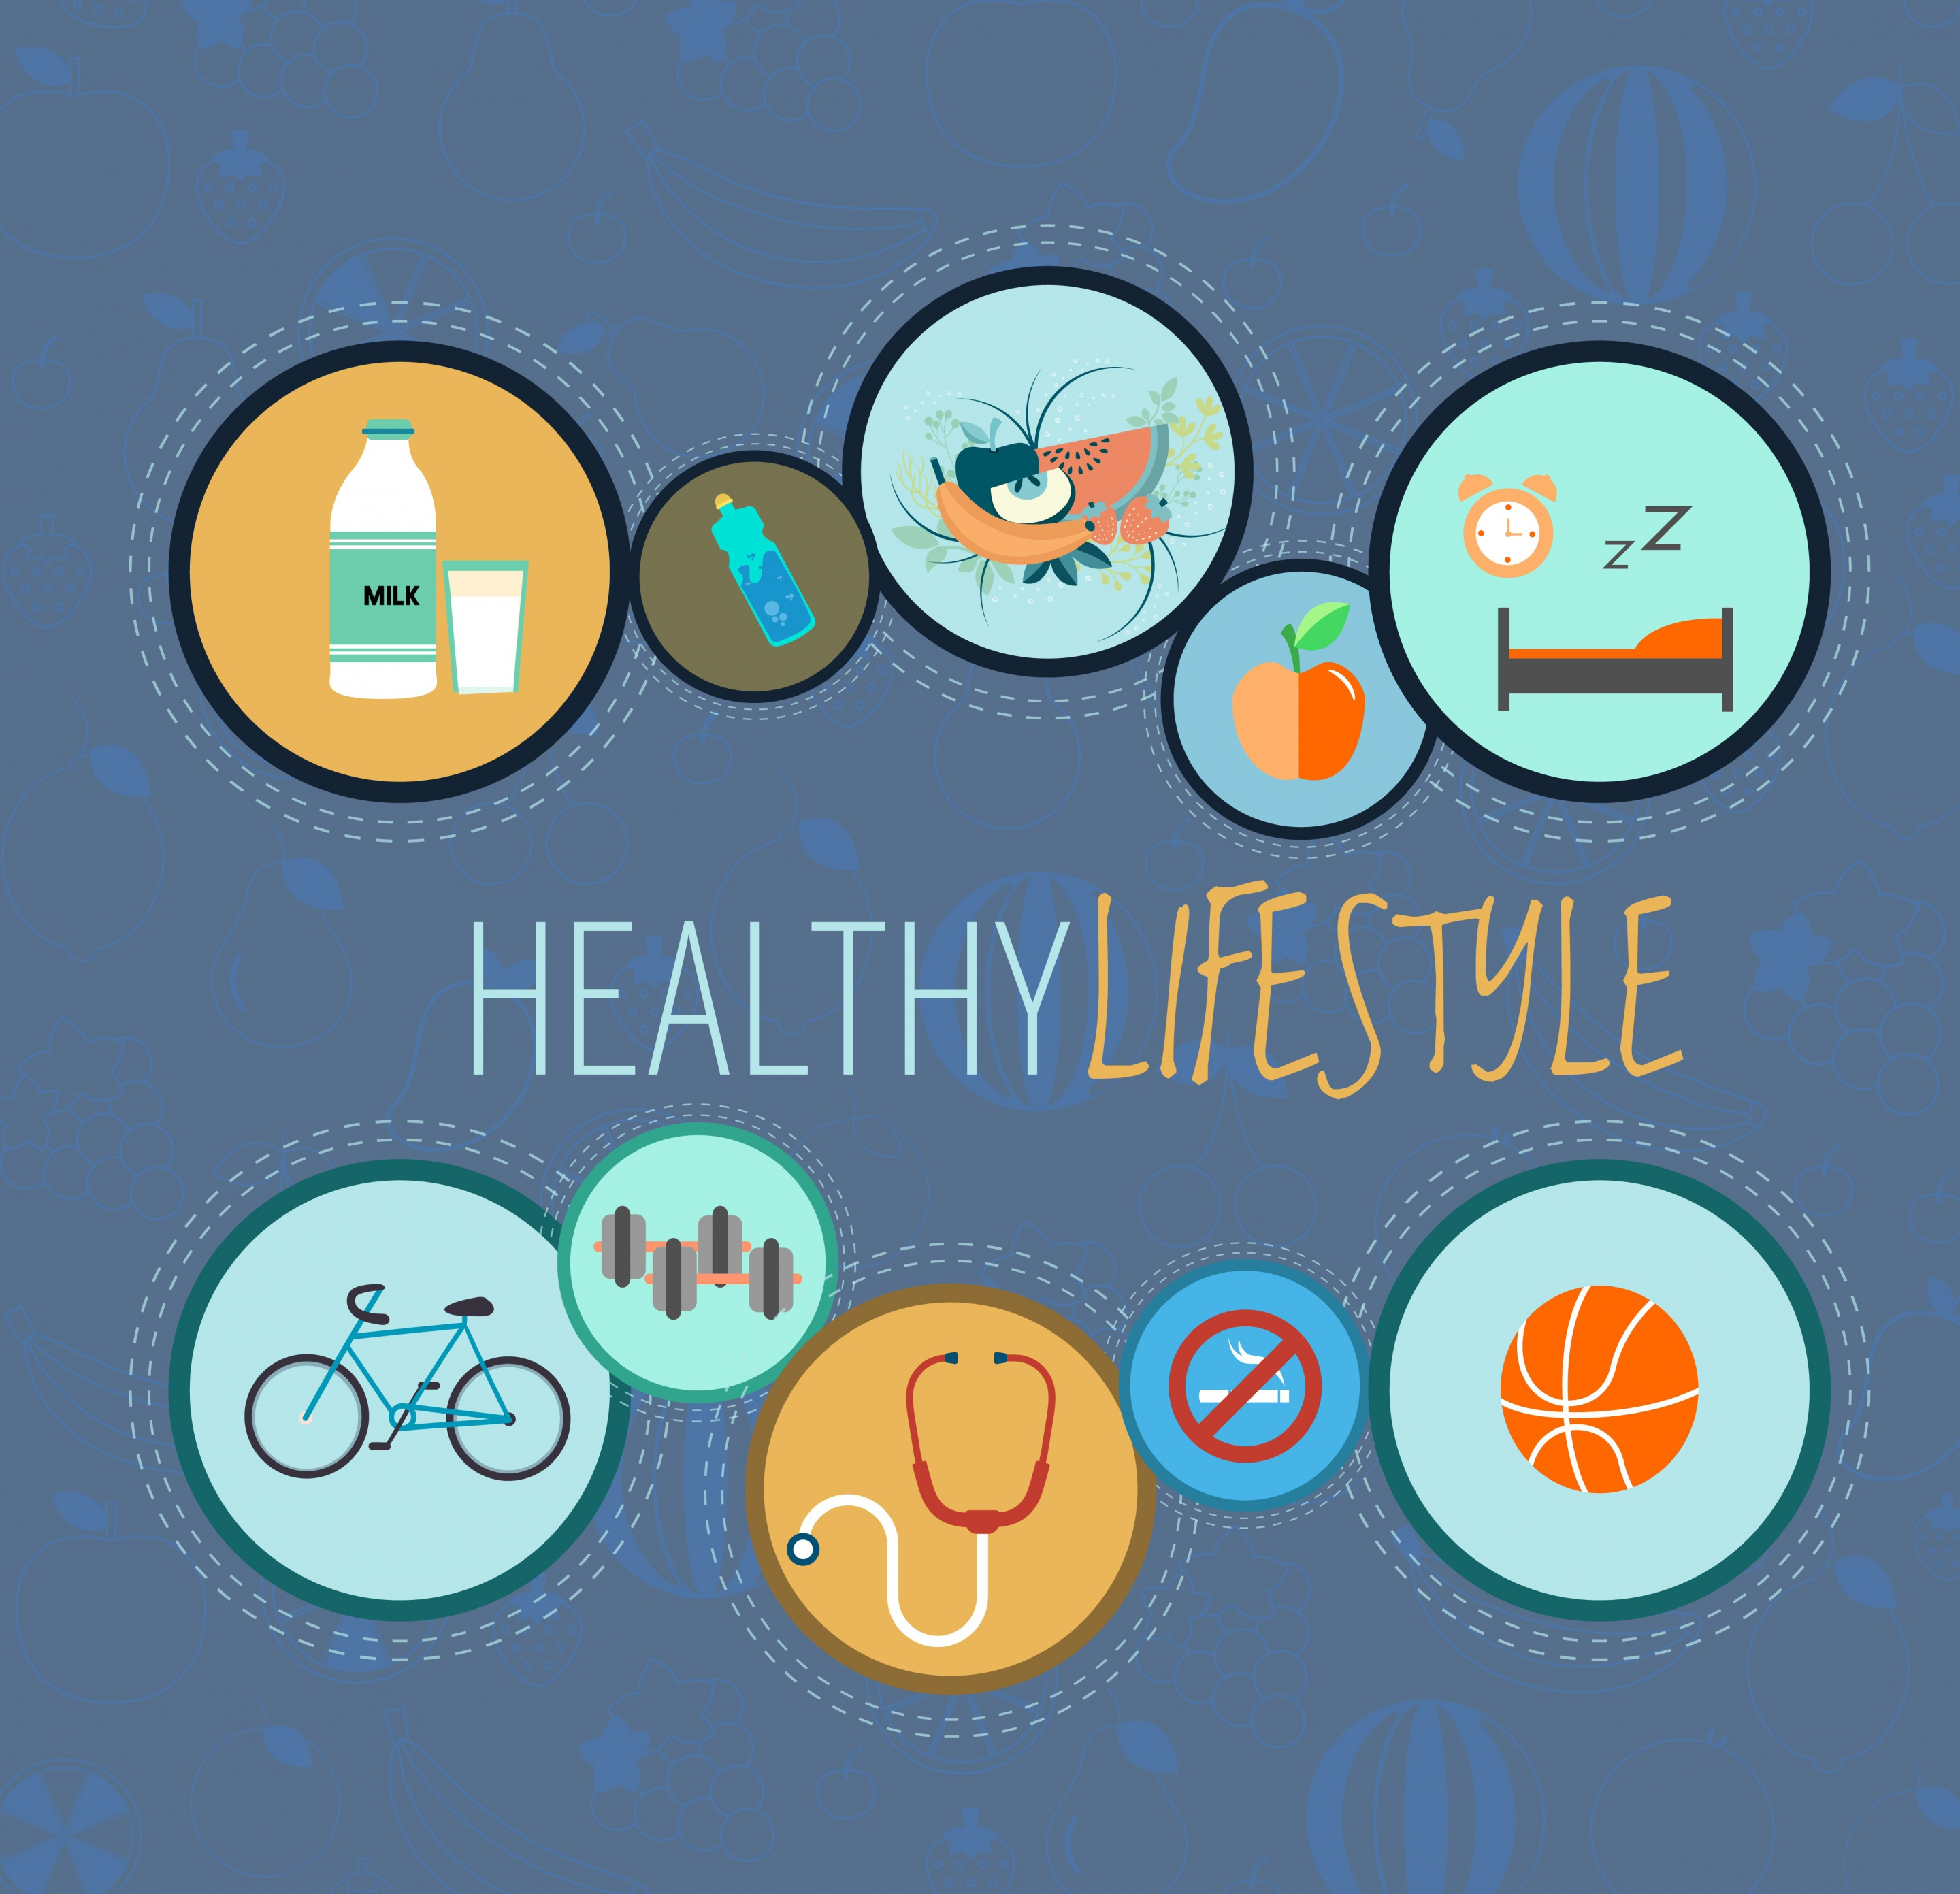
UNIT 2. HEALTH
LESSON 3: A CLOSER LOOK 2

Slide 2


UNIT 2. HEALTH
LESSON 3: A CLOSER LOOK 2
Grammar: Imperatives with more and less

Slide 3
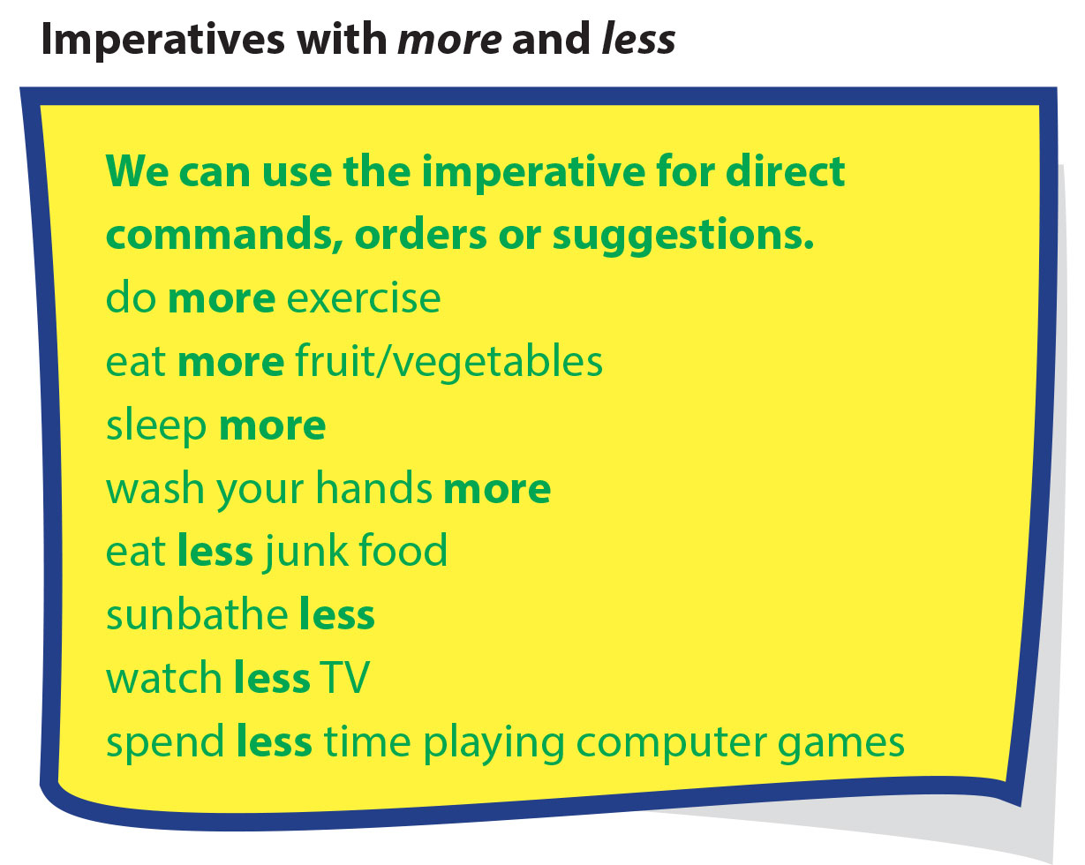

Slide 4
UNIT 2. HEALTH
LESSON 3: A CLOSER LOOK 2
Grammar: Imperatives with more and less
*Form
*Examples
Do more exercise
Eat less junk food
V + more/less

Slide 5

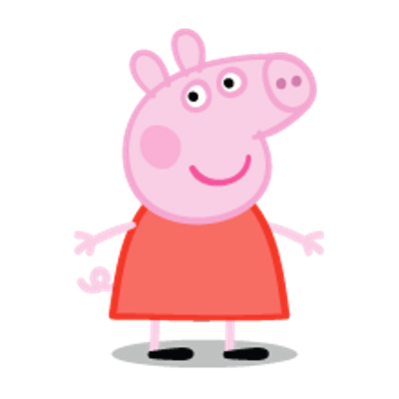
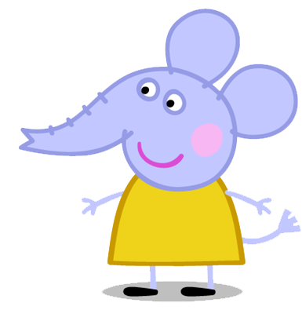

1
2
3
4
5
6
7
8
7
8
6
10
9
5
3
4
2
1
7
10
9
6
8
1
2
3
4
5
LUCKY STARS
PEPPA
EMILY

Slide 6


YOU ARE LUCKY
+2

Slide 7

You should …
eat more fruit
eat less junk food
eat less candy

Slide 8

You should …
do more exercise
Watch less TV
Sunbath less

Slide 9
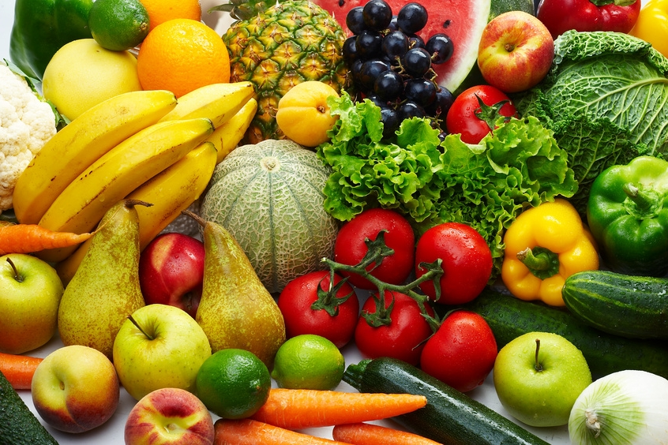
You should …
eat more junk food
eat less fruit and vegetables
eat more fruit and vegetables

Slide 10

You should …
wash your hand less
wash your hand more
wash your face more

Slide 11

You should …
watch less TV
watch more TV
watch more video

Slide 12
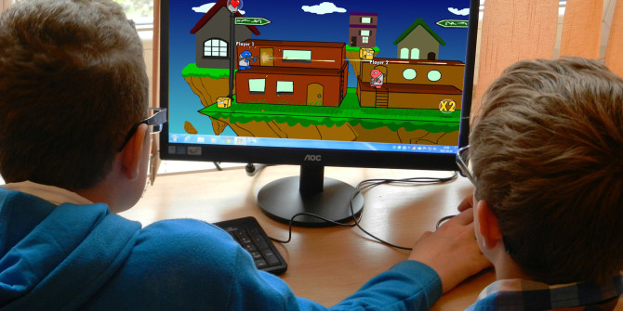
You should …
spend less time playing computer games
spend more time playing computer games
spend less time watching TV

Slide 13


Task 1. Look at the pictures. Which health tips from the box above would you give to each of these people?
a. Oh, I feel so sick. I have cough and flu.
c. I put on weight.
Sleep more
Wash your hands more.
Do more exercise
Eat less junk food.
Eat more fruit/ vegetables
b. I can’t see clearly. My eyes are so weak.
d. My face is red. I got sunburnt.
Spend less time playing computer games.
Sunbath less

Slide 14
Task 2. Top health tips for teens
Look at the health tips in the yellow box. Which six do you think are the most important to you and your classmates? Explain why.
1……………………………………………
2……………………………………………
3……………………………………………
4…………………………………………..
5…………………………………………..
6…………………………………………..

Slide 15
Task 3. Look at the article on the Teen Health website. Fill in the blanks to complete their top six health tips.
Staying in shape is our most important tip. You can play football, or even go for long walks. It’s OK, but make sure it’s three times a week or more!
Getting plenty of rest is really important! It helps you to avoid depression and it helps you to concentrate at school. You’ll also be fresher in the mornings!
You are what you eat! So make sure it’s healthy food like fruits and vegetables, not junk food. It can help you to avoid obesity too.
It’s so easy to get flu. We should all try to keep clean more. Then flu will find it harder to spread!
There are some great things to watch. But too much isn’t good for you or your eyes.
Many of us love computer games, but we should spend less time playing them. Limit your time to just one hour, two or three days a week, or less.
1.
Do more exercise!
2.
Sleep more!
3.
Eat less junk food.
4.
Wash your hands more.
5.
Watch less TV.
6.
Spend less time playing computer games.

Slide 16
UNIT 2. HEALTH
LESSON 3: A CLOSER LOOK 2
II. Compound sentence (Câu ghép)

Slide 17
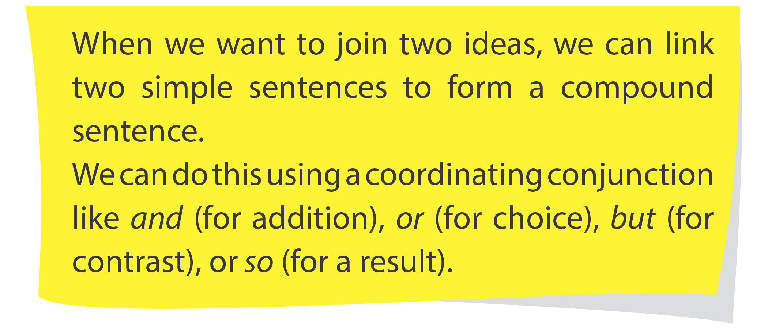

Slide 18
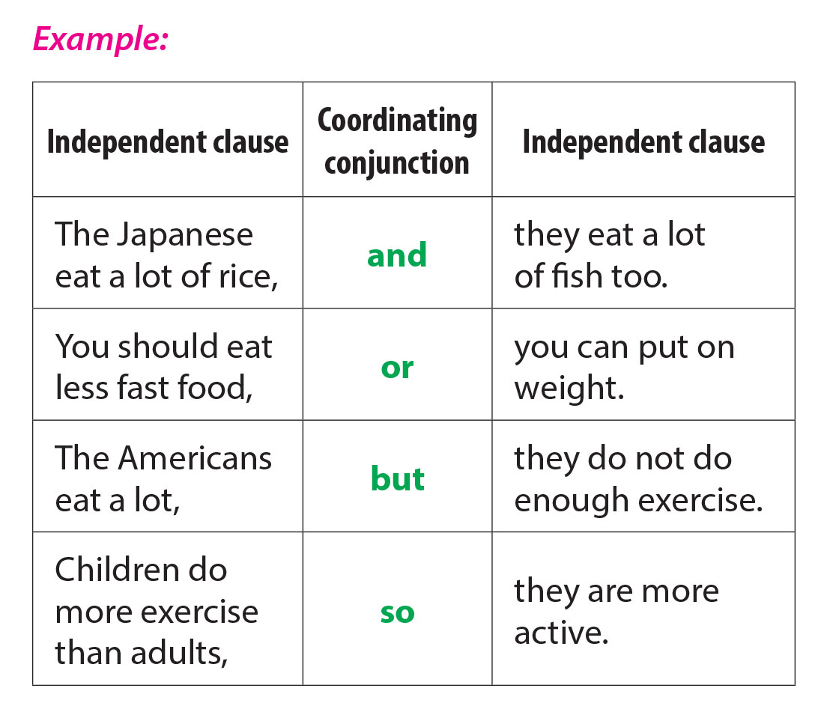

Slide 19


Slide 20
UNIT 2. HEALTH
LESSON 3: A CLOSER LOOK 2
II. Compound sentence (Câu ghép)
AND: và He likes playing football and playing the guitar.
BUT: nhưng She wants to eat some ice cream, but she has a sore throat.
OR: hoặc We can go to the cinema, or we can go to the museum tonight.
SO: vậy nên Dane eats too many sweets, so he has a stomachache.

Slide 21
Task 4. Make compound sentences by joining two simple sentences
1. I want to eat some food. I have a sore throat. (but)
→ I want to eat some food, but I have a sore throat.
2. The Japanese eat healthily. They live for a long time. (so)
→ The Japanese eat healthily, so they live for a long time.
3. I feel tired. I feel weak. (and)
→ I feel tired, and I feel weak.
4. You can go and see the doctor. You can go to bed now and rest. (or)
→ You can go and see the doctor, or you can go to bed now and rest.

Slide 22

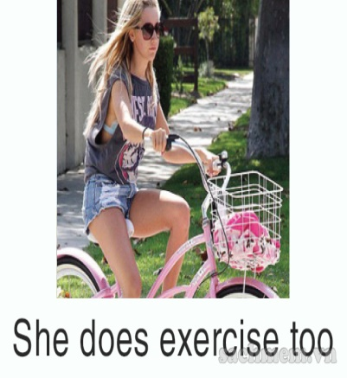
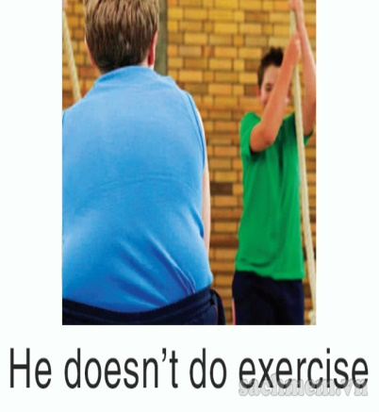

Task 5. Match beginning of the sentences with the picture that completes them
1. Nick washes his hands a lot, so…
he doesn’t have flu. (d)
2. David eats lots of junk food, and
he doesn’t do exercise. (c)
3. The doctor told Elena she should sleep more, or …
she should try to relax more. (a)
4. My sister plays computer games, but …
she does exercise too. (b)

Slide 23
Task 6. Now, complete the second part of the compound sentences.
1. Nick washes his hands a lot so_______________________
2. David eats lots of junk food, and ______________________
3. The doctor told Elena she should sleep more, or________________ _________________________
4. My sister plays computer games, but _________________________
he doesn’t have flu.
he doesn’t do exercise.
she should try to
relax more.
she does exercise too.

Slide 24
III. Wrap- up
UNIT 2
A CLOSER LOOK 2
Imperatives with more and less
Compound sentences
and
or
but
so
V + more/less

Slide 25

III. Homework
Do exercises in Workbook
Prepare: Unit 2 – Skills 1

