Slide 1



UNIT 1. MY HOBBIES
Lesson 2: A Closer look 1

Slide 2


WARM UP
I like _________________________

Slide 3


UNIT 1. MY HOBBIES
Lesson 2: A CLOSER LOOK 1
I. Vocabulary

Slide 4


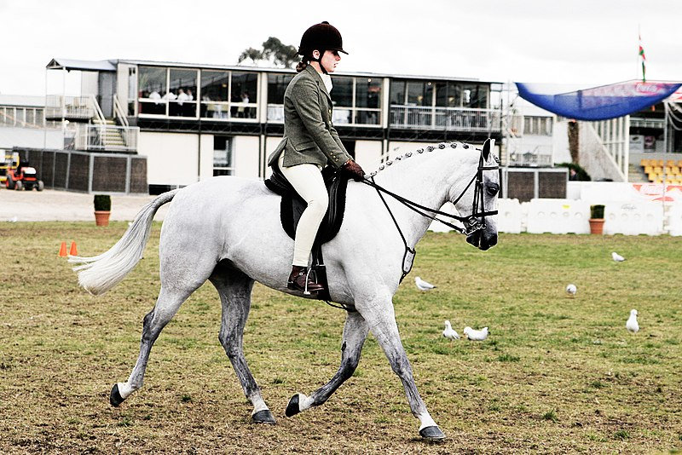


I. Vocabulary
1. horse-riding (n): cưỡi ngựa /ˈhɔːs raɪdɪŋ/
2. gymnastics (n): thể dục dụng cụ /dʒɪmˈnæstɪks/
3. camping (n): sự cắm trại /ˈkæmpɪŋ/
4. catch (v,n): bắt lấy /kætʃ/
5. headphones (n) : tai nghe /ˈhedfəʊnz/
6. melody (n): giai điệu (âm nhạc) /ˈmelədi/
1
2
3
4
5

Slide 5

VOCABULARY
1. Match the correct verbs with the hobbies
TV
bottles
photos
mountain climbing
horse riding
the piano
gymnastics
badminton
camping
dolls
go
do
collect
play
take
watch
- bottles
- photos
dolls
- mountain climbing
-horse riding
-camping
- the piano
-badminton
TV
gymnastics
photos

Slide 6
2. Fill in each blank in the sentences with one hobby or one action from the box below
Hobbies: listening to music, gardening, fishing, painting, swimming Action Verbs: listen, plant, catch, swim, paint
1. I like ____________. There is a pool near my house, so I go there four times a week and __________ . It is fun because you can play in the water and keep fit at the same time.
2. I always _______________. to Ngoc’s songs. I love the sweet melodies. At home I have to use my headphones because my parents don’t like loud noise . ______________________ is my favourite hobby.
3. I love being outdoors with the trees and flowers. There is a small garden behind my house.
I __________flowers and vegetables there. I like ___________. a lot.
4. My father and I share the same hobby. At weekends, we usually go to a small lake in Ha Tay. It’s exciting when you can _______________. some fish for dinner. We love _______________. !
5. My sister’s favourite hobby is _______________ . She is very creative and she _______________. very well. I like the colours in her pictures.
swimming
swim
listen
Listening to music
plant
gardening
catch
fishing
painting
paints

Slide 7

3. Write down keywords to describe the hobbies. You can use the words from 2 to help you.
Hobbies | Keywords
listening to music | melody, songs,
gardening
fishing
painting
swimming
headphones, noise, rhythm, lyrics...
trees, flowers, garden, plant (v/n), vegetables, grow, fruit...
lake, exciting, catch, fish, water, boat...
creative, colours, pictures, artist, painting...
pool, fun, water, keep fit, swim...

Slide 8


Slide 9
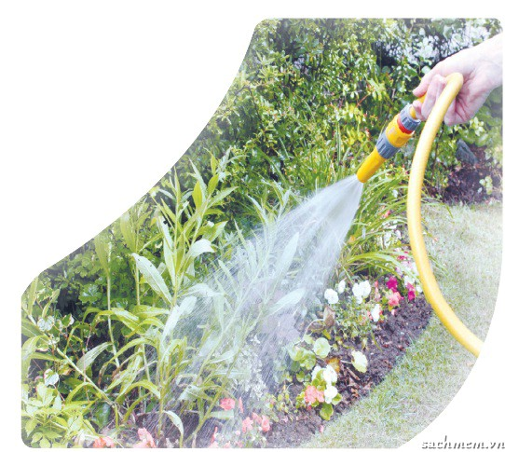
4. GAME: THE KEY TO MY HOBBY
1. Each student thinks of a hobby and says the keywords out loud.
2. The class tries to guess what the hobby is. One point is given for each correct guess.
3. The student with the most points is the winner.
Example:
A: water, grow, flowers, vegetables
B: Is it gardening?
A: Yes, it is.

Slide 10
Pronunciation:
/ә/ and /з:/
1. /ә/ : again, water, melody
Mẹo: chữ cái “a” đứng đầu
các chữ cái “er” “el” “ment” đứng cuối từ
2. /з:/ : bird, girl, turn
Mẹo: các chữ cái “ur” + phụ âm
“ir” + phụ âm

Slide 11




Pronunciation
5. Listen and tick the words you hear. repeat the words.
 | YES | NO
1. bird-watching
2. away
3. burn
4. hurt
5. birth
6. answer
7. neighbour
8. singer
9. heard
10. common

Slide 12

Pronunciation
6. Listen again and put the words in the correct column
bird-watching
away
burn
hurt
birth
answer
neighbour
singer
heard
common
/ә/
/з:/
away
burn
answer
birth
common
hurt
neighbour
heard

Slide 13

Pronunciation
7. Listen to the sentences and tick /ә/ or /з:/.
 | /ә/ | /з:/
1.His hobby is collecting toy cars.
2.My sister has a lot of photos.
3.When I have free time, I usually go surfing.
4.I love the colours in their paintings.
5.My friend has an unusual hobby: learning foreign languages.

Slide 14
UNIT 1. MY HOBBIES
Lesson 2: A CLOSER LOOK 1
Vocabulary
Pronunciation:
Wrap - up
/ә/ and /з:/

Slide 15
III. Wrap- up
go horse-riding, do gymnastics, take photos, collect bottles,…..
Vocabulary
/ә/ : away, answer, common, neighbour
/3:/ : burn, birth, hear, heard
Pronunciation

Slide 16

IV. Homework
Learn by heart all the new words (Vocabulary)
Do exercise 1,2 (Workbook, page 3)
Prepare: Unit 1 – A closer look 2

Slide 17
UNIT 1. MY HOBBIES
Lesson 2: A CLOSER LOOK 1
I. Vocabulary
1. horse-riding (n): cưỡi ngựa
2. gymnastics (n): thể dục dụng cụ 3. camping (n): sự cắm trại 4. catch (v,n): bắt lấy 5. headphones (n) : tai nghe 6. melody (n): giai điệu (âm nhạc)
II. Pronunciation: /ә/ and /з:/
1. /ә/ : again, water, melody
2. /з:/ : bird, girl, turn
III. Homework
- Write each word in Vocabulary: 3 lines
- Do exercise 1,2 (Workbook, page 3)
- Prepare: Unit 1 – A closer look 2

