Slide 1

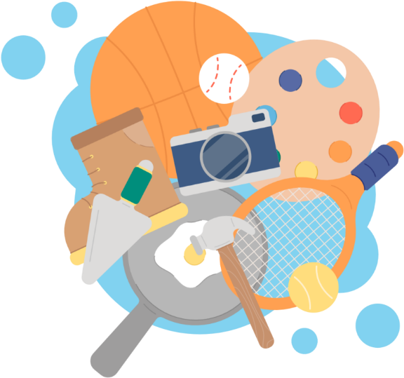
UNIT 1. MY HOBBIES
Lesson 4: Communication

Slide 2
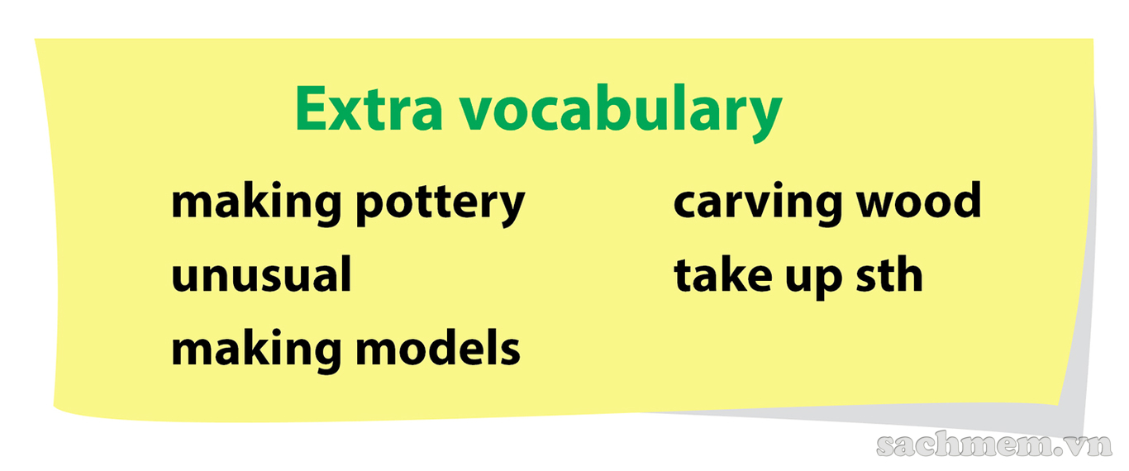


Slide 3
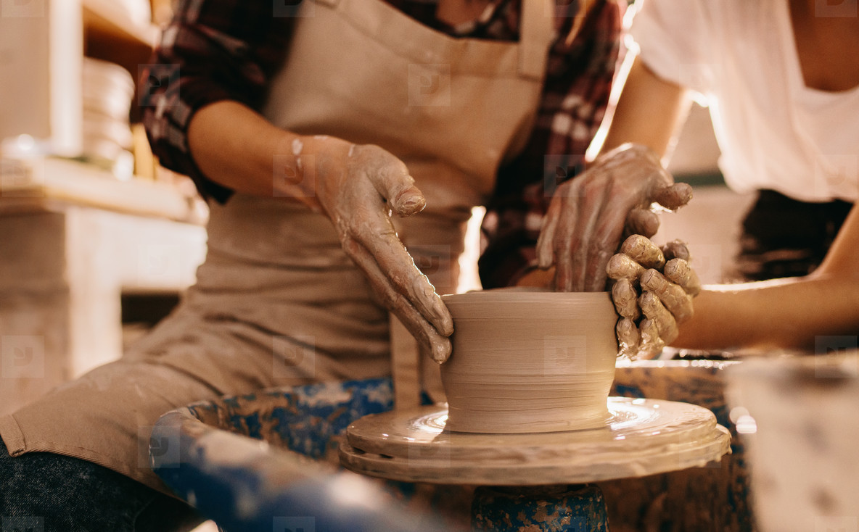
making pottery

Slide 4
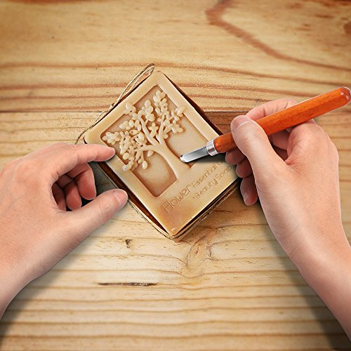
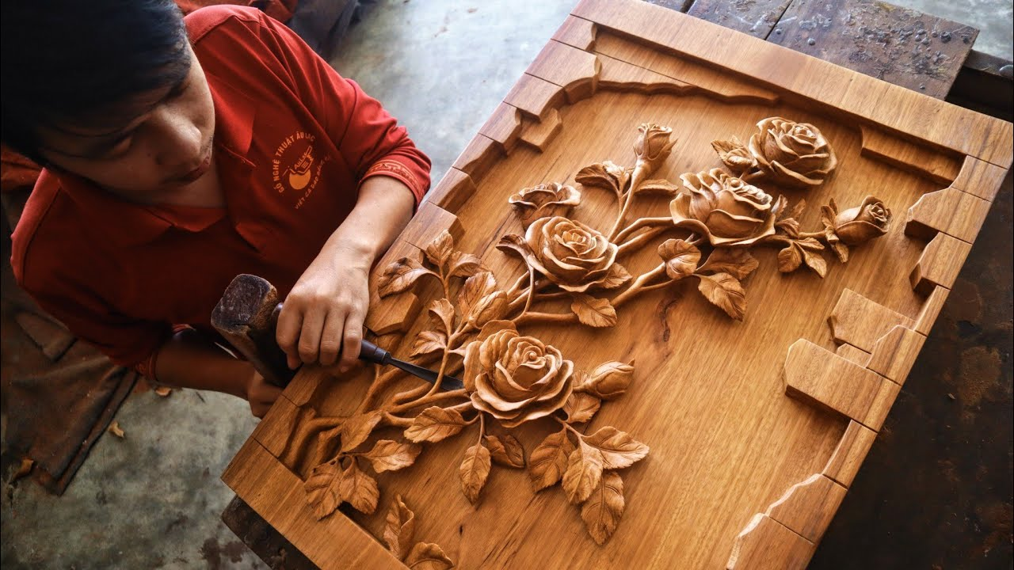
carving wood

Slide 5
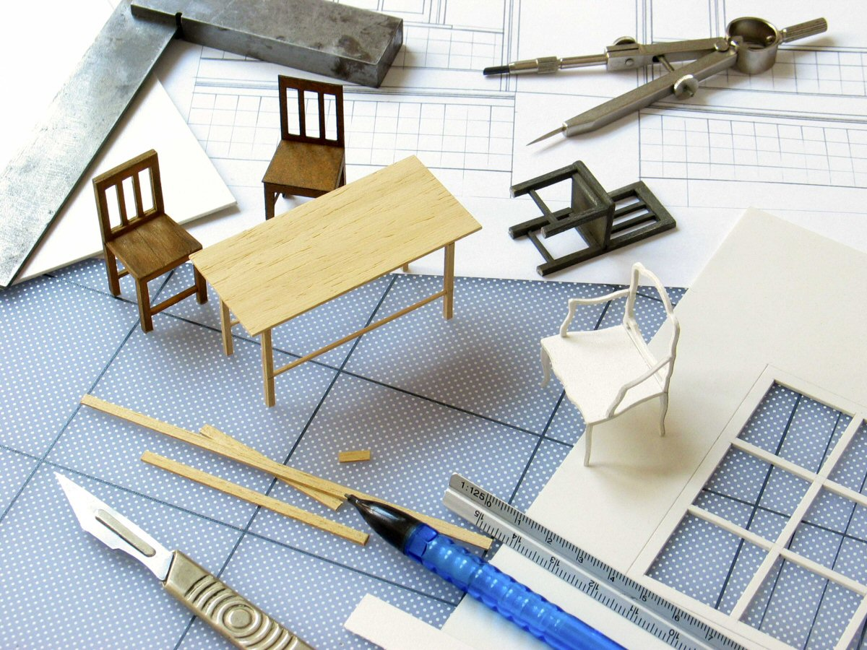
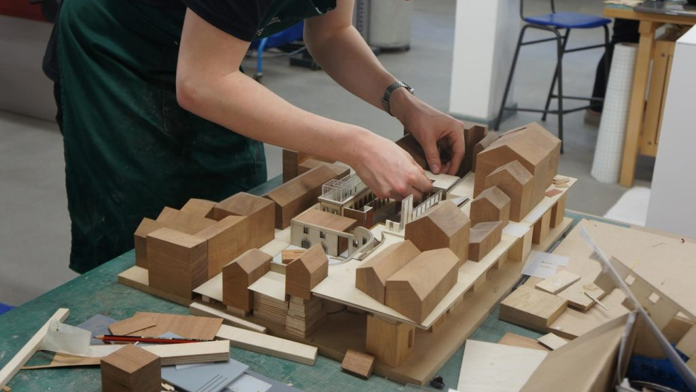
making models

Slide 6


UNIT 1. MY HOBBIES
Lesson 4: Communication
Vocabulary
1. making pottery (n): làm đồ gốm
2. making model (n): làm mô hình
3. carving wood (n): chạm, khắc gỗ
4. to take up sth (ph.v): bắt đầu (một sở thích mới)
I will take up making pottery next month.
5. ice-skating (n): trượt băng
6. to find (v): thấy, nhận thấy

Slide 7

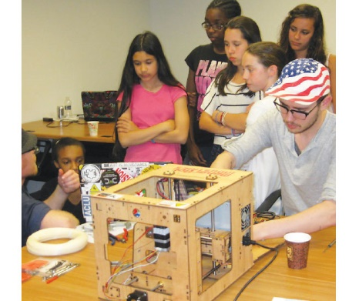
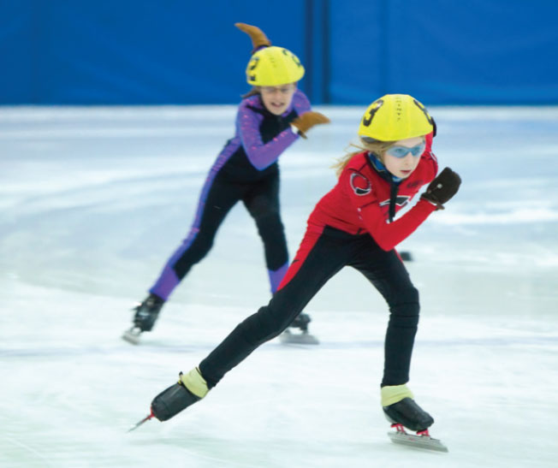
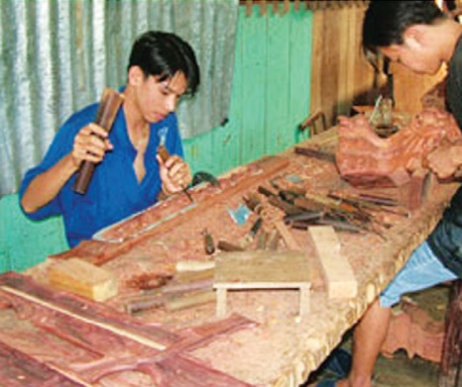
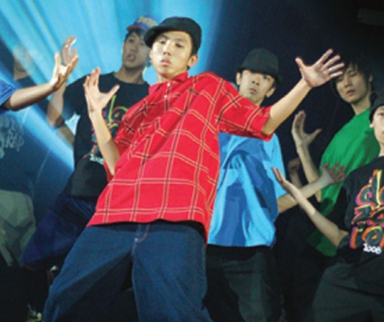
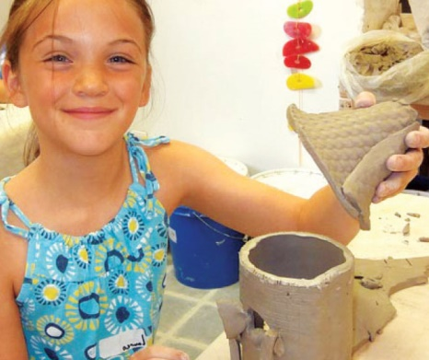
1. Match the activities with the pictures.
B
C
A
carving wood
making models
ice-skating
D
E
dancing
making pottery

Slide 8

2. What do you think about the hobbies?
Look at the tables and tick the boxes
 | boring | unusual | interesting
1. making pottery
2. dancing
3. ice-skating
4. making models
5. carving wood

Slide 9
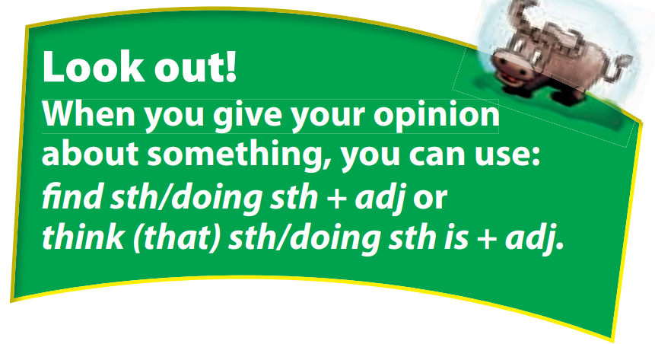
I find making pottery interesting.
I think (that) making pottery is interesting.
 | boring | unusual | interesting
1. making pottery
2. dancing
3. ice-skating
find sth/doing sth + adj (tính từ)
think (that) sth/doing sth is + adj (tính từ)

Slide 10

UNIT 1. MY HOBBIES
Lesson 4: Communication
II. Giving opinion
find sth/doing sth + adj (tính từ)
= think (that) sth/doing sth is + adj (tính từ)

Slide 11
2. Complete the sentences below by writing one reason to explain your choice.
1. I find making pottery _____________ because _______________________
2. I think dancing is _______________because __________________________
3. I find ice-skating _______________because _____________________
4. I think making models is ___________because _________________________
5. I find carving wood __________because ____________________________
interesting
it’s a creative activity.
interesting
it makes me feel relaxed.
unusual
it’s difficult.
boring
it takes a lot of time.
boring
it’s difficult and takes a lot of time.
Cues:
make me happy - take a lot of time
make me feel relaxed - difficult

Slide 12
3. Interview a classmate about the hobbies in 1.
Example:
You: What do you think about making pottery?/
How do you find making pottery?
Mai: I think it is _____./I find it _____.
You: Why?
Mai: Because __________.
You: Will you take up making pottery in the future?
Mai: Yes, I will./I’m not sure.

Slide 13
III. Wrap- up
COMMUNICATION
Vocabulary
Giving opinion
making pottery
carving wood
making model
take up sth
find sth/ doing sth + adj
think (that) sth/doing sth is + adj

Slide 14

IV. Homework
Learn by heart the vocabulary, the structures
Do exercise 3, 4 in Workbook (page 4)
Prepare: Unit 1 – Skills 1

