Slide 1


Lesson 1
Vocabulary:
Daily routines

Slide 2
Vocabulary

Slide 3
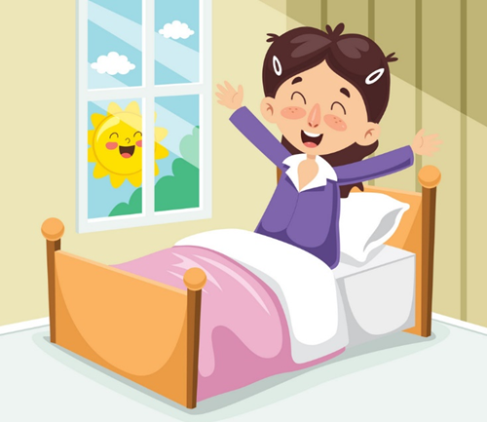
Get up

Slide 4

Do morning exercise

Slide 5
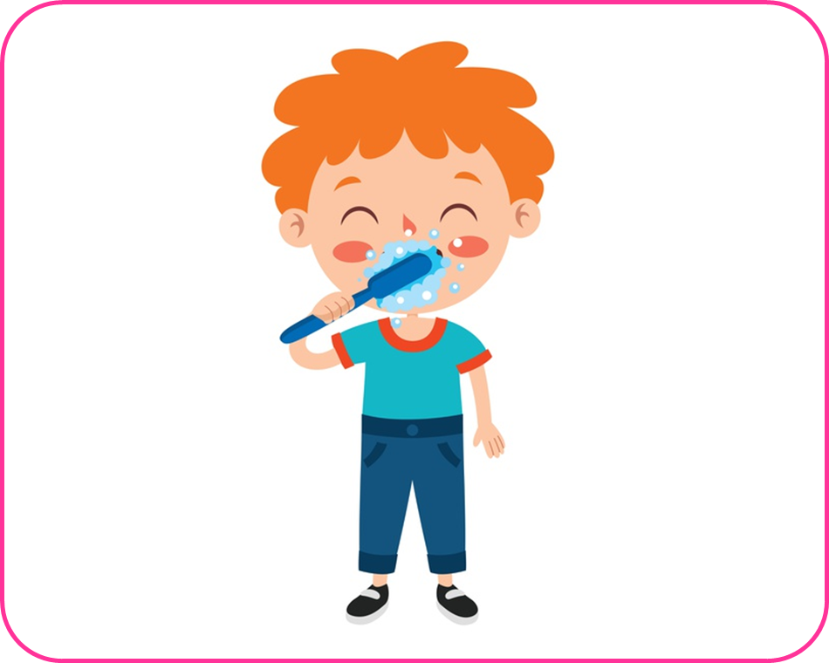
Brush my teeth

Slide 6
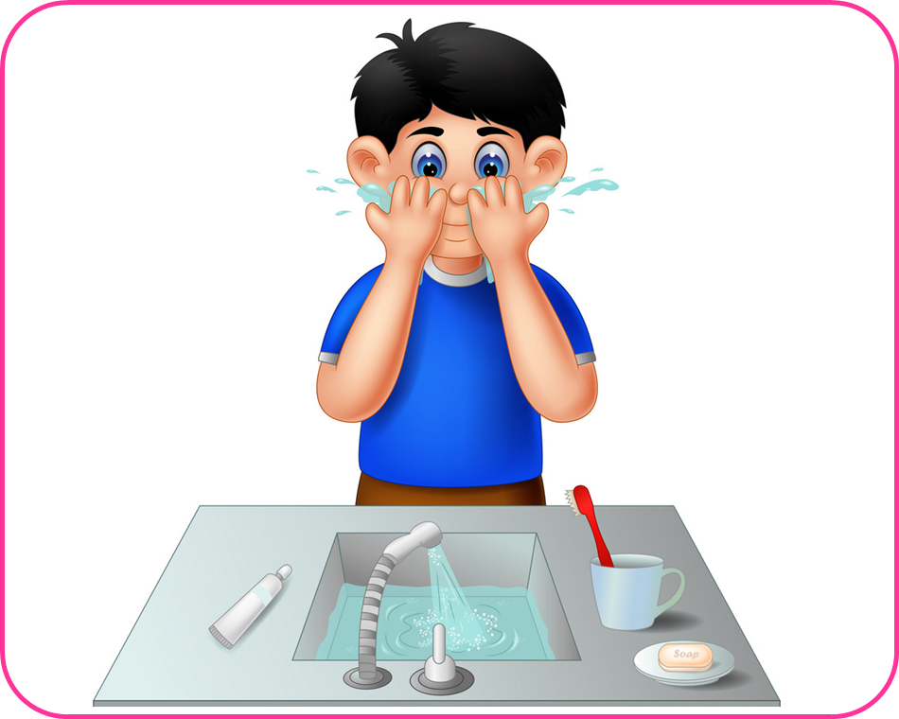
Wash my face

Slide 7
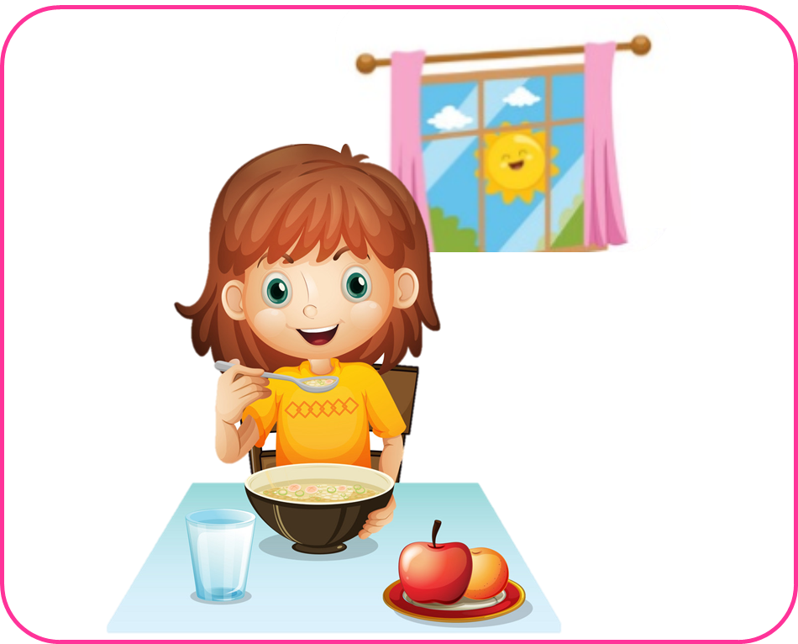
Have breakfast

Slide 8

Have
lunch

Slide 9
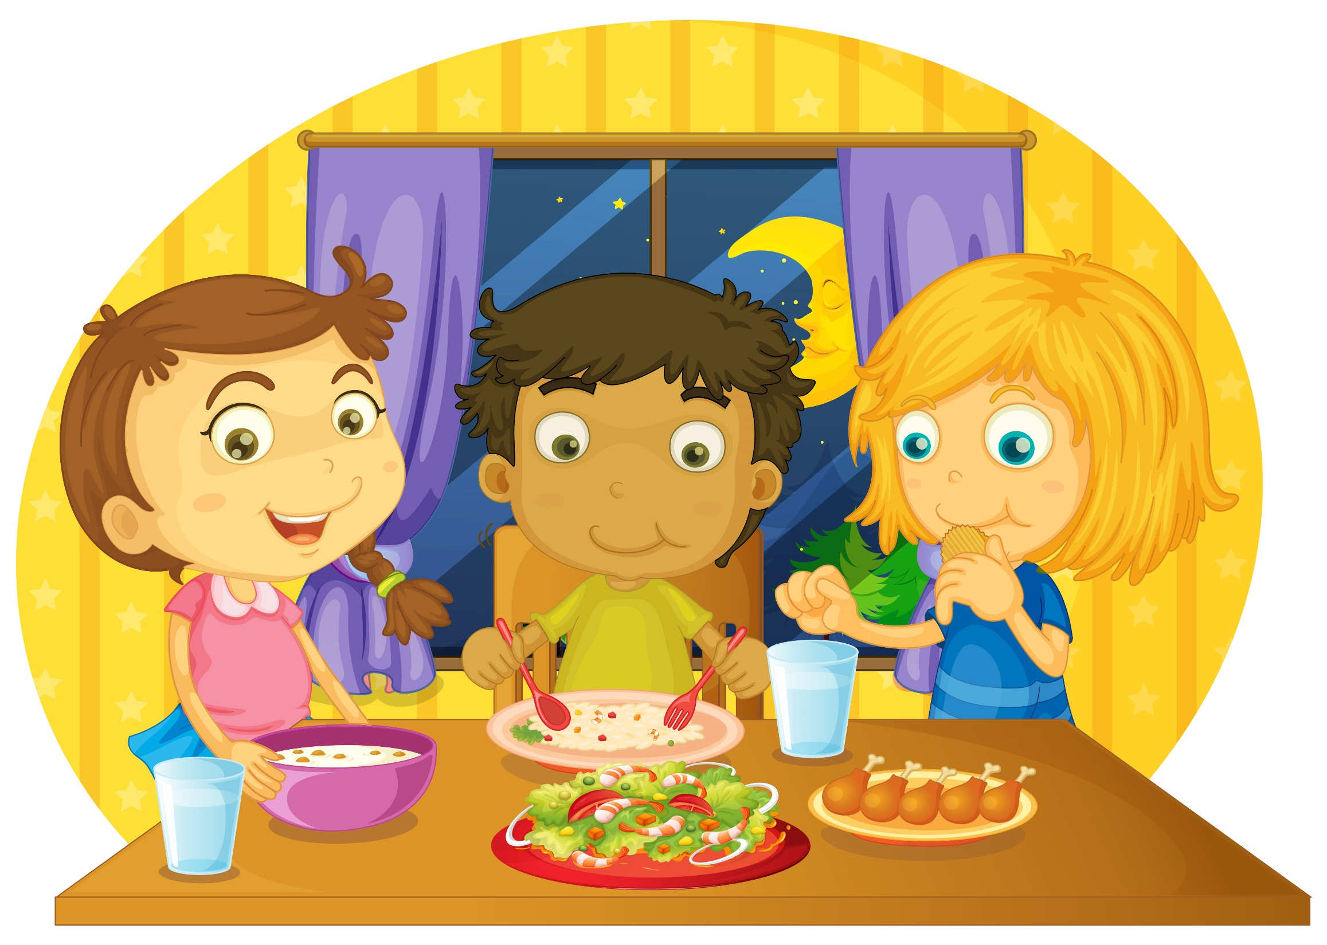
Have
dinner

Slide 10
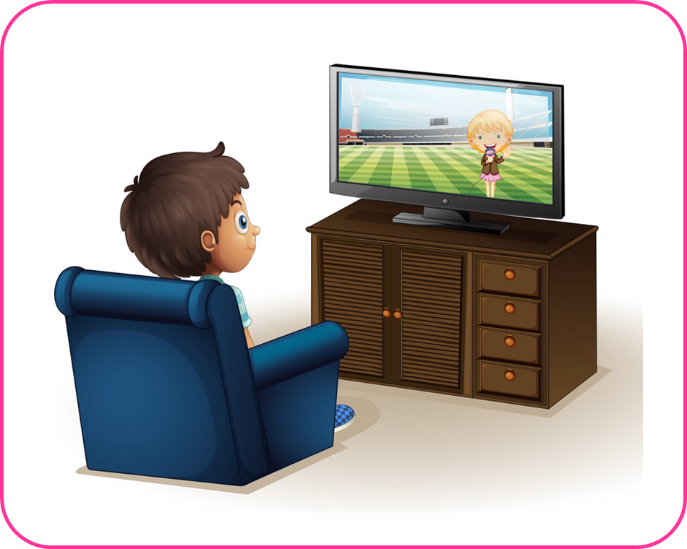
Watch TV

Slide 11
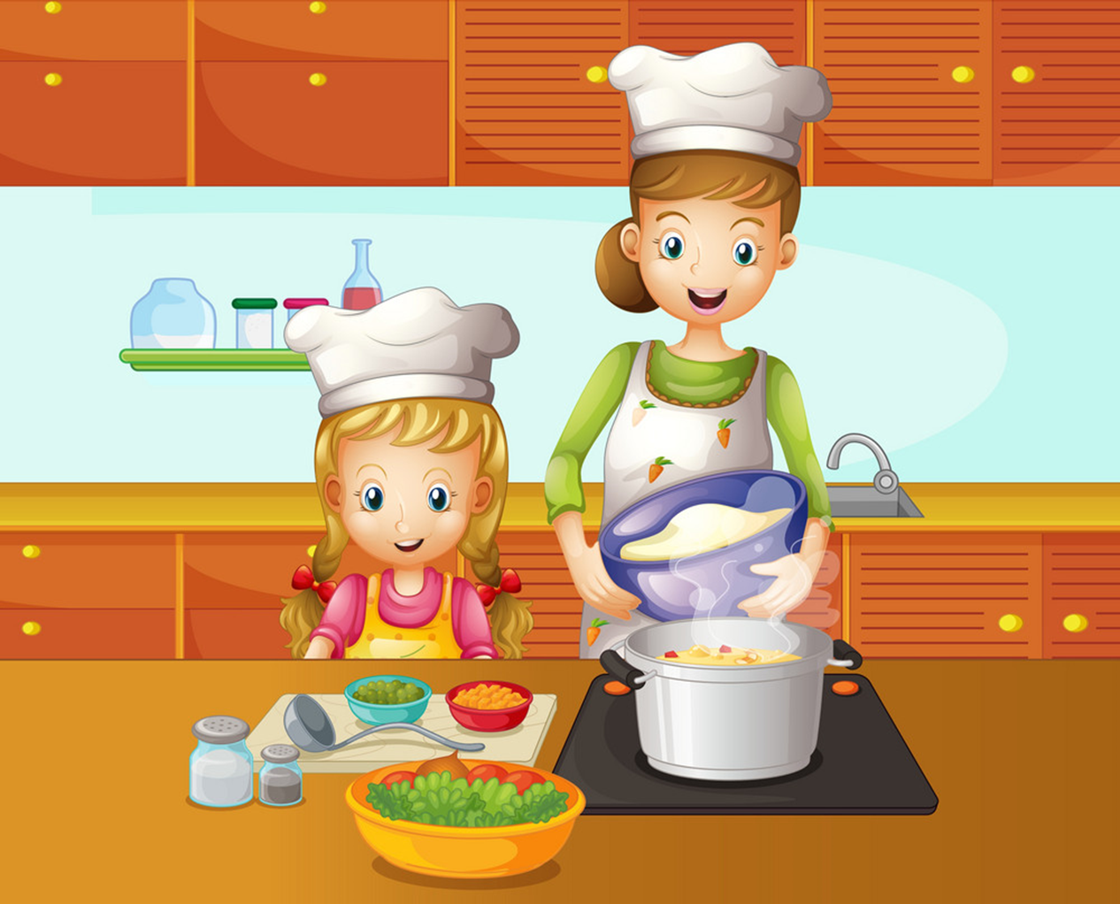
Cook

Slide 12
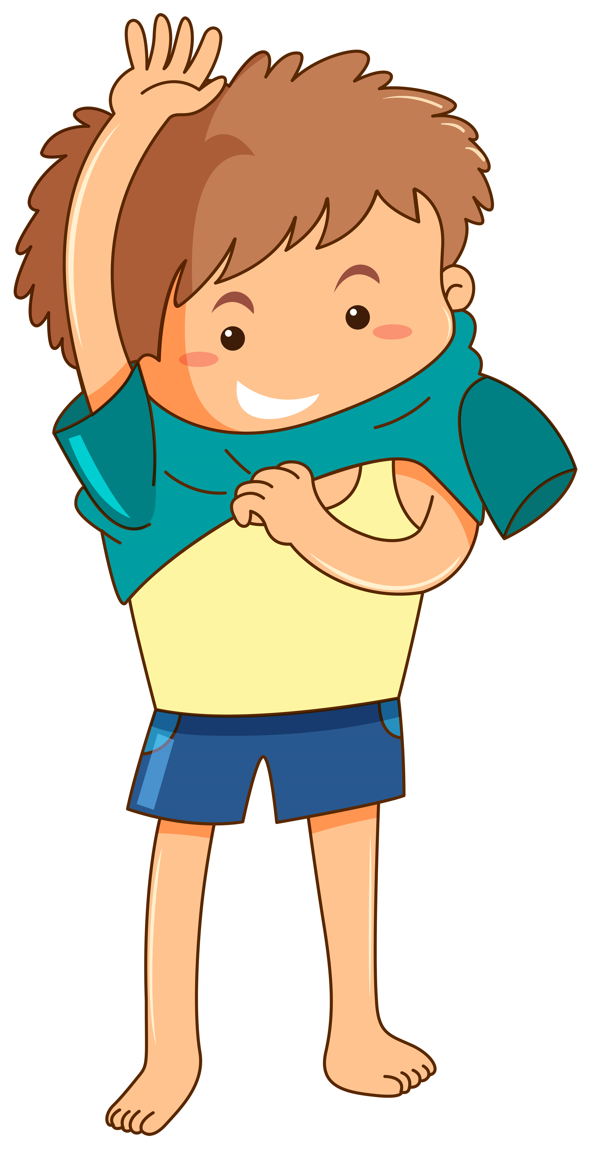
Get dressed

Slide 13

Go to school

Slide 14
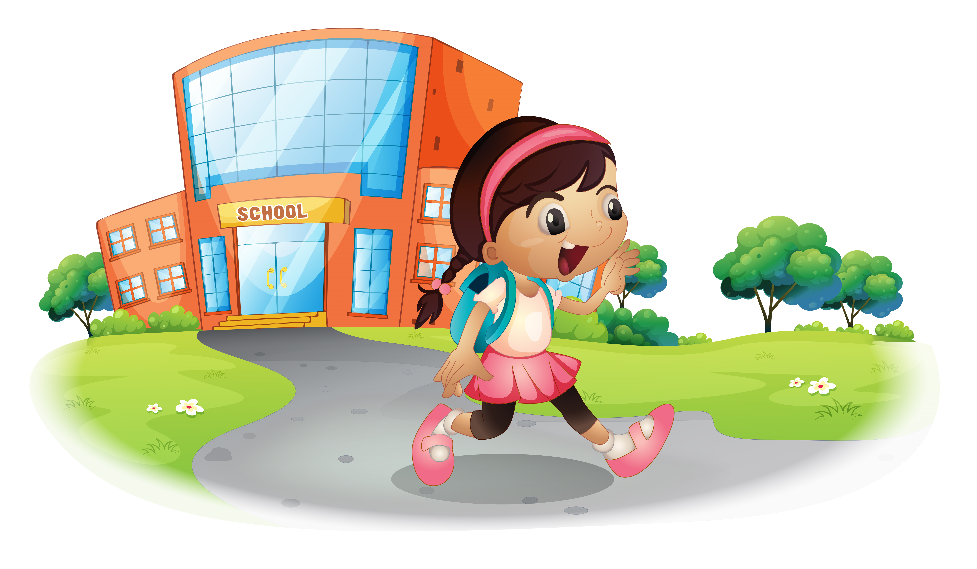
Go home

Slide 15

Go to bed

Slide 16

Surf the Internet

Slide 17
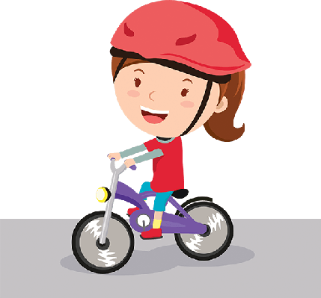
Ride a bicycle

Slide 18

Do homework

Slide 19

Read a book

Slide 20
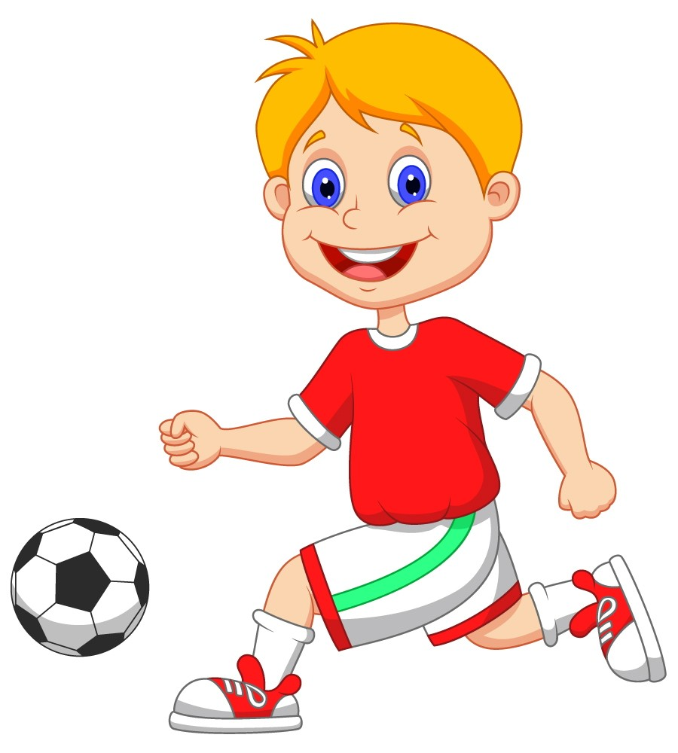
Play football

Slide 21
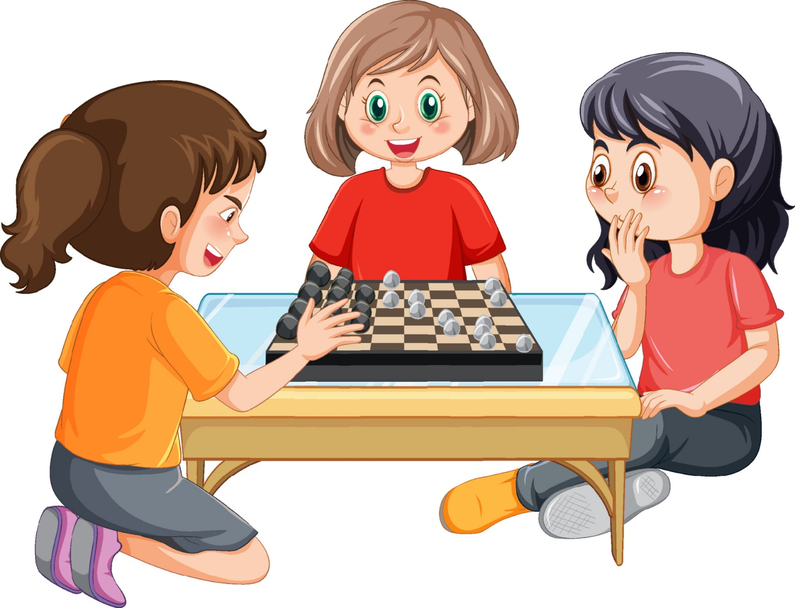
Play chess

Slide 22
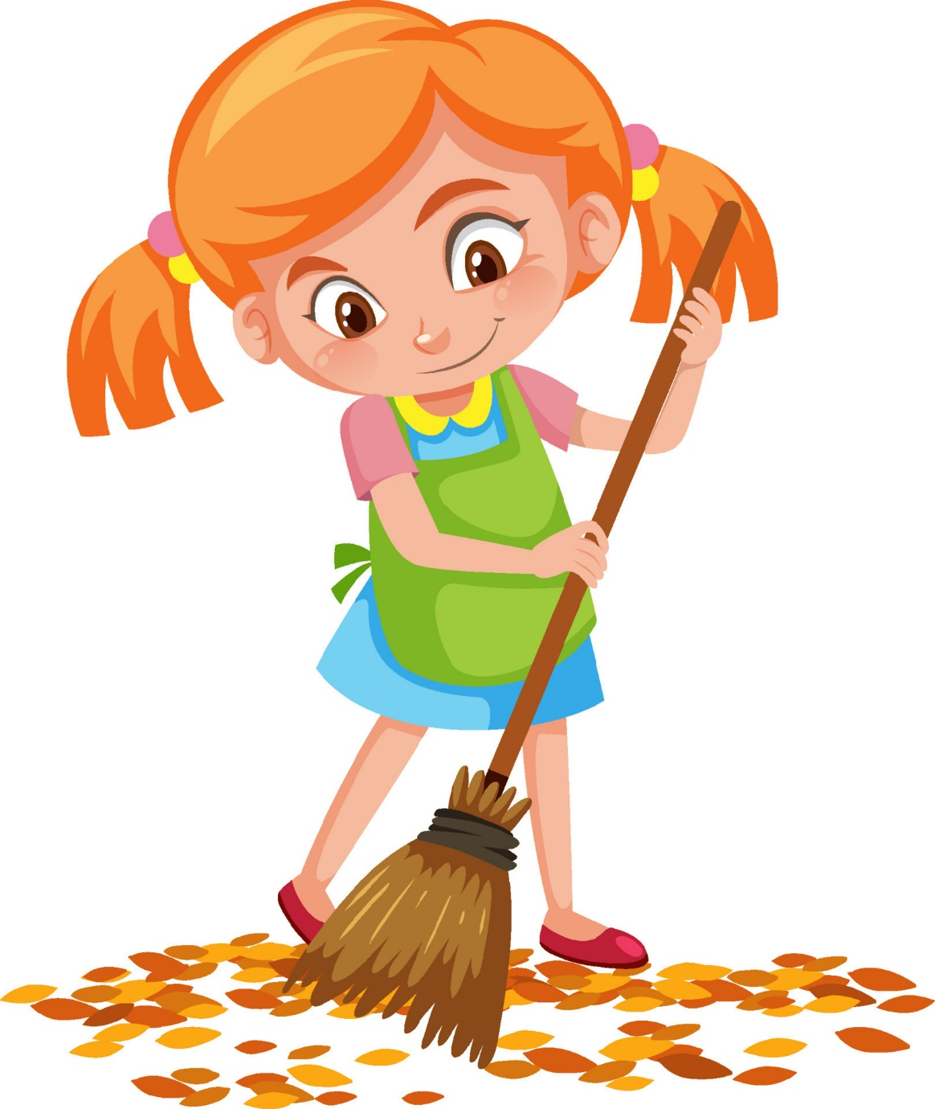
Sweep
the floor

Slide 23
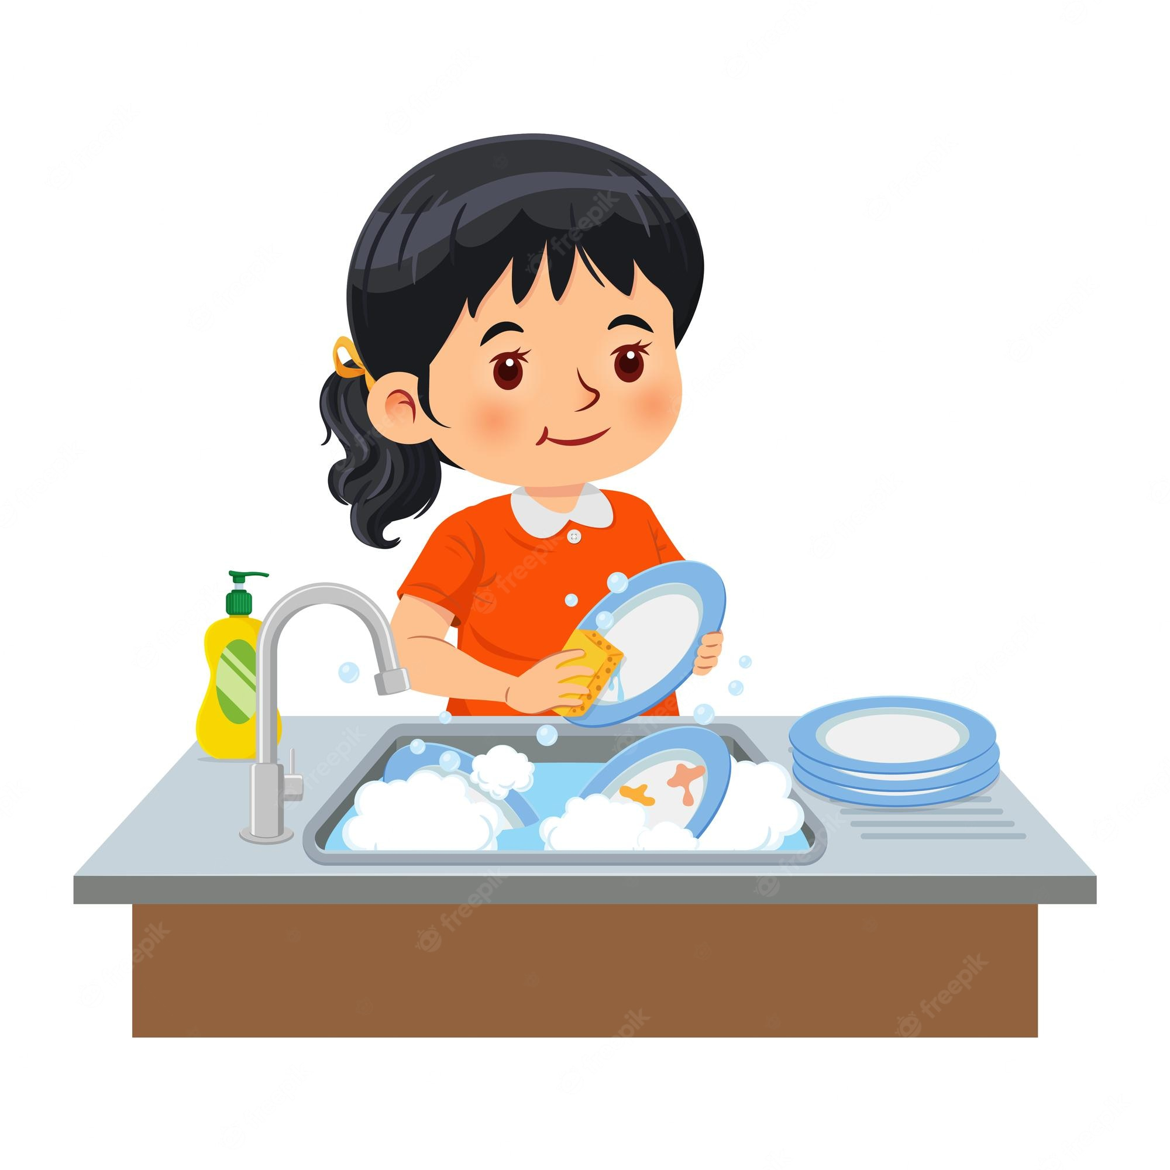
Wash dishes

Slide 24
EXERCISE 1: GAME: WHO’S THE FASTEST?
1
2
3
Have breakfast
Do morning exercise
Brush my teeth
4
5
6
7
Wash my face
Get up
Cook dinner
Watch TV

Slide 25
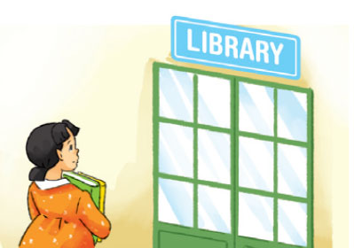
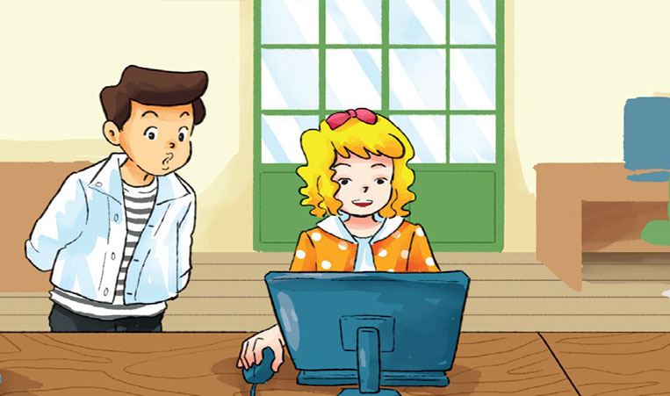
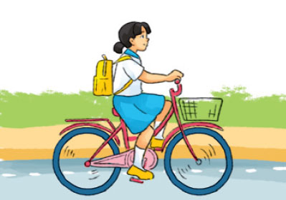
EXERCISE 1: GAME: WHO’S THE FASTEST?
8
9
10
Go to the library
Surf the Internet
Ride a bicycle

Slide 26

Lesson 1: Vocabulary: Daily routine
(công việc hằng ngày)
Vocabulary
1. get up (v) : thức dậy
2. do morning exercise (v): tập thể dục buổi sáng
3. brush teeth (v): đánh răng
4. have breakfast (v): ăn sáng
5. have lunch (v): ăn trưa
6. have dinner (v): ăn tối
7. watch TV (v): xem Ti-vi
8. ride a bicycle (v): đạp xe đạp
9. do homework (v): làm BTVN

Slide 27
EXERCISE 2:
Write the best word to complete the sentences.
1. I usually _______ up at 6.00 a.m.
2. I _________________lunch in the school canteen at 1 p.m.
3. We usually _______________ dinner at about 6 p.m.
4. My school finishes at 3 p.m. and then I ____________ home by bus.
5. I always _______________ my teeth before I go to bed.
6. I _______________ to school with my friends at 8.00 a.m.
get
have
have
go
brush
go

Slide 28
Structures

Slide 29
What do you do in the _________?
I usually _____________________.
morning
do morning exsercise

Slide 30
Lesson 1: Vocabulary: Daily routine
(công việc hằng ngày)
Vocabulary
Structure
Q: What do you do in the morning/ in the afternoon/ in the evening?
A: I always/ usually/ often/ sometimes…………………..

Slide 31
Practice: Point and say
What do you do in the afternoon?
I often ____________.
cook dinner

Slide 32
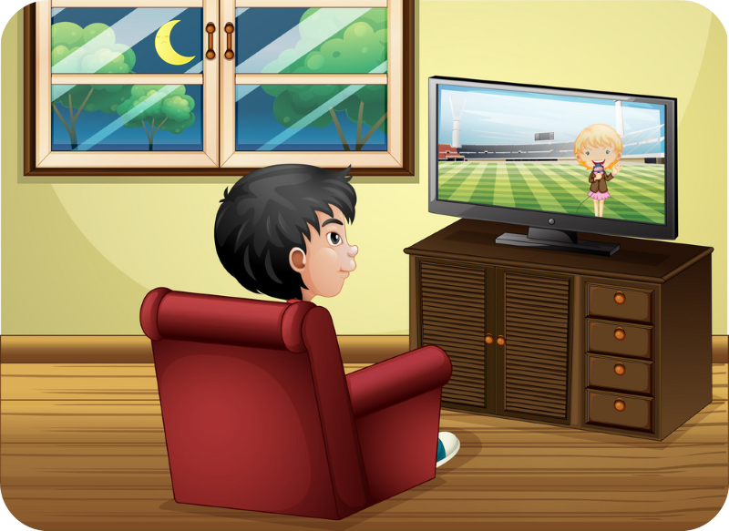
Practice: Point and say
What do you do in the _________?
I sometimes ____________.
evening
watch TV

Slide 33






EXERCISE 3: Work in pairs.
Ask and answer questions about your friend’s daily routine.
A: What do you do in the morning?
B: I always brush my teeth.
A: What do you do in the afternoon?
B: I sometimes get up early.
A: What do you do in the evening?
B: I usually……………...

Slide 34
Wrap- up
Vocabulary
Daily routine

Slide 35
Homework
Learn by heart vocabulary “Daily routine”
Prepare the presentation

