Slide 1

UNIT 12. ROBOTS
A CLOSER LOOK 2

Slide 2
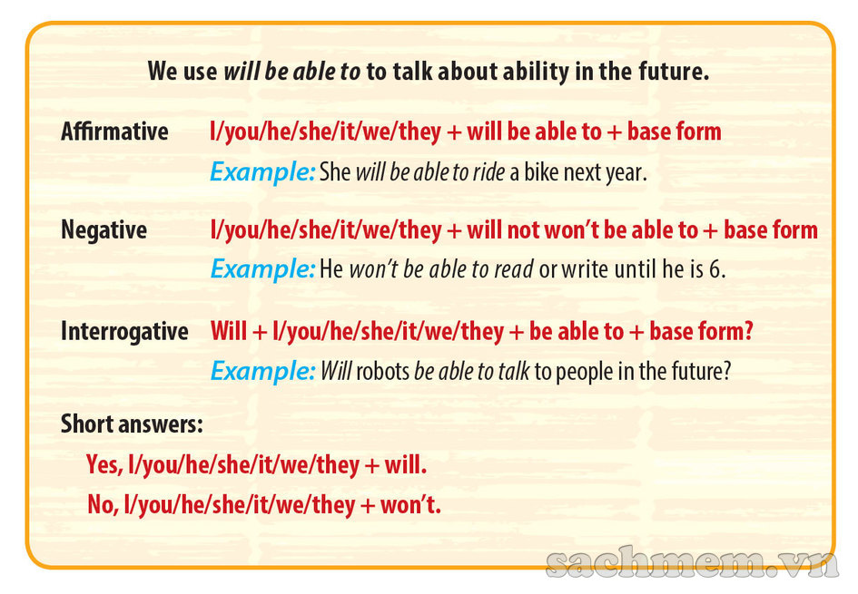
Grammar
WILL BE ABLE TO: will be able to để nói về khả năng trong tương lai.

Slide 3
WILL BE ABLE TO: will be able to để nói về khả năng trong tương lai.
Use
Diễn tả ai đó hoặc sự việc có khả năng làm việc gì đó trong tương lai hoặc không có khả năng làm việc gì đó trong tương lai.
2. Form
(+) S + will be able to + V nguyên thể
(-) S + won’t be able to + V nguyên thể
(?) Will + S + be able to + V nguyên thể?
Yes, S + will.
No, S + won’t.

Slide 4

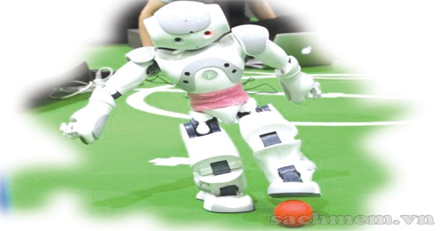
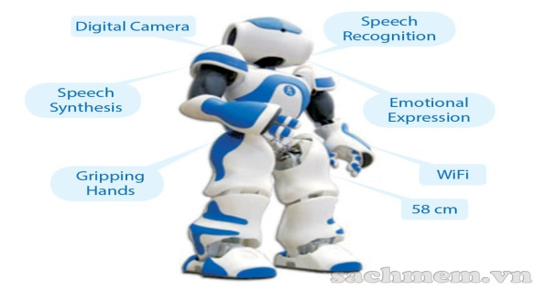
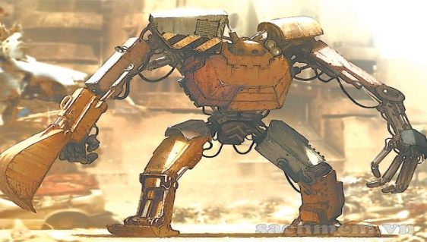
Grammar
Exercise 1. Put the words in the correct order
1.will be able to/In 2030,/robots/do many things like humans/.
→ In 2030, robots will be able to do many things like humans.
2.be able to/Will robots/talk to us then/?
→ Will robots be able to talk to us then?
3.won’t be able to/Robots/play football/.
→ Robots won’t be able to play football.
4.be able to/robots/Will/recognise our faces/?
→ Will robots be able to recognise our faces?

Slide 5

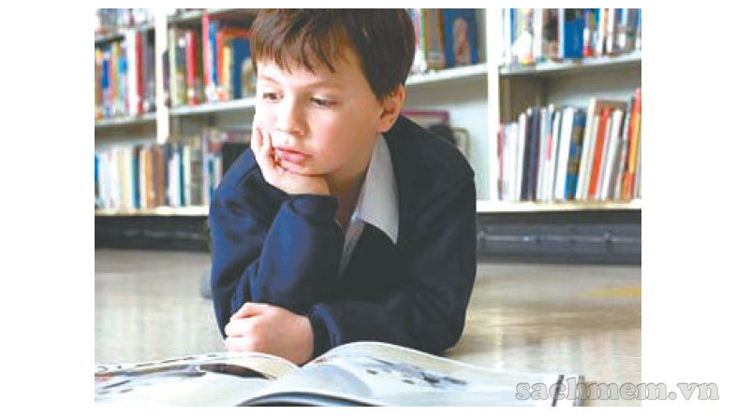
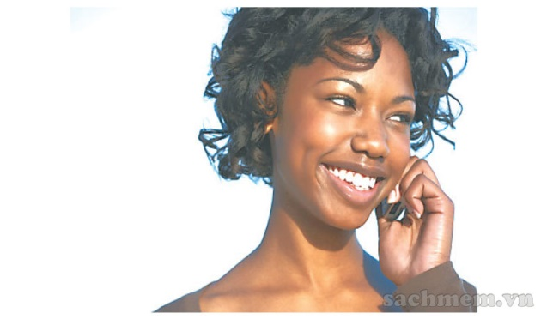
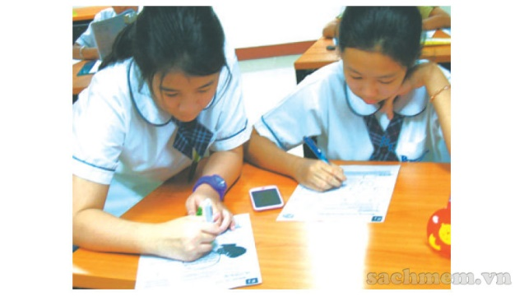


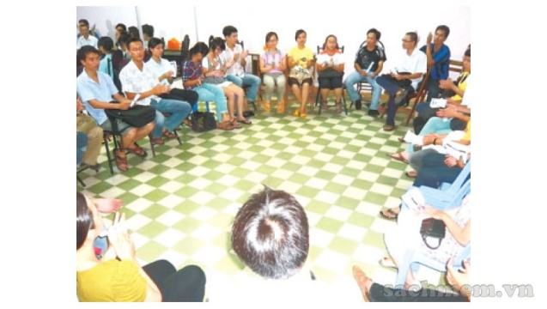
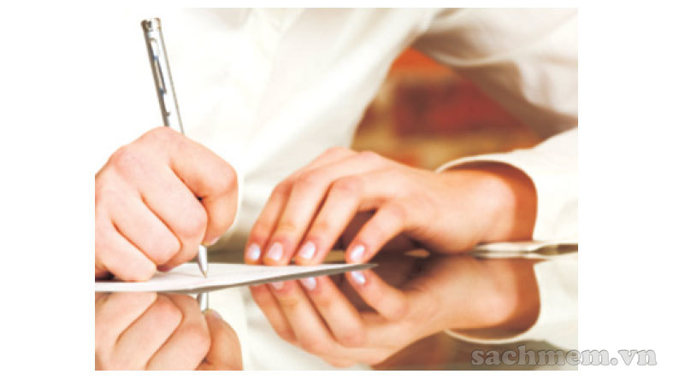
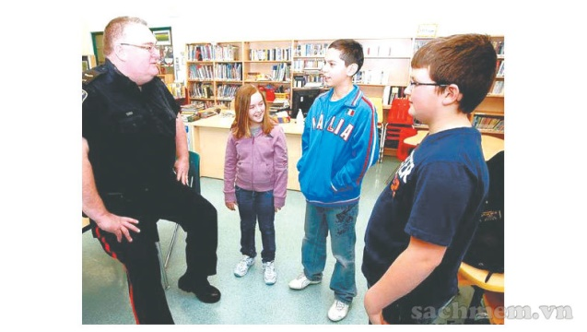
Grammar
EXERCISE 2. Look at the pictures and tick (✔) Yes or No. Then write what you think you will be able to /won’t be able to when you are in Year 8.
read an English book
speak English on phone
write an essay in English
speak English with a group of people
understand English in conservation
write a letter to an English friend

Slide 6

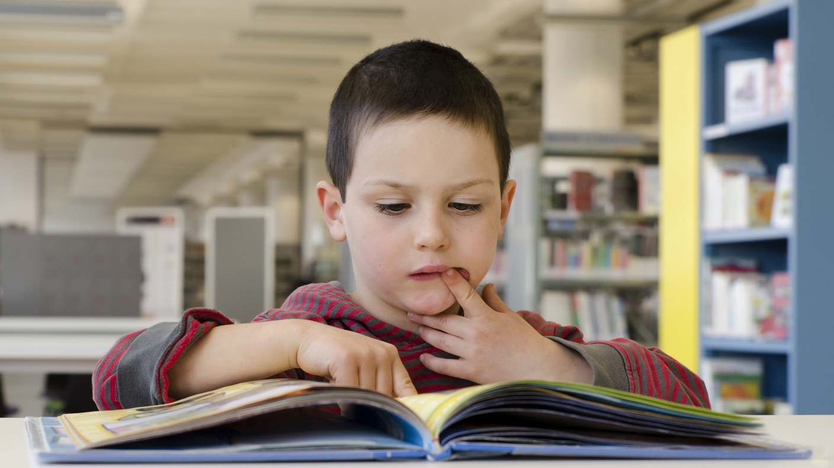

Grammar
Exercise 3. Ask and answer the questions about the activities in 2.
Example:
A: Will you be able to read an English book when you are in Year 8?
B: Yes, I will. /No, I won’t.

Slide 7

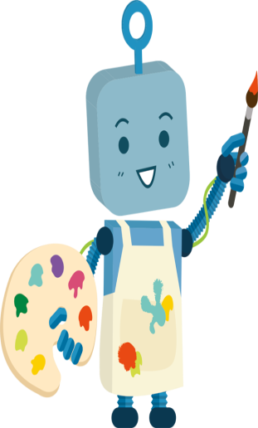
Grammar
4
Fill the gap with can/ can’t/ could/ couldn’t/ will be able to
1.In the past, robots teach in classes, but they can now.
2.Robots can’t talk now. In 2030, they talk to people.
3.Mr Van run very fast when he was young.
Now he .
4.In 2030, robots will be able to talk to us, but they do do do more complicated things.
5.My little sister is very clever. She already read some words.
couldn’t
will be able to
could
can’t
won’t be able to
can

Slide 8
Grammar
Complete the sentences. Use will able to/ can/ could/ and the verbs from the box
5
guard
make
recognise
do
1.This robot our faces when the scientists improve it.
2.Home robots are more useful today – they the bed.
3.Even in the past, robots the laundry.
4.Now, robots the house. When there’s a problem, they send a message to our mobile.
will be able to recognise
can make
could do
can guard

Slide 9
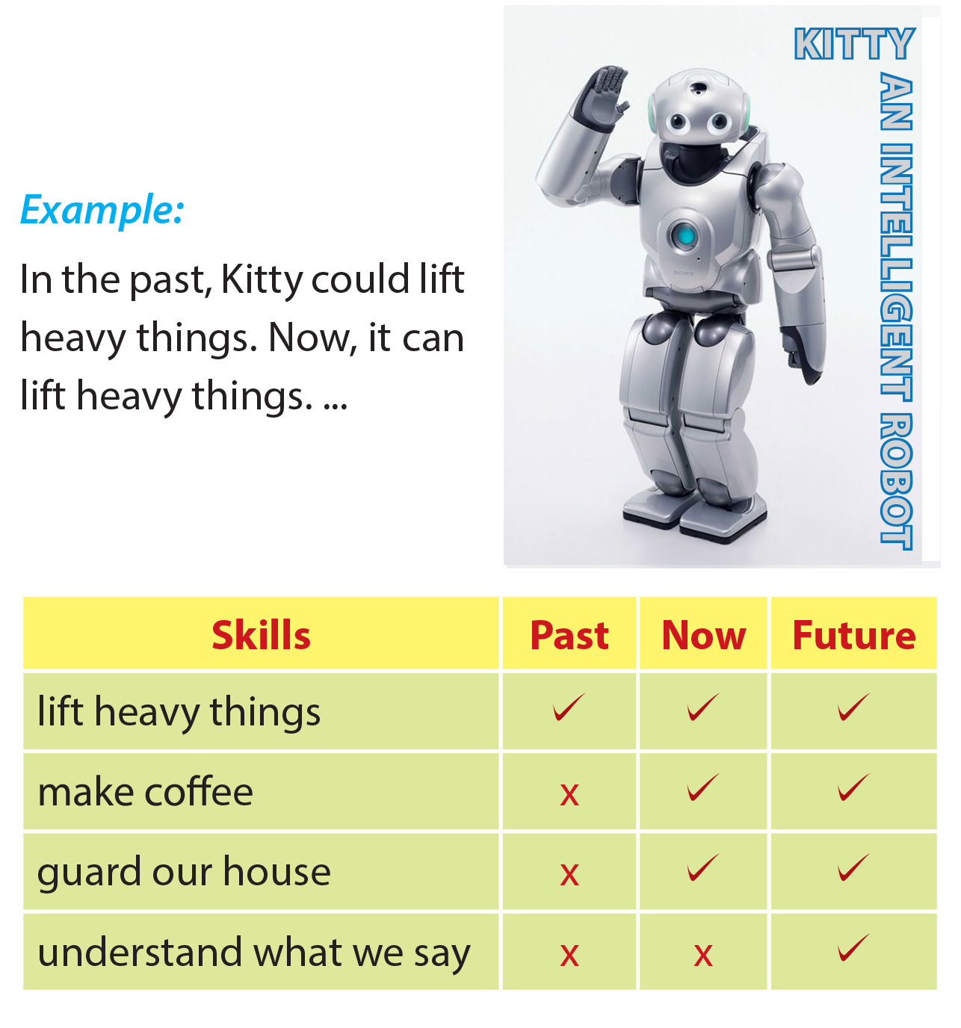
Grammar
6
Work in pairs

