Slide 1


UNIT 7. TELEVISION
A CLOSER LOOK 1

Slide 2


WARM UP
Divide these words into the correct column
Game show
relaxing
popular
Science
Education
funny
live
good
Animals
News
PROGRAMMES
DESCRIBE
Game show
relaxing
Science
popular
Education
funny
Animals
live
News
good

Slide 3
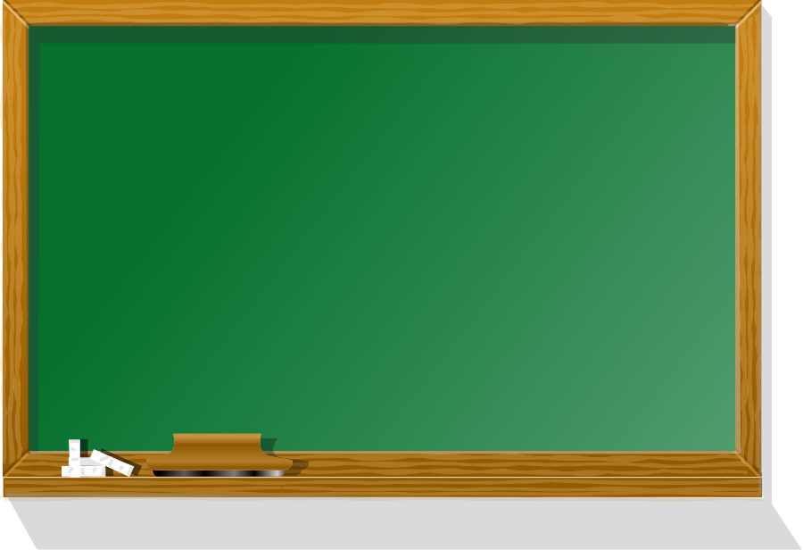


Unit 7. Television
A CLOSER LOOK 1
I. Warm up
II. New words

Slide 4
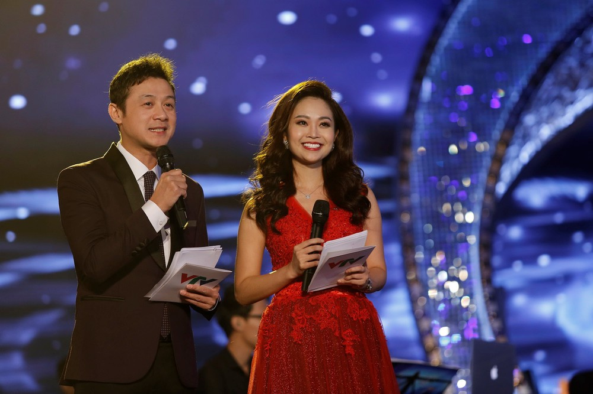
MC (n)

Slide 5
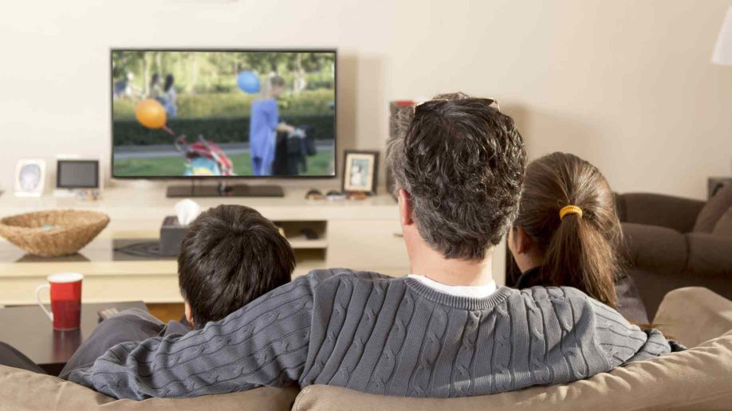
viewer(n)

Slide 6
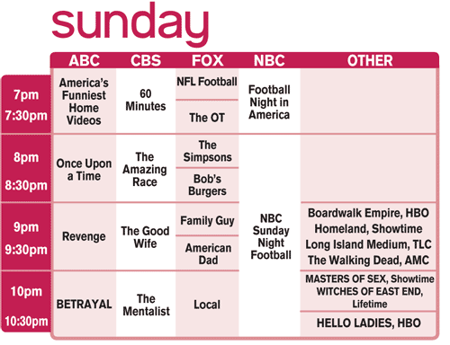

TV schedule (n)

Slide 7
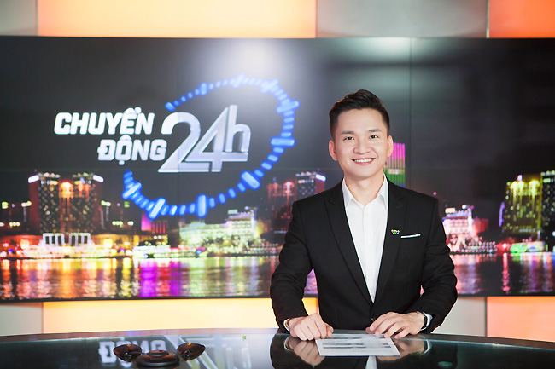
newsreader (n)

Slide 8
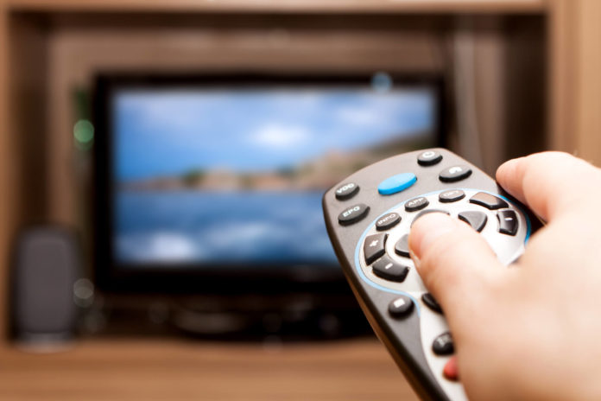
remote control (n)

Slide 9
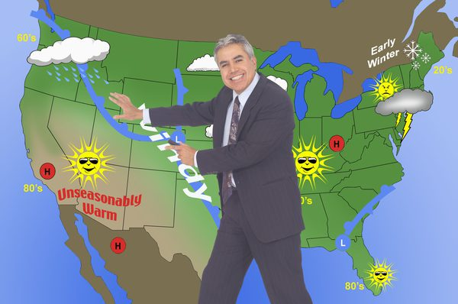
weatherman (n)

Slide 10

Monday ……………
Unit 7. Television
A CLOSER LOOK 1
I. Warm up
- Guess TV channels in the world.
II. Practice
1. New words
- MC (n)
- viewer (n)
- TV schedule (n)
- weather man (n)
- newsreader (n)
- remote control (n)
2. Write the words

Slide 11



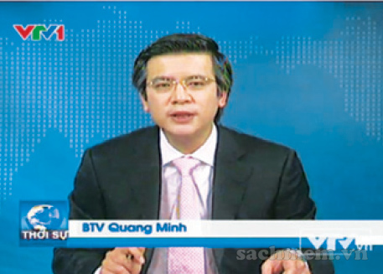
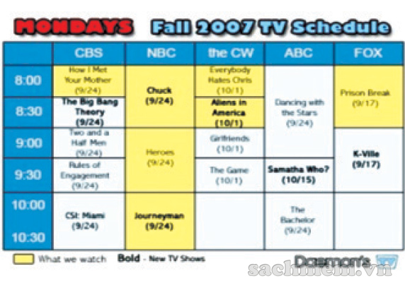
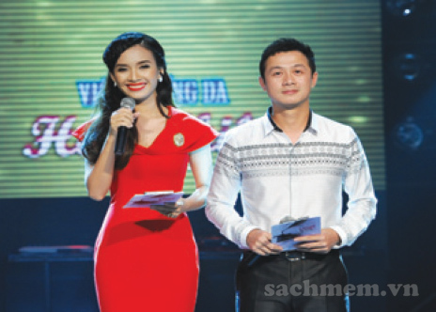
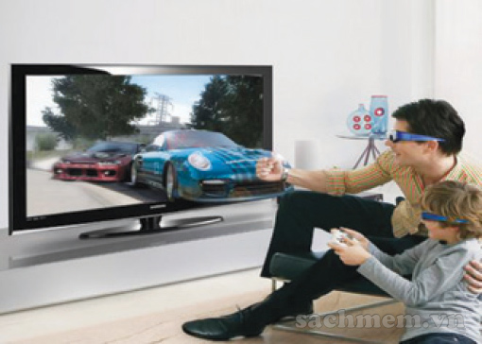
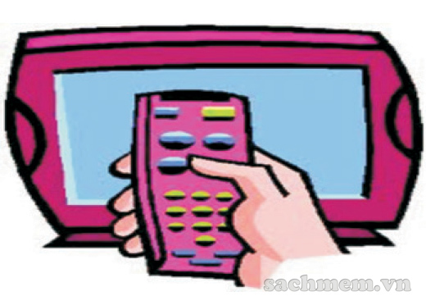
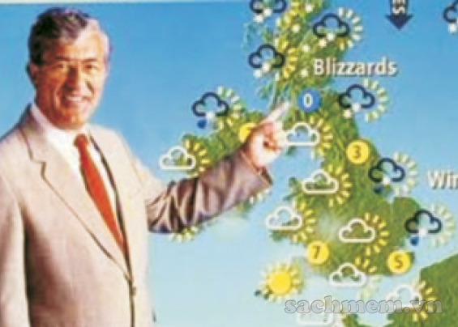
Vocabulary
1
Write the words/phrases in the box under the pictures.
MC
viewer
weatherman
newsreader
TV schedule
Remote control
1
newsreader
2
TV schedule
3
MC
4
viewer
5
Remote control
6
weatherman
Listen, check your answers and repeat the words.

Slide 12







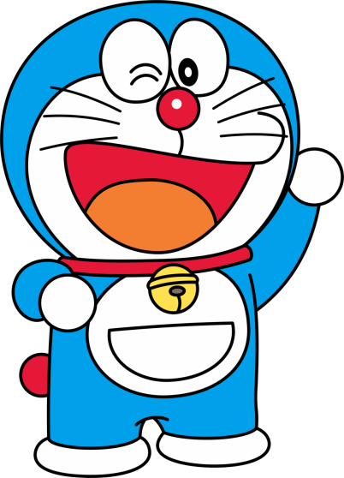
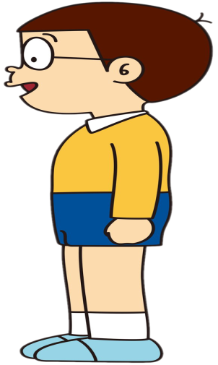
6
5
3
4
2
1
6
1
2
3
4
5
TELEVISION
PEPPA
EMILY

Slide 13


A man on a television or radio programme who gives a weather forecast.
A
B
C

Slide 14

Someone who reads out the reports on a television or radio news programme.
A
B
C

Slide 15

We use it to change the channel from a distance.
A
B
C

Slide 16


A person who announces for a TV event.
A
B
C

Slide 17

It is a button on the TV to change the volume.
A
B
C

Slide 18


A person who watches TV.
A
B
C

Slide 19
Monday ……………
Unit 7. Television
A CLOSER LOOK 1
I. Warm up
- Guess TV channels in the world.
II. Practice
1. New words
- MC (n)
- viewer (n)
- TV schedule (n)
- weather man (n)
- newsreader (n)
- remote control (n)
2. Write the words
3. Choose description

Slide 20
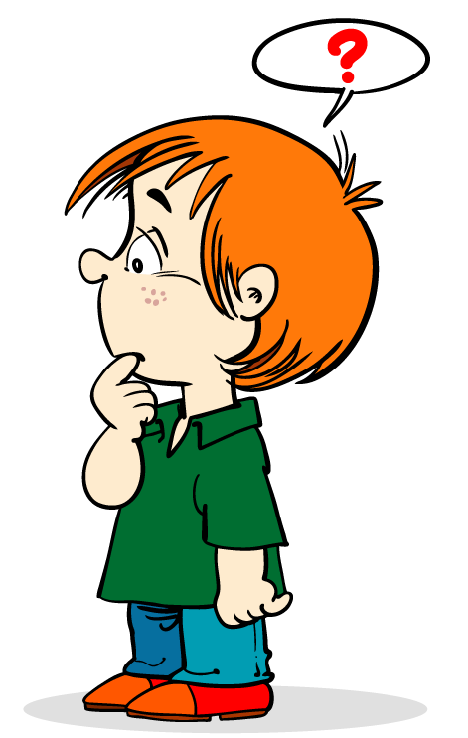
Vocabulary
2
Choose a word from the box for each description below.
MC
TV viewer
weatherman
newsreader
volume button
remote control
1 A man on a television or radio programme who gives a weather forecast.
Weatherman
2 Someone who reads out the reports on a television or radio news programme.
Newsreader
3 We use it to change the channel from a distance.
Remote control
4 A person who announces for a TV event.
MC
5 It is a button on the TV to change the volume.
Volumn button
6 A person who watches TV.
TV viewer

Slide 21
Monday ……………
Unit 7. Television
A CLOSER LOOK 1
I. Warm up
- Guess TV channels in the world.
II. Practice
1. New words
- MC (n)
- viewer (n)
- TV schedule (n)
- weather man (n)
- newsreader (n)
- remote control (n)
2. Write the words
3. Choose description
4. Play game: “What is it?”

Slide 22
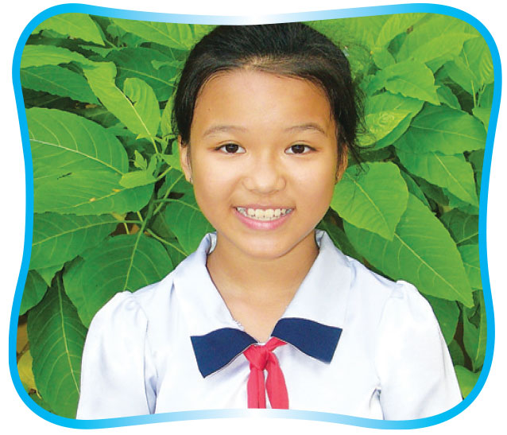
Vocabulary
3
Game.
What is it?
Divide the class into groups of 4 – 5. Each group chooses two words from the list below and work out a description for each word. The groups take turns reading the descriptions aloud. The other groups try to guess what word it is. The group with the most correct answers wins.
WORDS
Suggested structure for description
Newsreader
Weatherman,
comedian
TV screen,
sports programme
Animals programme,
TV schedule
A person who _____.
A programme which _____.
It ______.

Slide 23
Unit 7. Television
A CLOSER LOOK 1
I. Warm up
- Guess TV channels in the world.
II. Practice
1. New words
- MC (n)
- viewer (n)
- TV schedule (n)
- weather man (n)
- newsreader (n)
- remote control (n)
2. Write the words
3. Choose description
4. Play game: “What is it?”
PRONUNCIATION

Slide 24


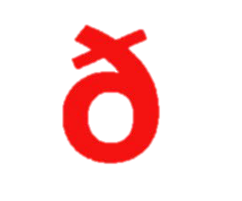
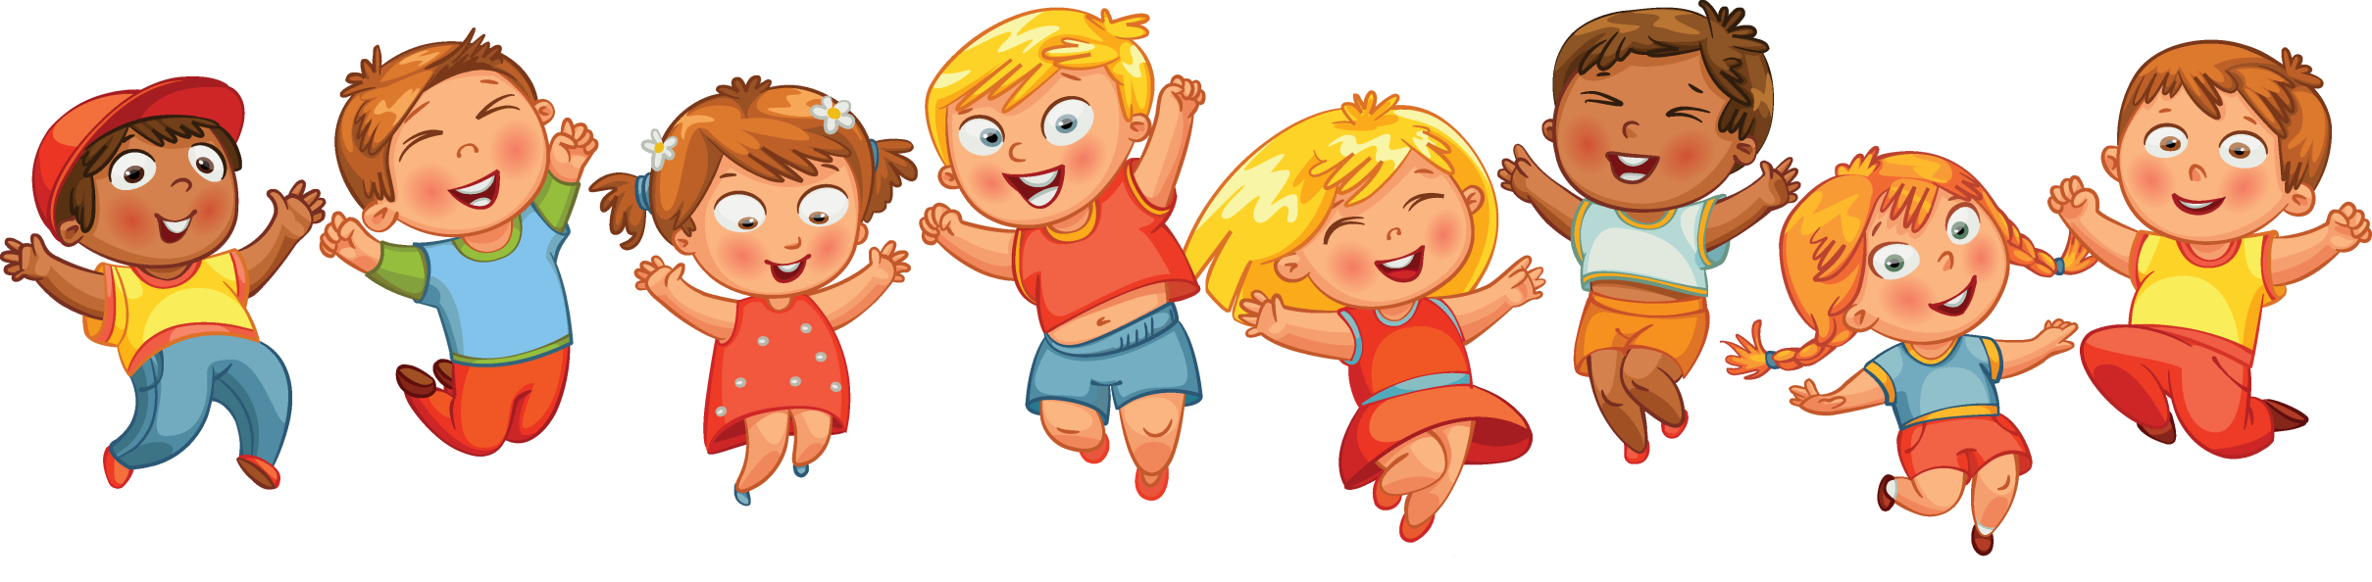
PRONUNCIATION
-th
-th
/ /
/ /

Slide 25


Pronunciation
4
Listen and repeat the words.
Note: nhấn vào các ô chữ để nghe từng từ và nhắc lại.
there
Thanksgiving
anything
them
weatherman
both
theatre
earth
feather
neither
than
through

Slide 26
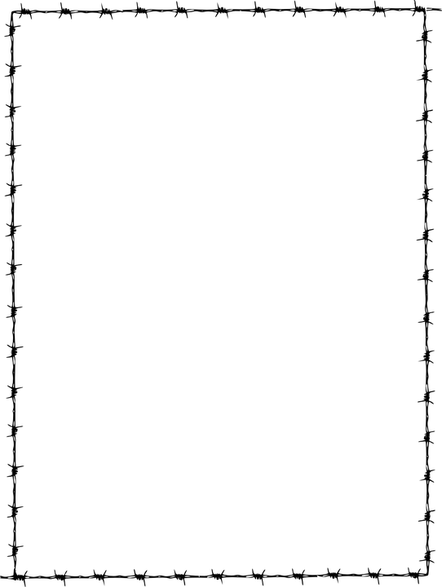


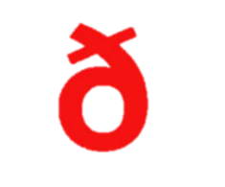
Pronuncation
Note: nhấn các ô chữ màu xanh để nghe từng từ. Nhấn keys để hiện đáp án.
5
Wich words in 4 have /θ/ and wich have /ð/ ? Listen again and write them in the correct column.
there
Thanksgiving
anything
them
weatherman
both
theatre
earth
feather
neither
than
through
/ /
/ /
theatre
there
Thanksgiving
them
earth
weatherman
anything
neither
both
than
through
feather

Slide 27
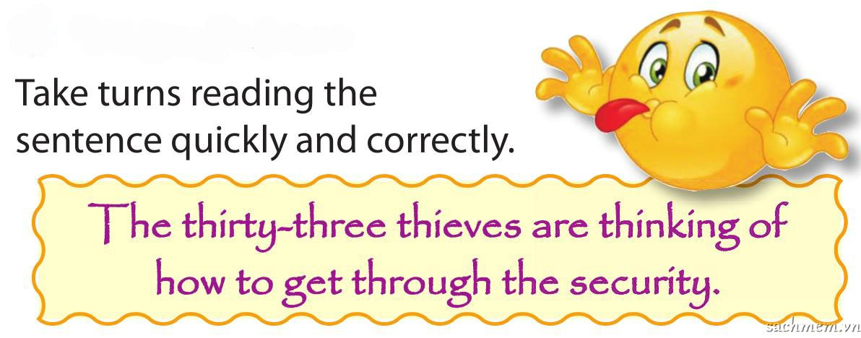
Pronunciation
6
Tongue twister.

Slide 28
Unit 7. Television
A CLOSER LOOK 1
I. Warm up
- Guess TV channels in the world.
II. Practice
1. New words
- MC (n)
- viewer (n)
- TV schedule (n)
- weather man (n)
- newsreader (n)
- remote control (n)
2. Write the words
3. Choose description
4. Play game: “What is it?”
PRONUNCIATION
III. Homework

