Slide 1

UNIT 8. SPORTS AND GAMES
SKILLS 2

Slide 2


When was he born?
In 1940
In 1941
In 1942

Slide 3
How many World Cups did he win?
2
3
4

Slide 4
When did he win his first World Cup?
In 1958
In 1959
In 1960

Slide 5

UNIT 8. SPORTS AND GAMES
LESSON 6: SKILLS 2
I. Listening

Slide 6


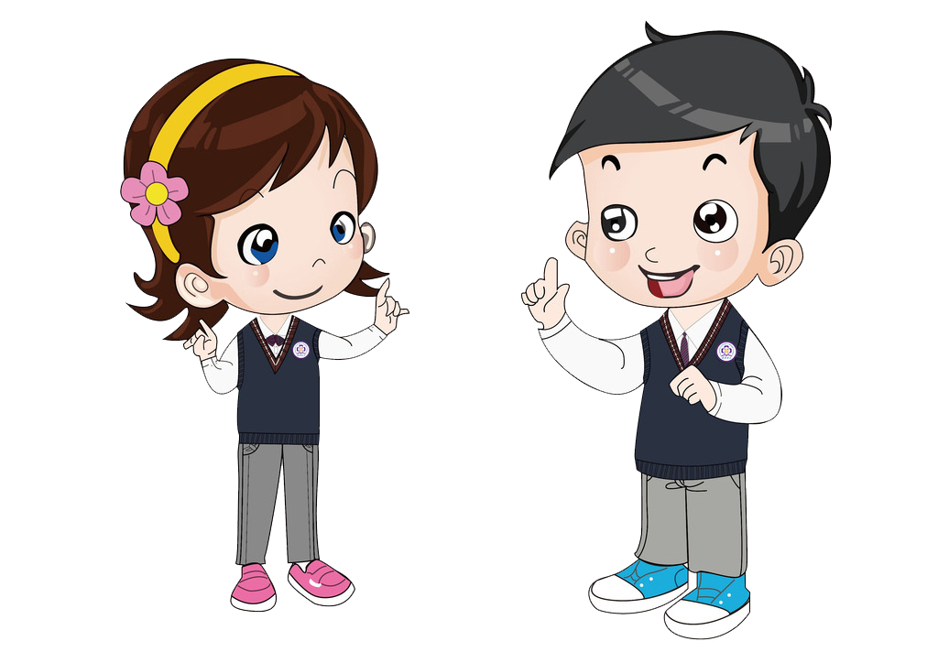
Listening
1
Listen to the passages. Who are they about?
They are Hai, Alice, Bill and Trung.

Slide 7
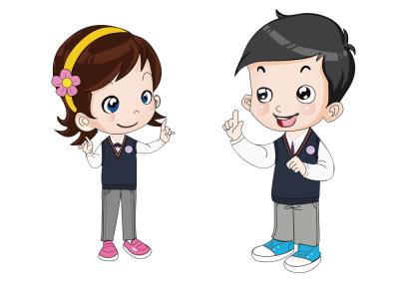




I'm Bill. After my lessons, I like to play computer game. The game I like best is 'Angry Birds'.
Listen to the passages again . Then write True (T) or False (F) for each sentences.
My name's Alice. I don't like doing sport very much, but I like watching ice skating on TV
Hi. I'm Bill. I hope that I can create a new kind of computer game in the future.
My name's Alice. My favourite hobby is playing chess. My friend and I play chess every Saturday.
Listening
2
My name's Trung. I don't do much sport, but I often go swimming with my friends on hot days.
1.Hai plays chess every Saturday.
2.‘Angry Birds’ is Bill’s favourite game.
3.Alice doesn’t like doing sports very much.
4.Trung is very good at playing football.
5.Bill’s dream is to create a new game.
T
F

Slide 8

Listening
3
Listen to the passages again . Fill in each blank to complete the sentences.
1.Hai practises at the three times a week.
2.Trung can the guitar.
3.Alice likes ice skating.
4. is at Rosemarrick Lower Secondary School.
5.Trung swimming on hot days.
club
play
watching
Bill
goes

Slide 9
UNIT 8. SPORTS AND GAMES
LESSON 6: SKILLS 2
Listening
Writing

Slide 10
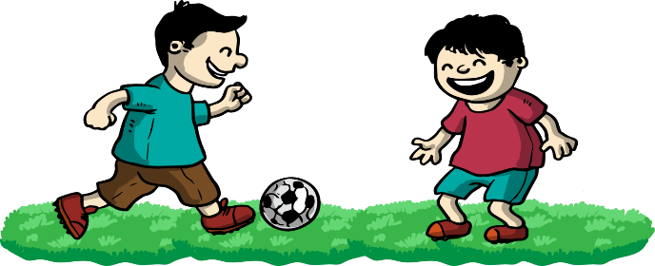
Writing
Write about a sport/game you like. Use your own ideas and the following as cues.
- Name of the sport/game.
- Is it a team or an individual sport/game?
- How long does it last?
- How many players are there?
- Does it need any equipment?

Slide 11
Writing
Write about a sport/game you like. Use your own ideas and the following as cues.
1. Name of the sport/game.
2. Is it a team or an individual sport/game?
3. How long does it last?
4. How many players are there?
5. Does it need any equipment?
1. FOOTBALL
2. Team sport
3. 90 minutes
4. 22 players (11 players on each side)
5. Ball, uniform, sports shoes…

Slide 12
Writing
Write about a sport/game you like. Use your own ideas and the following as cues.
My favorite sport is football. It’s a team sport.
It usually lasts 90 minutes for an official football match. There are 22 players. You need a ball and sports shoes to play this sport. I usually play football with my classmates every Saturday. I love playing football because it’s fun and good for health.

Slide 13
Writing
Write about a sport/game you like. Use your own ideas and the following as cues.
My favorite sport/game is ……….(badminton/ swimming /running /chess/…………)
It’s …………………(a team sport/game; an individual sport/game).
It usually lasts ………………………… minutes. There are ………….. players. You need………………,...,…… (ball, racket, goggles, bicycle, skateboard, skis, sports shoes…) to play this sport/game.
I usually…..………………. with my ………..
I love…………………….. because it’s ……..(fun, good for health/ interesting/….)

