Slide 1
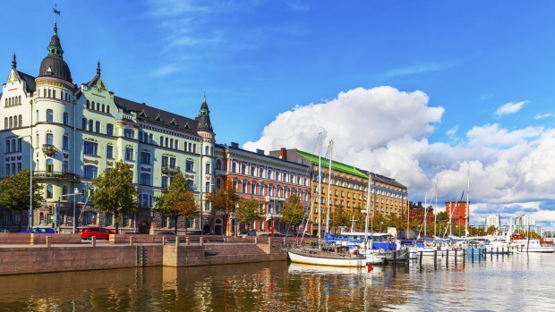

UNIT 9. CITIES OF THE WORLD
A CLOSER LOOK 1

Slide 2

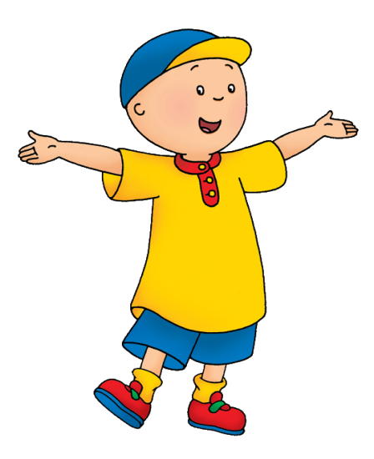

VOCABULARY
1
Match the words in A with their opposites in B. Some words may have more than one opposite.
A
B
old
> <
new
1.old
A.safe
dangerous
> <
safe
2.dangerous
B.dirty
quiet
> <
noisy
C.wet
3.quiet
D.polluted
dry
> <
wet
4.dry
E.new
clean
5.clean
> <
dirty
F.exciting
6.historic
historic
> <
modern
G.hot
7.boring
H.modern
boring
> <
exciting
8.cheap
I.expensive
cheap
> <
expensive
J.noisy
9.cold
cold
> <
hot

Slide 3
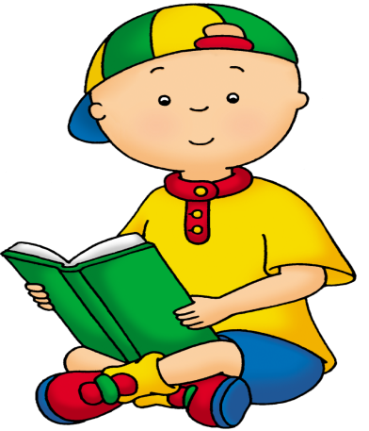


2
Create word webs.
beautiful
peaceful
exciting
modern
city
big
polluted
safe
beautiful
friendly
nice
people
Unfriendly
open
noisy
interesting

Slide 4

awful
delicious
good
old
tall
tasty
food
buliding
modern
new
rainy
cold
bad
weather
hot
wet

Slide 5

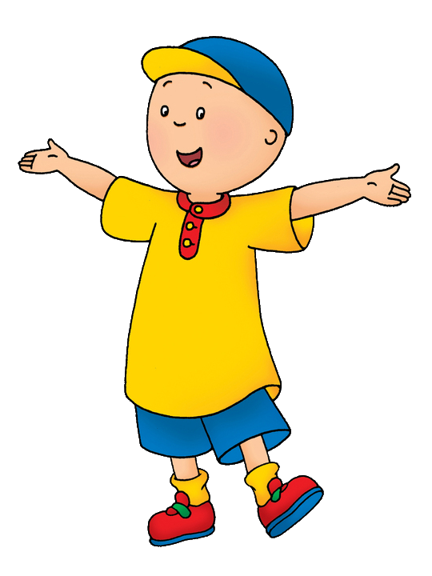
Pronunciation
3
Listen and write the words you hear in the appropriate column. Then, read the words aloud.
/əu/
/aɪ/

Slide 6

Pronunciation
3
Listen and write the words you hear in the appropriate column. Then, read the words aloud.
/əu/
Cold
/aɪ/
Sky
snow
exciting
old
high
clothes
fine
hold
flight

Slide 7

Pronunciation
4
Listen and repeat.
1.New York is an exciting city with many skyscrapers.
2.It’s very cold in Sweden in the winter with lots of snow.
3.I like looking at tall buildings at night with their colourful lights.
4.Write and tell me how to cook that Thai curry.
5.You can go boating on the West Lake. It’s nice!
6.Oxford University is the oldest university in Britain.

Slide 8
Grammar
Superlatives of long adjectives.

Slide 9
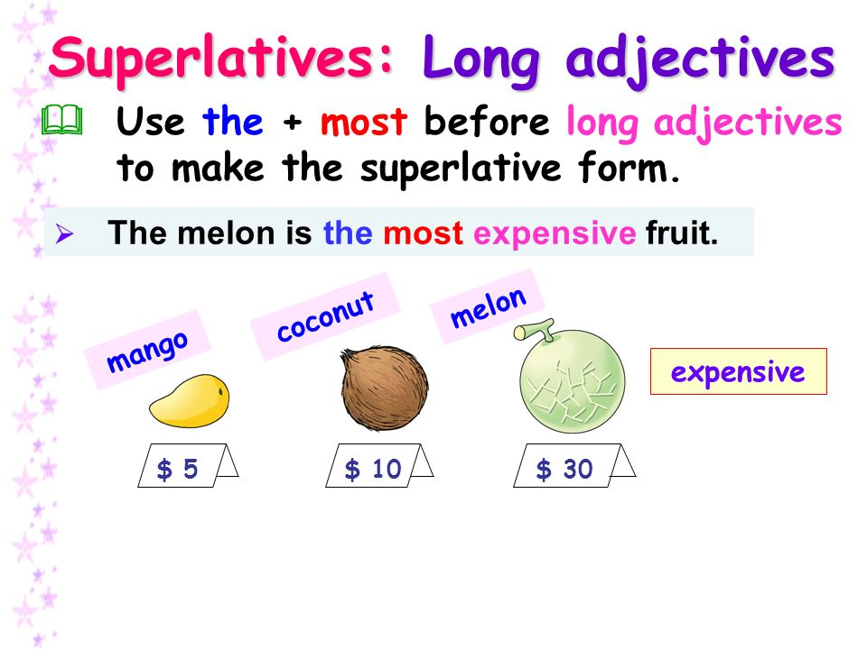

Slide 10
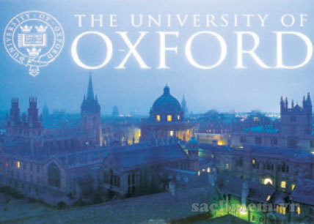
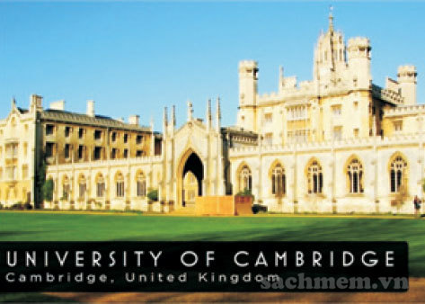

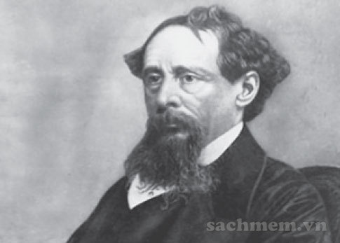
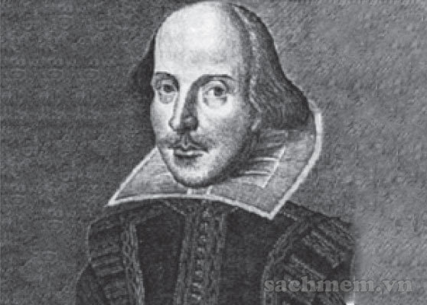
Grammar
5
Complete the fact sheet by choosing one picture. Compare your fact sheet with a classmate. Do you agree with his/her answers?
COUNTRY: BRITAIN
Biggest city: London
1.Oldest university:
a. University of oxford
b. University of Cambridge
2.Most popular British writer:
a. Dickens
b. Shakespeare

Slide 11
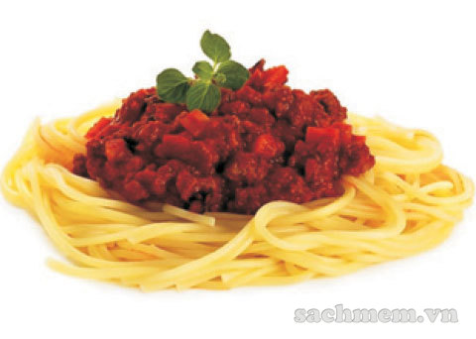
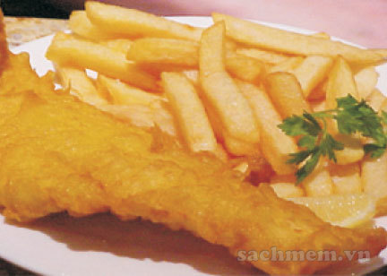
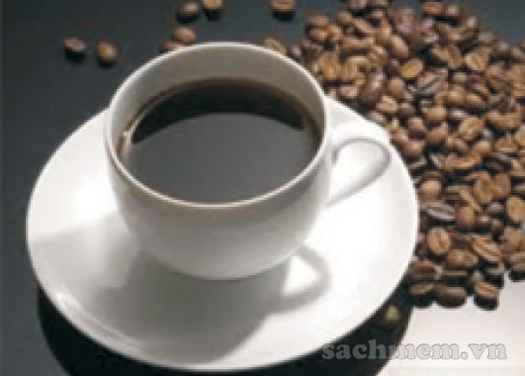
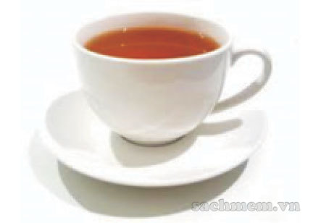
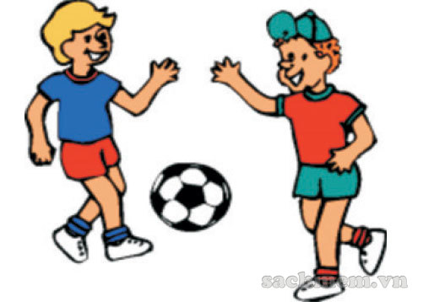
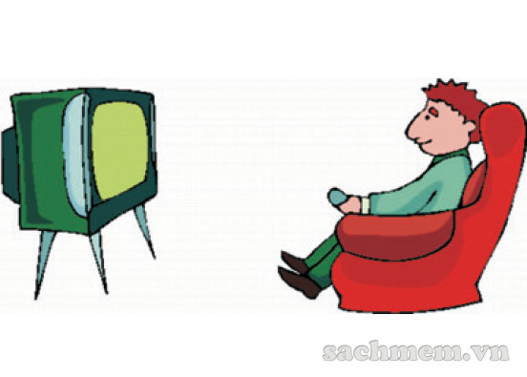
3.Most popular food:
a. Fish and chips
b. spaghetti
4.Most popular drink:
a. tea
b. coffee
5.Most common activity:
a. Playing football
b. Watching TV

Slide 12
Grammar
6
Read this article about Britain. Then, look at your fact sheet. Did you have correct answers?
London is Britain’s biggest city.
Oxford University is the oldest university in Britain. It was built in the 12th century.
The playwright William Shakespeare (1564-1616) is the most popular British writer in the world.
Britain’s most popular food is fish and chips. Tea is the most popular drink.
Britain’s most common leisure activities are watching television and films and listening to the radio.

