Slide 1
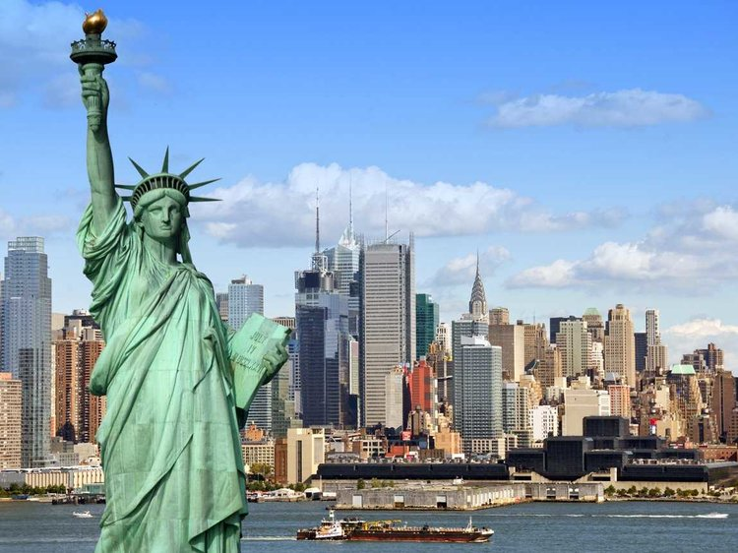
UNIT 9. CITIES OF THE WORLD
GETTING STARTED

Slide 2



Unit 9. Cities of the world
Getting started
Listen and read:
“What nice photos!”

Slide 3
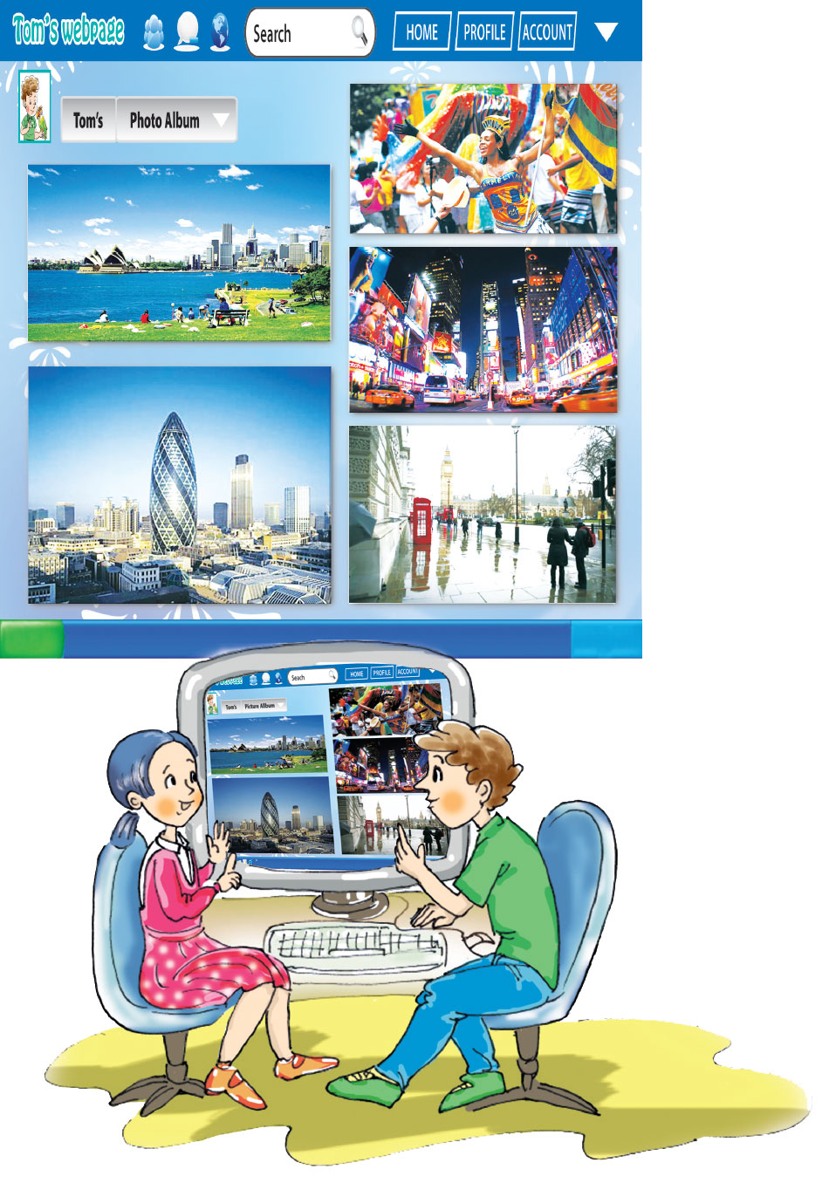
What are they looking at?
What are Mai and Tom doing?

Slide 4

1. Listen and read.
WHAT NICE PHOTOS!
Mai: What nice photos! Have you been to all these places?
Tom: Yes, I’ve been to most of them. This is Rio de Janeiro. It’s an exciting city, but sometimes it’s very hot.
Mai: Is the weather there hotter than in Sydney?
Tom: Oh yes! Sydney isn’t so hot. I’ve been to the beaches there many times with my family. They’re the cleanest and the most beautiful in the world!
Mai: Is this London? What bad weather!
Tom: Yes, we’ve been there twice. Can you see Big Ben? There are also modern buildings, like this egg-shaped building...
Mai: And this must be Times Square in New York.
Tom: Yes! I’ve never been there. This photo is from my brother. It looks great, doesn’t it?

Slide 5



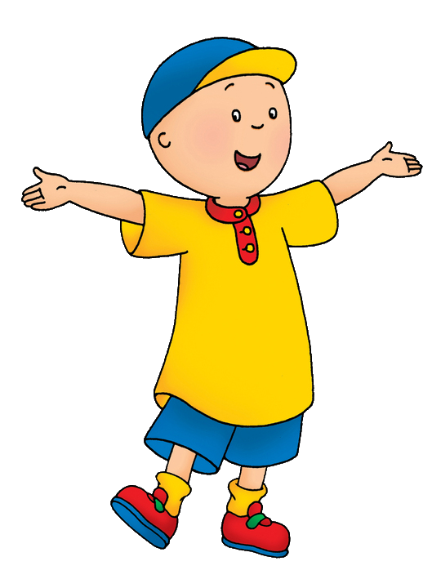

2
Read the conversation again. The tick (v) True (T) or False (F).
This is Rio de Janeiro.
Sydney isn't so hot.
Is this London? -Yes, we've been there twice
Sydney isn't so hot. I've been to the beaches there many times with my family
There are also modern buildings
This photo is from my brother.
1.Tom and Mai are reading a book.
2.Tom has been to all four cities.
3.Tom has been to Sydney many times.
4.All the buildings in London are old.
5.Tom has taken many photos of Times Square.
T
F

Slide 6
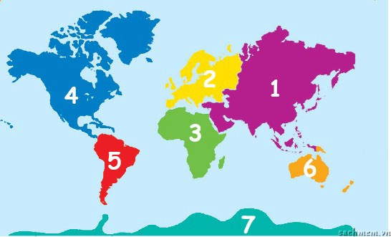

3
Name the continents.
Europe
E.............
A.................
Asia
N ........A.....
North America
Africa
A..............
7.A.....................
Australia
A..............
South America
S .....A.......
Antarctica
A.............

Slide 7
Vocabulary
Continent (n): châu lục
North America: Bắc Mỹ
South America: Nam Mỹ
Antarctica: châu Nam cực
Australia: châu Úc
Africa: châu Phi
Asia: châu Á
Europe: châu Âu
Sweden: nước Thụy Điển
Capital (n): thủ đô
Place of interest (n.p): địa điểm thu hút tham quan

Slide 8

4
Match the words in the blue box to the names of the places in the yellow box.
 | continent | country | city | capital | place of interest
1.Ha Noi
2.Nha Trang
3.Asia
4.Sweden
5.Ben Thanh Market
6.the Lourve
7.Armsterdam
8.Africa
9.the USA
10.Liverpool

Slide 9
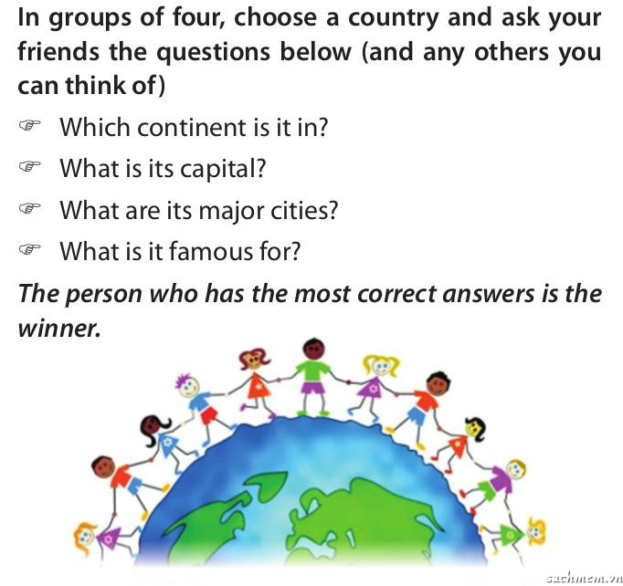
5
GAME: Around the world
It’s in………………………………..
Its capital is ………………………
They are …………………………..
It’s famous for……………………

Slide 10








Slide 11



What continent is it?
Europe
A
Antarctica
B
Asia
C
Africa
D

Slide 12
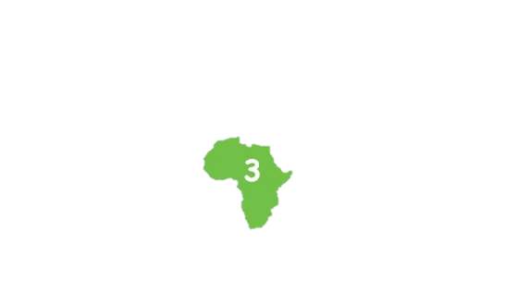
What continent is it?
South America
A
Asia
B
Australia
C
Africa
D

Slide 13
What country is it in?
England
A
German
B
The USA
C
China
D

Slide 14
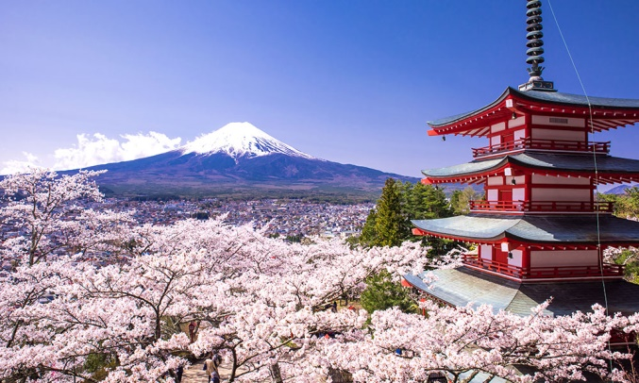
What country is it in?
Sweden
A
China
B
Japan
C
Viet Nam
D

