Slide 1

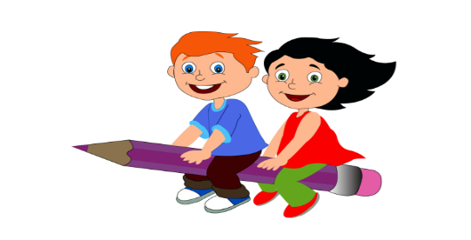

Slide 2
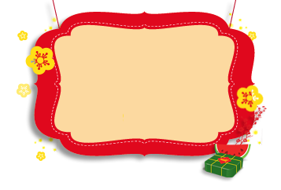


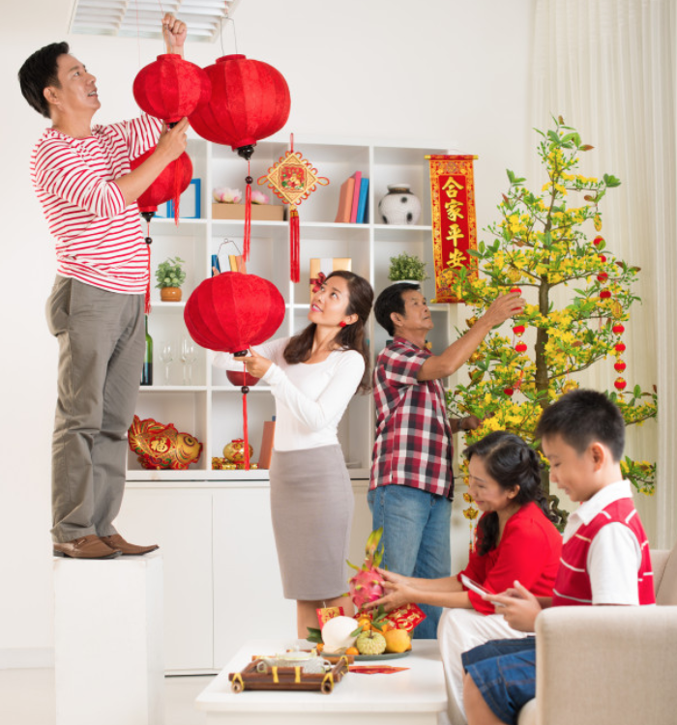
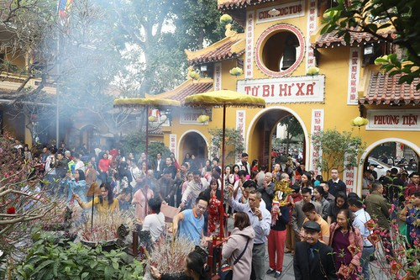
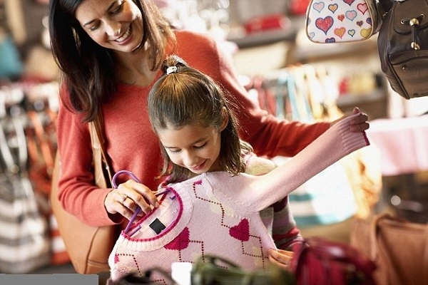
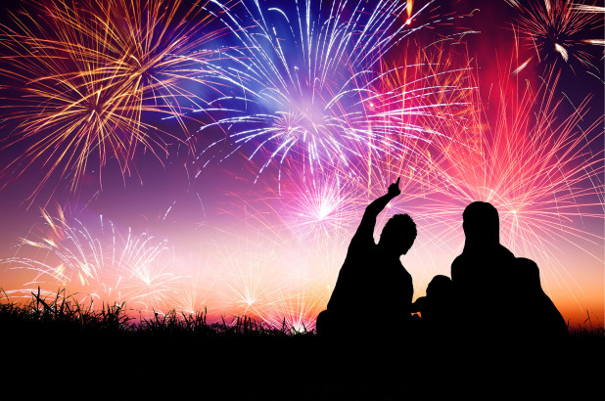
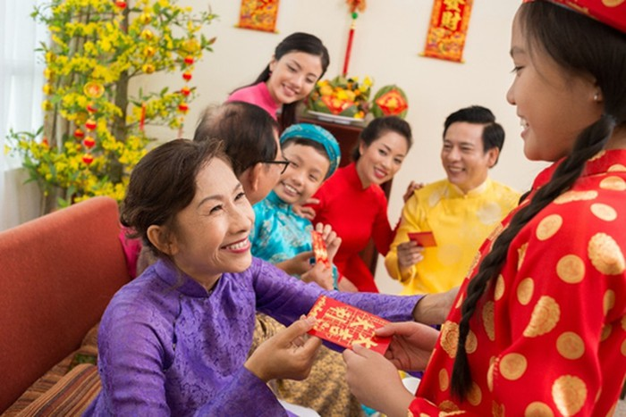
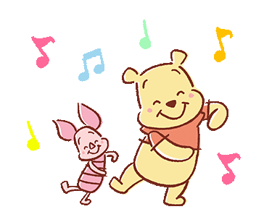
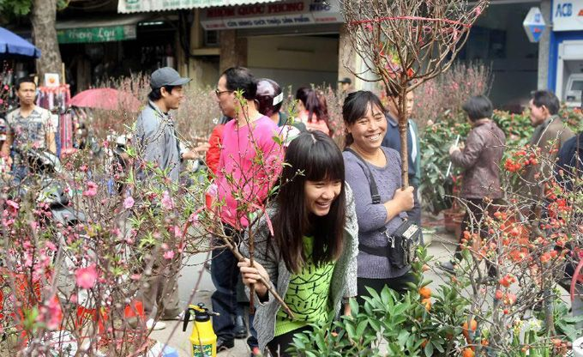
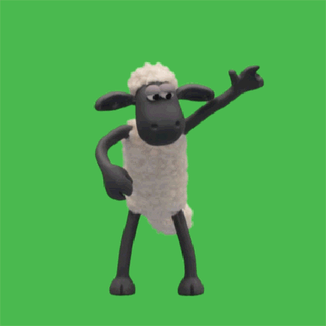
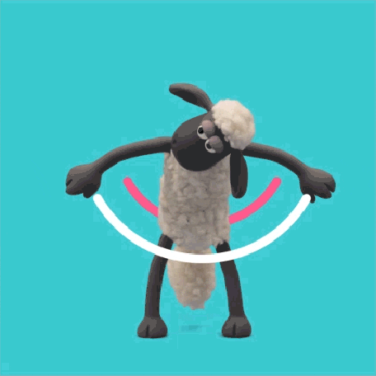


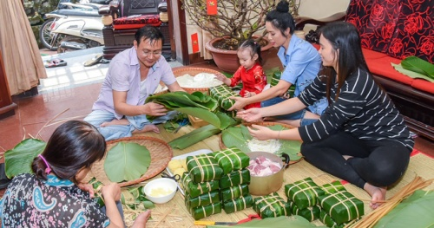

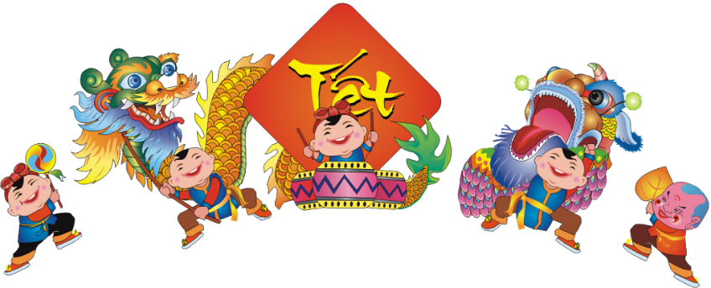
Activities at Tet

Slide 3
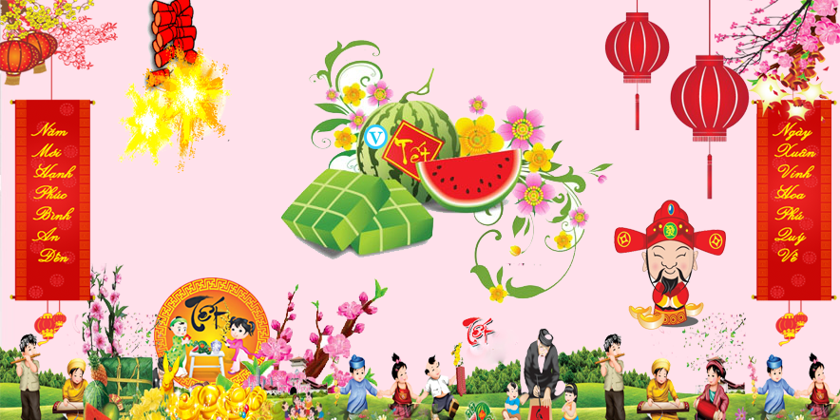
UNIT 6. OUR TET HOLIDAY Lesson 6. Skills 2

Slide 4
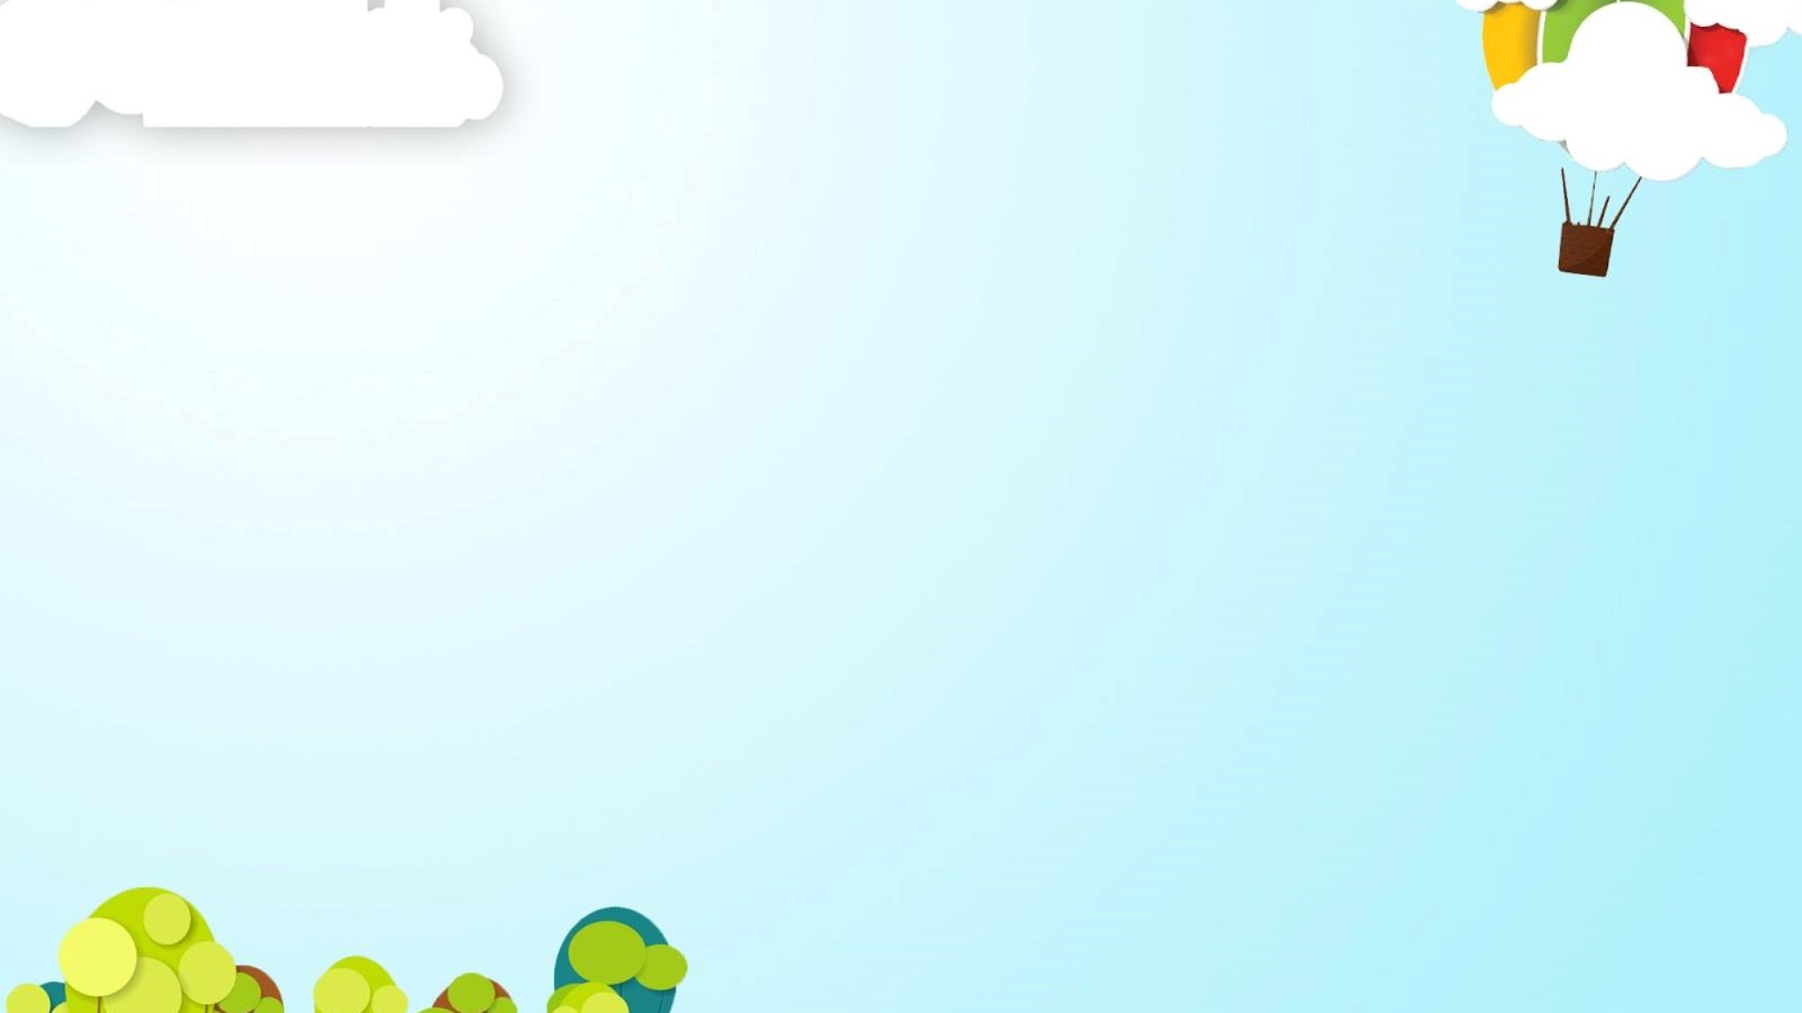

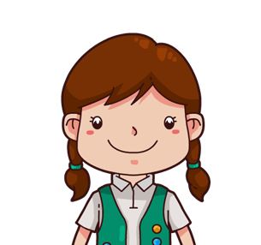

Mai
Mai’s mother

Slide 5


Exercise 1. Mai and her mother are going shopping for Tet. Listen and tick (√ ) the things they will buy.
j
1. peach blossoms
2. banh chung
3. new clothes
4. a tie
5. sweets
6. fruit
7. chocolate biscuits
We’ll buy a beautiful one.
√
We won’t buy banh chung.
√
I’ll buy some new clothes…
√
We’ll buy a tie.
√
We will get them some sweets.
We shouldn’t buy fruit.
√
I will buy you the most delicious biscuits.

Slide 6





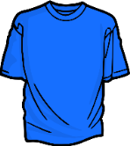
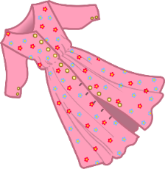
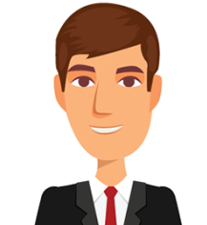

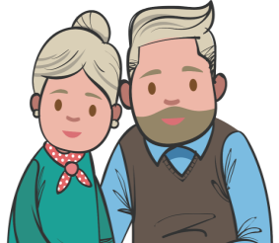
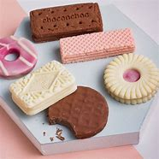
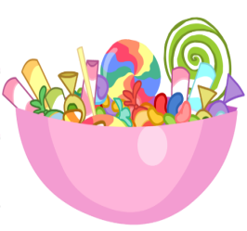




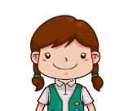
Exercise 2. Listen again and write the name of the things they will buy for the people in column A.
A. People | B. Things

Slide 7

Chatting
S1: I will………………………………………
S2: I won’t…………………………………….
S3: People should……………………………..
S4: People shouldn’t……………………..........

Slide 8
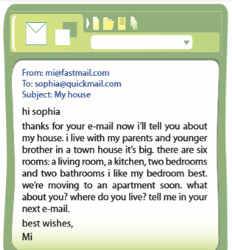

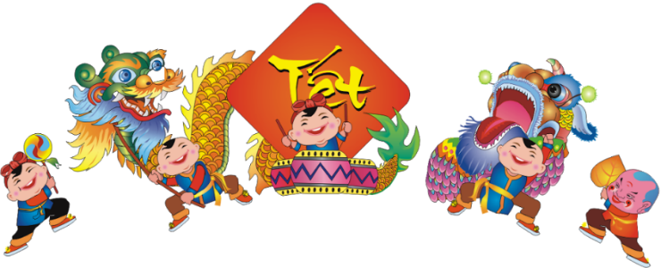
Exercise 3. Now write an e-mail to a friend about your Tet holiday. Include what you will and won’t do. Also include things people should and shouldn’t do.
From:……………………………………
To:………………………………………
Subject:…………….. Dear…………………,
I feel very …………………………………. Our Tet holiday is coming.
This year I will …………………………………………….……………
I won’t ……………………………………………………..……………
At Tet, people should ……………………………………………………
People shouldn’t…………………………………………………………
Write soon, ……………………..
Tet Holiday

Slide 9

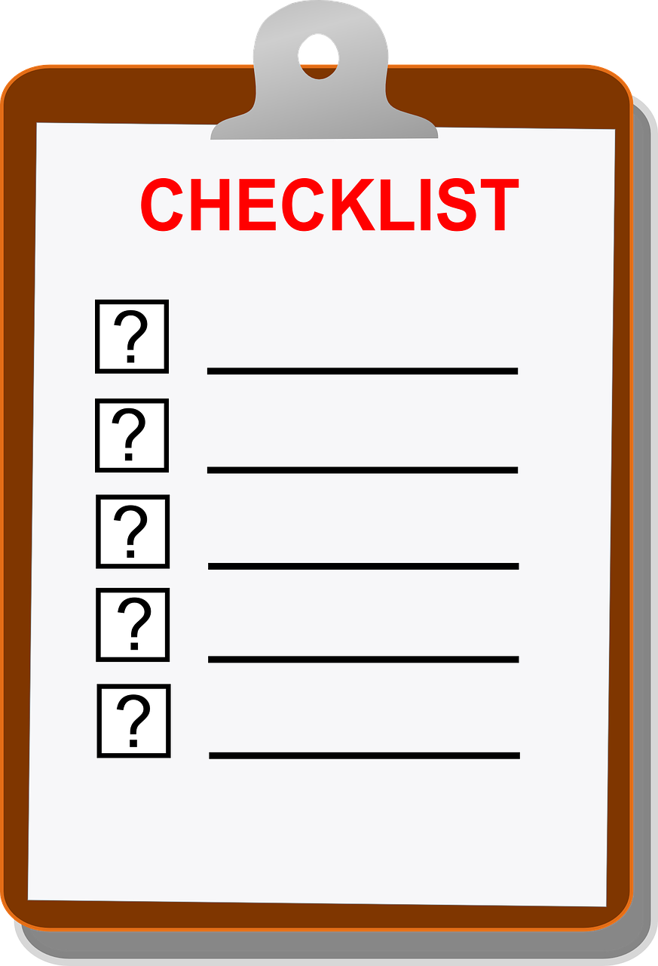
√
Form of an email
2. Subject
3. Greeting (Dear…, Hi…, Hello…,)
4. Introduction
5. Body: idea 1 idea 2 idea 3 idea 4
6. Conclusion (Write soon, Best wishes,…..)
7. Bonus (Good idea, good vocabulary, creativity…………..)

