Slide 1


UNIT 12. AN OVERCROWDED WORLD
A CLOSER LOOK 1

Slide 2



VOCABULARY
1
Listen and number the words in the order you hear them
crime
healthcare
disease
poverty
1
8
5
3
shortage
malnutrition
space
dense
4
2
6
7

Slide 3
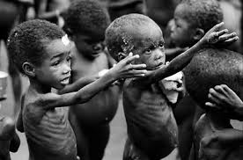
New words :
A. VOCABULARY
- Poor (adj ) – poverty (n) :
sự nghèo đói
- Malnutrition (n) :
suy dinh dưỡng
- Shortage (n) = Lack of :
sự thiếu thốn, thiếu hụt
- Dense (adj) = crowded:
đông đúc ,dày đặc
- Commit (v):
phạm tội
- Spread( v):
lan rộng

Slide 4
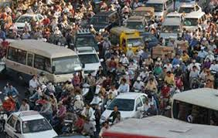
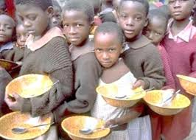
Malnutrition
poverty
dense
2
1
3

Slide 5


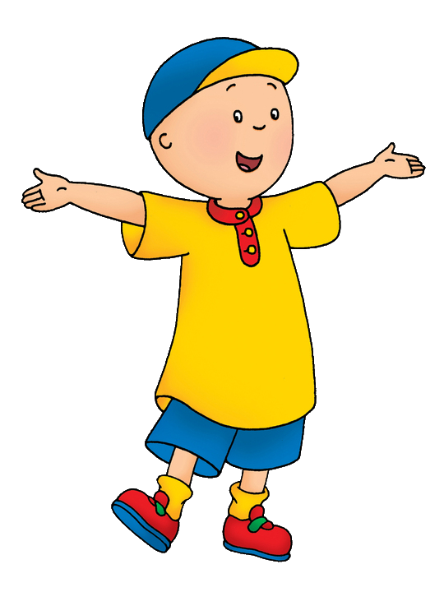
VOCABULARY
2
Complete these sentences with some of words from 1
1.Good helps people to stay healthy, and to live longer.
2.When people need money badly, they may commit
3. spreads more quickly in overcrowded areas.
4. is the major cause of death for children living in the slums.
5.In most big cities there are many wealthy people, but is still a problem.
healthcare
crime
disease
malnutrition
poverty

Slide 6

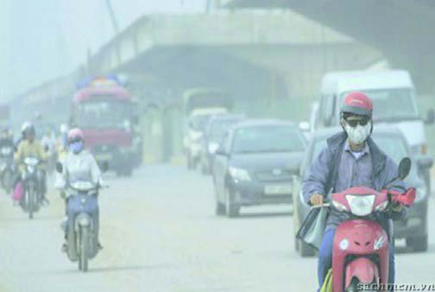
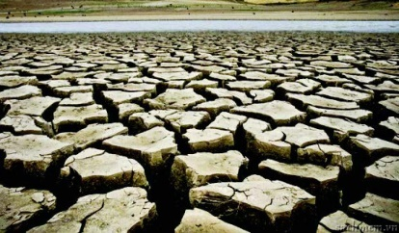



VOCABULARY
3
Match the causes with its effects
1.poverty
b. crime
a. not enough space
2.overpopulation
a. not enough space
b. crime
3.not enough food
f. malnutrition
c. air pollution
4.shortage of clean water
d. disease
d. disease
5.too many vehicles
c. air pollution
e. drought
6.no rain
e. drought
f. malnutrition

Slide 7
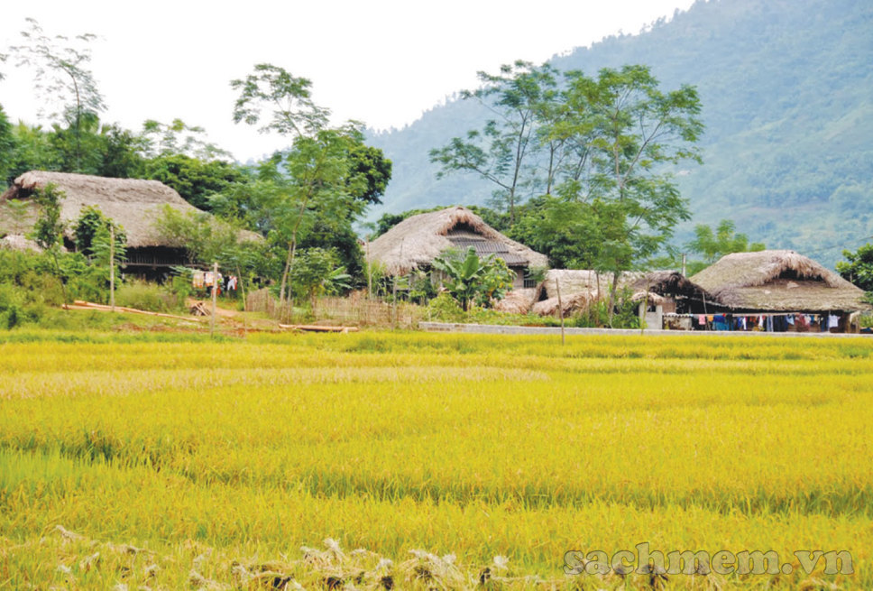
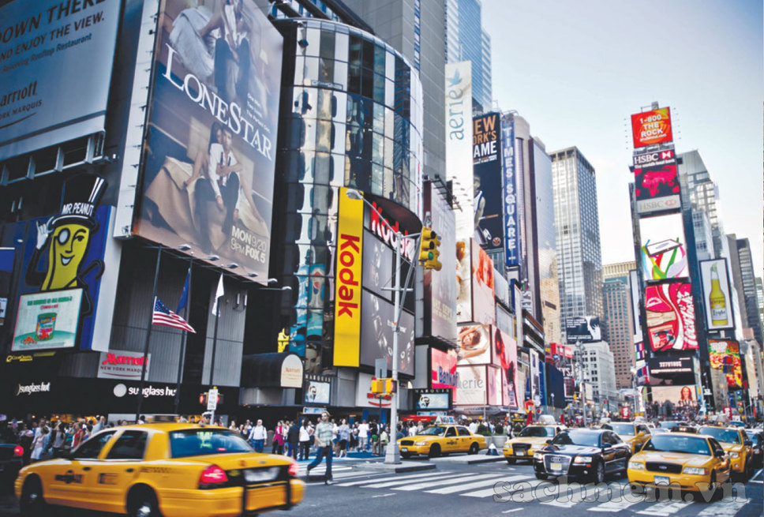
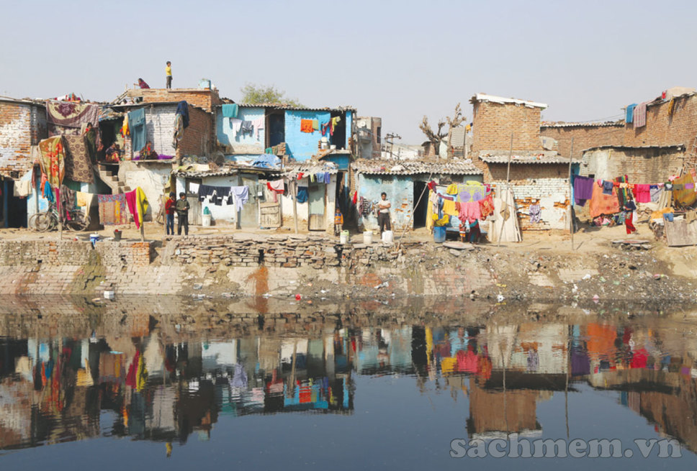
VOCABULARY
4
Work in groups. Think of some problem for each place below and write them under the place
lack of entertainment, few opportunities for employment, not enough services
noise/ air pollution, crime, overcrowded, shortage of accommodation
poverty, slums, disease, pollution, unemployment, poor healthcare

Slide 8
Look out
Some two syllabe words can be a noun or a verb. The stress changes when the use of word changes
 | Noun | Verb
General rules | Stress on the first syllable 0o This record is great | Stress on the second syllable o0 Can you record this program for me?
 | Group 1 | Group 2
Exceptions | Both N and V have stress on the first syllable 0o There is no answer to this question. | Both N and V have stress on the second syllable o0 Shall we go and watch the parade?

Slide 9

PRONUNCIATION
5
Listen and mark the stress in the words
spacious
'spacious
stressful
'stressful
increase
shortage
in'crease
'shortage
po'llution
su'pport
support
disease
pollution
hungry
di'sease
'hungry
'poverty
nutrition
poverty
nu'trition
healthcare
violence
'healthcare
'violence

Slide 10
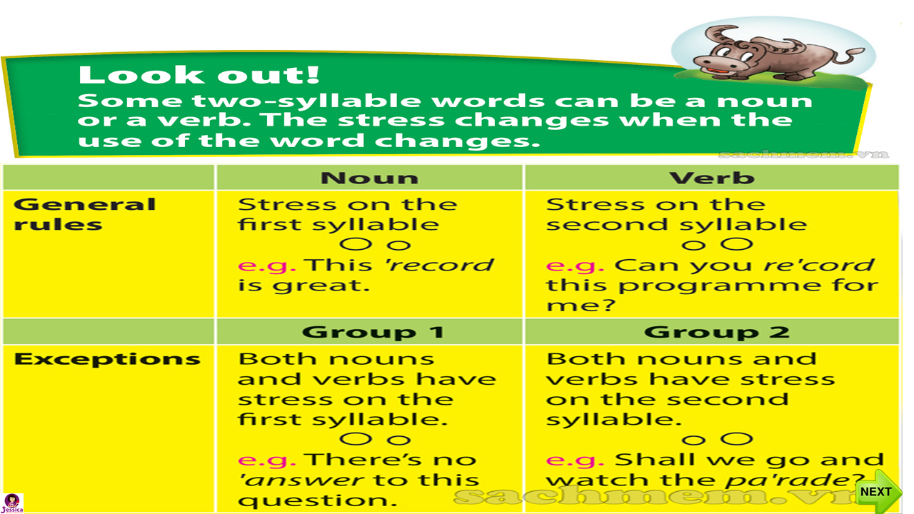

Slide 11

Pronunciation
6
Listen and repeat each pair. Mark he stress on the words in the table below
Example: 'record (n) re'cord (v)
Words | As a noun | As a verb
record | record | record
picture | picture | picture
answer | answer | answer
parade | parade | parade
support | support | support

