Slide 1
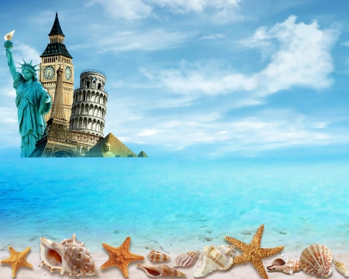

UNIT 12. AN OVERCROWDED WORLD
GETTING STARTED

Slide 2



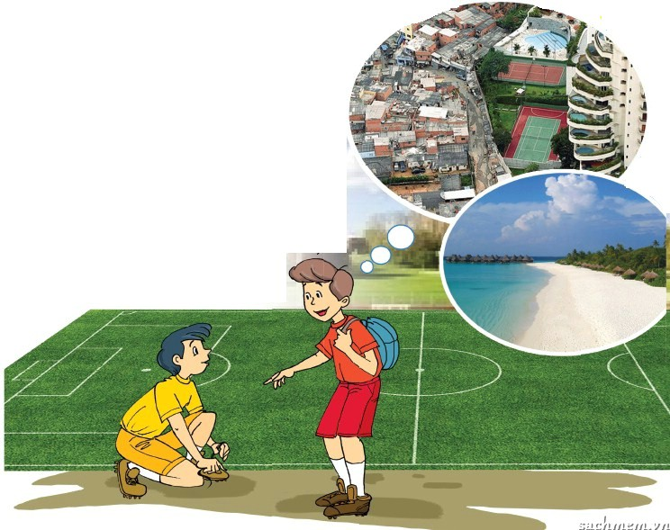
A HOLIDAY STORY
Nam: Welcome back, Phuong! Brazil is amazing, isn’t it?
Phuong: Yes. However, I love Brazil and I had a very good time there.
Phuong: It is, Nam, and it’s very diverse!
Nam: What do you mean?
Nam: Sure, it’s a real experience, isn’t it?
Phuong: The beaches in the south are so peaceful, while cities like Rio are overcrowded.
Phuong: It is.
Nam: What about the people?
Phuong: In Rio some people are wealthy, with high living standards. But there are also poor people who live in slums.
Nam: Life must be difficult in the slums
Phuong: Yes, the slums are overcrowded, and crime is a major problem there.
Nam: Crime affects everyone in the city, doesn’t it?
Phuong: It does, Nam. But there are probably other problems in the slums too, like disease, and poor healthcare,...
Nam: Wow, did you see that yourself?
Phuong: No, visitors don’t usually visit the slums. It’s too dangerous.
Nam: There are probably fewer things to see and to do in the slums, aren’t there?

Slide 3
New words:
Diverse /daɪˈvɜːrs/ (a):
Đa dạng
Overcrowded (a):
Quá đông đúc
Wealthy (a):
Giàu có
Standard /ˈstændəd/ (n):
Tiêu chuẩn
Slum (n):
Khu ổ chuột
Crime (n):
Tội phạm
Worthwhile/wɜːrθˈwaɪl/ (a):
Đáng giá
Spacious (n):
Rộng rãi

Slide 4


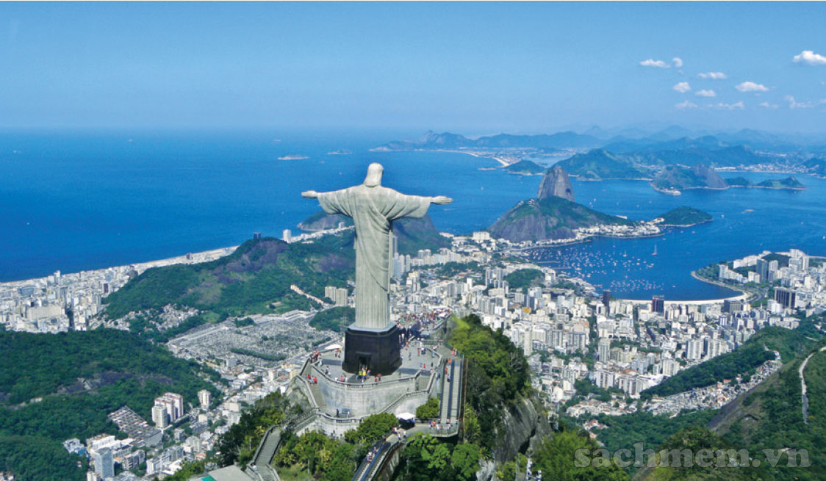

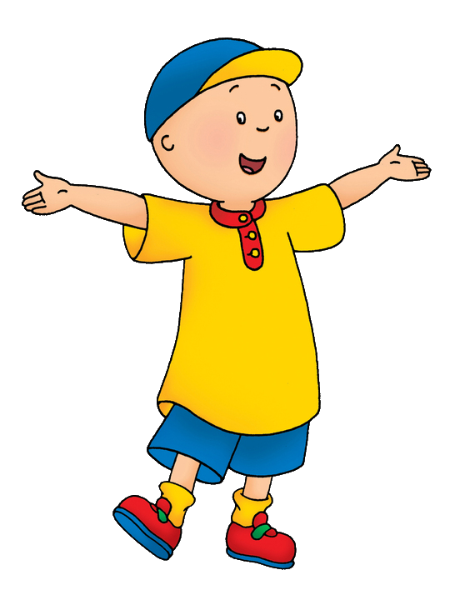
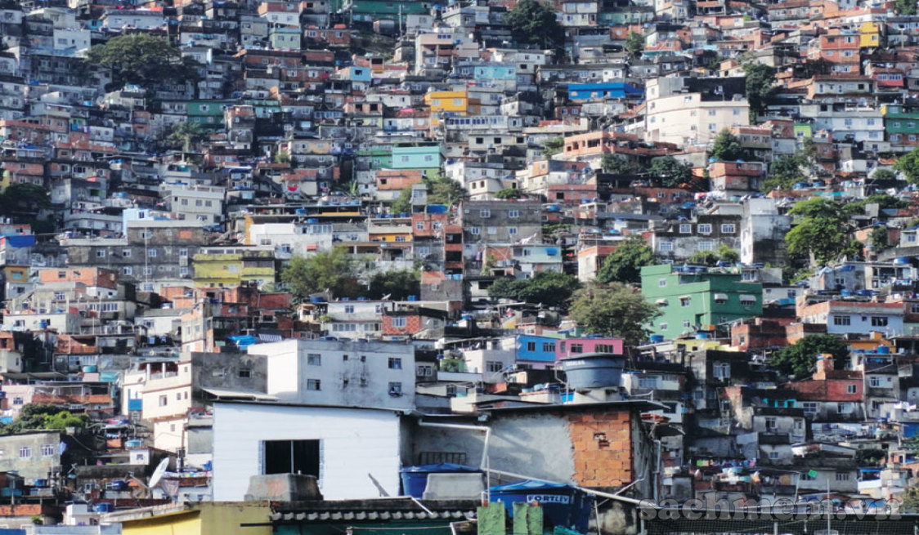

1
Listen and read. a. Tick True or False
T
F
1.Phuong thinks Brazil is interesting.
2.Places in Brazil are very different.
3.Rio’s problems are only in the slums.
4.It is not safe for tourists to visit the slums.
5.Nam thinks Phuong’s visit to Brazil is not worthwhile.

Slide 5



1
Listen and read. a. Find a word or phrase to match the following.
very different
rich
big or serious
small houses in bad condition where poor people live
bad action against the community
diverse
wealthy
major
slums
crime

Slide 6
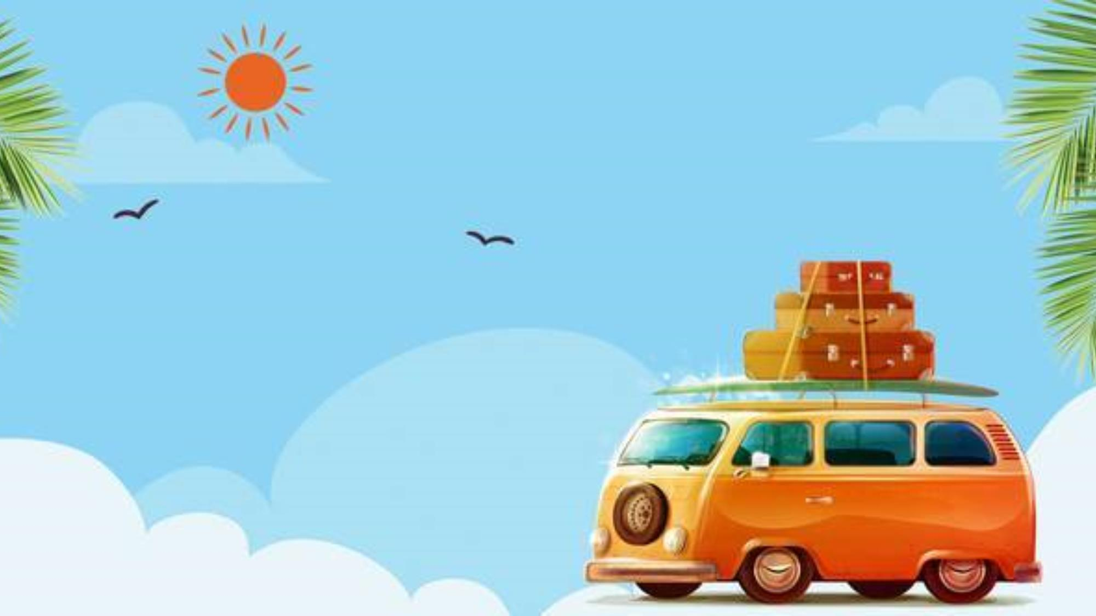
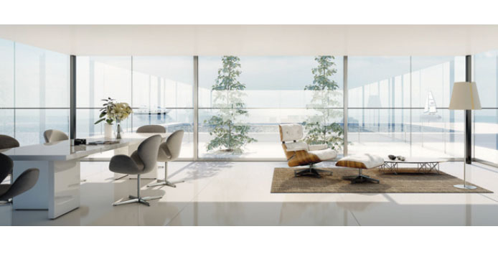
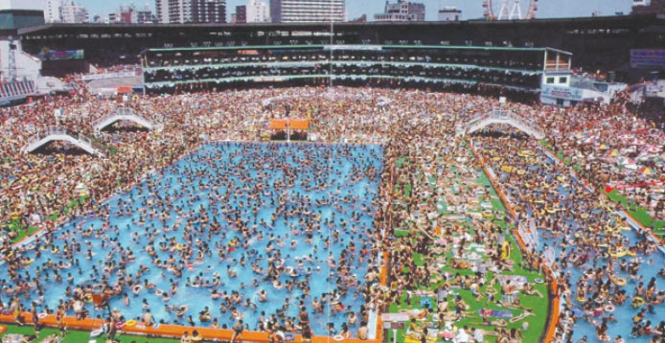
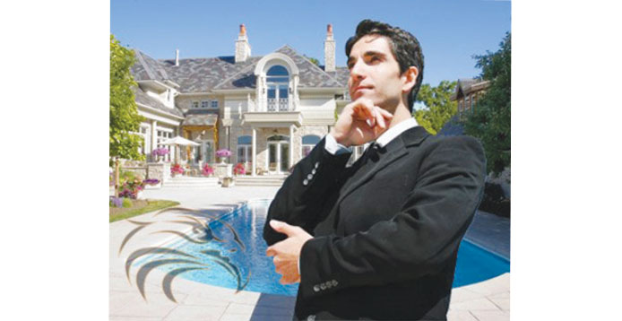
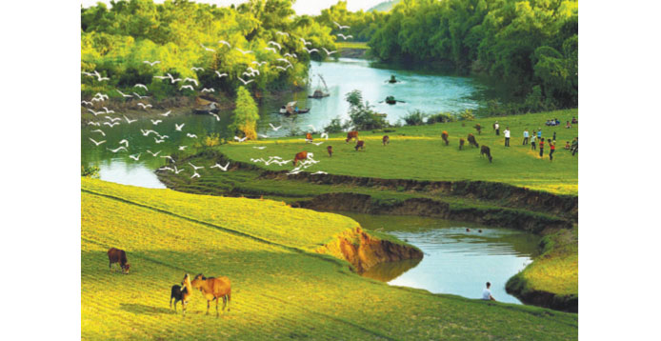
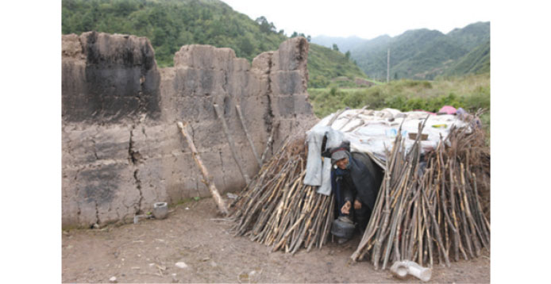
2
Match the words in the box with the pictures. Then listen and repeat the words
overcrowded
peaceful
wealthy
spacious
poor
overcrowded
wealthy
peaceful
poor
spacious
Note: nhấn vào các ô chữ màu xanh để nghe từng từ

Slide 7
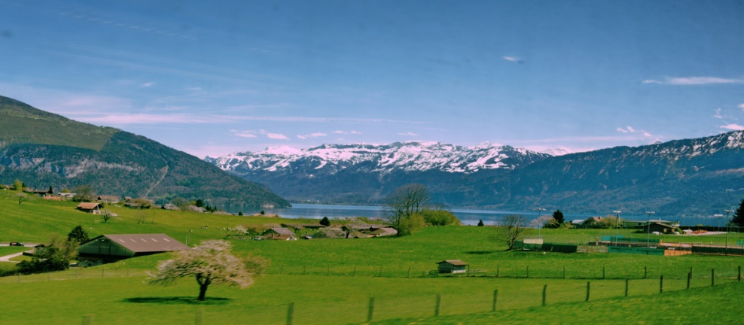
3
Use the words in 2 to describe a person or a place you know
Example:
I visit my native village every year. I love the peaceful atmosphere there.
my native village
peaceful

