Slide 1
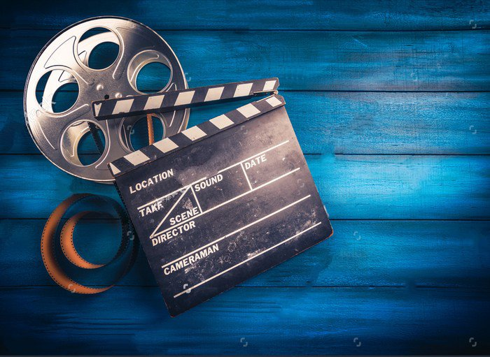

UNIT 8. FILMS
SKILLS 2

Slide 2
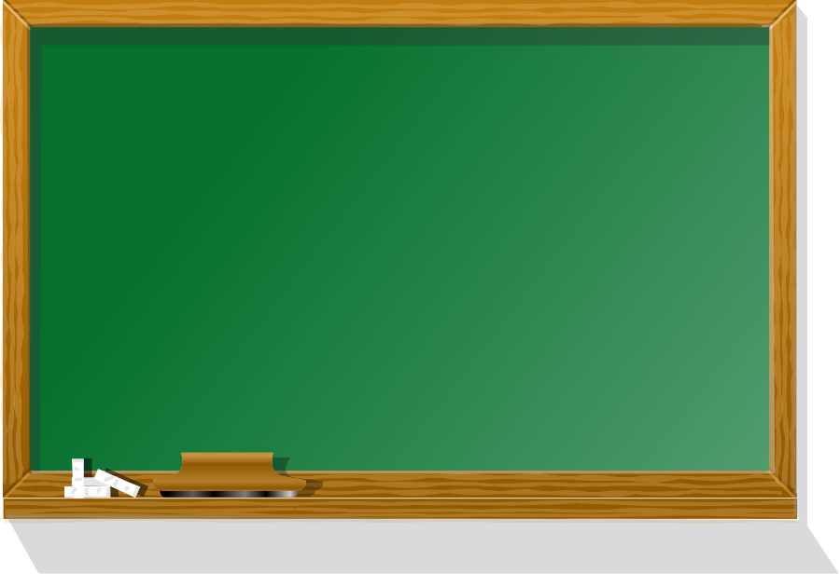
UNIT 8. FILMS
LESSON 6: SKILLS 2
Listening
*Vocabulary:
1. a role (n): vai diễn
2. an award (n): phần thưởng, sự tặng thưởng
3. soldier (n): người lính, quân nhân
4. lawyer (n): luật sư

Slide 3



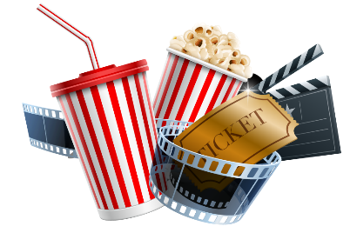
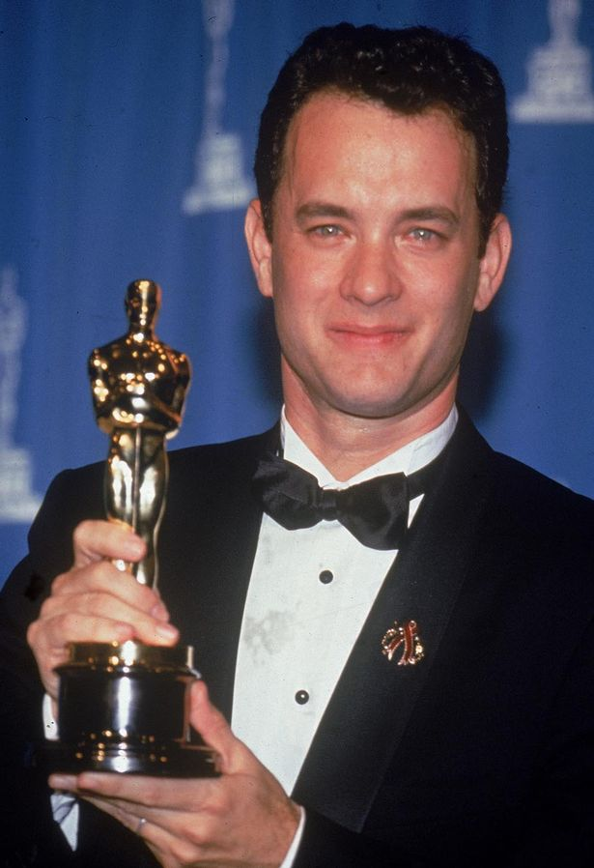
Listening
Nick and his father are talking about Tom Hanks, a Hollywood film star. Listen and correct the following statements.
1
1.Tom Hanks is Nick’s favourite film star.
→ Tom Hanks is Nick’s father’s favourite film star.
2.Tom Hanks is a handsome actor.
→ Tom Hanks isn’t a handsome actor.
3.Tom Hanks has won three Oscars.
→ Tom Hanks has won two Oscars.

Slide 4
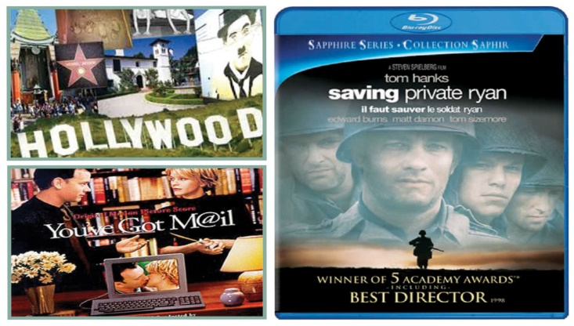
Listening
Listen and answer these questions below
2
1.Which Oscar has Tom Hanks won twice?
→ He has won the Oscar for Best Actor twice.
2.What do critics say about Tom Hanks?
→ They say he is one of the best actors in Hollywood.
3.What role does Tom Hanks play in Saving Private Ryan?
→ He plays the role of a soldier in Saving Private Ryan.
4.Why does Nick’s father recommend You’ve Got Mail to Nick?
→Because it is one of the biggest comedies of the 1990s.

Slide 5

Nick: Who is your favourite film star, Dad? Dad: Tom Hanks, of course. Nick: Tom Hanks? Who is he? Dad: He is one of the most famous and richest actors in Hollywood. Nick: Really? Has he won any awards? Dad: Yes, he has won the Oscar for Best Actor twice. Nick: Two Oscars? Amazing! He must be very handsome! Dad: No, he isn’t. He isn’t an attractive actor, compared to other actors in Hollywood. However, most critics say that he is one of the best actors. Nick: What kind of roles does he often play? Dad: He often plays serious roles such as a soldier in Saving Private Ryan, or a lawyer who has AIDS in Philadelphia. He also appears in many other entertaining films such as Bachelor Party, The Man With One Red Shoe, etc. Nick: Can you recommend one of his best films? Dad: Of course, You’ve Got Mail. It’s one of the biggest comedies of the 1990s.

Slide 6
UNIT 8. FILMS
LESSON 6: SKILLS 2
Listening
Writing

Slide 7
Writing
3
Make notes about one of your favourite film
Name of film: Big Ben Down
Type of film: Action
Actors: It stars Bruce Willis as a New York cop on holiday in London. 2. The plot:
About a group of terrorists who take control of Big Ben, and threaten to blow it up.
3. Other aspects of the film, The acting, the music, the special effects, the visuals, etc. The acting is very good. The music, the special effects are incredible.
4. Critics’ reviews, your overall opinion
Critics say the film is violent and gripping.
I think that the film is so wonderful from actor, actress to visual, music.
1. Name of film, type of film, and actors or director.
2. The plot:
- What happens in the film? How is the film? (gripping/moving/hilarious)
- What about the ending?
3. Other aspects of the film, the acting, the music, the special effects, the visuals, etc.
4. Critics’ reviews, your overall opinion.

Slide 8
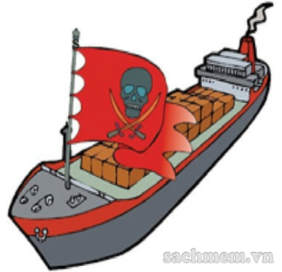
PIRATES OF SOUTHEAST ASIA Documentary: About modern day pirates in Indonesia and Malaysia who attack other ships. It stars Peter O’Toole as the voice of the narrator. Critics say the film is shocking, but it
is a must-see.
THE CHAINSAW MASSACRE AT HALLOWEEN Horror: About a killer who escapes from a hospital. The story takes place in a children’s camp on Halloween. It stars Jamie Lee Curtis as a school teacher who falls in love with the killer. Critics say the film is very frightening
and may be the scariest film ever.
BIG BEN DOWN Action: About a group of terrorists who take control of Big Ben, and threaten to blow it up. It stars Bruce Willis as a New York cop on holiday in London. Critics say the film is violent and
gripping.
PLANET OF THE JELLYFISH Sci-fi: About super intelligent space jellyfish that attack the Earth in the future. It stars Cameron Diaz as a soldier, who is sent to stop the attack of space jellyfish. Critics say that the film is fantastic
and gripping.

Slide 9
Writing
4. Write a review of your favourite film
My favourite film
My favourite film is Big Ben Down
It is an action film. It stars Bruce Willis as a New York cop on holiday in London.
It’s about a group of terrorists who take control of Big Ben, and threaten to blow it up. The film is gripping so I couldn’t take my eyes off the screen.
The acting is excellent.The music , the visuals are incredible.
Critics say that the film is violent and gripping.
But I think that the film is a must – see. Go and see it if you can.
1
2
3
4

Slide 10

Writing
4. Write a review of your favourite film
My favourite film
My favorite film is……………….
It is a/an……………..(action/comedy/horror/……) film. It stars……..
It’s about ……………………………………………………………..
The film is…………………………….( moving/hilarious/gripping).
The acting is…………………………………………...
The music , the visuals are …………………………………………………….
Critics say that the film is……………………………………….. I think that the film is……………………………………………
1
2
3
4

